Slide 1

Analytical Report By –
SHROBANA ROY
AF0434718
Batch-DANCIL
Guidance by –Khusbu Thakur

Slide 2
I would like to thank my Teacher, Khusbu Thakur for guiding me throughout the course of this assignment. She was there to help me every step of the way, and her motivation is what helped me complete this assignment successfully. I thank all the teachers who helped me by providing the equipment that was necessary and vital, without which I would not have been able to work effectively on this assignment. I would also like to express my sincere gratitude to my friends and parents, who stood by me and encouraged me to work on this assignment.
Acknowledgment

Slide 3
Project Statement
Here we can see a Raw data Related to a Person Nitin Agarwal
Nitin works as a Graphic Designer in a Renowned company. He earns Rs 15,000/- per month. He is planning to buy a scooter for his daily commute to the office.
For the last couple of months, Nitin is not able to save at all for his scooter. His friend Ayush told him that he needed to figure out where most of the money goes and cut down that expense.
Help Nitin increase his savings by removing some unnecessary expenses.
From The Next Slide We’re Going to start our Analysis & try to make a Report Briefly by Helping Nitin to Discover more Pattern that How he can save more Throughout the Month

Slide 4
:Visual Report of the Amount spent against each Category by Nitin:
The grocery category stands out with the highest expenditure of 30,990. This indicates a strong focus on daily essentials, suggesting a prioritization of food security and household management
With a total of 12,000 spent on entertainment, it reflects the importance of leisure activities in maintaining a balanced lifestyle. This category could be explored further for opportunities to optimize spending.
The spending on tickets and bills amounts to 16,040, highlighting the need for effective budgeting in this area. This category might include travel, events, or subscription services, warranting a closer look at potential savings.
Miscellaneous and shopping expenses, at 7,720 and 8,700 respectively, indicate that there is a level of discretionary spending that could be analyzed for possible reductions.
The relatively lower expenditure of 4,000 on doctor and medicine suggests either effective healthcare management or possible underutilization of medical resources. It may be beneficial to assess whether this aligns with health needs.
The data presents an opportunity to revisit budget allocation across categories, especially in grocery and entertainment, to ensure a balanced financial approach

Slide 5
:Visual representation of the amount spent on different items of Entertainment and Tickets & bills category:
Row Labels | Sum of Expense (INR)
Doctor and Medicine | 4000
Mother's doctor visit | 1300
Mother's medicine | 2700
Entertainment | 12000
Movie | 2500
North Bengal Trip | 7500
Outing with friends | 2000
Ticket and Bills | 16040
Electricity bill | 2940
Gas | 5100
House help | 6000
Railway Monthly Ticket | 2000
Grand Total | 32040
The budget reflects a diverse allocation of funds across various categories
Medical expenses, totaling 4,000, indicate a significant investment in health, particularly for your mother, with doctor visits and medicine costing 4,000
Entertainment expenses are notably high at 12,000, suggesting a strong emphasis on leisure activities, including a movie outing and a trip to North Bengal
The ticket and bills category is substantial at 16,040, indicating frequent travel or events
Essential utilities like electricity and gas, along with house help, further contribute to necessary expenditures
Overall, while there is a clear prioritization of health and well-being, the budget also highlights a lifestyle that values entertainment and social experiences

Slide 6
:Amount spent on each item of the categories with highest and 2nd highest expense amount Visual representation of the data with data bars:
The comprehensive expense analysis totals INR 47,030, highlighting significant spending patterns across various categories
The "Grocery" category dominates expenditures at INR 30,990, reflecting a strong emphasis on essential food items
"Ticket and Bills" also represents a substantial cost at INR 16,040, indicating significant transportation or service-related expenses
Considerable expenses include "House Help" at INR 6,000 and "Gas" at INR 5,100, which suggest a reliance on external support and energy needs
The analysis of smaller categories such as "Beverages," "Bread and Bakery," and "Snacks" shows varied spending but collectively contributes to overall grocery costs
This project offers valuable insights into spending behavior, enabling targeted strategies for budget management
Identifying key expenditure areas can guide future financial planning, helping to optimize costs while ensuring essential needs are met
This analysis serves as a foundation for informed decision-making and financial wellness

Slide 7
How many times money has been spent against different items of each category & Visual Representation of the data for Grocery & Shopping items
The detailed expense analysis totals INR 39,690, showcasing a diverse allocation of funds across various categories
This is complemented by notable expenditures on "Foodgrains and Cereals" (INR 7,660) and "Vegetables" (INR 9,390), emphasizing the importance of fresh produce in the overall budge
The "Grocery" category is the most significant expense at INR 30,990, reflecting a substantial investment in essential food items
In addition to groceries, "Shopping" emerges as a considerable expense at INR 8,700, with notable contributions from "Shirts" (INR 3,500), "Shoes" (INR 2,700), and "T-shirt and Jeans" (INR 2,500), Indicates a balanced approach to both necessities and discretionary spending
The analysis provides valuable insights into spending behavior, highlighting areas for potential savings, particularly in discretionary categories
By closely monitoring these expenses, there is an opportunity to optimize budgeting strategies for enhanced financial management
Overall, this project offers a solid foundation for informed decision-making, aiding in achieving long-term financial goals

Slide 8
:Month-wise trend of expenses Represented by Pivot table & Pie Chart:
The expense analysis reveals significant fluctuations across the first half of the year
February marked the highest spending at 10,620, while April saw a notable drop to 2,550, the lowest for the period
This pattern suggests seasonal variations or specific one-time costs influencing monthly expenses.
Overall, while the total expenses amount to 38,980, the inconsistency highlights the need for a closer examination of spending drivers to optimize future budgeting and identify potential savings opportunities

Slide 9
:Category wise expenses Visually represent it with data bars to display categories with the highest and lowest expense amount:
The expense report indicates a total of 38,980 across various categories, with 36 individual entries
The largest expenditure was in Entertainment at 10,000, followed by Shopping at 7,700.
Grocery and Miscellaneous also contributed significantly, with expenses of 6,560 and 4,220, respectively. In contrast, Food was the lowest expense category at 2,400
These figures suggest a heavy focus on discretionary spending, particularly in entertainment and shopping.
To enhance financial management, it may be beneficial to analyze the necessity and frequency of these expenditures while exploring potential areas for cost reduction, especially in non-essential categories.

Slide 10
:Month-wise expense of each category (Pivot table) & Representaion of 2 categories with higher expenses for each of the 6 months:
This report summarizes the monthly expenses for February and March, with a grand total of 18,030.
February Total Expenses: 10,620 & from March Highlights Total Expenses: 7,410
The analysis reveals a significant focus on travel in February, which dramatically influenced total expenses
In March, discretionary spending on dining and shopping emerged as notable factors.
To optimize financial management, reviewing and adjusting budgets in these areas may yield better control over expenses moving forward
Here Top two categories are one is North Bengal Trip from February Month & another one is category Shoes from March

Slide 11
: spent in each month against different items of Entertainment, Food and Shopping categories & the highest amount spent over the items:
This report provides a comprehensive overview of monthly expenses categorized into Entertainment, Food, and Shopping.
The total expenditure for the period is 20,100, with Entertainment being the most significant category, driven largely by the North Bengal trip and social outings.
Food expenses, including dining out and online orders, also represent a considerable portion of the budget
Shopping expenditures reflect diverse needs, particularly in clothing.
optimize future spending, it may be beneficial to analyze discretionary categories like Entertainment and Shopping for potential savings.
Overall, maintaining a balanced approach to these expenses will enhance financial well-being.
Furthermore, We can see that the Month January has Highest amount spent for Dining Out & Movie purpose, Grand Total of Food is “2650” & Entertainment “2500”. Altogether its “5150 Rs.”

Slide 12
:Expense Analysis of six month on the Essential & Non-Essential Items:
Total Expenses: Over the last six months, total expenses amount to 58,770 INR, with essential expenses slightly lower than non-essential expenses.
Essential Expenses:
Food: Essential food expenses total 9,850 INR, indicating a significant investment in necessary nourishment.
Doctor and Medicine: Healthcare costs are consistently present, totaling 3,600 INR, emphasizing the importance of health-related expenses.
Grocery: Essential grocery expenses amount to 7,900 INR, reflecting a focus on buying necessary food items.
Ticket and Bills: Utilities and transport total 3,250 INR, highlighting regular commitments for essential services.
Miscellaneous: Essential miscellaneous expenses total 2,200 INR, mainly covering unavoidable costs
Non-Essential Expenses:
Entertainment: This category is the largest non-essential expense, totaling 8,500 INR, showing a substantial investment in leisure activities.
Shopping: Non-essential shopping expenses amount to 8,200 INR, indicating discretionary spending on clothing and accessories.
Miscellaneous: Non-essential miscellaneous expenses total 3,570 INR, suggesting some level of impulsive or luxury purchases.

Slide 13
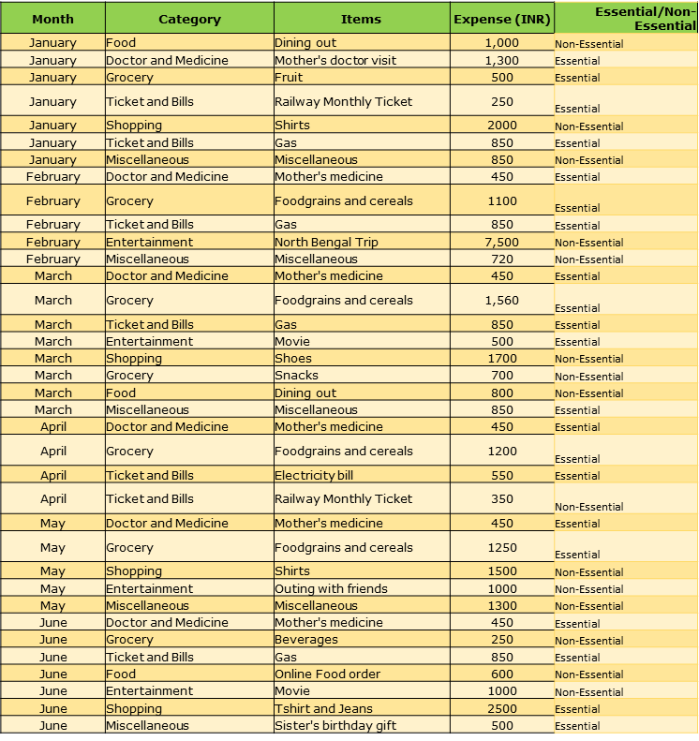
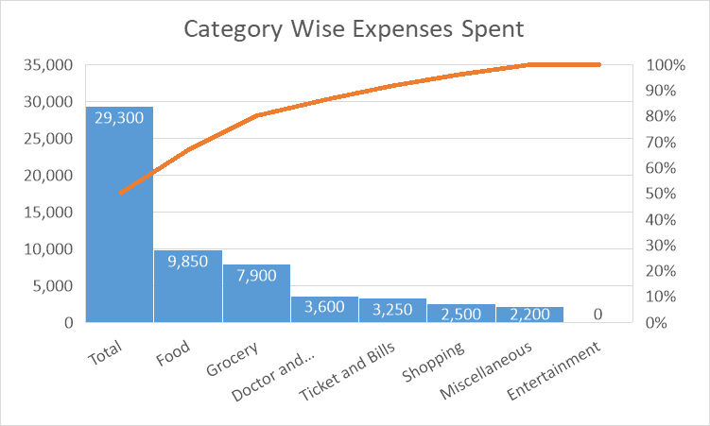
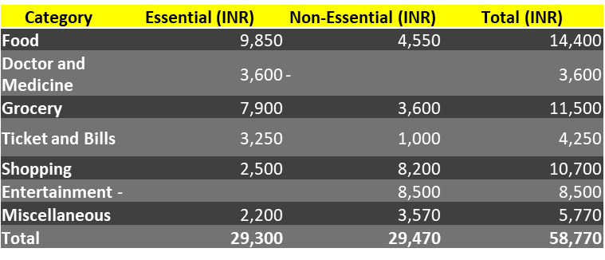
Expense Analysis of six month on the Essential & Non-Essential Items:

Slide 14
:Some Recommendations how Nitin can increase his saving Throughout the Month:
:Recommendations:
Budget Adjustment: Consider adjusting your budget to reduce non-essential spending, especially in entertainment and shopping, which are significant contributors to total expenses.
Monitor Essential Spending: While essential expenses are necessary, keep an eye on fluctuations in categories like grocery and food to identify opportunities for savings.
Review Non-Essential Items: Evaluate the necessity of high non-essential expenses each month, particularly on entertainment and shopping, to find potential reductions.
Create a Savings Plan: With a clearer understanding of essential vs. non-essential spending, Nitin Should develop a plan to allocate savings from reduced non-essential expenses to savings or investment accounts.
By focusing on these areas, Nitin can achieve better financial balance and ensure that your essential needs are met while managing discretionary spending effectively.
Smart Budget Plan

Slide 15
Thank You

