Slide 1


Research Presentation
Submitted by
Yaksi Ketan Shroff
(202203103510201)
Guided by: Dr. Vishvajit Bakrola
Department of Computer Science and Engineering,
AMTICS, UTU
12 September 2025

Slide 2
Contents
Proposed Title
Domain of Interest
Problem Statement
Reason for choosing
Research Papers Summary and Gaps
Final Findings (Table form)
Conclusion

Slide 3
Proposed Title
“Synthetic Tabular Data Generation at the Intersection of Privacy, Fidelity, and Rare Events: A Diffusion-Based Approach”

Slide 4
Selected Domain of Interest
Artificial Intelligence (AI)
Synthetic Data Generation
Privacy-Preserving Machine Learning
Diffusion Models for Tabular Data

Slide 5
Problem Statement
Data in sensitive domains (finance, healthcare) is valuable but restricted by GDPR & DPDP.
Synthetic tabular data allows safe data sharing but fails to balance three requirements simultaneously:
Utility — ≤5% AUC drop vs real data.
Privacy — Formal DP (ε≈1–2) and resilience to MIAs/PIAs.
Rare-event fidelity — Preserve rare but important patterns (<1% prevalence).

Slide 6
Reason for choosing
Urgent industry need (fraud detection losses >$50B, GDPR fines €1.6B).
Novel opportunity: 3-way optimization challenge.
Strong academic + policy impact potential.

Slide 7
Research Papers Summary and Gaps
Gaps Identified:
No approach balances utility, privacy, and rare-event fidelity together.
Rare-event metrics are inadequate (<1% prevalence poorly measured).
Diffusion models lack formal privacy guarantees.
Limited resilience testing against MIAs/PIAs.

Slide 8
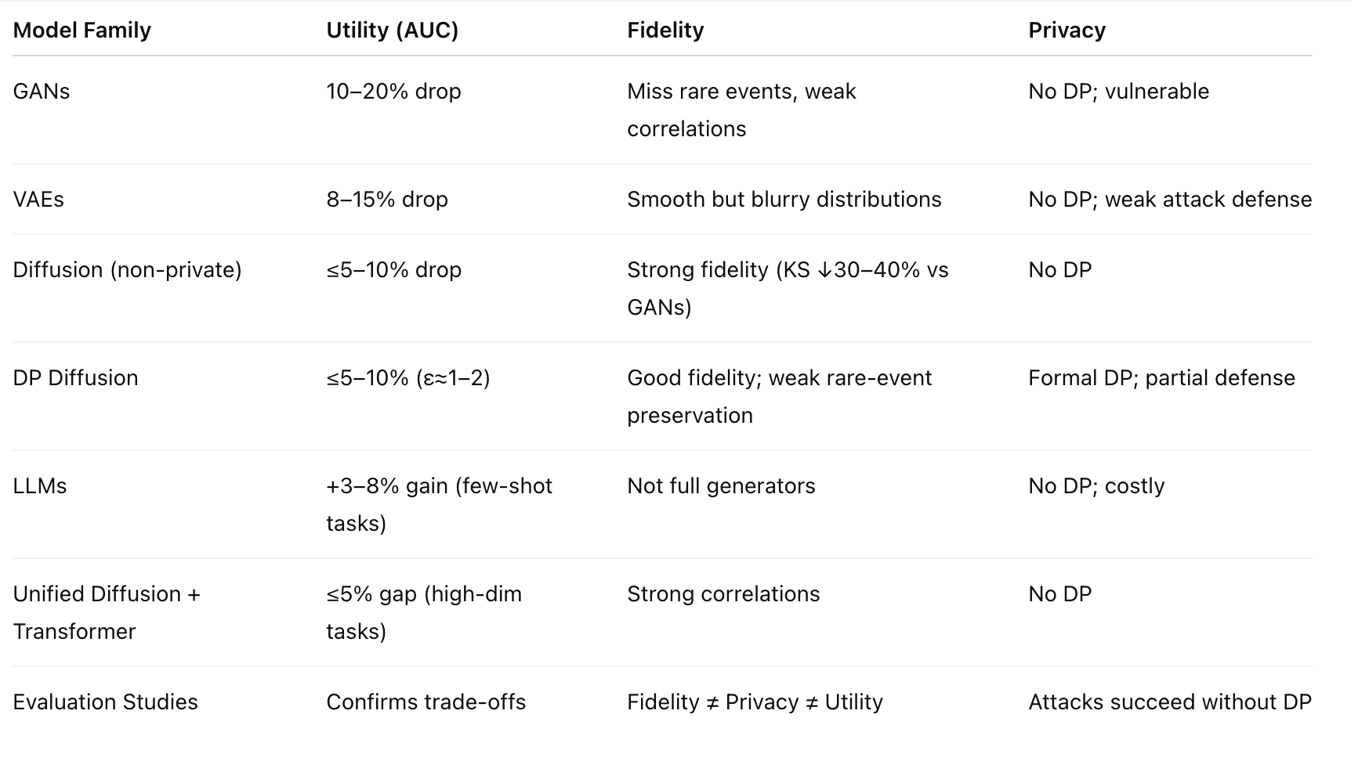
Final Findings

Slide 9
Conclusion
Current models fail to achieve the privacy–fidelity–utility balance.
Proposed: Differentially Private Diffusion Model with rare-event calibration.
Ensures regulatory compliance, supports finance & healthcare, and provides new evaluation standards.
This research bridges a critical gap in synthetic data generation and opens new directions for academia and industry.

Slide 10
Future Work Plan
Develop a Differentially Private Diffusion Model (DP-DM) with ε≈1–2.
Introduce a rare-event calibration mechanism.
Create a comprehensive evaluation framework (utility, fidelity, privacy).
Benchmark against CTGAN, TVAE, non-private diffusion models.
Validate on fraud detection & healthcare datasets.

Slide 11
Thank You

