Slide 1


Research Presentation
Submitted by
Yaksi Ketan Shroff
(202203103510201)
Guided by: Dr. Vishvajit Bakrola
Department of Computer Science and Engineering,
AMTICS, UTU
19 November 2025

Slide 2
Contents
Introduction
Research Problem
Motivation
Scope of Study
Research objectives
Methodology Overview
Privacy-Preserving Diffusion
Federated Learning & Decentralized Privacy
Rare-Event Modeling
Gaps Identified
Conceptual Framework Proposed
Evaluation Protocol Designed
Final Outcomings
Conclusion
Future Work

Slide 3
Introduction
Synthetic Tabular Data Generation at the Intersection of Data in finance, healthcare, education is restricted by GDPR & DPDP
Synthetic tabular data offers a privacy-safe alternative.
Diffusion models are emerging as the most reliable generators for tabular data.
Challenge: Achieving privacy, high fidelity, and rare-event preservation simultaneously.

Slide 4
Research Problem
To understand and analyze diffusion-based synthetic tabular data generators that:
Provide quantifiable differential privacy,
Retain statistical + predictive fidelity,
Preserve rare and extreme events (<1% prevalence) essential for high-impact applications.

Slide 5
Motivation
Regulatory need: GDPR/DPDP restrict data sharing.
Modeling gaps: GANs/VAEs fail with mixed types, privacy, and tail events.
Practical importance: Fraud detection, disease outbreaks, risk modeling rely heavily on rare events.
Diffusion models offer a promising direction.

Slide 6
Scope of Study
Focus on single-table tabular datasets.
Models studied: DDPM, TabDDPM, CoDi, MTabGen.
Privacy mechanisms: DP-SGD, RDP, Federated DP diffusion.
Rare-event modeling through EVT, tail-aware sampling.
Not implementing multi-table, causal fairness, or large-scale deployment.

Slide 7
Research Objectives
Survey diffusion-based tabular synthesis and privacy-preserving methods.
Compare architectures for mixed-type feature generation.
Analyze rare-event modeling strategies using EVT.
Identify gaps in privacy–fidelity–rare-event trade-offs.
Propose a conceptual pipeline integrating all three.

Slide 8
Methodology Overview
Review of 45 peer-reviewed papers.
Categorized across:
Diffusion architectures
Privacy-preserving diffusion Federated learning
Rare-event modeling
Evaluation metrics & privacy attacks
Comparative tables, metric analysis, and synthesis matrix.

Slide 9
Privacy-Preserving Diffusion
Works analyzed: DPDM, DP-FedTabDiff, DP-Fed-FinDiff, FairSYN-Edu.
Key observations:
DP-SGD adds quantifiable noise → reduces leakage.
Federated diffusion prevents raw data sharing.
Strong privacy (ε ≤ 1) hurts fidelity and tail accuracy.
No model fully balances privacy + rare-event preservation.

Slide 10
Federated Learning & Decentralized Privacy
Federated diffusion enables cross-institution collaboration.
Substantial privacy gain (~34%) at ε ≈ 1.
But: non-IID data, gradient noise → tail-class accuracy suffers.

Slide 11
Rare-Event Modeling
Rare events (<1% frequency) are critical in real-world tasks.
Works studied: EVT-GAN, EVT-Mix, RareDiffusion.
Key observations:
EVT improves tail recall by 15–20%.
Diffusion models lack built-in rare-event emphasis.
No existing method offers both DP + rare-event fidelity.

Slide 12
Gaps Identified
Across all literature:
No unified model balancing Privacy–Fidelity–Rare Events.
Diffusion models leak information under MIAs.
Rare-event performance mostly unreported.
DP heavily damages tail fidelity.
Evaluation frameworks do not include EVT-based metrics.

Slide 13
Conceptual Framework Proposed
Your conceptual model integrates:
Dual-stream diffusion for mixed-type features.
Adaptive DP-SGD for formal privacy.
EVT-guided rare-event conditioning.
Unified evaluation suite: Utility + Fidelity + Privacy + Tail metrics.
This addresses the tri-objective gap.

Slide 14
Evaluation Protocol Designed
Designed a comprehensive evaluation plan including:
Statistical Fidelity: JS Divergence, Wasserstein, Correlation recovery.
Predictive Utility: TSTR, TRTS, AUROC.
Privacy Risk: DCR, MIA AUC, re-identification metrics.
Rare-event Accuracy: Tail F1, EVT Quantile Error.

Slide 15
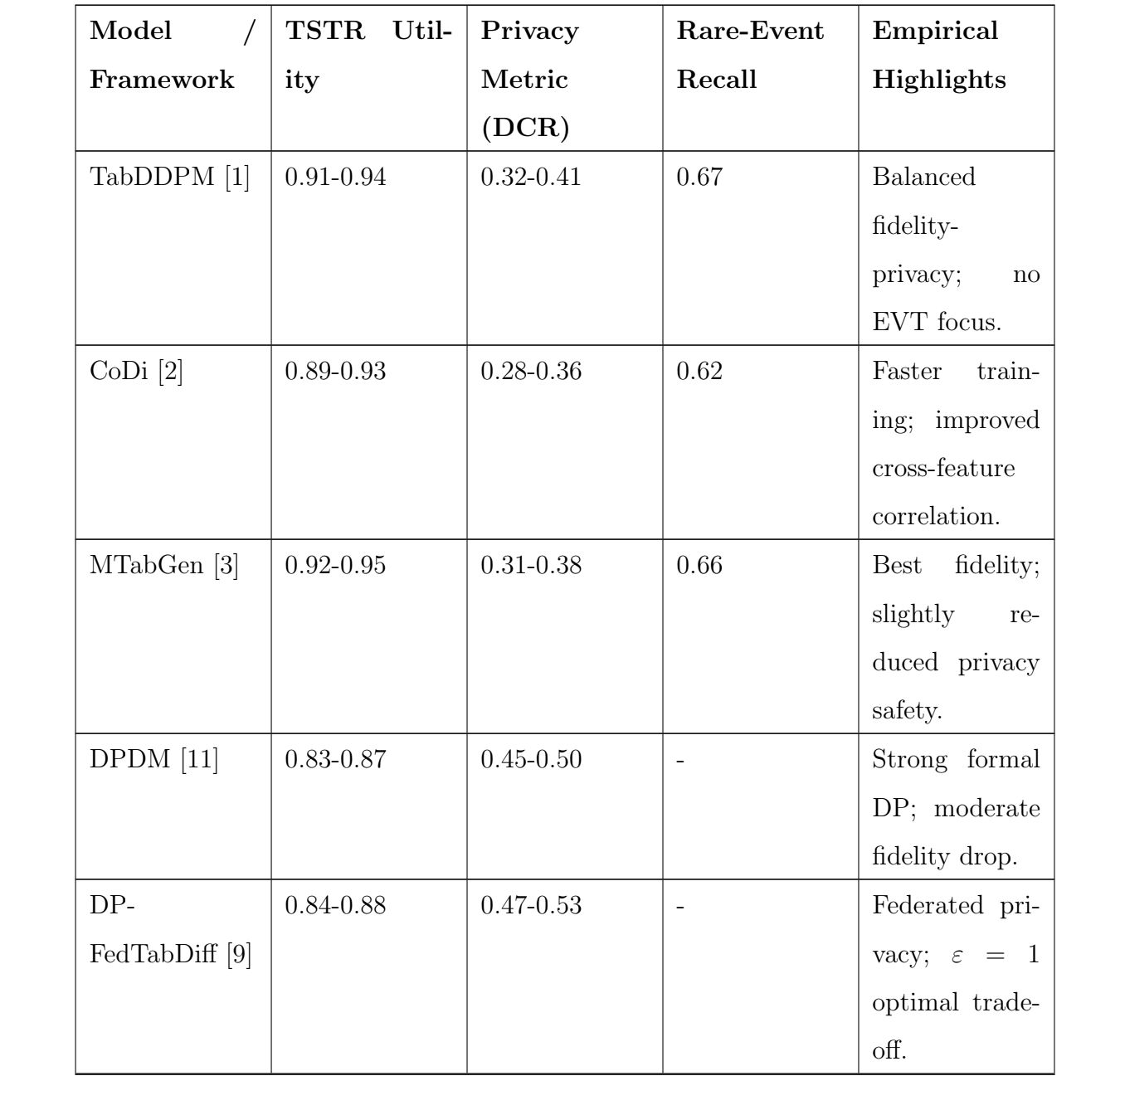
Final Outcomings

Slide 16
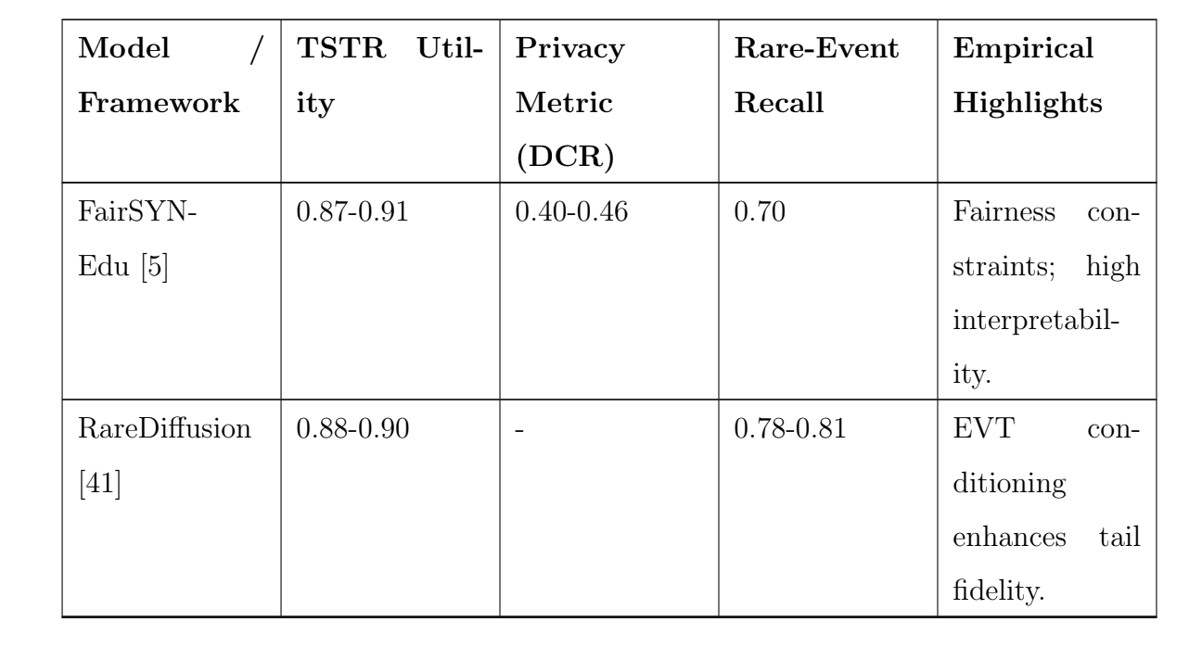
Final Outcomings

Slide 17
Conclusion
Synthetic tabular data is crucial for privacy-preserving analytics.
Diffusion models outperform GANs/VAEs in fidelity.
Strong privacy worsens rare-event performance.
Existing models fail to achieve the privacy–fidelity–rare-event balance.
A framework that offers a unified direction toward closing this gap.

Slide 18
Future Work
Implement DP-Diffusion with adaptive privacy budgets.
Integrate EVT-based rare-event calibration.
Develop composite evaluation benchmark.
Test on finance & healthcare datasets.
Compare with CTGAN, TVAE, non-private diffusion.

Slide 19
Thank You

