Slide 1
EPICS: An Introduction

Slide 2
What is EPICS
A collaboration of the controls groups of many research organizations that use the EPICS tool-kit.
A distributed architecture that supports a wide range of solutions from small test stands to large integrated facilities.
A set of tools that reduces software application and maintenance costs by providing:
Configuration tools in place of programming
A large installed base of tested software
A modular design that supports incremental upgrades
Well defined interfaces for extensions at every level

Slide 3
EPICS architecture
EPICS software architecture is client/server based - with independent data stores providing read/write access directly between any two points
EPICS V3 is physically a flat architecture of front-end controllers and operator workstations that communicate via TCP/IP and UDP
System scales through the addition of new computers
Physical hierarchy is made through bridges, routers, or a gateway
Network bandwidth is the primary limiting factor

Slide 4
EPICS architecture
Operator Interface
Sequencer
Database Links
Server: Provides read/write connections to information in this node to any client on the network through channel access client calls. The data resides here!
Client: Provides read/write connections to any subsystem on the network with a channel access server
Services: Dynamic Channel Location, Get, Put, Monitor, Access Control, Connection Monitoring, Automatic Reconnect, Conversion to client types, Composite Data Structures
Channel Access Client
Channel Access Client
Channel Access Client
LAN/WAN
TCP/IP & UDP
Channel Access Server
EPICS Process Database
Notes:
A Channel Access server provides connection, get, put, and monitor services to this database A Channel Access client provides access to process DBs in other IOCs
Process Blocks are the basic elements: AI, AO, BI, BO, Motor, CALC, PID, SUB, etc.…
Process Blocks consist of fields for: SCHEDULE, I/O, CONVERT, ALARM, MONITOR
They hold runtime values: VALUE, TIMESTAMP, ALARM CONDITION, etc.…
New process block are easily added
Configured using VDCT, GDCT, Relational DB, Text Editor at the workstation
Loaded as ASCII records at boot time
All fields can be read/written through the channel access client interface during operation

Slide 5
Terminology
EPICS has network servers (IOCs) and clients (OPIs and IOCs)
IOC = Input Output Controller The server application
OPI = Operator Interface Generic term for client application
CA = Channel Access The network protocol (analogous to HTTP)
PV = Process Variable The unit/quantum of addressable data with CA protocol

Slide 6
What is a PV?
A name identifying some signal value
In hardware A temperature or pressure reading
In software connection status or error counter
PV Name examples
UT:BR-Cu:2{Pmp:1}PD-I
Booster cooling water skid, copper system #2, pump #1, differential pressure indicator.
SR:C09-PS:RGB1{PS:CXM1B-ASM:XG-CH1}T:1-I
SR cell #9 rack group B1 corrector power supply 1B heat exchanger, channel #1 temperature indicator (chain #1)

Slide 7
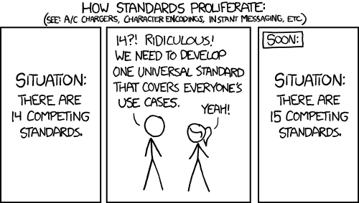
PV Naming Standards
https://xkcd.com/927/

Slide 8
Basic CA Client Tools
Always available
Simple and good for debugging, but not much more
caput – Change a setting
caget – Fetch the present value once
camonitor – Watch the value until interrupted
cainfo – Fetch diagnostic info

Slide 9
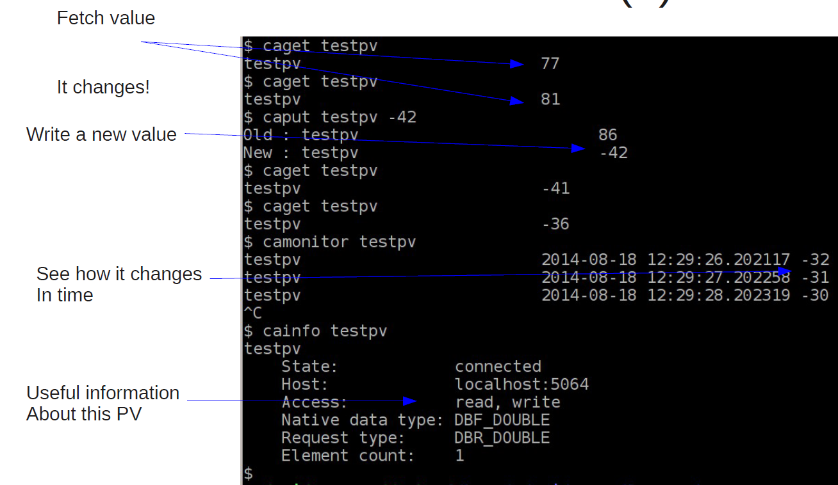
Basic CA Client Tools (2)

Slide 10
What comes with a caget?
Value: Integer, Float, String
Absolute time of last change
Alarm state (severity and status codes)
Limits (alarm, display, and control)
Units string
Precision (number of decimal digits)
List of states strings (for enumeration)
eg. ['invalid','moving','closed','open']

Slide 11
Mapping Records to Channels
Channel Access Client:
Connect to “LSX16a:M1:LVDT<.VAL>”
LSX16a:M1:LVDT.VAL
LSX16a:M1:LVDT.STAT
LSX16a:M1:LVDT.SEVR
LSX16a:M1:LVDT.TS
LSX16a:M1:LVDT.HOPR
LSX16a:M1:LVDT.LOPR
LSX16a:M1:LVDT.EGU
Connect to “LSX16a:M1:LVDT.SCAN”
LSX16a:M1:LVDT.SCAN
LSX16a:M1:LVDT.STAT
LSX16a:M1:LVDT.SEVR
LSX16a:M1:LVDT.TS
# Choices
List of choices
Channel Access Client:
Monitor request--------
Add Event to
alarm change
monitor change
archive change
Make data type request
Value
Status & Severity
Time Stamp
Display and Control
Information
Record:
AI:
Name
SCAN
VAL
STAT ACK
SEVR ACKT
HOPR EGU
LOPR
HIHI HHSV
HIGH HSV
LOW LSV
LOLO LLSV

Slide 12
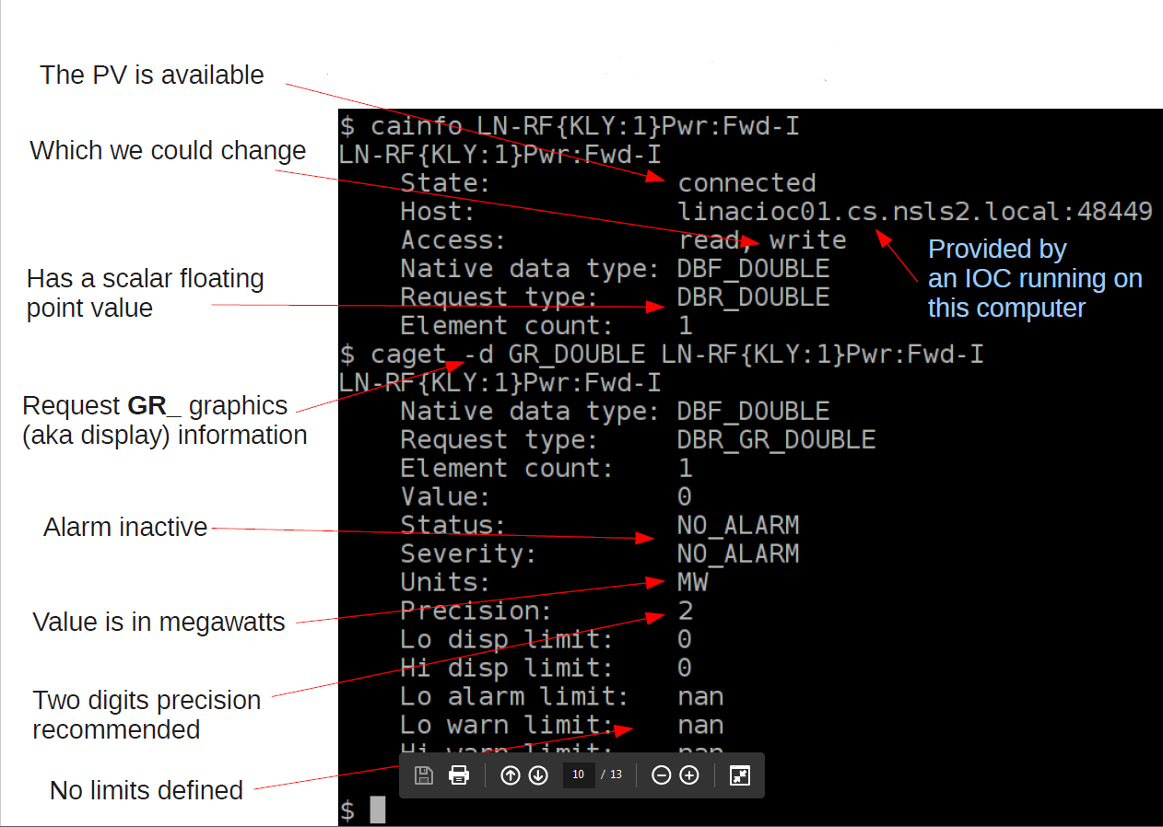
Investigating a Channel

Slide 13
Investigating a Channel(2)
Something is wrong here!
Alarm ranges are defined
Display range: 40 to 80 C
MINOR range: 1 to 55 C
MAJOR range: < 60 C

Slide 14
Alarm State
Severity
NO_ALARM (0) - Normal
MINOR (1) – Warning (yellow/orange)
MAJOR (2) - Error condition (red)
INVALID (3) - Value not meaningful (white/violet)
eg. device is powered off or disconnected.
Status
READ, WRITE, …
Knowing status codes isn't as important

Slide 15
Understanding Alarms
Alarms are subjective
Not all MAJOR alarms are equal
OPI clients can highlight alarming PVs with a colored border
Specialized Alarm clients (ALH or Beast) which aggregate large number of alarms.

