Slide 1
EPICS → ADO Bridge
Contents:
EPICS vs ADO
Bridge as IOC
Flowchart
Configuration

Slide 2
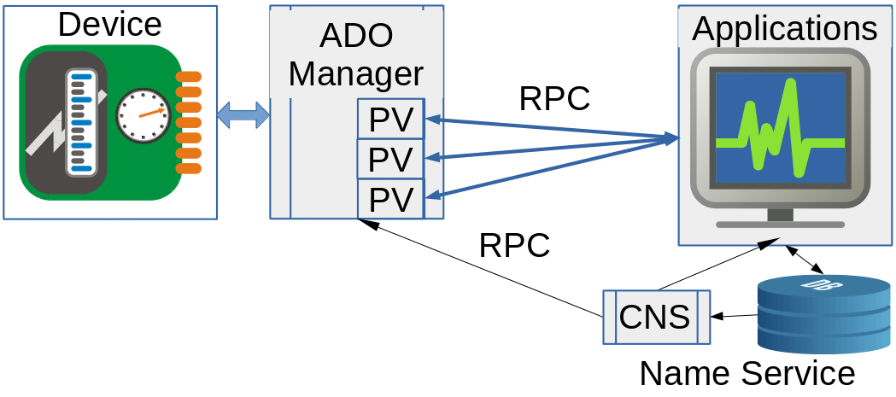

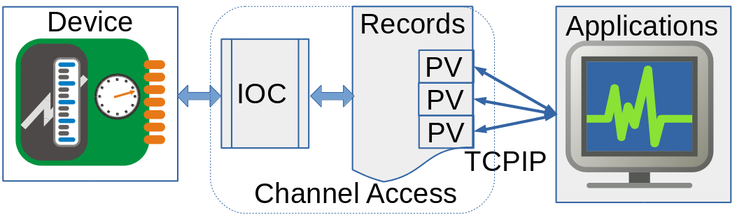

EPICS vs ADO
Naming conventions:
Device:Parameter
ADO names are easy-translated to EPICS.
Fig. 1. RHIC Controls client-server concept
Naming conventions:
Flat namespace.
No rules.
Time stamping supported:
A tuple of (seconds, nanoseconds)
Fig. 2. EPICS client-server concept
The concepts of records and state machine in EPICS looks overcomplicated. They were introduced at times when CPUs were slow and memory was small.

Slide 3
The bridge is soft IOC
The bridge is ordinary soft IOC.
One bridge can serve several ADOs.
Implemented in python using p4p.
p4p: python binding of PVAccess protocol.
Very well organized (developed by M. Davidsaver, 2023).
Easy installation using pip.
The PVs are treated very similar to ADO parameters:
  PV is defined by its properties. There is no records and state machine.
  4 ways to access PV:
    get() → get()
    put() → set()
    monitor() → subscribe()
    post() → publish()
EPICS Normative Types are tightly bound to NumPy arrays.
Fast.
Disadvantages:
Info() request is not supported.
Documentation is scarce.

Slide 4
Bridge flowchart
Create PVs:
Translate EPICS properties to ADO,
Supply writable parameters with setters,
  Handle legalValues,
Subscription:
for par in ADOpars:
subscribe(callback,par)
RHIC Controls supported
devices
ADO
Manager
PV
def callback(args):
for ADOPar,value in args:
pv(ADOPar).post(value)
PV
PV
PV
PV
PV
CNS
Name Service

Slide 5
Configuration
The input for the bridge could be:
A list of ADOs:
adoEpics -p'prefix1:' -a am_simple.1 simple.test
A list of python scripts, containing translation map:
adoEpics -p'prefix2:' -f a2e_am_simple.py a2e_simple.py
Translation map:
Is a python file, which will be imported during startup.
It should contain translationMap variable:
ranslationMap = {
'ado1:parameter1': {}, # Automatic (native) translation.
'ado1:parameter2': {map_of_properties} # Specific translation.
…
adoX:parameterY': (map_of_propertiesZ)
}
Map_of_properties defines the PV properties, which will be used instead of native ones.
Currently supported properties:
name, desc, units, opLow, opHigh, engLow, engHigh.

Slide 6
Example of translation map file
# Definitions
ro = {'readOnly':True}
units = 'units'
name = 'name'
desc = 'desc'# description
# Translation map
TranslationMap = {
'simple.test:timerIntervalS':{name:'simple:updatePeriod',
desc:'Update period', units:'s'},
'simple.test:alarmEnableS':{desc:'Enable alarm', **ro},
'simple.test:stringS':{desc:'String Setting'},
'simple.test:doubleS':{},
# 'simple.test:timerEnableS',
# 'simple.test:degM',
'simple.test:sinM':{},
}

Slide 7
Summary
Fully functional bridge have been released as adoEpics program.
Gitlab project: https://gitlab.pbn.bnl.gov/python/cli-tools/adoEpics
Performance:
Bridge crossing time on the same host: ~1 ms.
It is time when PV value have appeared in monitor callback relative to time when it was modified in ADO.
Todo:
Translate alarm properties.
Implement PPM user as command line option.

