Slide 1
EPICS GPClient

Slide 2
What is the Generic Purpose Client?
A generic purpose API that focuses on user productivity
Generic (not general) in the sense that is good for 90% of the use cases (but not all)
Give a quick way to implement complex cases with all the hard bits taken care
User interfaces, scripts and productivity tooling would typically bind to this API
Scripts
User interfaces
Testing
Data integration
Generic Purpose API
(focus on user productivity)
Protocol Level API (focus on raw performance and feature completeness)

Slide 3
What is the Generic Purpose Client?
It’s a better version of pvmanager/diirt
Client library to be used when writing a generic purpose application, that does not particularly care about protocol details and does not need an ad-hoc caching and synchronization model
It’s a redesign based on the past experience: we kept what was working, removed the parts of the architecture that we never actually used and better generalized the parts that were used
It’s the “just give me some data and take care of all the threading stuff” client library
PVReader<VType> pv = GPClient.read(“pva://MGNT10:CurrRB")
.addListener((PVEvent event, PVReader<VType> p) -> {
System.out.println(event + " " + p.isConnected() + " " + p.getValue());
})
.start();

Slide 4
Main characteristics
Small footprint
The core is 46 classes
Extensible architecture: each boundary point is exposed through an interface/abstract class
E.g. Data sources, caching strategy, event aggregation strategy, background computation, thread pool for processing, notification thread, etc. are all things that can be customized
A well thought out threading strategy that shields the user from all typical concurrency issues
Minimizes use of locks, locks are not leaked, client processing does not lag, computation is done in the background, notification is done on the thread you need to, …
The strategy is well documented in the code, using standard best practices
All that can be final/immutable is made so
Each class has a lock that guards a specific set of private variables and the lock is never exposed in a user callback

Slide 5




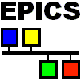

GPClient core architecture
Collectors
Rate decoupler
Client callback
Background computation
Desired rate
Source rate

Slide 6
GPClient simplest setup
Monitor one PV with no processing
Collectors
Rate decoupler
Client callback
Desired rate
Source rate

Slide 7
GPClient simplest setup
New value from EPICS
is written in the collector
Collectors
Rate decoupler
Client callback
Desired rate
Source rate

Slide 8
GPClient simplest setup
Collector notifies
rate decoupler
Collectors
Rate decoupler
Client callback
Desired rate
Source rate

Slide 9
GPClient simplest setup
Rate decoupler reads
value and prepares notification
Collectors
Rate decoupler
Client callback
Desired rate
Source rate

Slide 10
GPClient simplest setup
Callback is notified
Collectors
Rate decoupler
Client callback
Desired rate
Source rate

Slide 11
GPClient simplest setup
Burst of values from EPICS
while the client
is processing
Collectors
Rate decoupler
Client callback
Desired rate
Source rate

Slide 12
GPClient simplest setup
Rate decoupler waits
(without locking)
Collectors
Rate decoupler
Client callback
Desired rate
Source rate

Slide 13
GPClient simplest setup
Once the callback is done
a new event is prepared
Collectors
Rate decoupler
Client callback
Desired rate
Source rate

Slide 14
GPClient simplest setup
Rate decoupler sends
a single new notification
Collectors
Rate decoupler
Client callback
Desired rate
Source rate

Slide 15
Advanced setup
Process a large dataset based
on UI input
Collectors
Rate decoupler
(e.g. from a large waveform, calculate the average/mean/min/max of a
selected window)
Client callback
Background computation
Desired rate
Source rate

Slide 16
Advanced setup
New waveform comes in
Collectors
Rate decoupler
Client callback
Background computation
Desired rate
Source rate

Slide 17
Advanced setup
Calculation starts on background thread
Collectors
Rate decoupler
Client callback
Background computation
Desired rate
Source rate

Slide 18
Advanced setup
While calculating user changes selection, current calculation is not affected
Collectors
Rate decoupler
Client callback
Background computation
Desired rate
Source rate

Slide 19
Advanced setup
Notification is done
on the UI thread
Collectors
Rate decoupler
Client callback
Background computation
Desired rate
Source rate

Slide 20
Advanced setup
Calculation starts on new values
Collectors
Rate decoupler
Client callback
Background computation
Desired rate
Source rate

Slide 21
Advanced setup
Notification of latest value
on the UI thread
Collectors
Rate decoupler
Client callback
Background computation
Desired rate
Source rate

Slide 22
Flexible pipeline
The GPClient allows the creation of flexible pipelines that combine notifications from various source (e.g. multiple EPICS channels, services, UI, …) into a well controlled stream
This is important because if each processing piece has its own queuing, background thread, etc it becomes very hard to coordinate them
The idea is to work on a customizable framework that covers multiple use cases instead of one pipeline for each application
It allows to use the same knowledge/testing/features in different setups

Slide 23
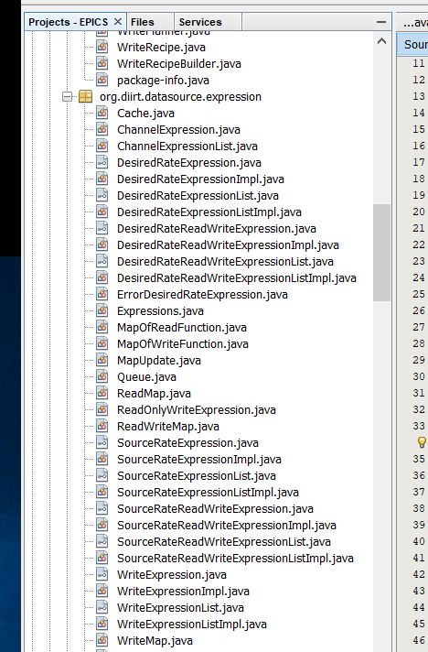
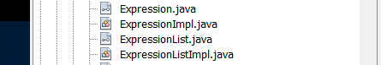
Changes from pvmanager/diirt design
In the new API:
Source rate expressions are removed
Never actually used
All expressions are ReadWrite
The compile time check could not remove the runtime check: may as well remove the compile time one and simplify the API
We currently have only 4 classes
The old API differentiated at compile time between:
Source/Desired rate expressions
Read/Write/ReadWrite expression
Single/Group of expression
To handle all cases, there are 20 classes

Slide 24
Changes from pvmanager/diirt design
DataSource recipes
In the old API each pv expression created a datasource request with all the channels the pv would connect to, so that the datasource could (in principle) optimize connection to multiple channels
In practice: 99% of expression mapped to a single channel and the batch connection was never optimized
In the new API each datasource request is for one channel only which simplifies the API and the implementation
However, the requests are posted on a processing thread and then batched, so if batch connection is ever implemented it would actually work across pvs
DataSource write implementation
In the old API, the write for a channel had to be implemented synchronously
In the new API, the write can either be implemented synchronously or asynchronously, simplifying the implementation of each data source

Slide 25
Changes from pvmanager/diirt design
Unified callbacks for read and write (ReadCollector and WriteCollector)
In the old API, the data source was given a different callback for connection/value/error/writeConnection/writeResponse
In the new API, a read request is given a ReadCollector and a write request is given a WriteCollector, and they can be used for all notifications
Generalized callbacks for read and write
In the old implementation, event notification for data sources is ad-hoc. If one wanted a pv to react from events that are non-DataSource generated, this had to be also handled ad-hoc
For example, graphene (the graph library) has to respond to data update events and to UI events, and the UI event pipeline had to be implemented separately
In the new API the ReadCollector and WriteCollector are not tied to the DataSources and therefore one can digest updates coming from different sources (i.e. UI events, command/response services, …)

Slide 26
Changes from pvmanager/diirt design
Unified event pipeline
In the old implementation, the events for connection/value/error/writeConnection/writeResponse where handled separately in an ad-hoc way, and the client event was yet a different object
In the new API, there is a single PVEvent that supports all of the types, and it is the same object for source rate notification and desired rate notification (i.e. it passes through in most cases)
That same object supports combining multiple events into a single events. Common events (i.e. connection and value) are actually the always same object (thus saving creating/destroying objects). The event batching preserves ordering (i.e. you can distinguish between “newValue-then-error” and “error-then-newValue” within a single notification)

Slide 27
Changes from pvmanager/diirt design
Null values are now supported
In the old implementation, null values could not be written and could not be received.
This was annoying when local pvs where used for selections. The null initialization would mean no selection but, once the value was changed, there was no way to “clear” the selection.
In the new API, null value are supported by the framework (though not necessarily by all data sources)
Channel name only connection
In the old API, one would always need to at least specify the maximum rate of events and whether the string represented a channel or a formula
In the new API, there is a default maximum rate and a “string only” expression

Slide 28
What still needs to be done
PVAccess support could be improved with a redesign of the pvaccess library
Currently, pvaccess library exposes a cache for the latest value therefore the only safe way to share that data is to make a defensive copy
Other functionality could be retrofitted from diirt
Support for services (command/response)
Formulas

Slide 29
Summary
The EPICS VTypes are a redesign of diirt Vtypes
It is part of EPICS core
Same idea of interfaces to immutable data
All utility methods are static methods of the respective classes
All object provide reasonable equals/hashcode/toString
The EPICS GPClient is a redesign of pvmanager/diirt
It is part of EPICS core
Continues to provide similar functionality to pvmanager/diirt
Simplified core (44 classes instead of 106)
Simplified interface
More flexible architecture

