Slide 1



Mansoura University
Faculty of Computer & Information Sciences
Automated Skincare System Based On Deep Learning (Pearl)
Supervised By:
Dr. Fatma El-Zahraa Ahmed
Eng. Kholoud Srour

Slide 2

Outline
1
Introduction
6
Design & Implementation
2
Problem Overview
7
Future Work
3
Objectives & Contribution
8
Competitions
4
Related work
9
Timeline
5
System Analysis
10
Team Members

Slide 3
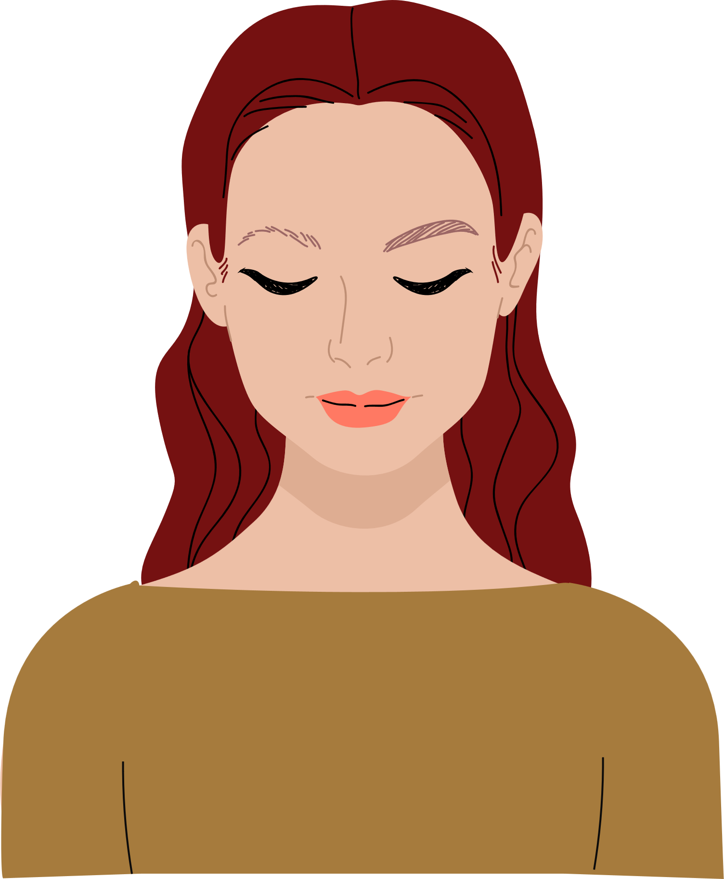
01
Introduction

Slide 4
Introduction :-
Skin – Definition
The skin, the body's largest organ, provides a barrier against pathogens, UV light, chemicals, and physical injury.

Slide 5

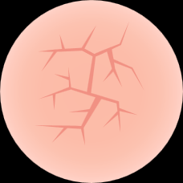



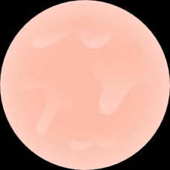

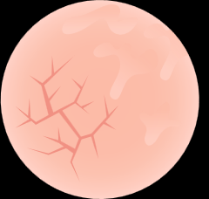
Introduction | Cont. :-
Skin – Types
Normal
Dry
Combination
Oily

Slide 6
Introduction | Cont. :-
Skin – Medical Problems
Acne
Rosacea
Eczema
https://www.aad.org/media/stats-numbers

Slide 7
Introduction | Cont. :-
Skin – Medical Problems
Our Survey
33.2%
Pores
39.8%
Hyperpigmentation
85.7%
Acne
Total | 600 Person
What are the problems that you are facing?

Slide 8
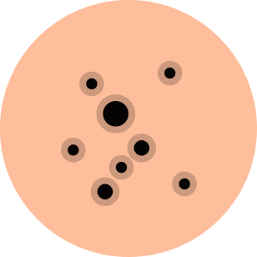

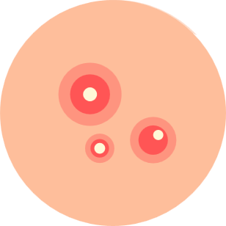
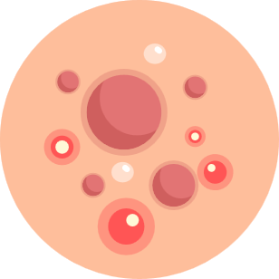
Acne Types and Severity
Blackheads
Whiteheads
Papules & Pustules
Cysts & Nodules
Mild
Moderate
Severe

Slide 9
Consequences Of Acne
96%
89.4%
46%
Depression
Quality of life
31%
96% of people with Acne have reported feeling depressed.
Acne had a negative impact on the QoL of 89.4% of individuals sharing the household with affected patients.
Self-esteem
Social Activity
46% to develop self-esteem issues over their complexions
31% to stay more at home, declining to participate in social activities.

Slide 10
02
Problem Overview

Slide 11
Problem Statement :-
Social Media – Our Survey
10.6%
Others
Total
600 Person
88%
57.9%
Products Reviews on Social Media
31.5%
Influencers
How do you get your skincare products information?

Slide 12
Lack of Knowledge

Slide 13
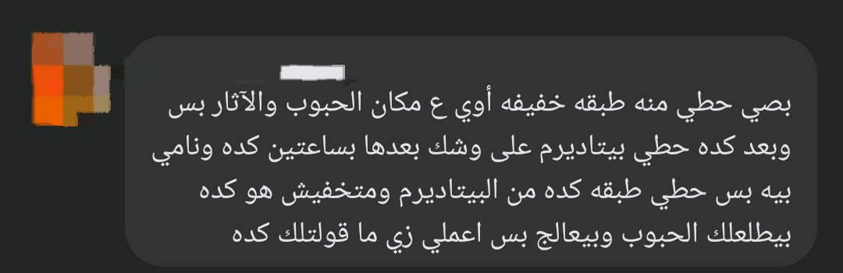
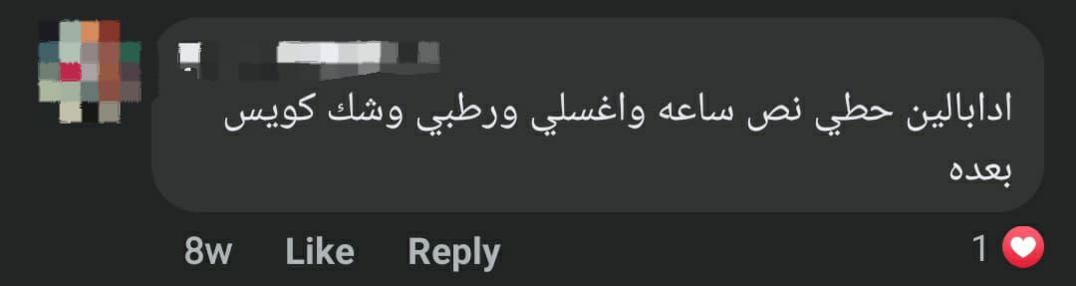
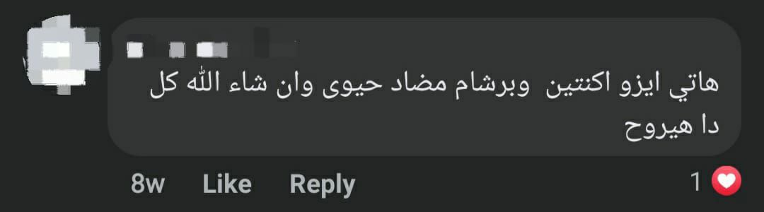
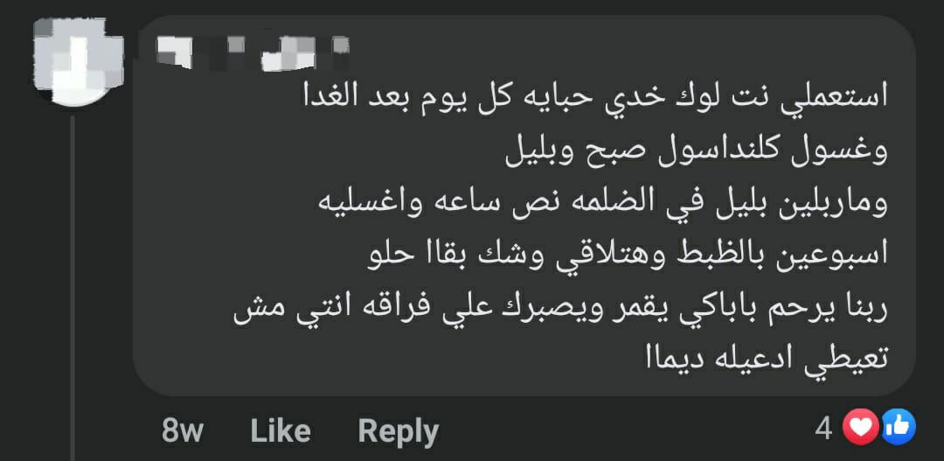
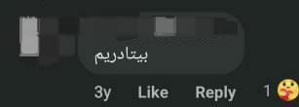
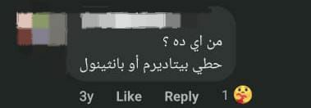
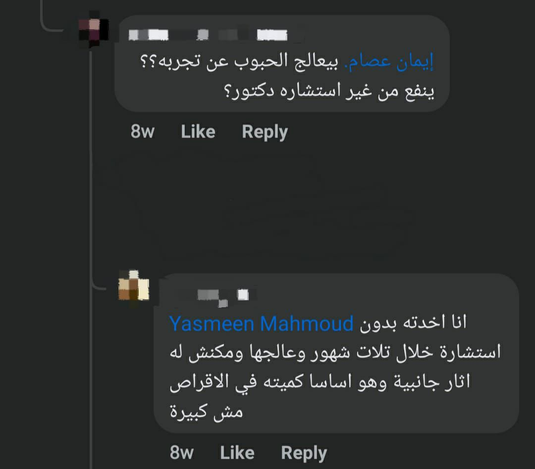
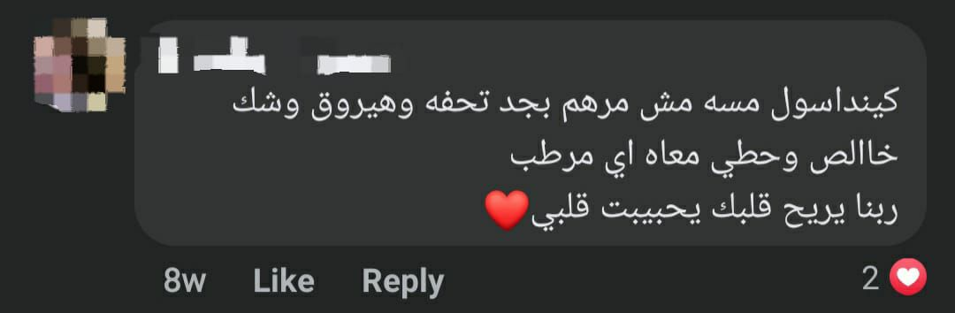
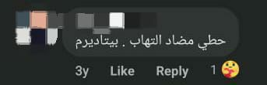
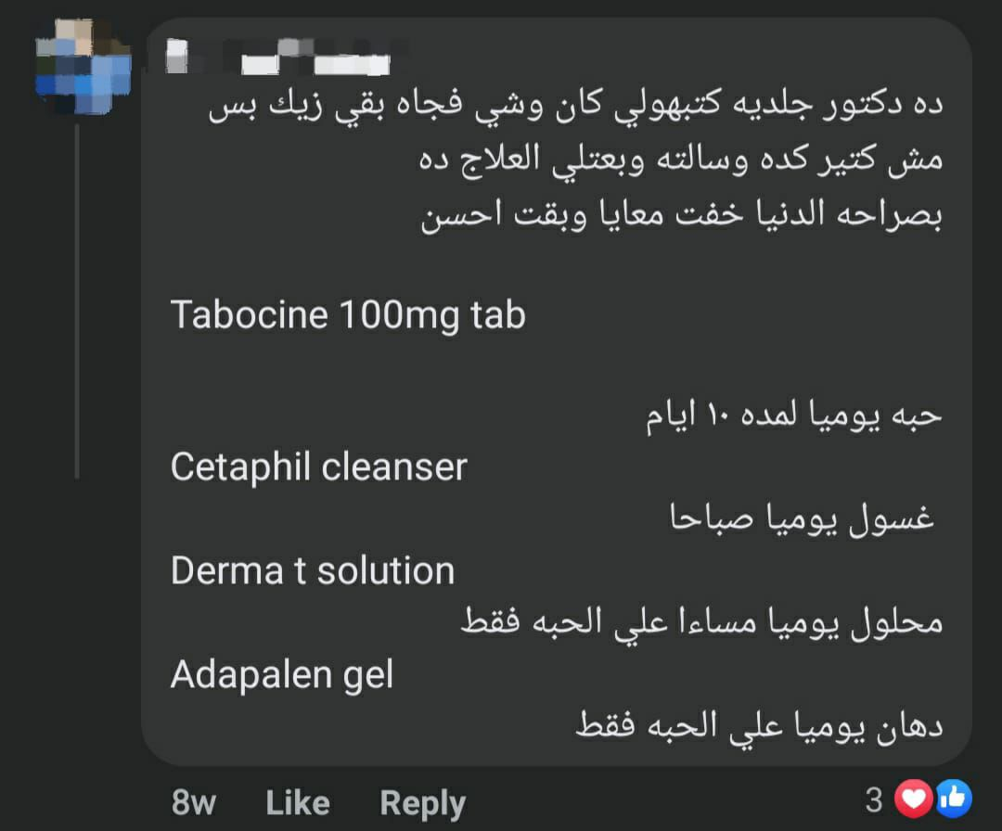
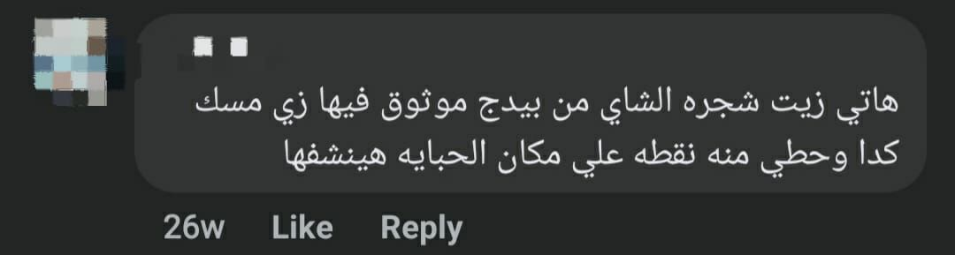
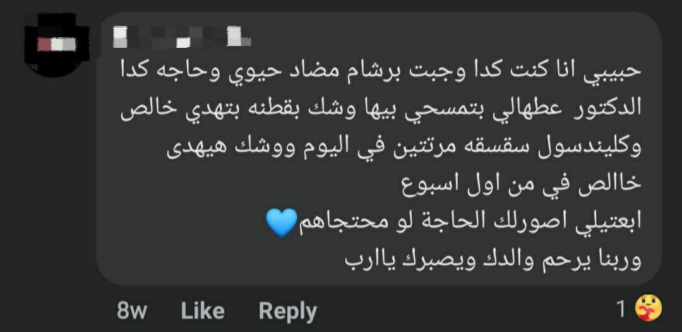
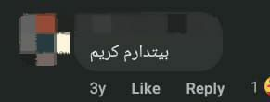
Lack of Knowledge

Slide 14
Doctor’s Opinions

Slide 15
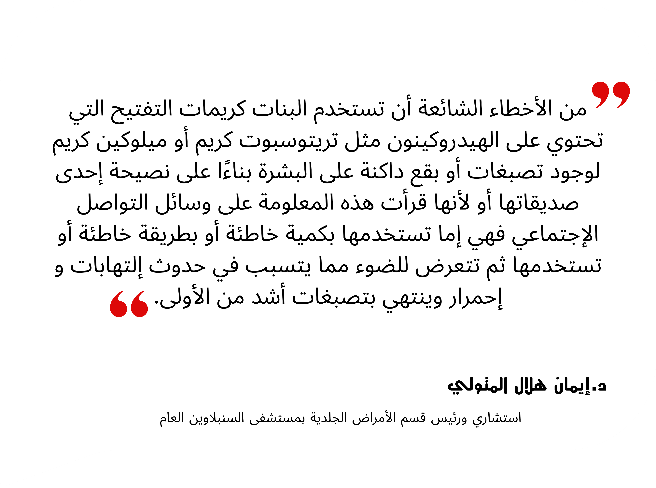
Doctor’s Opinions

Slide 16

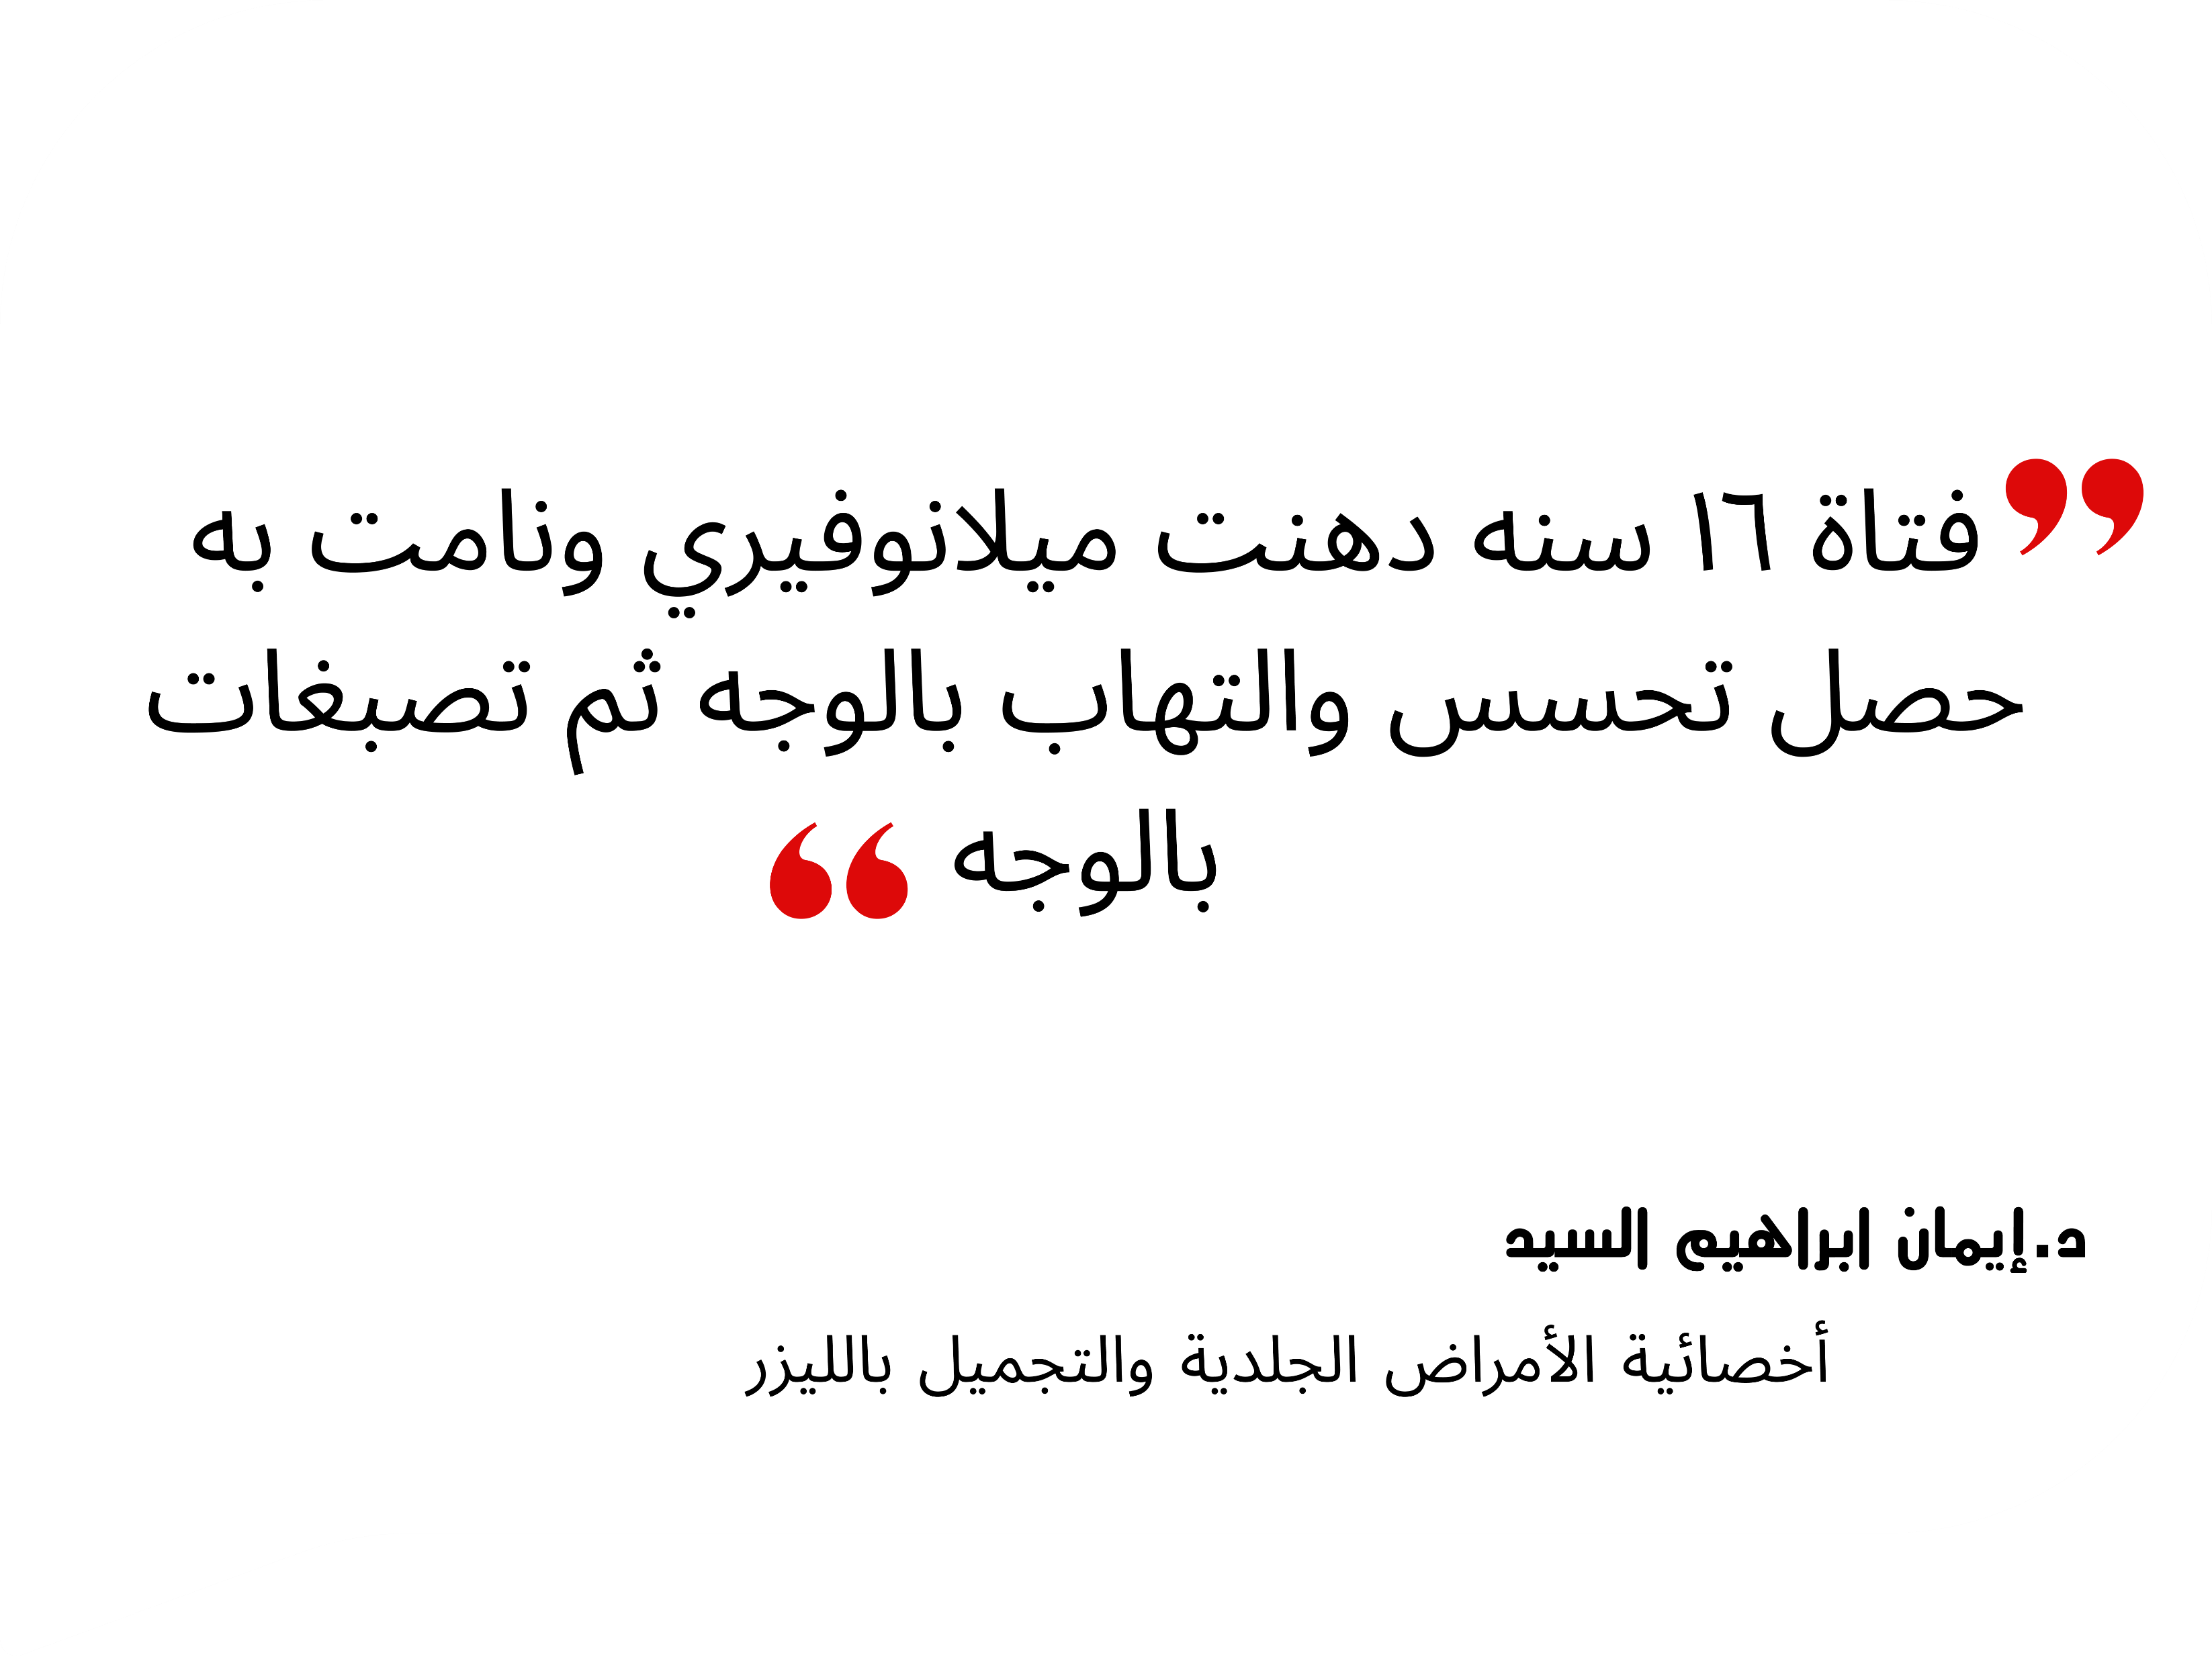

Slide 17

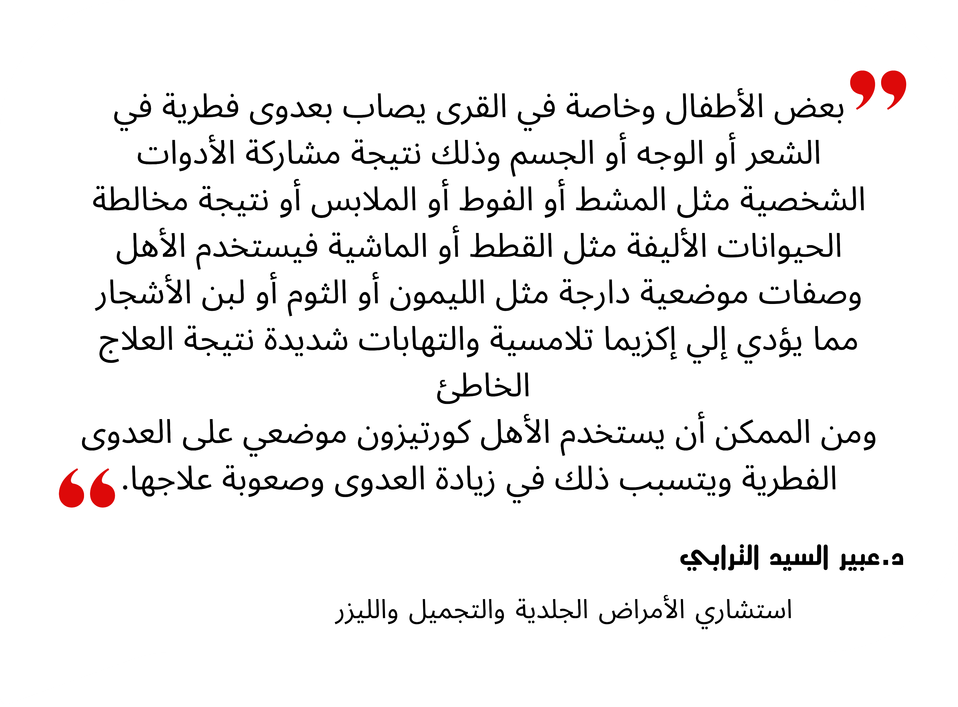

Slide 18
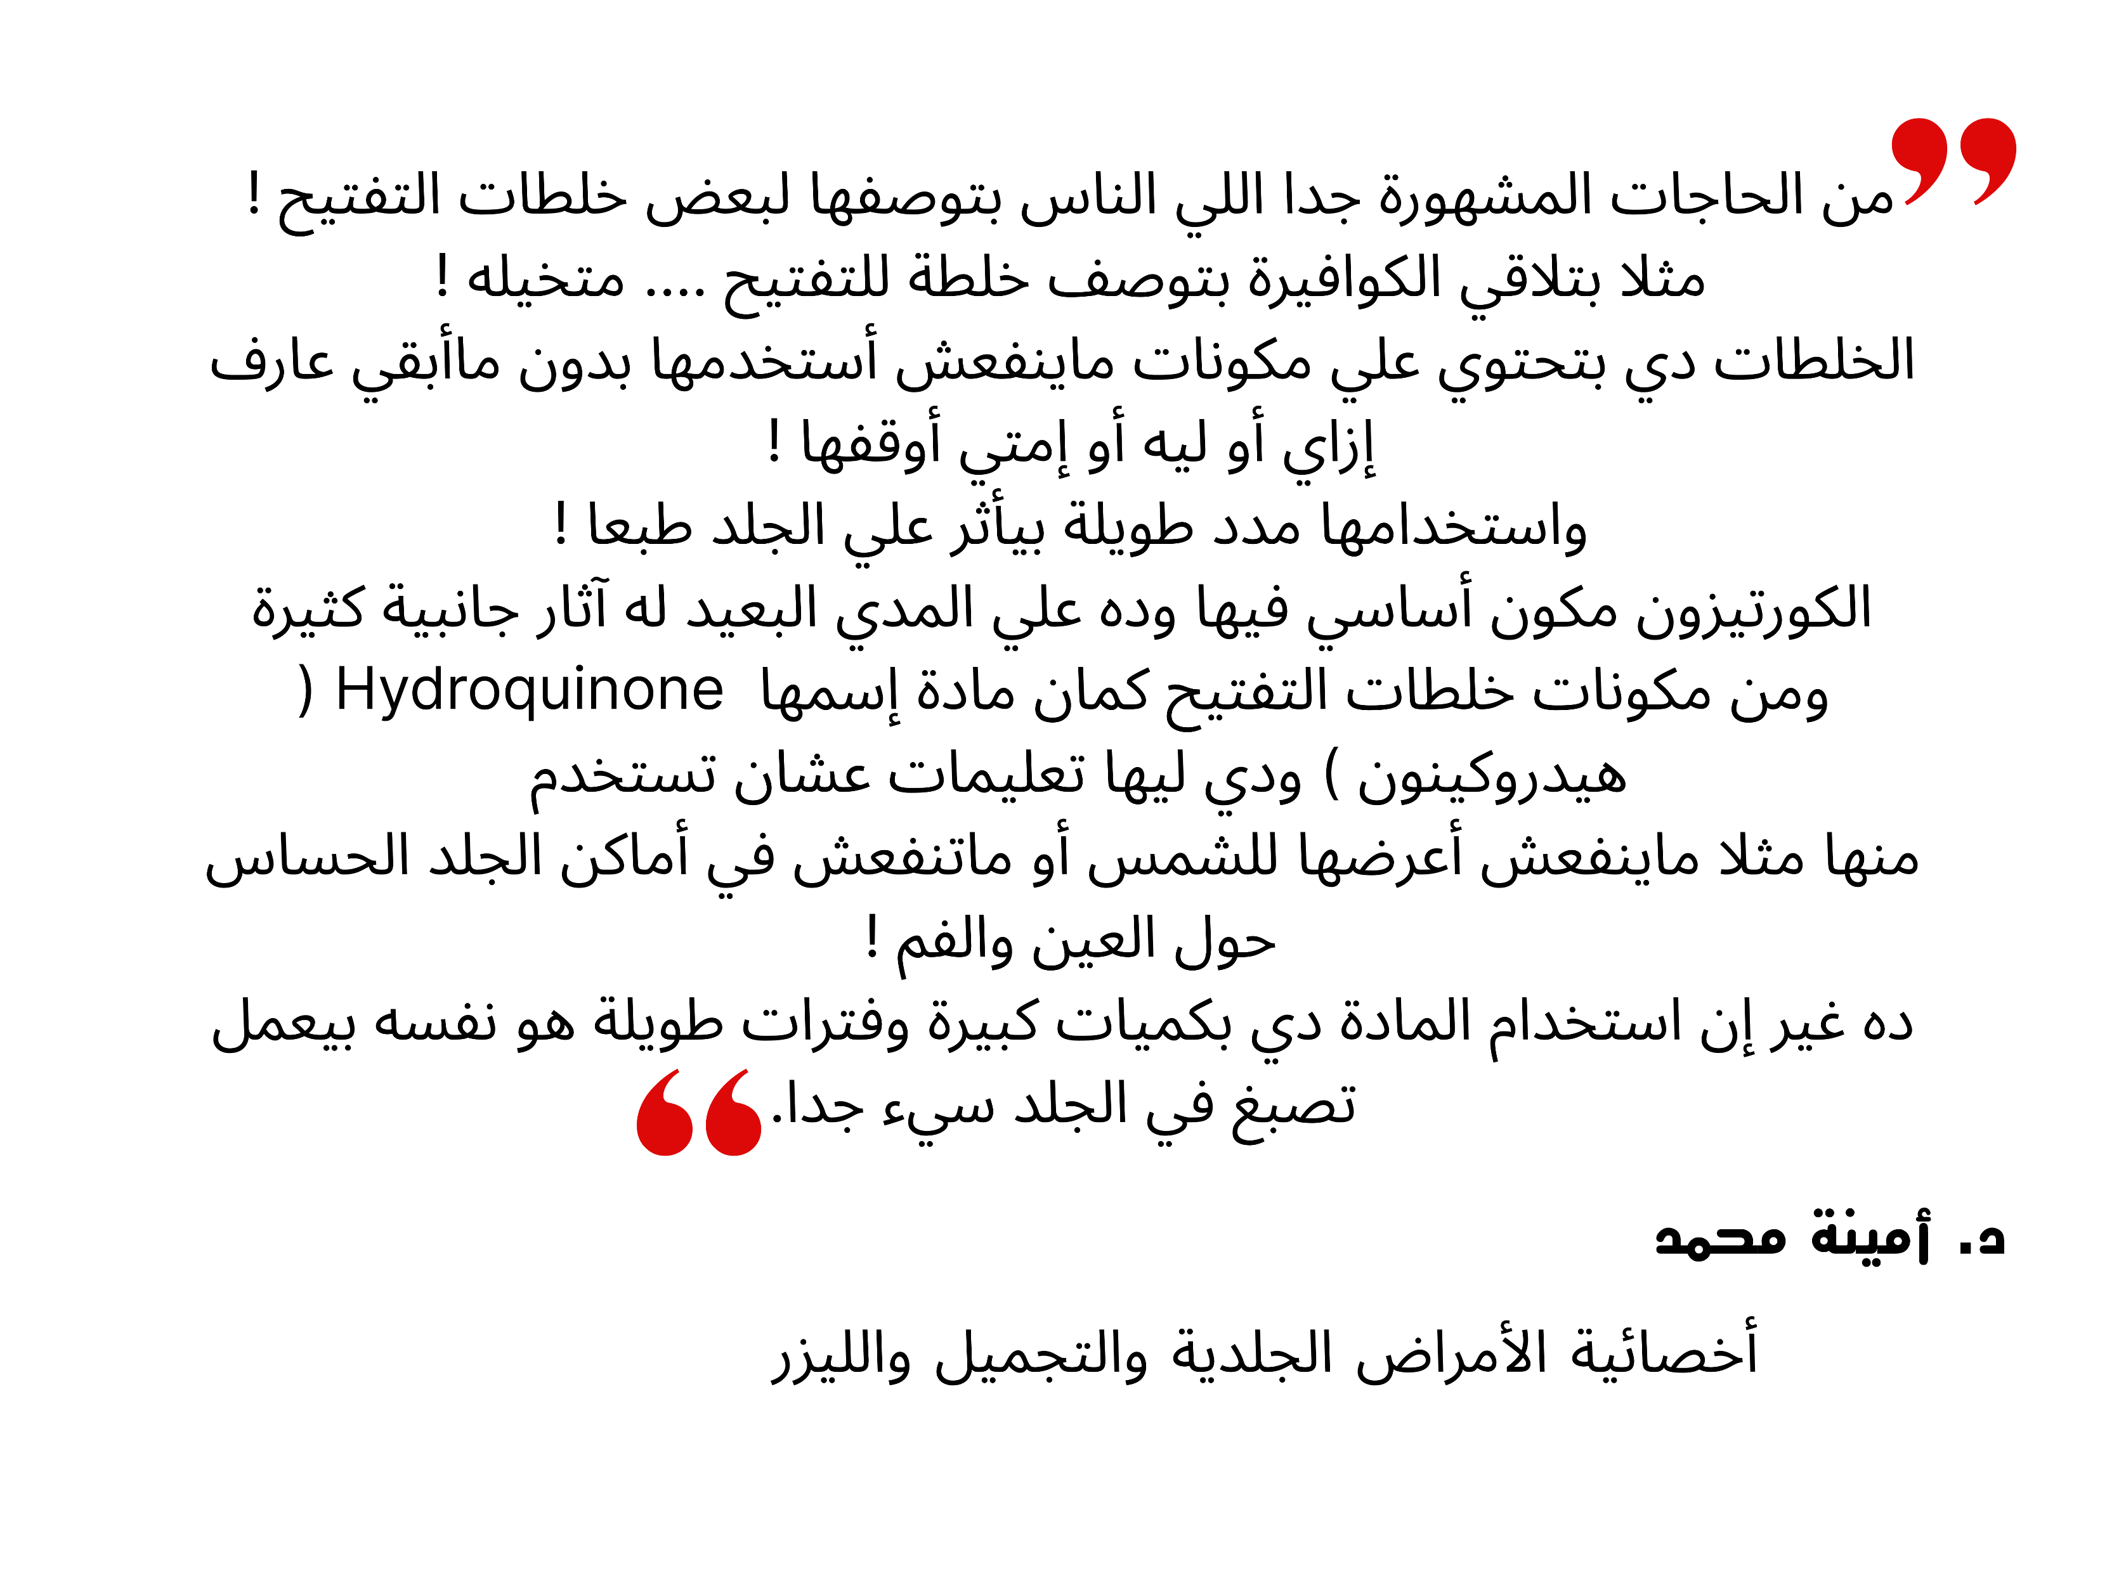

Slide 19
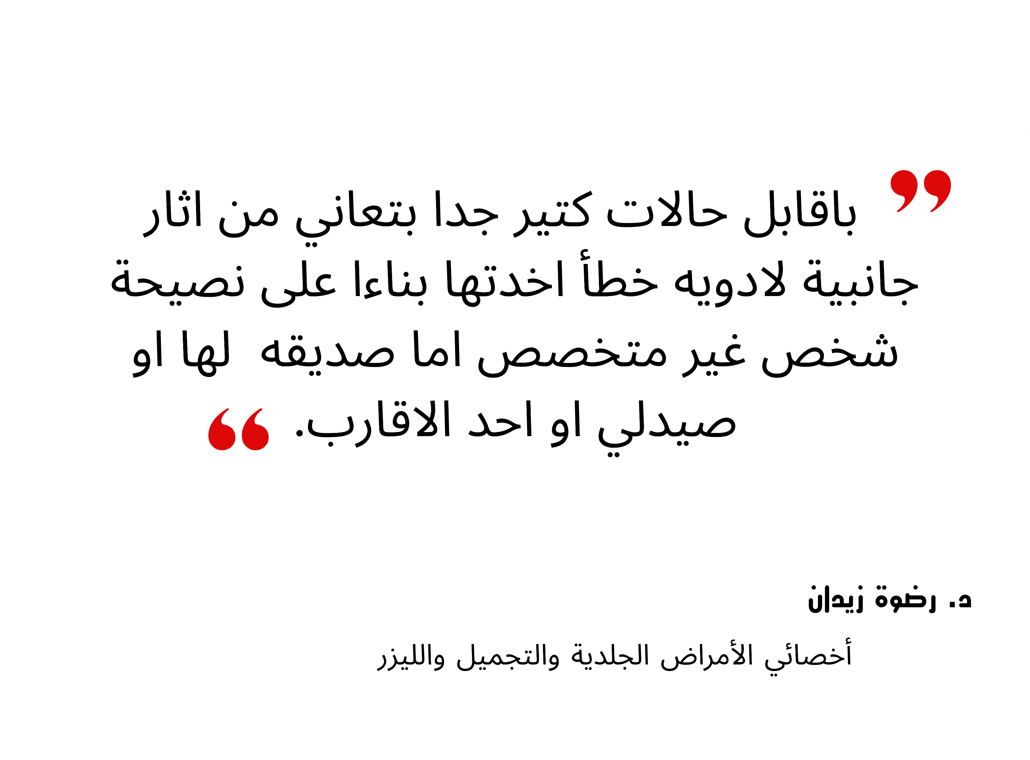

Slide 20
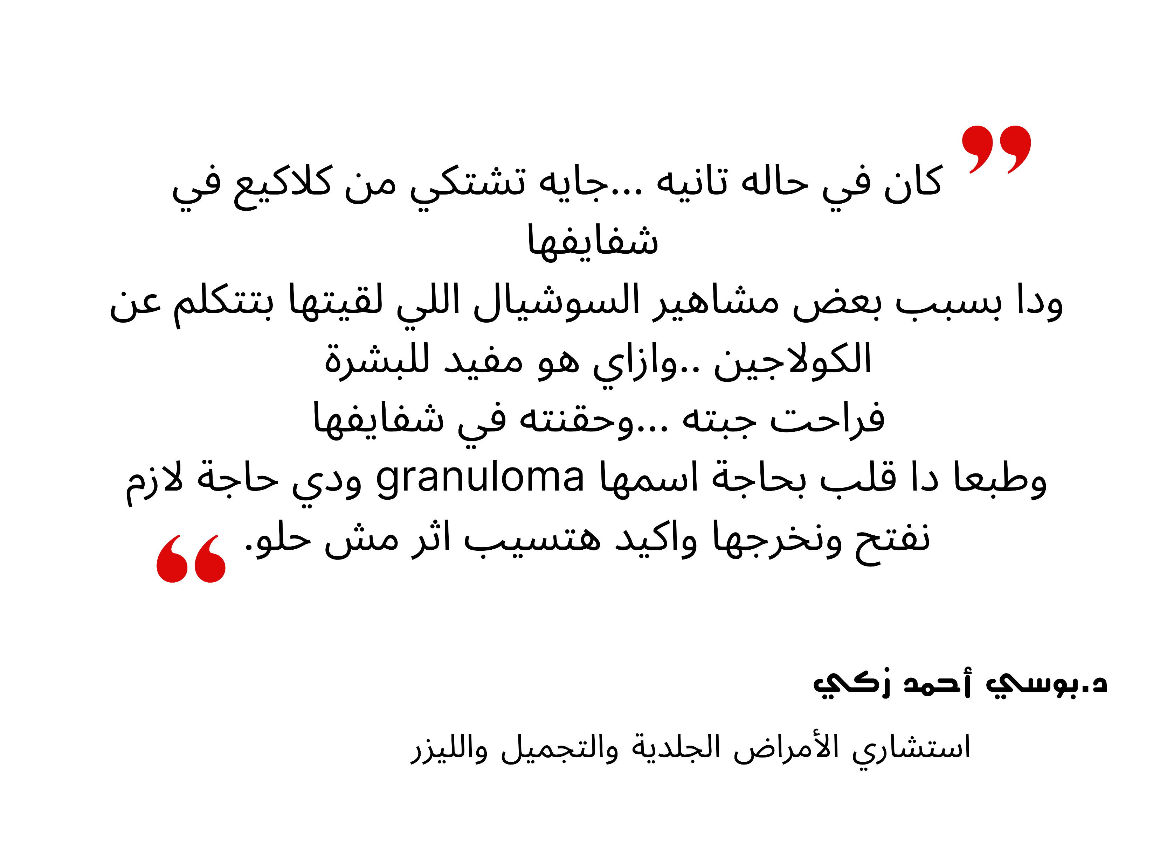

Slide 21
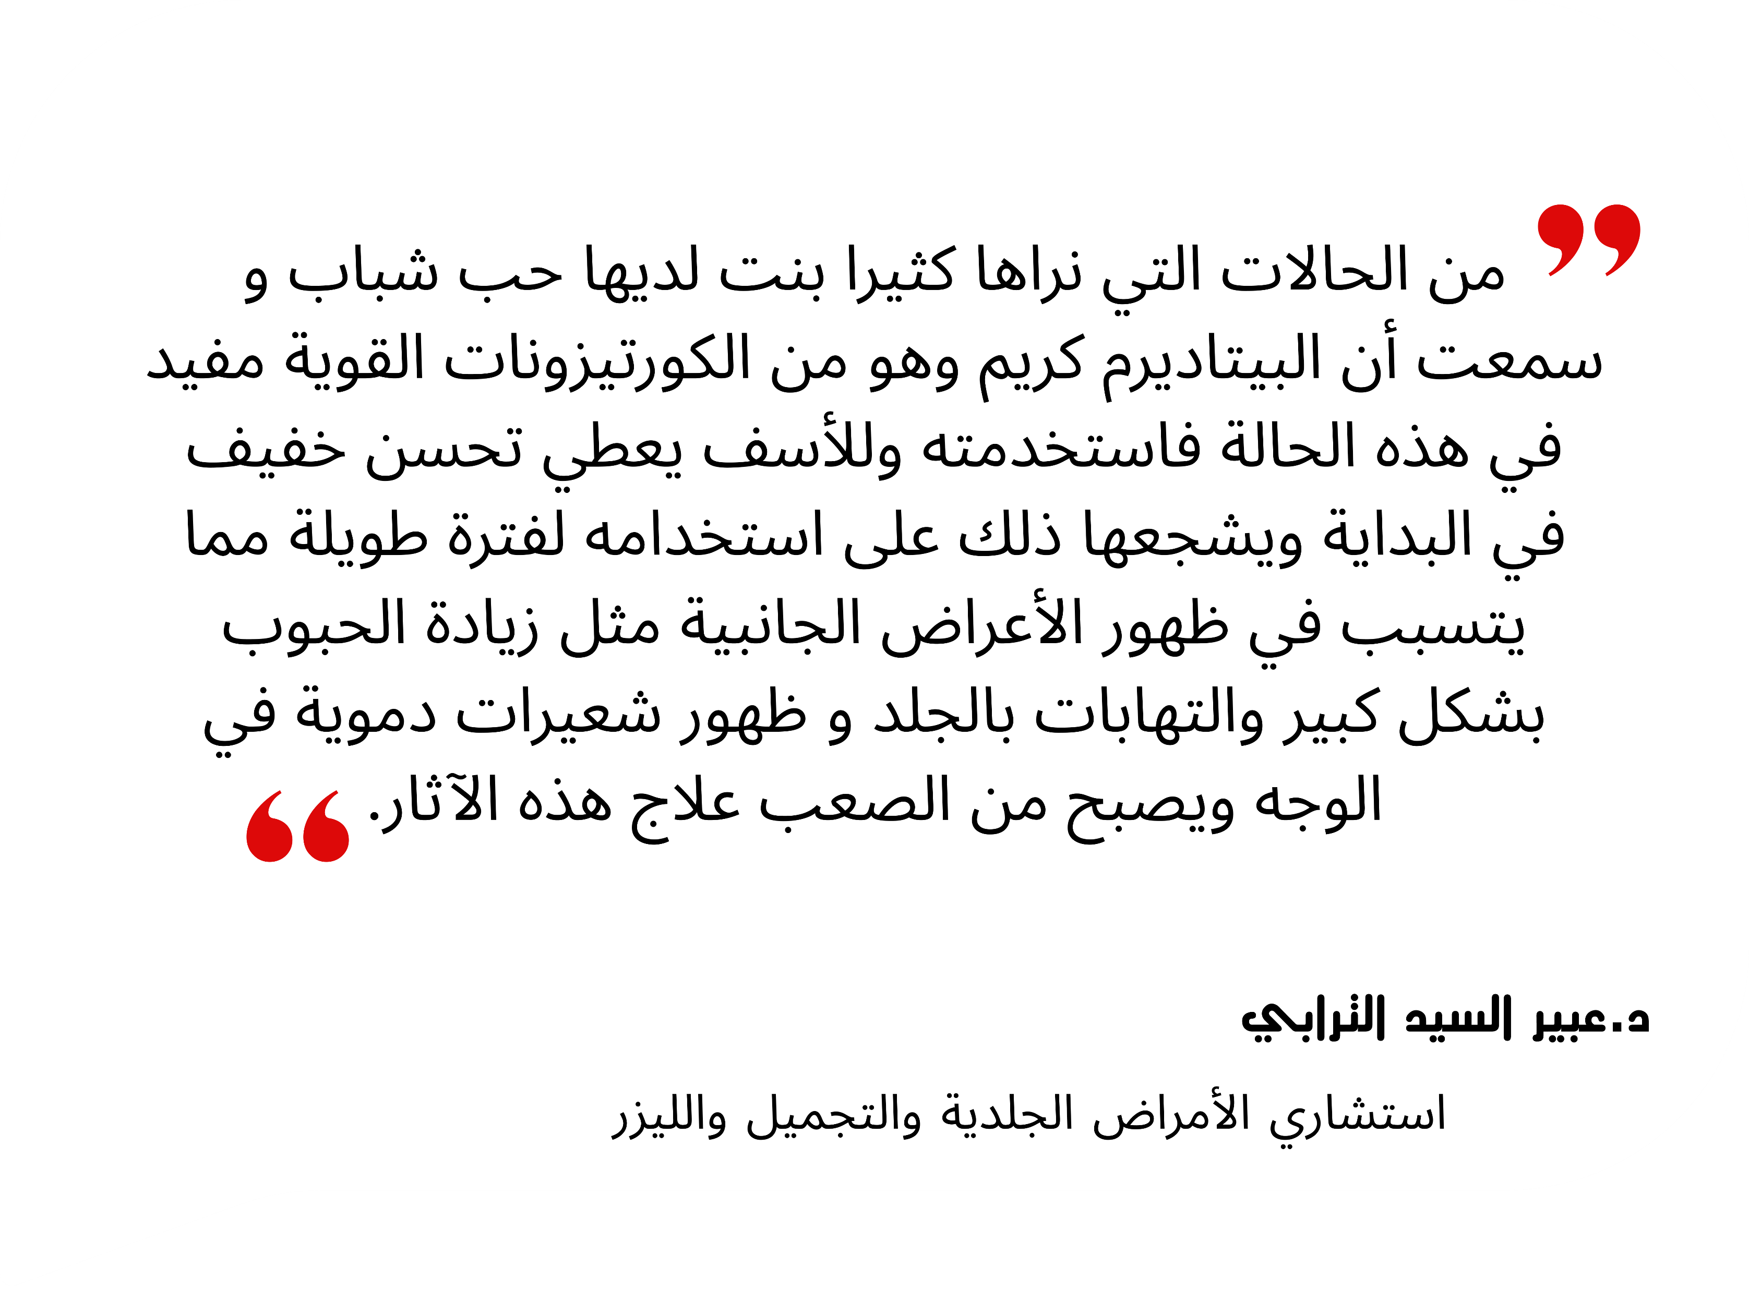

Slide 22
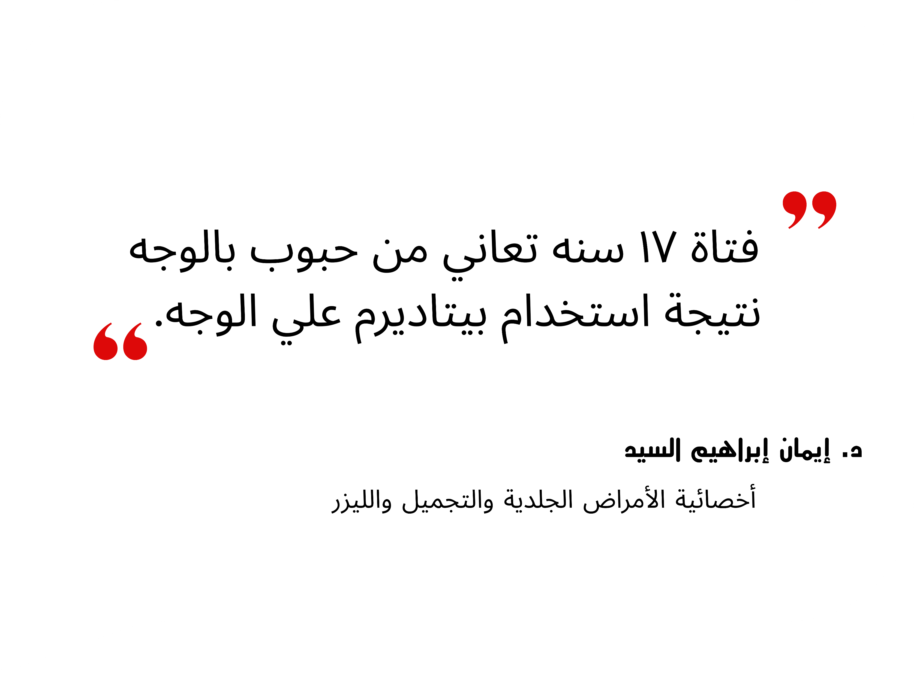

Slide 24
03
Objectives & Contribution
Pearl’s Solution

Slide 25

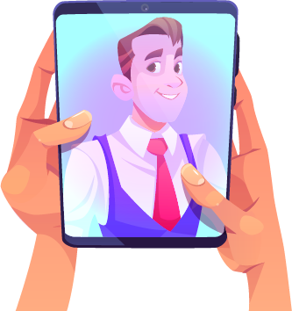
Pearl’s Solution

Slide 26

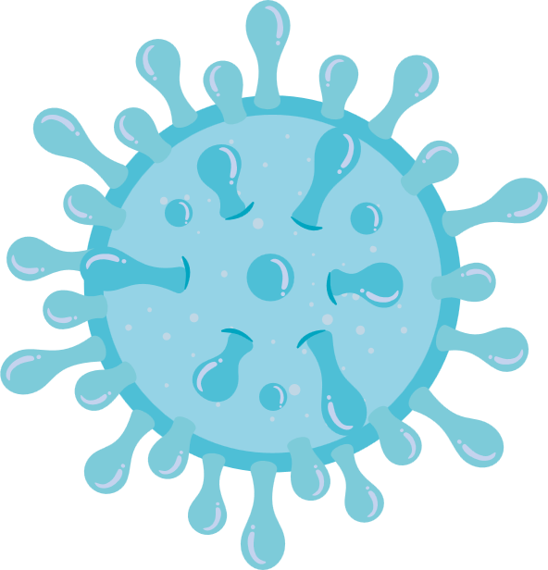


Pearl’s Solution
Objectives
1.
Collect medication information through photo and question answers for skincare analysis.
Drinking water
History of autoimmune diseases
Previous skin treatments
Dietary preferences

Slide 27

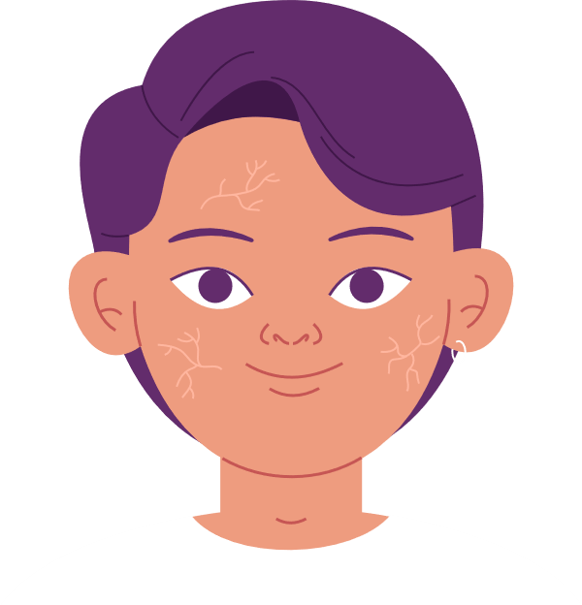




Objectives
2.
Detecting User’s skin type.
Normal
Dry
Oily

Slide 28
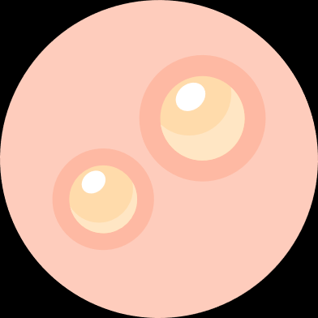

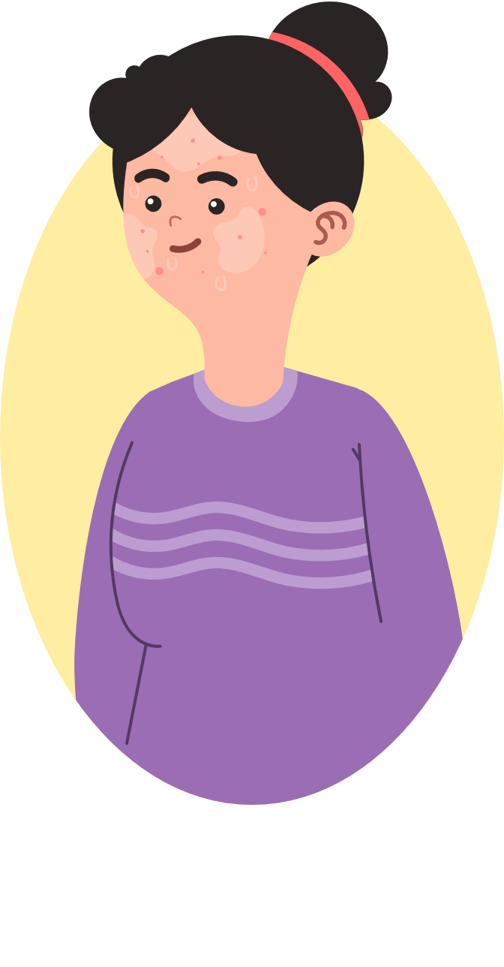
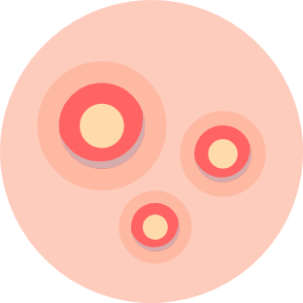
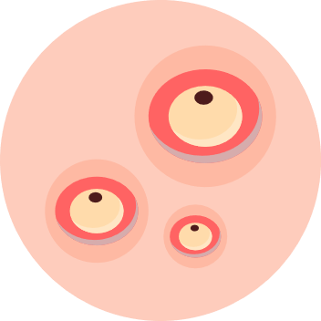
Objectives
3.
Highlight acne severity.

Slide 29
Objectives
4.
Provide solutions through personalized routines.

Slide 30
Objectives
5.
Customized Diets for Optimal Skincare.

Slide 31
Objectives
6.
Track user skin’s Progress to motivate him.

Slide 32
Objectives
7.
Consider suggesting doctors.

Slide 33
Objectives
8.
Streamline patient history access for efficient consultations.

Slide 34
Objectives
1
Youth Empowerment
2
Accessible Healthcare Services
3
Improving Healthcare Services
4
Enhancing Quality of Life

Slide 35
04
Related work

Slide 36

Related Work
Competitive
Free Acne
Acne safe
Ai
dermatologist
Troveskin
Pearl
Automatic Skin Type Detection
Detect Acne
Automatic Acne Severity Detection
Routine Recommendation
Integrate with Doctors
Provide a Diet
Skin Tracking

Slide 37
Related Work
Competitive
Free Acne
Acne safe
Ai
dermatologist
Troveskin
Pearl
Automatic Skin Type Detection
Detect Acne
Automatic Acne Severity Detection
Routine Recommendation
Integrate with Doctors
Provide a Diet
Skin Tracking

Slide 38
05
System Analysis
More…

Slide 39
Architecture Diagram
Notes:
Architecture
Diagram

Slide 40
Architecture Diagram
Notes:
Architecture
Diagram

Slide 41
Architecture Diagram
Notes:
Architecture
Diagram

Slide 42
Notes:
Architecture
Diagram

Slide 43
Notes:
Architecture
Diagram

Slide 44
Notes:
Architecture
Diagram

Slide 45
Notes:
Architecture
Diagram

Slide 46
Notes:
Architecture
Diagram

Slide 47
Notes:
Architecture
Diagram

Slide 48
Business Model

Slide 49
Business Model

Slide 50
Deep Learning Frameworks

Slide 51
Skin Types Deep Learning Framework

Slide 52
Skin Types Deep Learning Framework
Skin Types Model Evaluation

Slide 53
Skin Types and Acne Vulgaris
Oily
Dry
Positive
67.7%
Negative
9.7%
Negative
11.8%
Positive
10.8%
https://talenta.usu.ac.id/smj/article/view/3279

Slide 54
Acne Severity Deep Learning Framework

Slide 55
Acne Severity Model Evaluation

Slide 56
06
Design & Implementation

Slide 57
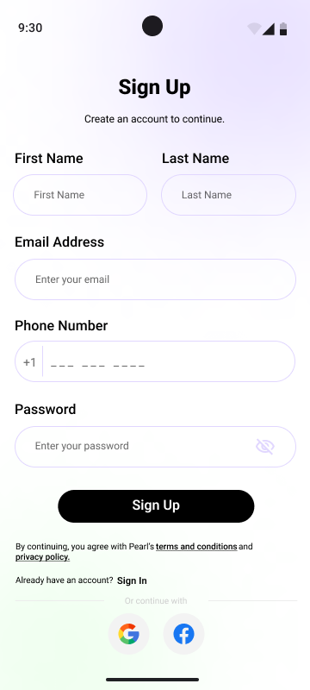
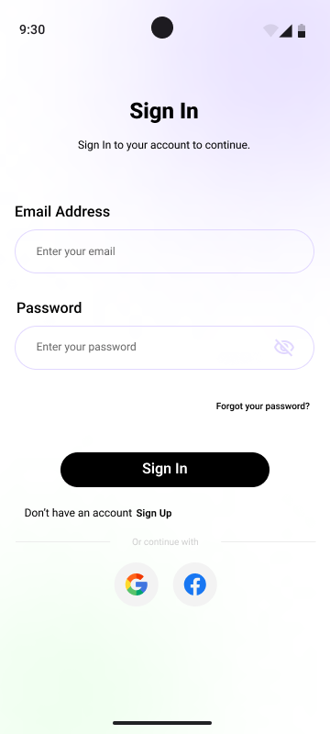
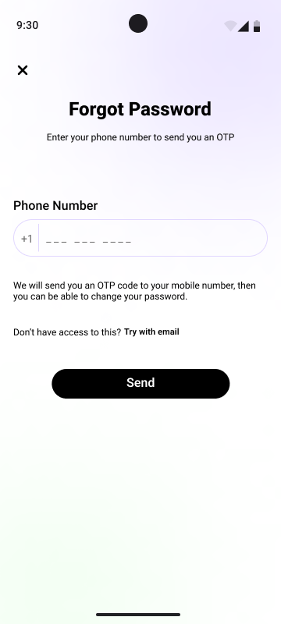
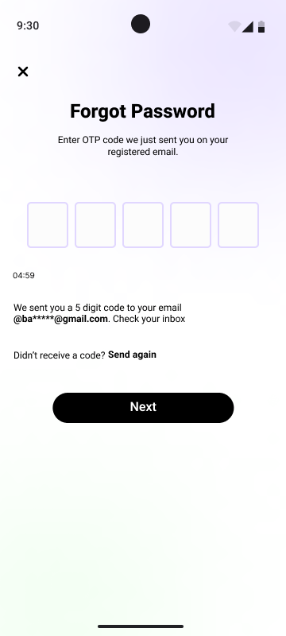
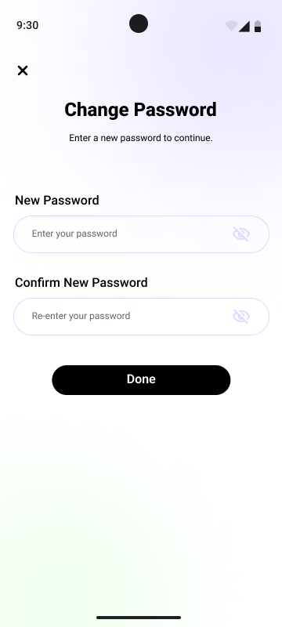
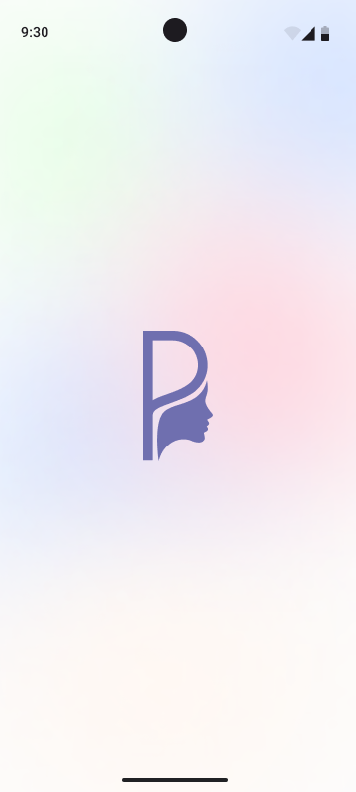
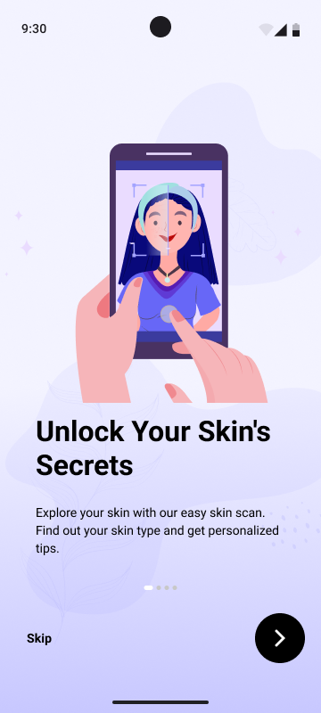
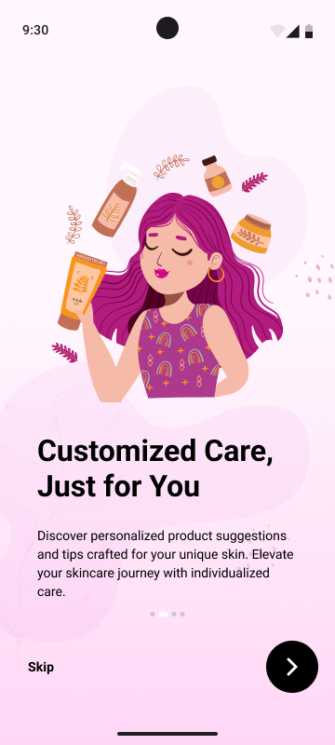
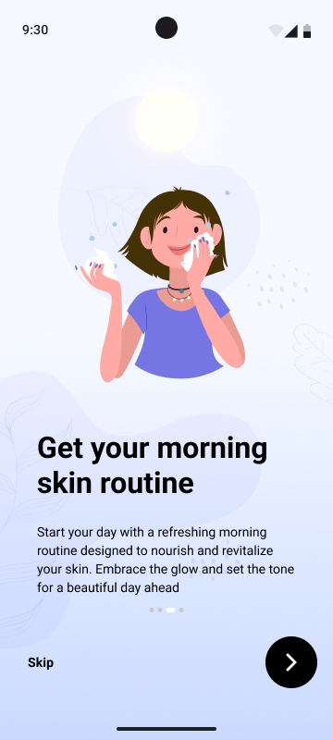
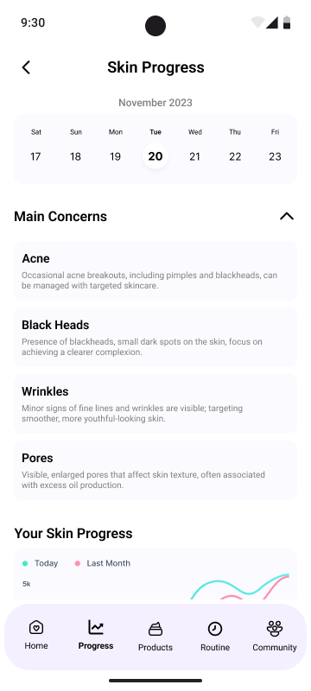
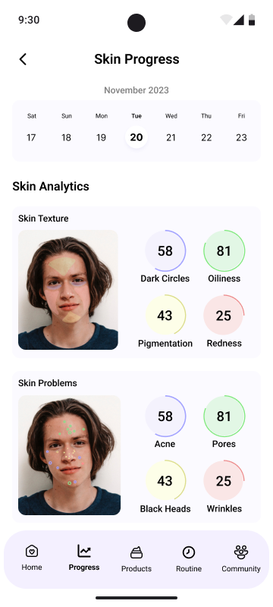
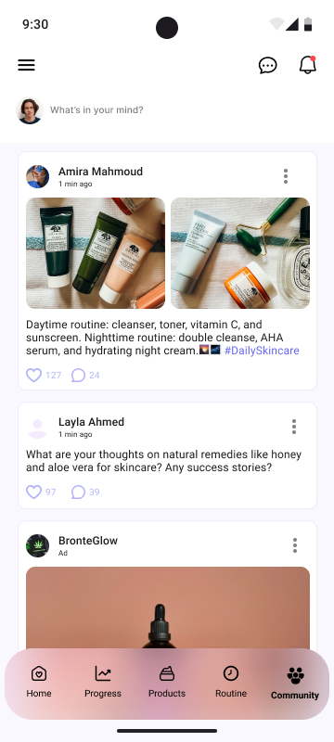
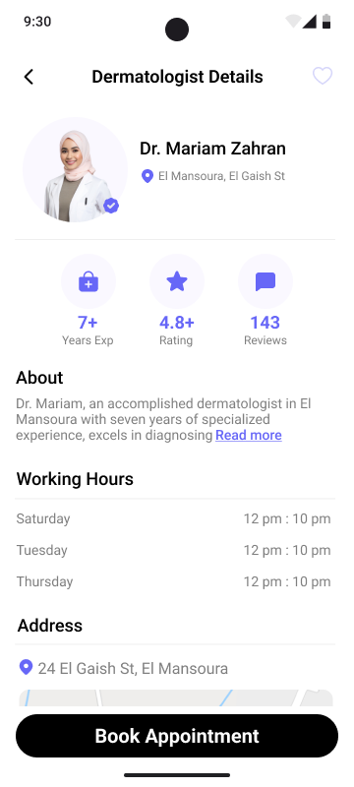
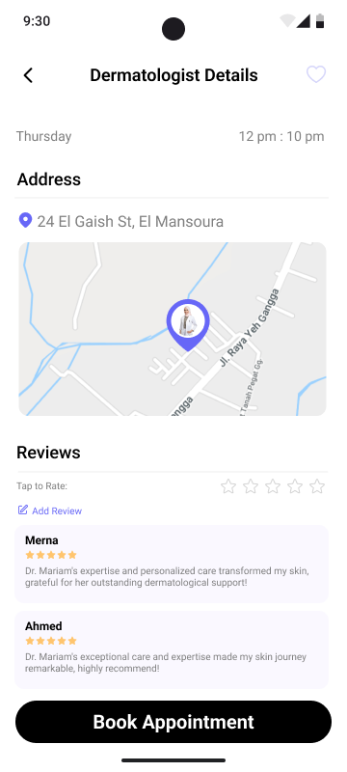
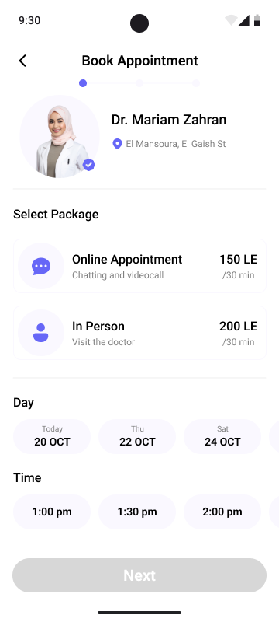







UI/UX

Slide 58
UI/UX

Slide 59

Color Palette
Primary Colors
Secondary Colors
#FFFFFF
#FAF6FF
#F5FFF7
#ECF3FF
#FFD6D6
#000000
Backgrounds
Icons
#FAF6FF
#F5FFF7
#FFFFFF
#000000
#6767F7
#7F7F7F

Slide 60
Color Palette
Primary Colors
Secondary Colors
#FFFFFF
#FAF6FF
#F5FFF7
#ECF3FF
#FFD6D6
#000000
Backgrounds
Icons
#FAF6FF
#F5FFF7
#FFFFFF
#000000
#6767F7
#7F7F7F

Slide 61

Typography

Slide 62
Implementation

Slide 63
Demo

Slide 64

Website
Summary Page

Slide 65
Website
Summary

Slide 66
Website
Schedule Page

Slide 67
Website
Patients Page

Slide 68
Website
Patients Page

Slide 69
Website
Patients Page

Slide 70
Website
Patients Page

Slide 71
Website
Clinics Page

Slide 72

Website
Add Clinic Page

Slide 73

Website
Clinics Page

Slide 74

Website
Doctor Profile Page

Slide 75



07
Future Work

Slide 76
Future Work
(In Progress)
1. Detection based on acne subtypes.
2. Detection of combination skin.
3. Streamline QR code for patient data access.
4. Foster a collaborative skincare community.
5. Implement skincare Product scanner.
6. Foster user engagement through streaks.
7. Chatting and online communication.
8. Implementing notifications.

Slide 77

1. Detection based on acne subtypes.
2. Detection of combination skin.
3. Streamline QR code for patient data access.
4. Foster a collaborative skincare community.
5. Implement skincare Product scanner.
6. Foster user engagement through streaks.
7. Chatting and online communication.
8. Implementing notifications.
Future Work
(In Progress)

Slide 78

Future Work
(In Progress)

Slide 79
Future Work
(In Progress)

Slide 80
08
Competitions

Slide 81




Competitions
Prefinals
Prefinals

Slide 82

09
Timeline

Slide 83
Timeline

Slide 84
Conclusion

Slide 85
“Remember that every skin problem have a solution , you only need to choose the right one.”

Slide 86
10
Team Members

Slide 87










Team members
ElAmir Mansour
Project Manager - BA
Basma Yasser
Frontend
Roaa Osama
Backend
Menna Sameh
Frontend
Abdullh Gaber
Android - Backend
Roa’a Badawy
Artificial Intillegence
Basmala Rafat
UI/UX
Rahma Ehab
Artificial Intillegence
Rana Reda
UI/UX
Shrouk Ehab
Artificial Intillegence

Slide 88
References
1- https://doi.org/10.33395/sinkron.v8i4.12831
2- https://doi.org/10.3390/electronics11010143
3- https://doi.org/10.1016/j.heliyon.2023.e21176
4- (PDF) A MODEL FOR CLASSIFICATION OF SKIN LESIONS USING IMAGE
PROCESSING TECHNIQUES AND NEURAL NETWOR (researchgate.net)
5- Table 2 | Skin Disease Classification and Detection by Deep Learning and Machine
Learning Approaches | SpringerLink

Slide 89
Thank You!

