Slide 1

Sentiment Analysis Project: Understanding Twitter Sentiment
BY:
Zeinab Mostafa – 211001793
Shrouk Gbr – 211001720
Mariam Farhat – 21001971
Sama Ayman – 211001876
Mawada Nagy – 211001572

Slide 2
Table of content:
Introduction
Dataset Overview
DATA Preprocessing
Models
Evaluation Plan
Results
Conclusion

Slide 3

Introduction
Our project aims to develop a robust model for sentiment analysis on Twitter, categorizing tweets as positive, negative, or neutral. Given the concise and often emoticon-laden nature of Twitter communication, accurately determining sentiment is challenging, especially with sarcasm and misinterpretation issues. Despite these challenges, we leverage a training dataset with sentiment labels from emoticons and employ advanced natural language processing and machine learning techniques to capture the true essence of public opinion on the platform.

Slide 4
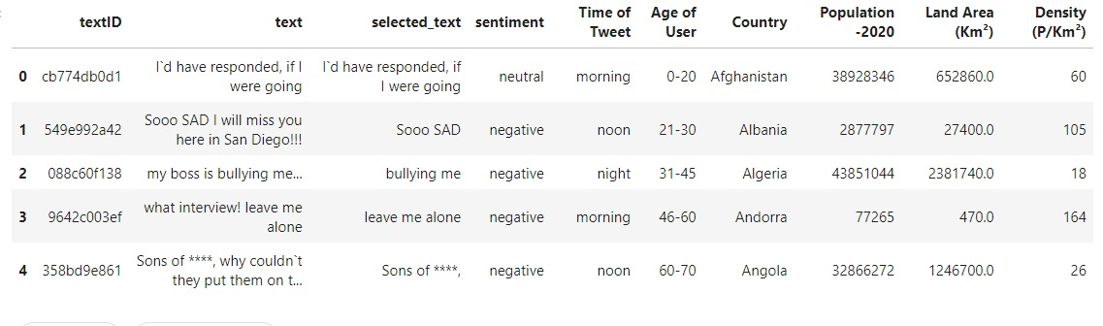
Dataset
The dataset for this sentiment analysis project consists of two parts: a train dataset and a test dataset. The dataset contains the following columns:
1. textID
2. text: The content of the tweet.
3. selected_text
4. sentiment
5. Time of Tweet
6. Age of User
7. Country
8. Population -2020
9. Land Area (Km²)
10. Density (P/Km²)
Target:
The target variable is the "sentiment". It represents the sentiment label associated with each tweet and can take values such as positive, negative, or neutral. This is the key variable that our sentiment analysis model will predict based on the input features provided.

Slide 5
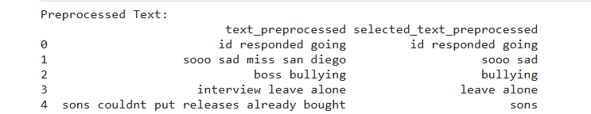
DATA Preprocessing
1. Lowercasing
- The text data in both train_data and test_data is converted to lowercase using the .str.lower() method.
2. Tokenization and Padding
- Tokenization is performed using the Keras Tokenizer class, which splits the text into individual words or tokens.
3. Text Preprocessing
- Non-alphabetic characters are removed using regular expressions (re.sub()).
- The text is converted to lowercase to maintain consistency.
- Tokenization is applied using split() to separate words.
- Stopwords are removed using the NLTK stopwords corpus.

Slide 6
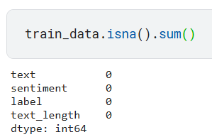
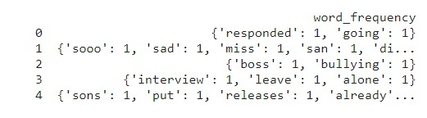
4. TF-IDF Vectorization
- TF-IDF vectorization is applied to both the original and pre-processed text data using TfidfVectorizer.
The TF-IDF vectorizer converts text data into numerical feature vectors, considering the frequency of words in the document and across the corpus.
Handle Missing Values: Check for missing values in the dataset and handle them appropriately.
Text Cleaning: Remove noise from the text data.
One-hot encoding or label encoding.

Slide 7

Model plan

Slide 8
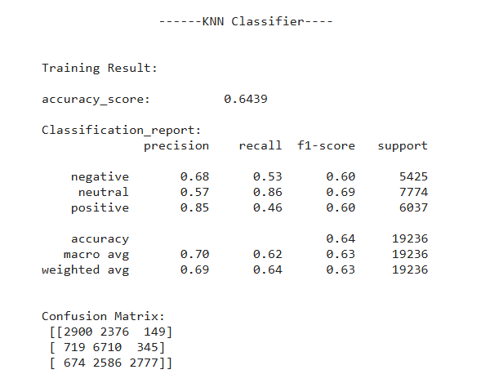
KNN Model
KNN operates on the principle that similar data points are close to each other in the feature space. When making a prediction, KNN identifies the k-nearest data points to the new, unseen instance based on a chosen distance metric, such as Euclidean distance.
Advantages:
KNN is easy to understand and implement. It determines the class of an instance based on the majority vote of its nearest neighbours.
Adaptability to new data: KNN can incorporate new training instances without retraining the model.
Disadvantages:
Computational complexity during prediction especially with large datasets.
KNN may struggle with datasets containing irrelevant features, as it considers all features equally in the distance calculation.

Slide 9
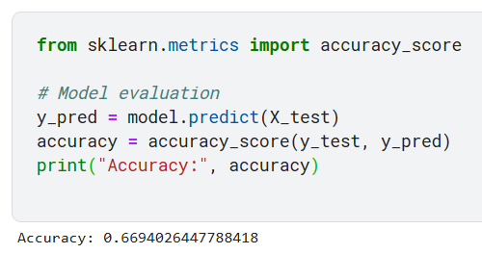
Logistic Regression Model
Logistic regression is a widely-used machine learning algorithm for binary classification tasks, which models the probability of a binary outcome based on one or more predictor variables. It works by fitting a logistic function (S-curve) to the data, providing outputs that range between 0 and 1, representing the probability of the outcome occurring.
Advantages: Logistic regression provides probability estimates for predictions. This is useful in various applications like risk assessment and decision-making.
While feature scaling can improve performance, logistic regression does not require features to be on the same scale for it to work correctly, unlike models that rely heavily on distance measures (e.g., KNN).
Disadvantages: Logistic regression can be sensitive to outliers, which can distort the model's estimates and lead to poor performance.
Compared to more complex models like decision trees, random forests, or neural networks, logistic regression has limited capacity to capture intricate patterns in the data.

Slide 10
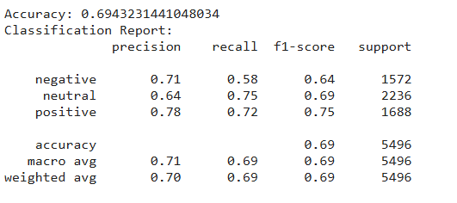
SVM Model
SVMs work by finding the optimal hyperplane that separates data points of different classes with the maximum margin, which helps in generalizing well to new, unseen data. They are effective in handling both linear and non-linear classification problems through the use of kernel functions that transform data into higher-dimensional spaces.
Advantages:
Works Well with Small to Medium-Sized Datasets as the computational cost is manageable.
Effective in high-dimensional spaces
Disadvantages:
Limited effectiveness with large datasets
Computational complexity during training when the dataset is large.

Slide 11
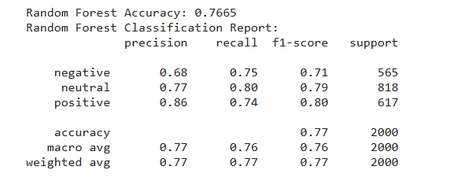
Random Forest Model
Random Forest builds multiple decision trees during training and merges their outputs to improve predictive accuracy and control overfitting. Each tree in the forest is constructed from a random subset of the training data, and features are randomly selected at each split, ensuring diversity among the trees.
Advantages: Random Forest often achieves high accuracy and robust performance due to its ensemble nature, combining the results of multiple decision trees.
Handles Overfitting: By averaging multiple trees.
Disadvantages: Training and prediction can be computationally expensive and memory-intensive, especially with a large number of trees and features.
Making predictions with Random Forest can be slower compared to simpler models, as it requires aggregating results from multiple trees.

Slide 12
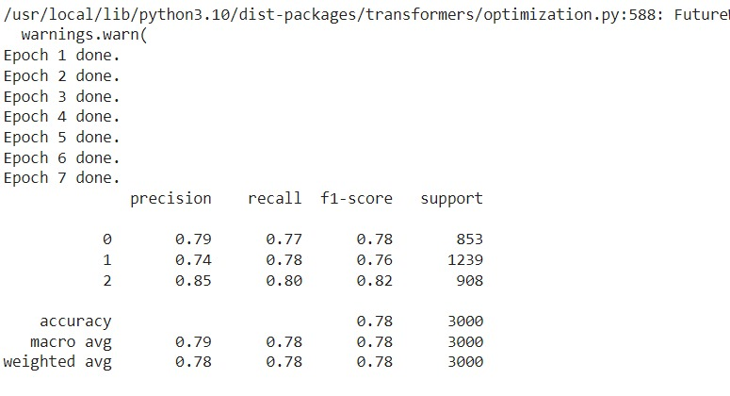
LLM using Bert

Slide 13
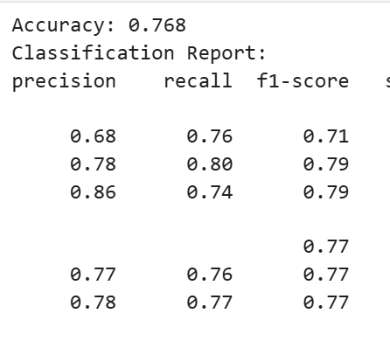
Evaluation plan
Model Evaluation: We will evaluate the performance of our trained models using appropriate evaluation metrics such as accuracy, precision, recall, F1-score, and confusion matrix.

Slide 14
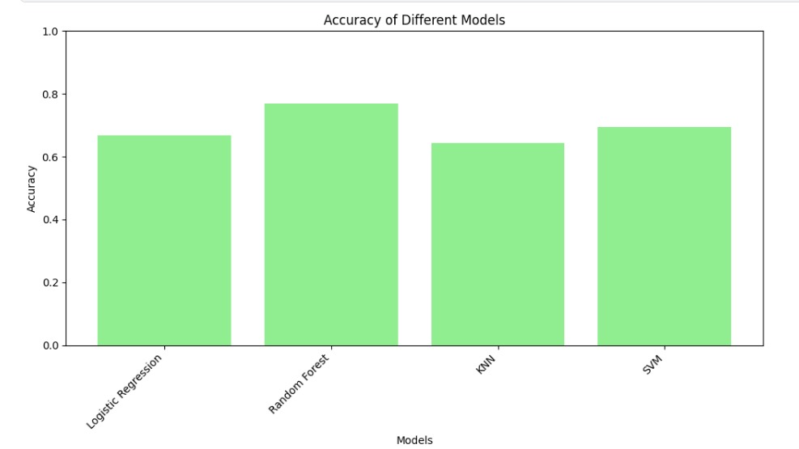
Results

Slide 15

Conclusion
In summary, our sentiment analysis project involved thorough preprocessing and evaluation of text data to prepare it for modelling. We explored various machine learning models, each with unique strengths and challenges.
SVM excelled in high-dimensional spaces,
Logistic Regression offered interpretability,
KNN was resource-intensive but straightforward, and
Random Forest provided high accuracy with resilience to overfitting.
This approach emphasized the significance of meticulous preprocessing in achieving reliable sentiment analysis outcomes.
And so, after trying many different models, we found that Random Forest is the most efficient model among the other models.

Slide 16

Thank You

