Slide 1

BLYNK

Slide 2
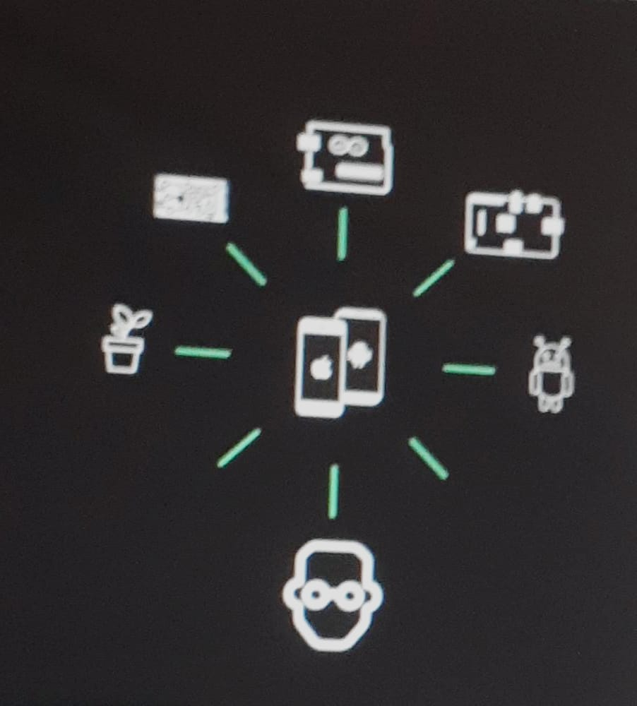
Blynk Today
Platform for Makers and electronic
hobbyists to help them tie their smartphone
to almost any connected hardware, and build
a visual user interface for their project in minute

Slide 3

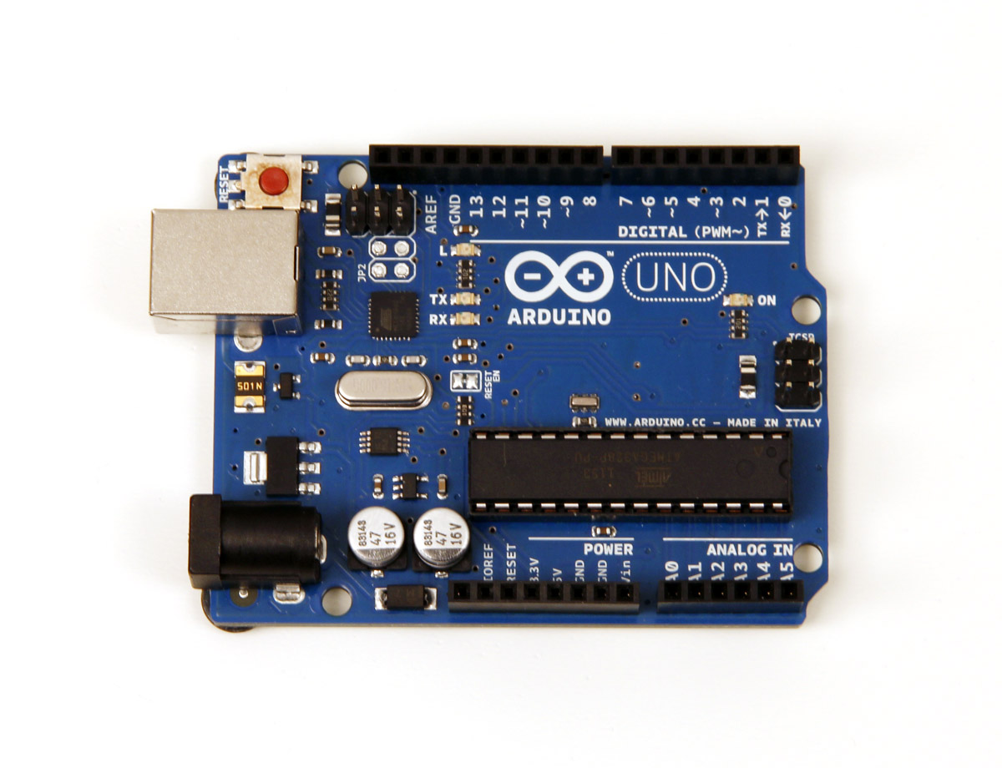

User experience
Set Up Widgets
Upload 8 lines of code
Done
#include <SPI.h>
#include <Ethernet.h>
#include <BlynkSimpleEthernet.h>
char auth[] = “YourAuthToken”;
void setup(){
Blynk.begin(auth);
}
void loop()
{
Blynk.run()
}
Remote control is achieved!
From there, makers can
implement any logic they want
This Photo by Unknown Author is licensed under CC BY-SA-NC
This Photo by Unknown Author is licensed under CC BY-SA

Slide 4
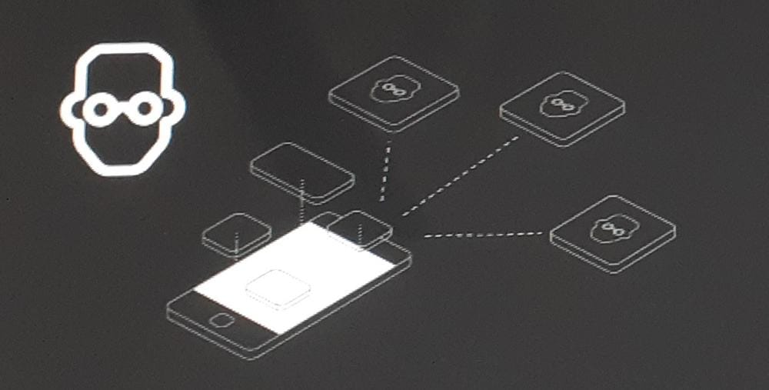
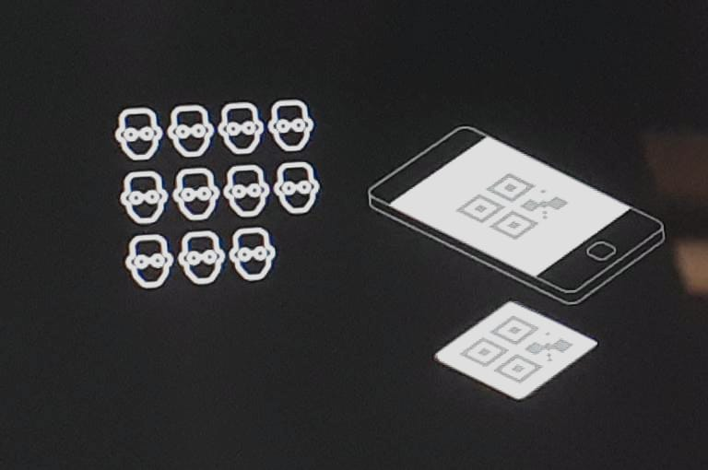
How Project sharing work
Community
•Scan QR from Blynk app
•Project opens up instantly
•Flash hardware with code
•Ready to Blynk
Creator
•Make a project
•Share a QR link from Blynk app
•Post QR code online with project description and code

Slide 5

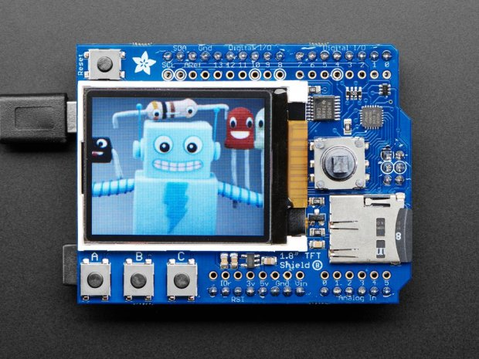


Blynk Cloud
Blynk Cloud is a Netty-based Java server with custom protocol
Open Source
Free for Blynk User
Ready for local deployment (Private cloud)
2 CPU handle 20k req/sec
Can run on even on Raspberry Pi

Slide 6
Embedded Solution
Blynk Libraries support various hardware platform. This list is constantly updated.
# Easy API
# EXTENSIBLE
Connectivity options (USB, Serial, Ethernet, WiFi, BT4.0 BLE)
Supports user-defined functions
portable (various platforms and boards)
# Low footprint: 4KB Flash, 512B RAM (Full, can be redused)
# Fast : up to 1000 req/s on Arduino UNO

Slide 7
Supported Hardware
Arduino
Uno
Duemilanove
Nano, Mini, Pro Mini, Pro Micro
Mega
YÚN (onboard WiFi, Ethernet via Bridge)
Due - limited support
Arduino-like:
Wicked WildFire (CC3000)
TinyCircuits TinyDuino (CC3000)
ESP8266
Particle (formerly Spark Core)
Raspberry Pi
Connectivity Hardware:
USB (Serial)
Official Ethernet shield (W5100)
Official Arduino WiFi shield
Adafruit CC3000 WiFi Breakout / Shield
ENC28J60
ESP8266 as WiFi modem
Seeed Studio Ethernet Shield V2.0 (W5200)
RN-XV WiFly

