Slide 1

CS 5330 · COMPUTER VISION FINAL PROJECT
CourtVision
Evaluating vision-guided frame selection for basketball VideoQA
MAIN FINDING
More visually “smart” frame selection did not automatically beat uniform temporal coverage.
Shreyas Sai Raman

Slide 2
Why frame selection matters
MOTIVATION
A basketball clip may contain hundreds of frames, but the VLM receives only a small visual budget.
Full video
374 frames
2.1%
of a 374-frame clip is all the model
actually gets to look at
Frame selector
the variable under study
RESEARCH QUESTION
Does computer-vision-guided keyframe selection provide better evidence than uniform temporal sampling?
8 frames
the visual budget
The task is not just finding a good-looking frame; it is preserving enough temporal evidence to answer the question.
Qwen3-VL answer
frozen decoder
CourtVision · 2/8

Slide 3
Controlled experimental setup
DATASET + MODEL
60
Sports-QA basketball QA pairs
8
frames per method
identical budget across all three
49 descriptive
11 causal
Frozen inference conditions
Why this matters
Model
Qwen3-VL-8B-Instruct
Only the frame-selection strategy changes. This isolates whether the visual evidence selection improves the frozen VLM output.
Resolution
448 × 252 per frame
Decoding
max_new_tokens = 16, deterministic
Prompt
Identical across all methods
Scope caveat — not held-out benchmark accuracy
The subset was drawn from the Sports-QA training split, so I report it as a fixed evaluation subset.
Question set
Same 60 QA IDs for all methods
CourtVision · 3/8

Slide 4
Three frame-selection strategies
METHODS
Uniform
Motion + YOLO
Motion + YOLO + CLIP
Evenly spaced across the whole video.
Scores frames by movement and basketball content.
Adds question relevance, so frames vary per question.
SELECTION SCORE
SELECTION SCORE
SELECTION SCORE
No scoring — Fixed Interval
0.57 M + 0.29 P + 0.14 B
0.40 M + 0.20 P + 0.10 B + 0.30 C
8 selected frames
8 selected frames
8 selected frames
Qwen3-VL-8B-Instruct same model · same prompt · same resolution · same 8-frame budget
M = frame-to-frame motion · P = detected players · B = detected ball · C = CLIP question relevance
CourtVision · 4/8

Slide 5
Uniform remains competitive
RESULTS
Overall performance on 60 Sports-QA basketball questions
Uniform
Motion + YOLO
Motion + YOLO + CLIP
Paired outcomes
McNemar test on discordant pairs
Motion + YOLO vs Uniform
3
only MY correct
3
only Uniform correct
p = 1.000
Motion + YOLO + CLIP vs Uniform
1
only MYC correct
3
only Uniform correct
No significant paired difference. Motion + YOLO changed which questions were answered correctly, but not how many — and CLIP did not improve this subset.
p = 0.625
CourtVision · 5/8

Slide 6
Coverage vs focus
EVIDENCE
Representative question: “How does the right team fail to do a 2-point shot?”
Uniform
Broad temporal coverage
Motion + YOLO
Visually active moments
Motion + YOLO + CLIP
Question-relevant-looking frames
frame 0
where each method spent its 8-frame budget in time
frame 374
Key interpretation: A relevant-looking frame is not always sufficient temporal evidence.
CourtVision · 6/8

Slide 7
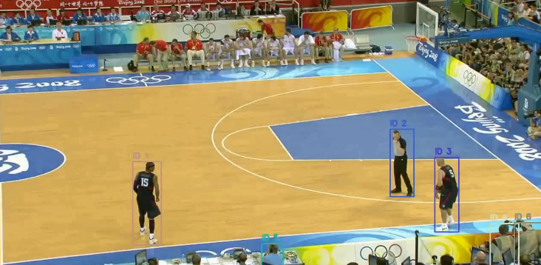
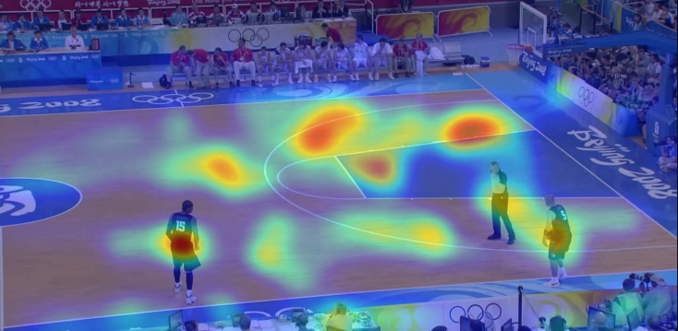
Basketball analytics extension
DEMO
Beyond VideoQA, the same CV pipeline can produce interpretable basketball analytics.
Tracked players
Occupancy heatmap
YOLO detection with persistent track IDs
Accumulated player positions over the clip
OUTPUTS
Persistent track IDs
Player trajectories
Pixel-based spacing
Occupancy heatmaps
Gradio analytics tab
Current limitation: These are pixel-space analytics, not calibrated court meters.
CourtVision · 7/8

Slide 8
Takeaways and next steps
SUMMARY
Three takeaways
Future work
01
Uniform sampling remained a surprisingly strong baseline because it preserved temporal coverage.
Select temporal windows
instead of isolated frames
02
Motion + YOLO changed which examples were answered correctly, but did not improve aggregate accuracy.
Evaluate a larger held-out split
of Sports-QA
Add court calibration
03
CLIP selected question-relevant-looking frames, but static relevance did not guarantee answerability.
and team / player identity
CORE CONCLUSION
For basketball VideoQA, preserving temporal context can be as important as selecting visually or semantically relevant individual frames.
Selected references: Sports-QA (IJCV 2026) · NExT-QA (CVPR 2021) · Q-Frame (ICCV 2025) · M-LLM frame selection (CVPR 2025)
CourtVision · 8/8
Thank you — questions welcome

