Slide 1
Facebook Network Analysis
Yuqi Peng
Aishwarya Kumar
Shreyas Sai Raman

Slide 2
Introduction
This project analyzes a publicly available dataset that represents a page-to-page graph of verified Facebook pages, providing a unique opportunity to explore the structure and interactions of mutual connections among official pages on one of the world’s largest social media platforms.
Dataset Overview:
Nodes: Each node represents a verified Facebook page.
Edges: Edges denote mutual "like" relationships between two pages.
id_1: Represents one verified Facebook page in a mutual connection.
id_2: Corresponds to the other page that forms a mutual connection with id_1.
Each row in the dataset represents an undirected edge between two nodes. The dataset contains 22,470 nodes and 171,002 edges, offering a rich network for analysis. Additionally, the dataset includes feature embeddings, which map numeric identifiers to corresponding lists of values. These embeddings are useful for implementing techniques like clustering and Principal Component Analysis (PCA) to uncover deeper insights.

Slide 3
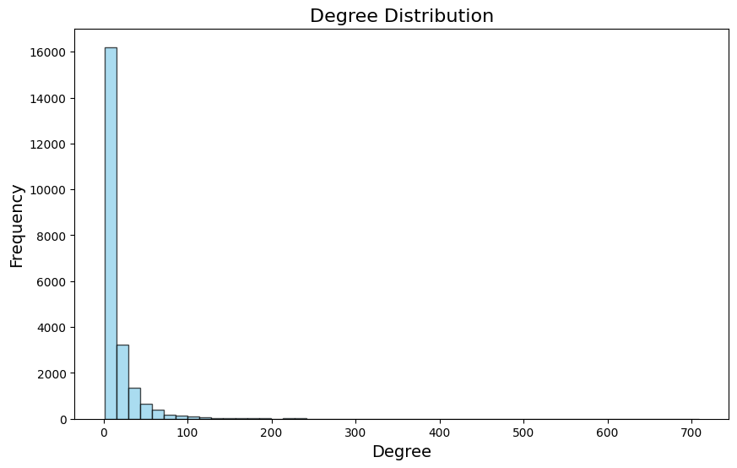
Exploratory Analysis
Key Graph Characteristics
Average Degree: On average, each node is connected to 15.22 other nodes, indicating a moderately connected network.
Median Degree: The median degree is 7, which suggests that a majority of nodes have relatively few connections, but a small fraction have many more.
Average Clustering Coefficient: The average clustering coefficient of 0.3597 indicates that there is a moderate tendency for nodes to cluster together. This shows a reasonable degree of local connectedness within the network.
Connected Components: The graph is fully connected, meaning there is only one connected component. All nodes are reachable from any other node.

Slide 4
Key questions
Community Structure:
How many communities exist in the network, and what are their sizes?
What are the dominant categories within each community?
Influence Distribution:
Which page is the most influential within the network?
Which communities exhibit the highest overall influence?
Feature-Category Relationship:
Are there any significant differences in feature distributions across categories?

Slide 5
Community analysis
Questions:
How many communities can be identified?
What is the size of each community, and what are the dominant categories in each community?
Challenges:
The graph is too large, making direct analysis computationally expensive.
After sampling, a significant number of pages in the graph are disconnected.
The normal Girvan Newman algorithm tends to produce a large number of single-node communities.
Approach:
Degree-based sampling and cleaning method.
Girvan Newman algorithm with minimum number of community nodes.
Use silhouette scores as an additional evaluation measure.
Multiple Minimum Community Threshold Experiments.

Slide 6
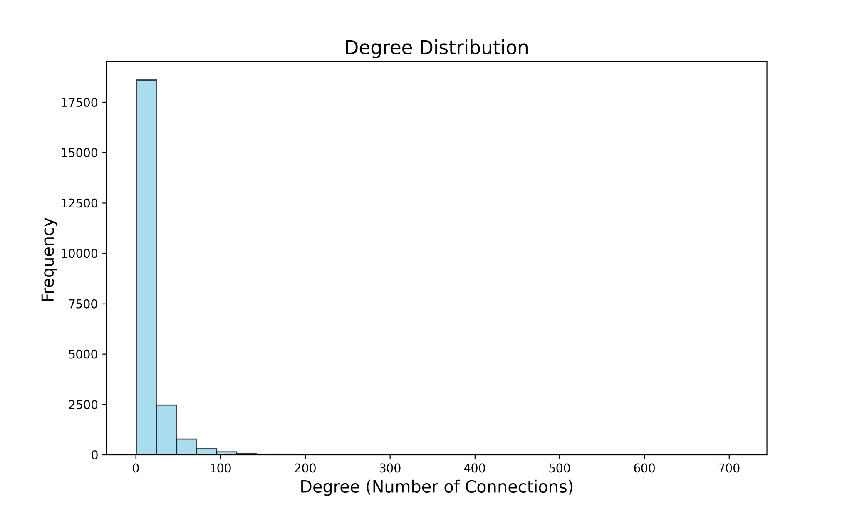
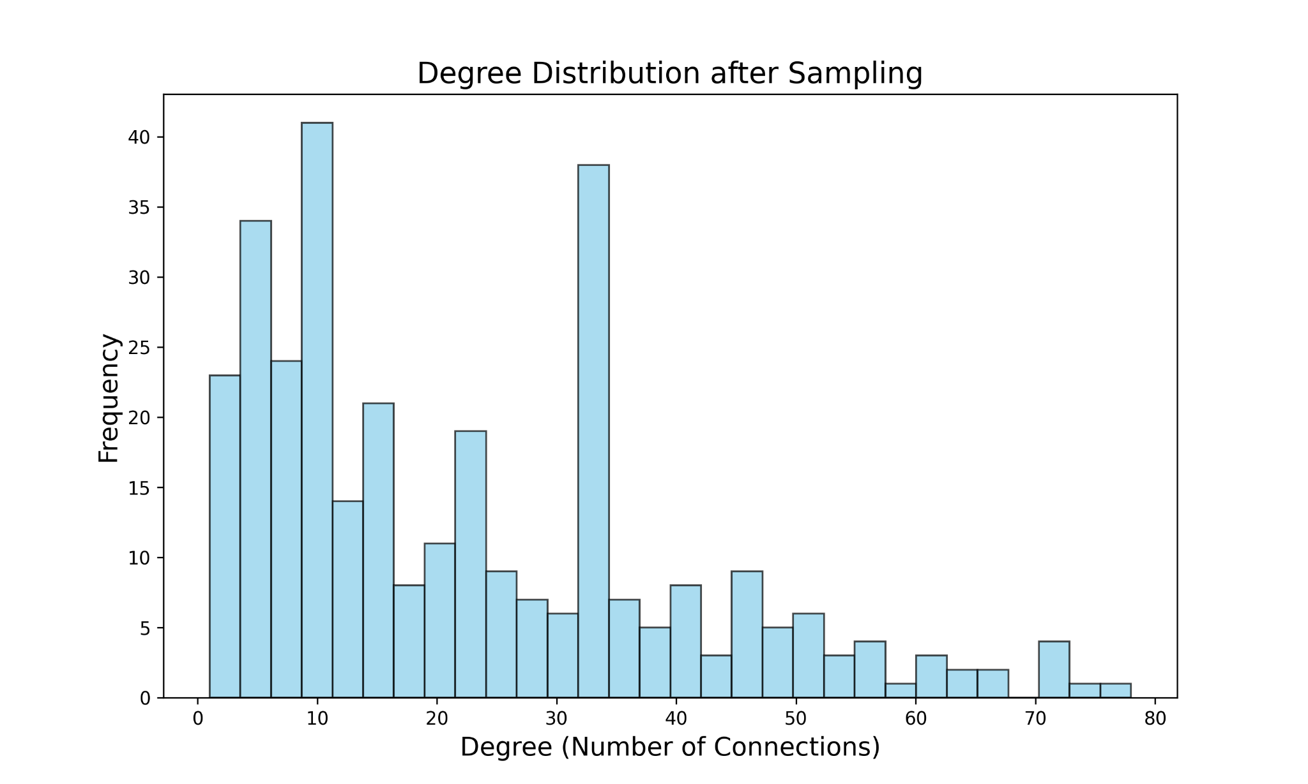
Degree-based Sampling Method
The number of nodes is very large.
The complete data is mainly composed of low-connected pages.
Select the 1.5% node data with the highest number of edges in each category.
Clean up communities with less than 20 nodes.
319 nodes and 3883 edges left.

Slide 7
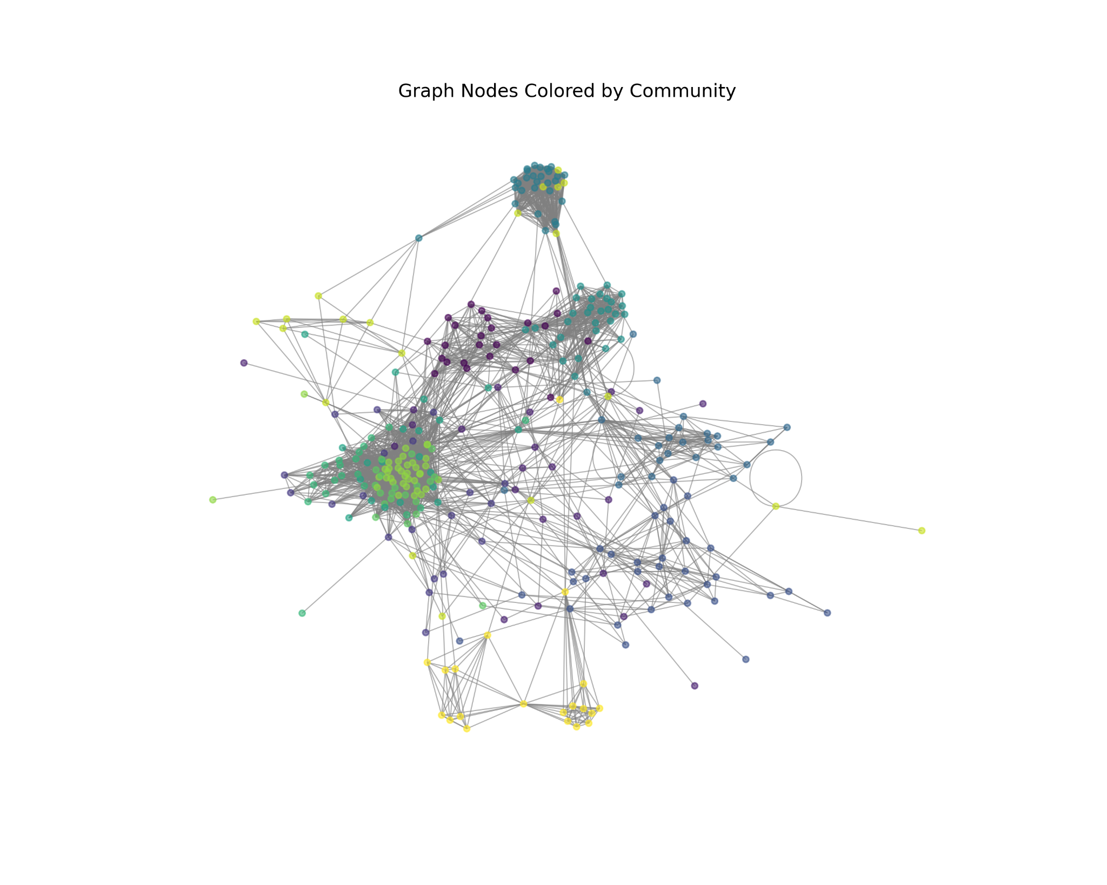
Girvan Newman Algorithm
Set 20 as the threshold of nodes in each community.
Detect 13 communities in total.
Government type of pages are the most dominant type in 5 of the communities.
Company type of pages are the most dominant type in 3 of the communities.
Politician and TVshow pages dominate in 2 communities each.

Slide 8
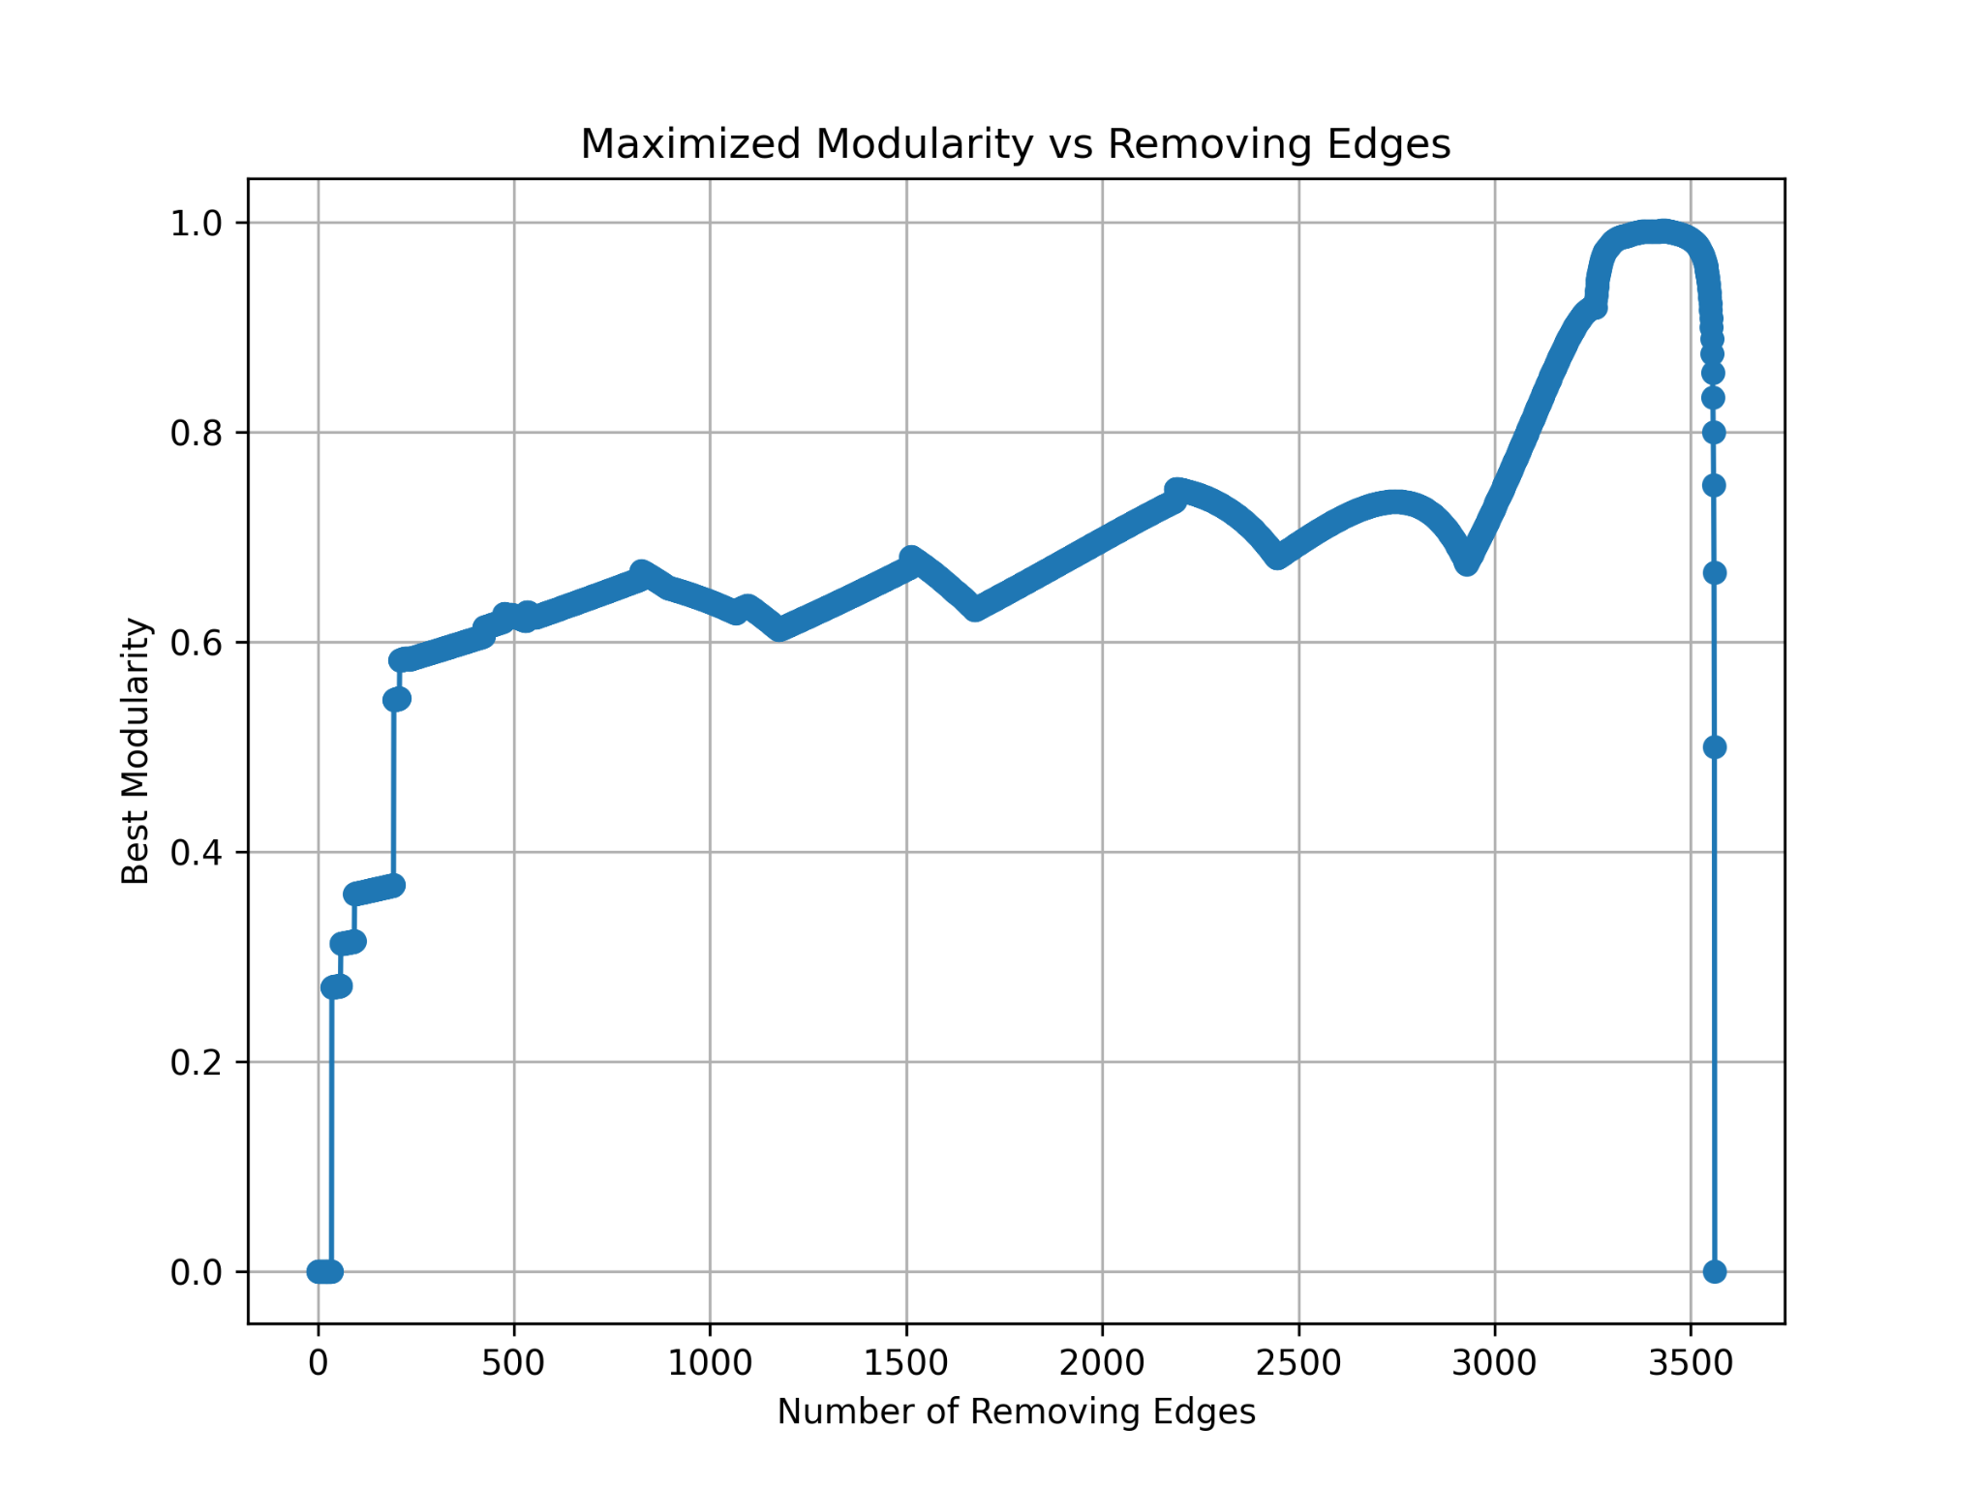
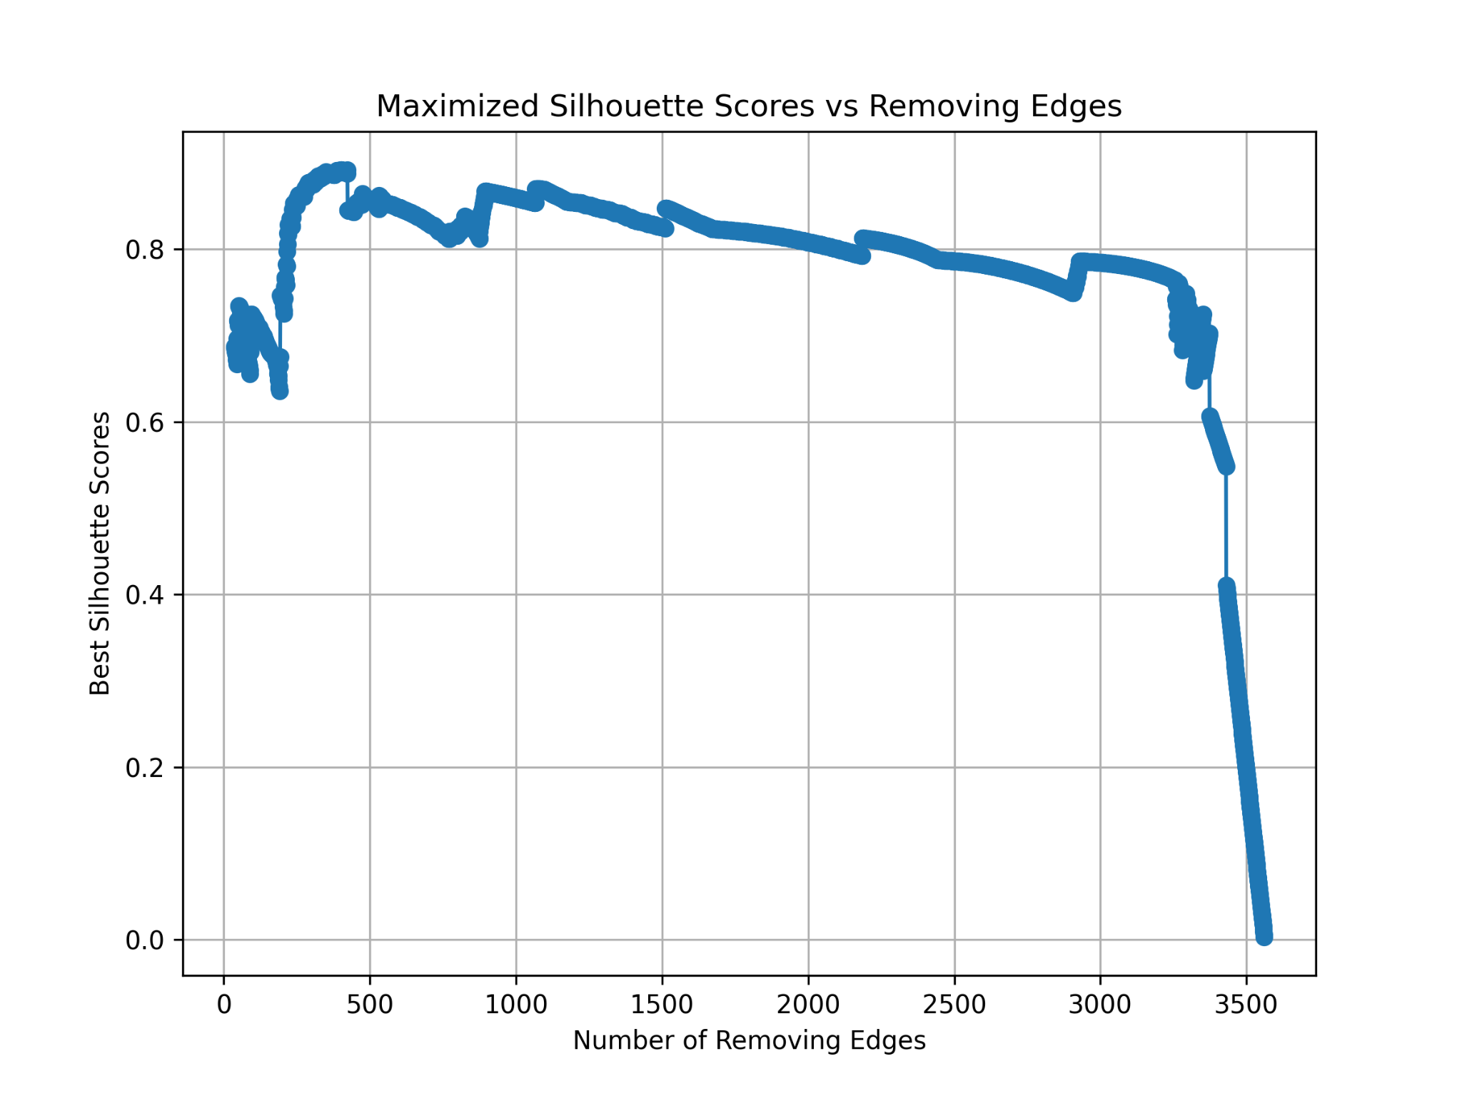
Metrics
The results show that when the minimum number of community nodes is set to 20, the optimal modularity (red triangle) is 0.92.
When the minimum number restriction is lifted, the modularity value is still increasing.
The best silhouette (green square) appears when only a small amount of edges are removed.
The silhouette score plummeted after the minimum community restriction was lifted.

Slide 9
Analyzing influence among Facebook gages
Questions:
Which community demonstrates the greatest overall influence?
What are the most influential pages in each community?
Challenges Faced:
The graph is very large and computationally expensive to process.
Initial attempts at community detection and clustering took significant time and yielded unclear results.
Approach:
Tried community detection on the entire graph, but had to quit (time-intensive).
Used spectral clustering on full graph (n_clusters = 5).
Performed random sampling of smaller graphs (2,000 and 10,000 nodes) for detailed analysis.
Used community analysis and Spectral clustering.

Slide 10
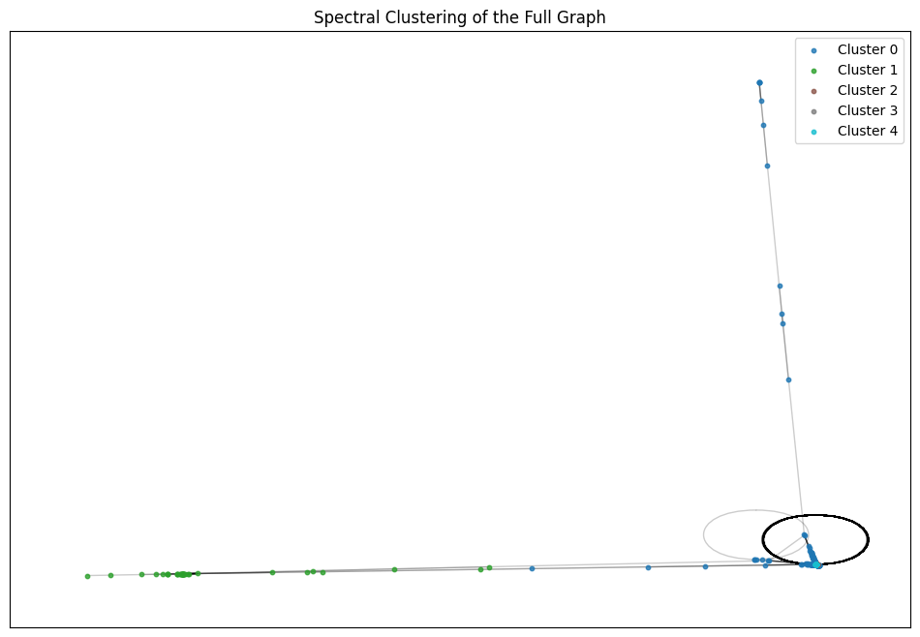
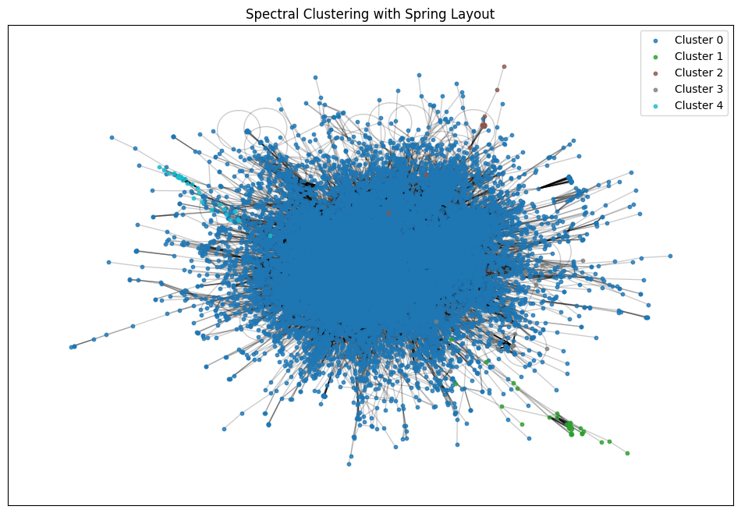
Spectral clustering on full-graph
N clusters= 5
Top influential nodes in each community:
Community 0: Node 16895 with Centrality 0.0316
Community 4: Node 21394 with Centrality 0.0009
Community 3: Node 1926 with Centrality 0.0008
Community 1: Node 8585 with Centrality 0.0010
Community 2: Node 10840 with Centrality 0.0005
Average centrality for each community:
Community 0: Avg Centrality 0.0007
Community 4: Avg Centrality 0.0005
Community 3: Avg Centrality 0.0006
Community 1: Avg Centrality 0.0002
Community 2: Avg Centrality 0.0003
Most Influential Community: 0 with Avg Centrality 0.0007
Drawbacks:
Insufficient Number of Clusters: n=5 may be too small, as the data appears to contain more clusters.
Cluttered Visualization: The visual representation is too cluttered, making it difficult to distinguish the individual
Next steps:
Elbow plot computation for the entire graph took too long as we increased n beyond 5.
We decided to create a subgraph of 10,000 nodes and another with 2000 nodes to improve performance and better analyze the clusters.

Slide 11
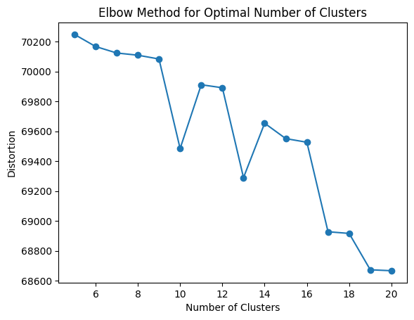
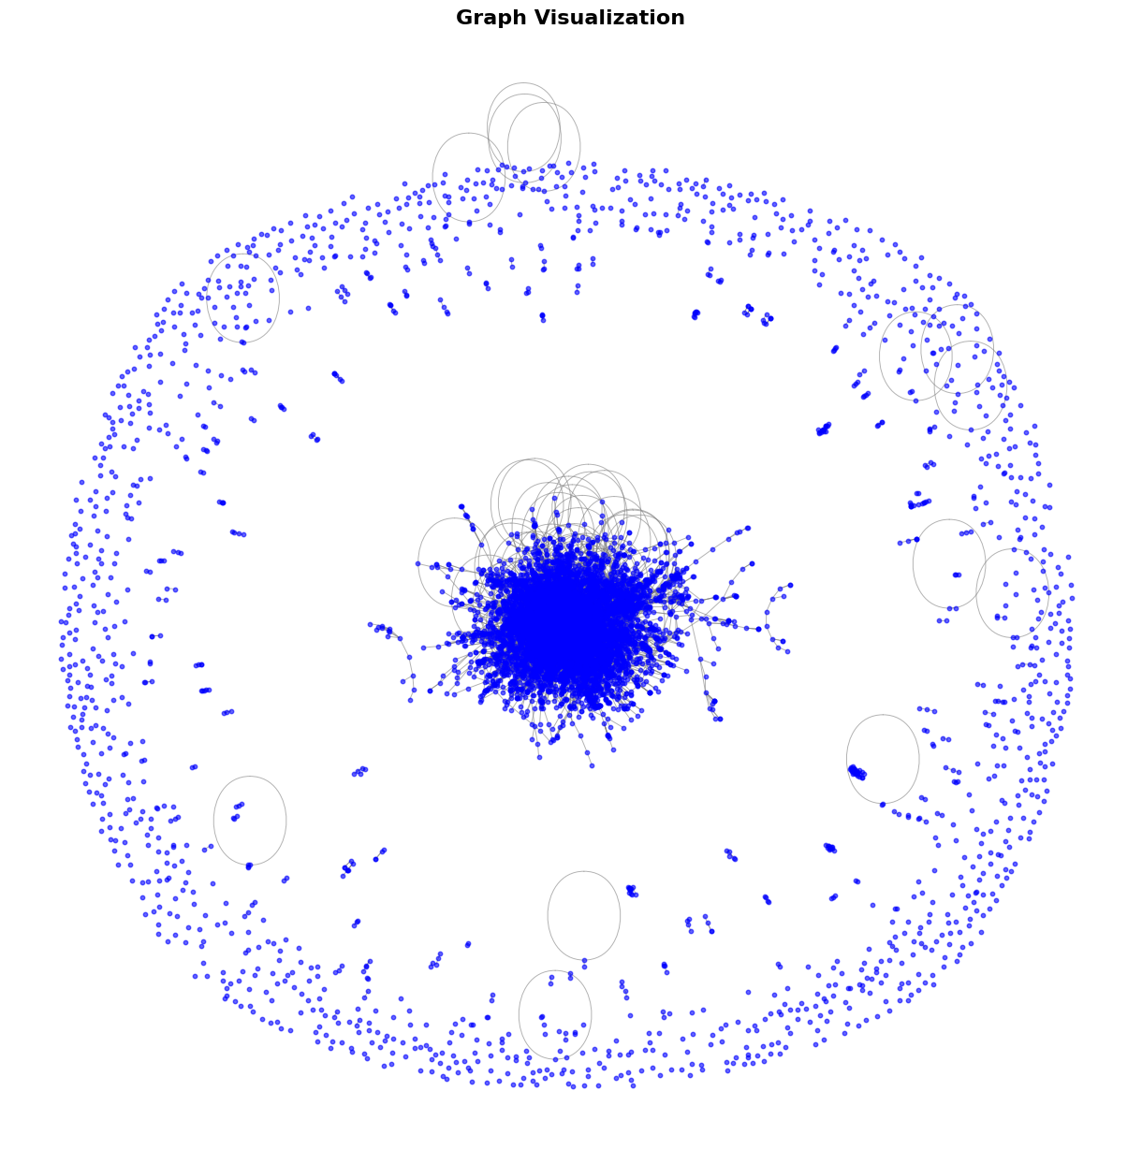
Random sample of 10k nodes
We created a sub-graph by randomly sampling 10000 nodes to explore a larger portion of the graph and analyze its structure with spectral clustering.
Key Characteristics of the Sub-Graph:
Nodes and Edges: 10000 nodes and 35,945 edges.
Connected Components: 1327 connected components, with the largest one containing 8285 nodes (83% of the total graph).
Average Clustering Coefficient: 0.3306
Elbow plot:We used an elbow plot to determine the optimal number of communities, finding that n = 10 was the best choice for community detection.

Slide 12
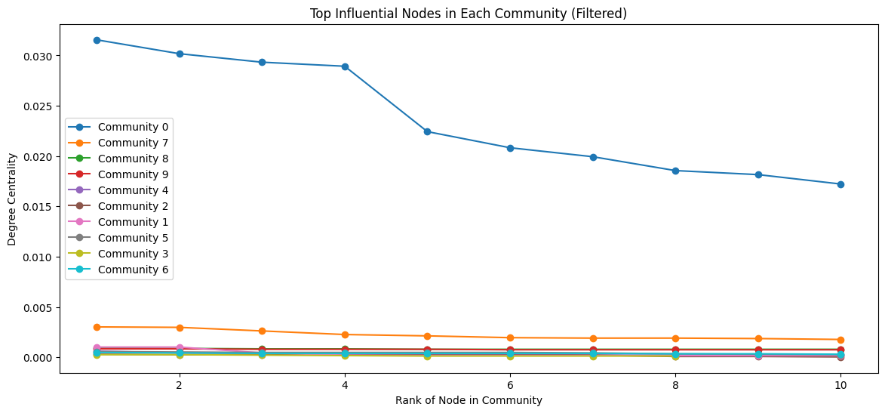
Spectral clustering on 10k nodes sub-graph
N clusters= 10
Top influential nodes in each community:
Community 0: Node 16895 (Centrality 0.0316)
Community 7: Node 20152 (Centrality 0.0030)
Community 8: Node 21394 (Centrality 0.0009)
Community 9: Node 1926 (Centrality 0.0008)
Community 4: Node 5672 (Centrality 0.0006)
Community 2: Node 10668 (Centrality 0.0003)
Community 1: Node 8585 (Centrality 0.0010)
Community 5: Node 948 (Centrality 0.0006)
Community 3: Node 18814 (Centrality 0.0003)
Community 6: Node 10840 (Centrality 0.0005)
Average centrality for each community:
Community 0: Avg Centrality 0.0007
Community 7: Avg Centrality 0.0004
Community 8: Avg Centrality 0.0005
Community 9: Avg Centrality 0.0006
Community 4: Avg Centrality 0.0002
Community 2: Avg Centrality 0.0002
Community 1: Avg Centrality 0.0002
Community 5: Avg Centrality 0.0003
Community 3: Avg Centrality 0.0002
Community 6: Avg Centrality 0.0003
Most Influential Community: 0 with Avg Centrality 0.0007

Slide 13
Feature-Category Relationship
Questions:
To examine the relationship between features and categories, are there noticeable differences in the distribution of pages across categories in the feature space?
Challenges Faced:
The exact nature and description of these embeddings (e.g., features, connections or some latent representation) remains unspecified from the data.
Approach:
Tried dimensionality reduction by PCA and t-SNE.
Cluster Analysis through K-Means Clustering.
Statistical Analysis of feature variations..

Slide 14
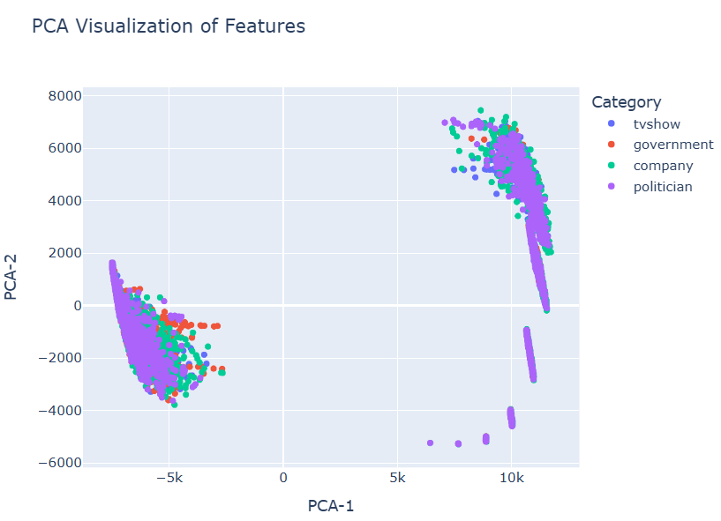
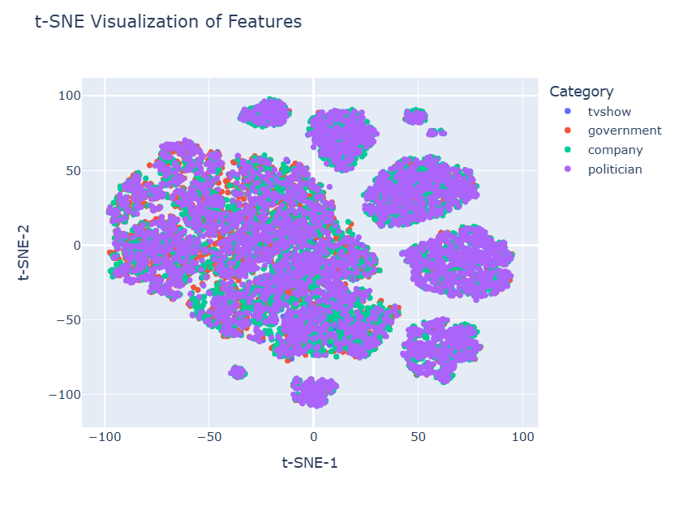
Dimensionality Reduction by PCA and t-SNE
From the PCA visualization, it appears that the clusters of data points overlap significantly across categories. This is because PCA may fail to capture non-linear relationships in the data, leading to overlapping clusters when the features have complex dependencies. The t-SNE plot shows tighter and more distinct clusters compared to PCA.
From the t-SNE plot, the purple category(Politician) seems to form tightest clusters. This suggests that its features are well-represented and distinct, with less overlap with other categories. Other categories, such as red category (government) and green category (company), seem more dispersed and intermixed and overlap significantly in the feature space.

Slide 15
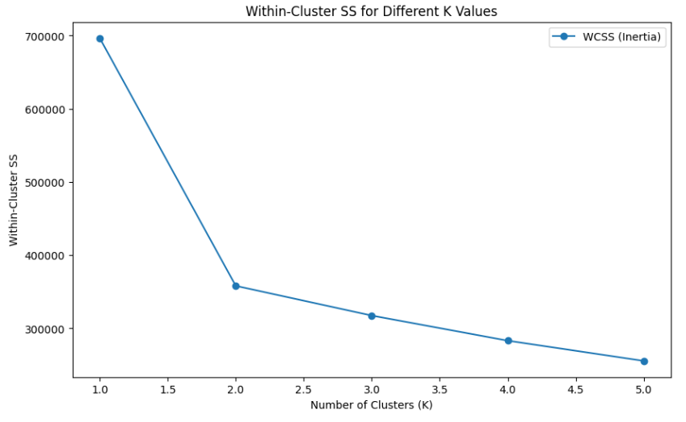
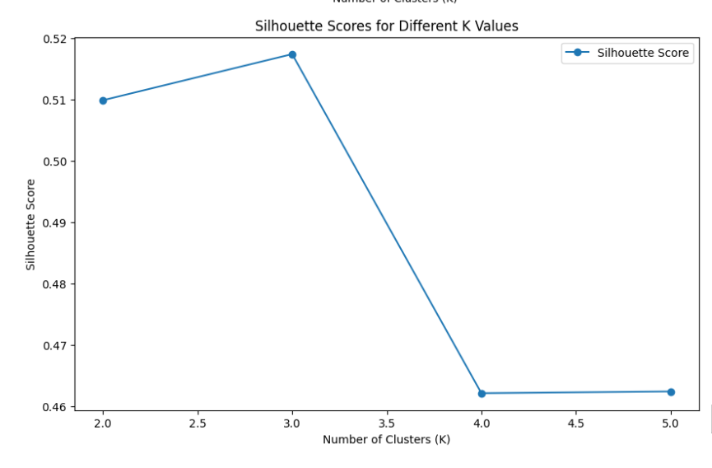
Cluster Analysis through K-Means Clustering
The "Within-Cluster SS (WCSS)" plot is used to identify the optimal number of clusters (K). A sharp decline in WCSS between K=1 and K=2, followed by a more gradual reduction, indicates that three clusters may effectively capture the structure of the data. This suggests meaningful groupings in the feature space, potentially representing distinct category patterns.
Similarly, the “Silhouette” plot evaluates the quality of clustering. It shows that K=3 achieves the highest score, indicating well-defined clusters. Beyond K=3, the drop in the score suggests that adding more clusters results in overlapping or less distinct groupings.

Slide 16
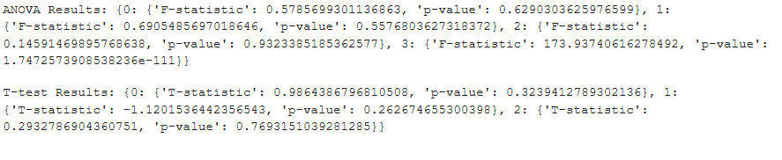
Statistical Analysis of feature variations
We perform ANOVA and T-tests between two categories(which are TV-Show and government).
From the ANOVA test, features with high F-statistics and low p-value indicates significant differences in the distribution of the feature across categories such as Feature 3, which has a F-statistic of 173.93 and p-value of 1.74*10^(-111).
From the T-tests, features with high T-statistics and low p-value indicate a large difference between two groups for a given feature. From the above figure, we have no features which have high T-statistic and low p-value.

Slide 17
Conclusion
Recommendations to the business
Target High-Centrality Nodes: Focus on Community 0 and its key node (Node 16895) for marketing, communication, or influencer engagement strategies, as it holds the highest potential for reaching a broader audience.
Niche Strategies for Smaller Communities: Communities with lower centrality scores could be targeted for niche or specialized interventions, helping build influence within those groups over time.
Monitor Community Dynamics: Continuously monitor the centrality scores of nodes in smaller communities, as changes in centrality over time could indicate emerging influencers or shifts in network dynamics.
Tailored Engagement: Based on the identified communities, customize outreach and engagement strategies to either focus on influential nodes for rapid growth or address the needs of lower centrality communities for long-term engagement.
Tailored Business Strategies: For overlapping categories, adopt more flexible and generalized strategies that account for the possibility of shared traits. For example, develop hybrid offerings or messaging that appeals to both government and company stakeholders.

Slide 18
Appendix

Slide 19
Challenges in Graph Analysis
1. Large Graph Size: The graph's large size, with 22,470 nodes and 171,002 edges, made computation and plotting very slow. To address this, we used sparse matrices, efficient algorithms, and sampling techniques for visualization.
2. Sparse Matrix Compatibility: Many algorithms did not support operations on sparse matrices. To overcome this, we converted sparse matrices to dense formats only when necessary, while carefully monitoring memory usage.
3. Visualization Complexity: Visualizing the graph was challenging as layouts appeared cluttered and unclear. We resolved this by experimenting with different layouts and optimizing visualization parameters, such as node size, transparency, and colors.

Slide 20
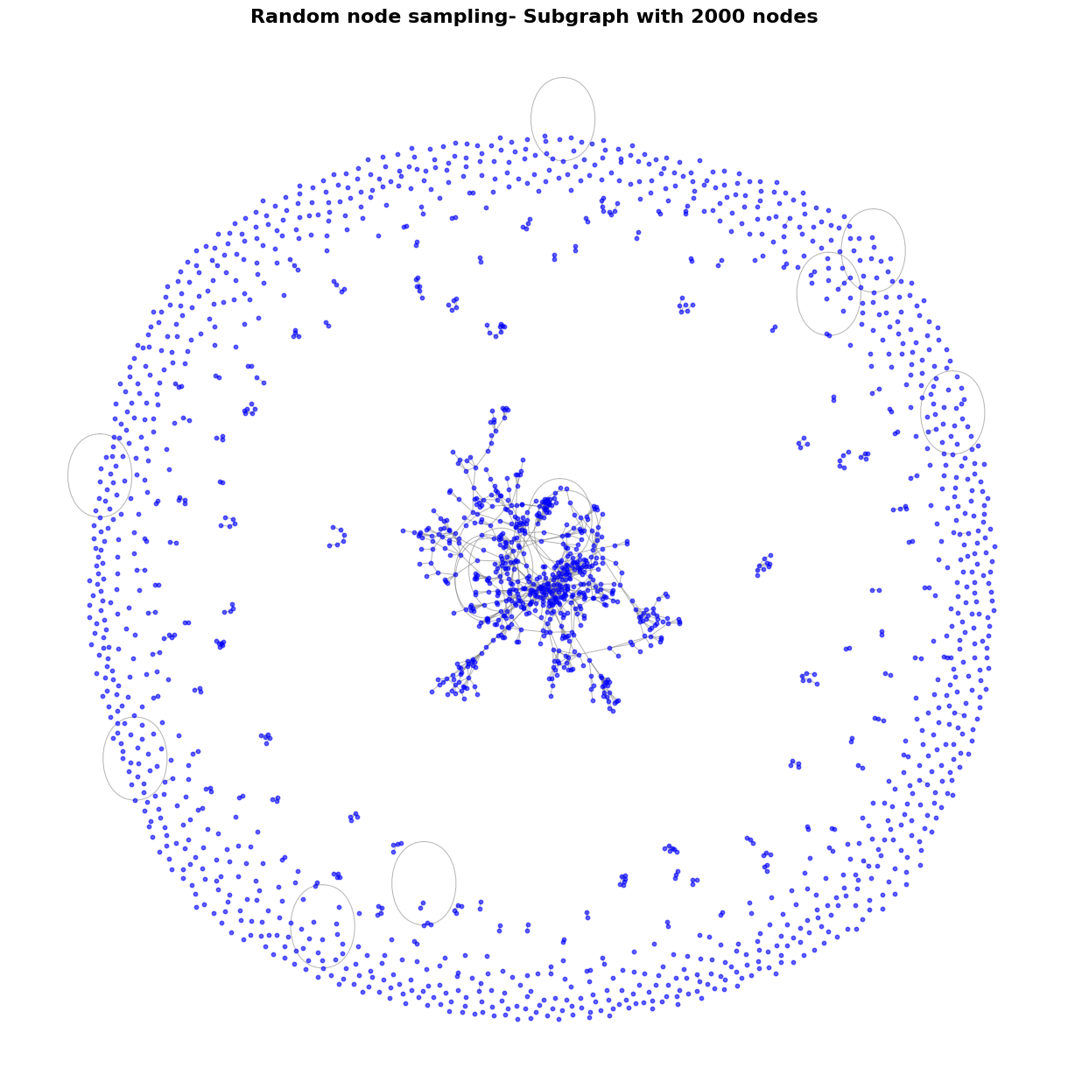
Random sampling of 2k nodes
We created a sub-graph by randomly sampling 2000 nodes from the original graph, focusing on understanding the structure of a smaller, representative portion.
Key Characteristics of the Sub-Graph:
Nodes and Edges: 2000 nodes and 1273 edges.
Largest Connected Component (LCC): 568 nodes, representing 28% of the total graph.
Average Clustering Coefficient: 0.0888, indicating sparse local connectivity.

Slide 21
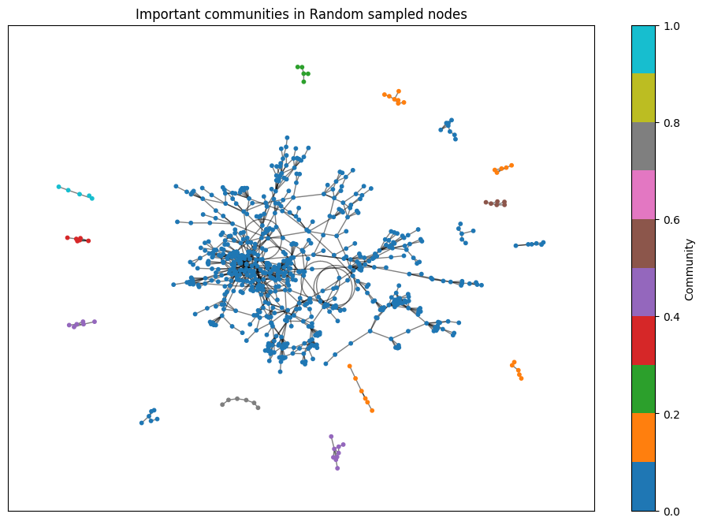
Community detection on random sampled sub-graph
Community Analysis Results
Most Influential Community: Community 14
Most Central Node: Node 9554 with Centrality: 0.0224
Average Centrality: 0.0060
Key Observations:
Top Communities:
Community 1: Node 19347 (Centrality: 0.0659)
Community 2: Node 4003 (Centrality: 0.0168)
Community 10: Node 16599 (Centrality: 0.0042)
Communities with Low Centrality:
Many communities (e.g., Community 55, 382, 535) feature nodes with lower centrality scores around 0.0028 - 0.0056, suggesting less influence within the network.
Community Structure:
A mix of highly influential nodes in some communities (e.g., Community 1, Community 14) and less influential nodes in others.
Central nodes within communities drive the structure and connectivity of the network.
The figure illustrates communities and their key central nodes.

Slide 22
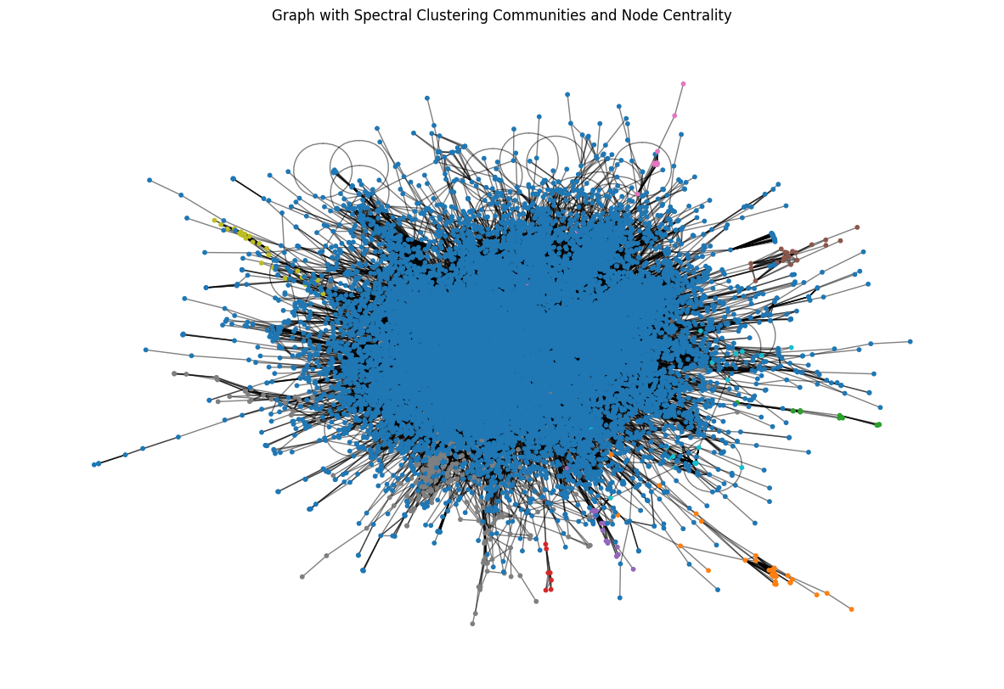
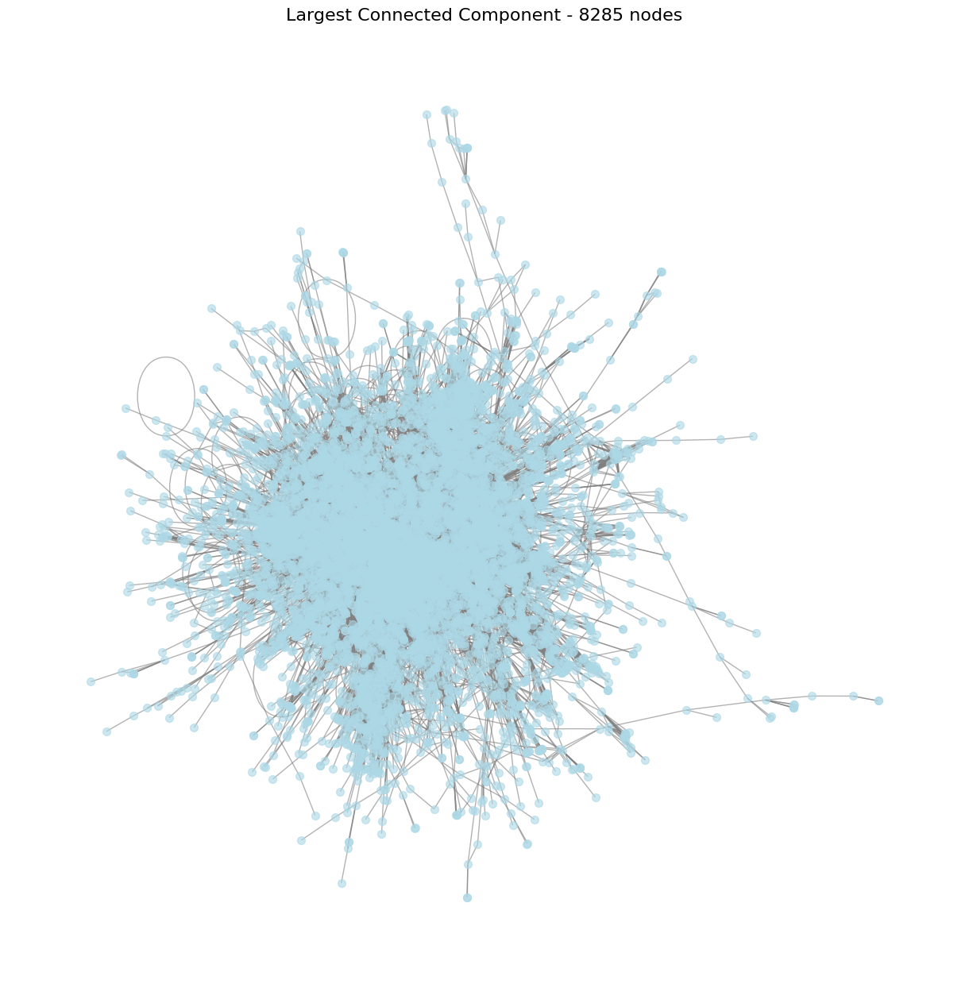
Sub-graph visualizations

