Slide 1

iPRIMED Education Solution Pvt Ltd.
Project Report on,
“Car Buy and Rental Application”
Submitted by, (Team 04)
Gangaram Yadav
P Sunil Kumar
Rakshith S
Sanskruti Krishnat Padaval
Sharath S
Guided by,
Ms. Tandra ma’am
FROM
HARMAN C++ BATCH-06

Slide 2
Introduction
CAR RENTAL AND BUY SYSTEM is a consoled based application through which we can rent and buy cars of our own choice. This system enables the company to make their services available to the public through the internet and also keep records about their services .

Slide 3
Problem statement
The Manual car rental system provides services only during office hours. So; customers have limited time to make any transactions or reservation of the cars. The existence of the online car rental systems nowadays has overcome the limitation of the business operation hour.
However; there is still a few numbers of these online car rental systems in Malaysia and most of the systems offered reservation service for tourists or traveller. Besides that, there are some customers who faced a problem in choosing car to be rented which suitable with some of the important requirements.
To rent a car a prospective renter must first go to the nearest office to register as a client.
Cars that provide difficulties to rent out are normally advertised in local or national newspaper, it involves a lot of paper work and consumes time.

Slide 4
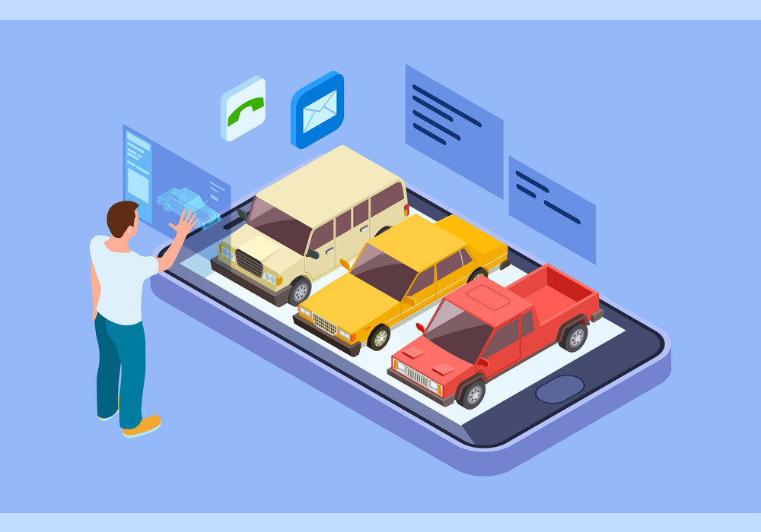
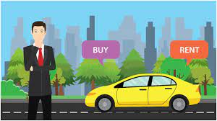
Proposed system

Slide 5
Goals of the project
The goal of the project Car rental and buying system is to give the full and easy facilities to the customers to rent or buy a car sitting at home. The customers can see all the details of the car which he/she want to rent or buy. They can see all the features like model name, milage, petrol/diesel engine, manufactured year etc. We know that there are many ways to buy or rent a car or vehicles through offline mode means from office. But our application helps the customers to take the car for how much days they wish, there won't be any bond for time or days.

Slide 6
Background of the project
“Car rent and buy” is a console-based application through which we can rent and buy our choices car. It is created by C++ programming language and MySQL database to store the user’s data, car’s data and other required data. As the application will start, it asks for admin or users. For admin, it asks for enter the credentials to login. The admin can update the cars and their details to the database. It can also update the user’s details. And for users, it asks for register or login. After registered, it asks for login and they can see the list of cars with its details. Then it asks for rent, buy or cancel. After clicking on the rent or buy option one has to paid the mentioned price and can get the car from the given location.

Slide 7
Features of the project
Admin Module :
Details and list of all cars will be displayed.
Inserting the details of new cars.
Removing of details of cars.
User Module:
Here the user will login and get access to buy and rent.
Details of available list of cars will be displayed.
After selecting the car user will have fill own details and then the process will be successful.

Slide 8




Technologies used
it’s a console application
programming language
Database
IDE: - Visual studio 2022

Slide 9
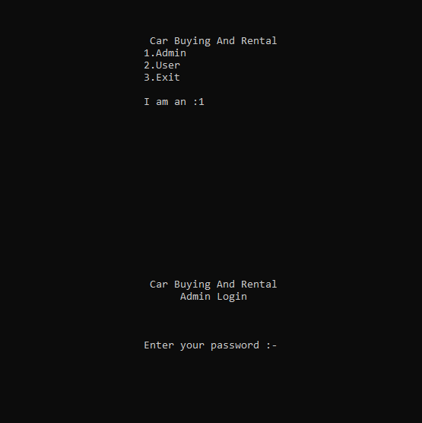
Functionality of the project
Login page:-
The initial landing page of the application asks if the person using it is admin or user and asks for the password before taking the user/admin to homepage.

Slide 10
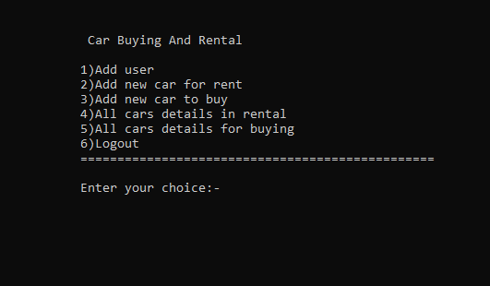
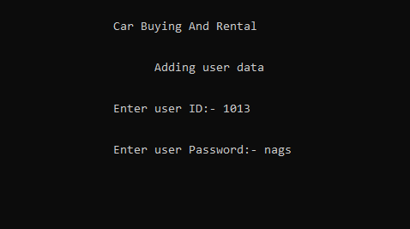
Admin homepage:-
In admin home page the application let’s admin to do the following tasks shown in the picture.
Adding new user:-
The admin can add new using by adding the id and password.

Slide 11
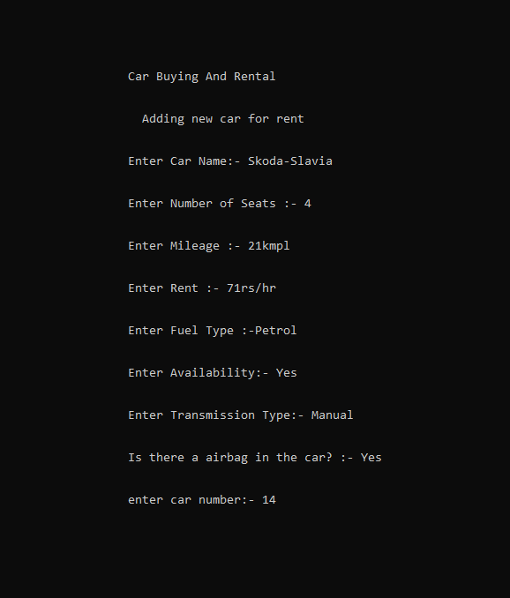
Adding car :-
The admin can add new car data to inventory for buying or renting the car.

Slide 12
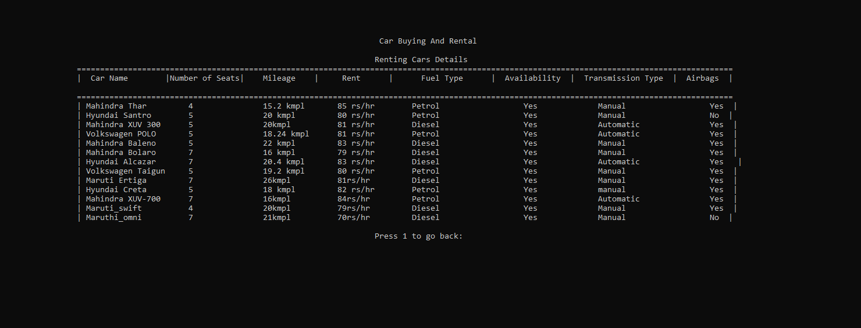
Display car details: -
The admin has the access to view the list of cars in the inventory for buying and renting.

Slide 13
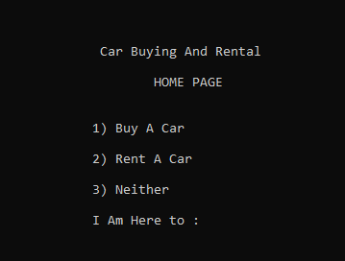
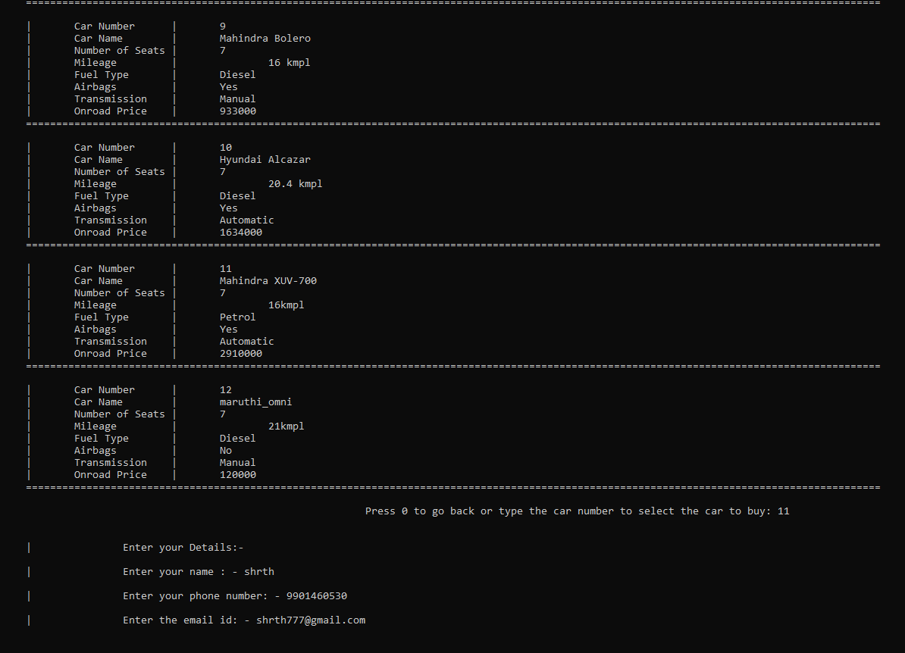
User home:-
The user has the access to buy or rent a car which he gets to choose in the homepage.
Buying car list:-
The user gets the list of cars and their details from which he can choose and add his details to confirm the booking.

Slide 14
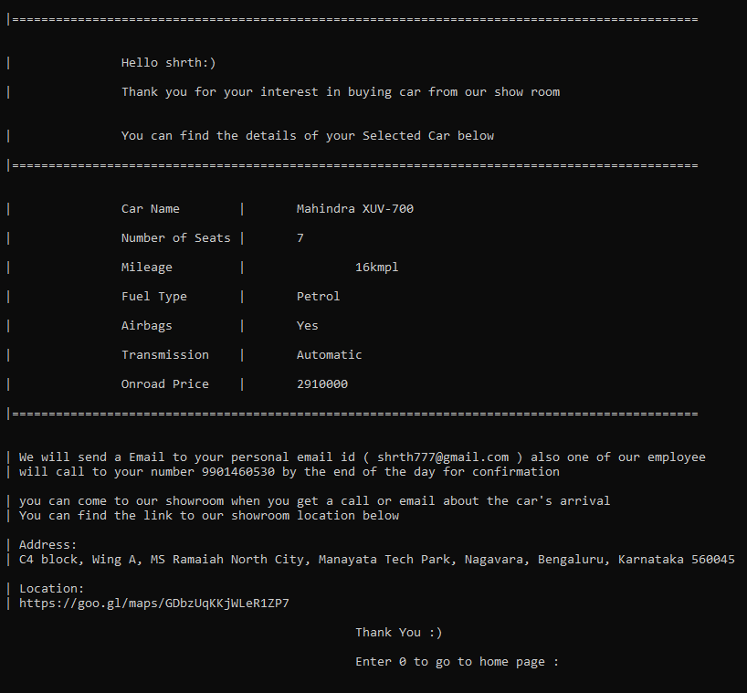
Confirmation bill:-
After the user adds his details the final confirmation bill will appear for further reference of the user.

Slide 15
Requirements
Hardware Requirements: -
2 GHz processor, 2 GB RAM or more (system memory)
20 GB of hard-drive space or more
VGA capable of 1024×768 screen resolution
Necessary computer peripherals such as keyboards etc.
Internet Connectivity (Wired/ Wireless)
Software Requirements: -
Windows/ Linux Based OS/ Mac OS/ Any OS capable of running C++.
MySQL database

Slide 16
Database Design
Cars_for_rent
Name Seat Milage Rent Fuel_type Availability Transmission_type Airbags Car_no
Cars_to_buy
Name Seat Milage Fuel_type Transmission_type Airbags Price Car_no
Login
Login_id Login_password

Slide 17
Architecture diagram
Car rent and buy system
Login
Car to rent
Car to buy
Cancel
Enter login id
Login password
See the car
Choose the car
Enter the details
Make the payment
Take the car
See the car details
Choose the car
Enter the details
Make the payments
Take the car
Cancel to go to main page

Slide 18
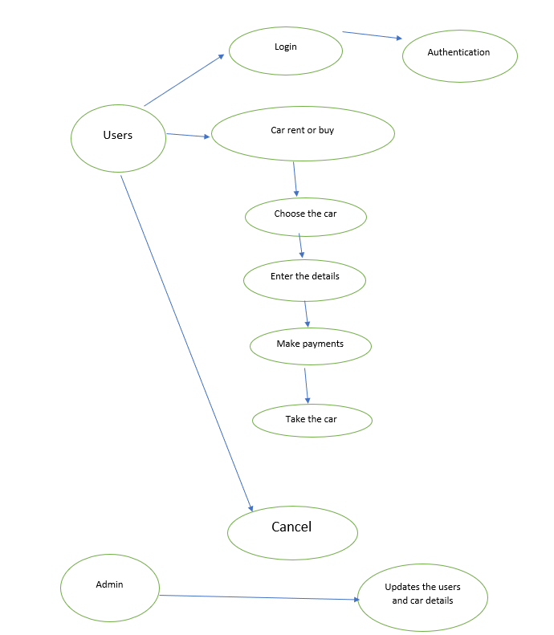
Use-case Diagram

Slide 19
conclusion
In conclusion, the system will be able to serve as a web-based application when it is finally developed, where these small upcoming companies can make use of it to publish their services in a wide range and also help the company to manage their service more effectively. On the other hand, it will enable customers to freely make their desired choice more freely and interactively.

