Slide 1



Water Potability Prediction using Machine Learning
By: D S ANUSHRUTHI

Slide 2

Learning Objectives
Understand dataset and handle missing values.
Train multiple ML models for classification.
Optimize models using hyperparameter tuning.
Compare models using evaluation metrics.
Identify key water quality parameters for potability.
GOAL
Source :
www.freepik.com/

Slide 3
Tools and Technology used
Python (Pandas, NumPy, Matplotlib, Seaborn)
Scikit-learn for ML models and evaluation
XGBoost for advanced boosting model
Google Colab for training
GitHub for submission

Slide 4
Methodology
Data loading and preprocessing (handled missing values with median)
Splitting dataset into Train (80%) and Test (20%)
Trained Logistic Regression, Random Forest, and XGBoost
Hyperparameter tuning with GridSearchCV / RandomizedSearchCV
Compared models and analyzed feature importances

Slide 5
Problem Statement:
Ensuring safe drinking water is a global challenge.
Traditional testing methods are costly and time-consuming.
There is a need for AI/ML models that can quickly and reliably predict water potability using available quality parameters.

Slide 6
Solution:
We built ML models to predict if water is potable based on 9 parameters such as pH, Sulfate, Hardness, and Chloramines. Through model optimization, Random Forest and XGBoost gave the most balanced results, highlighting key features influencing water quality.

Slide 7
Results: Model Metrics
Logistic Regression (tuned):
Accuracy = 52%, Precision = 41%, Recall = 53%, F1 = 46%,
ROC-AUC = 55%
Random Forest (tuned):
Accuracy = 67%, Precision = 66%, Recall = 32%, F1 = 43%,
ROC-AUC = 66%
XGBoost (tuned):
Accuracy = 66%, Precision = 63%, Recall = 32%, F1 = 42%,
ROC-AUC = 65%

Slide 8
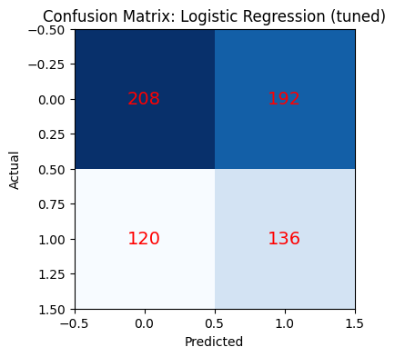
Results: Confusion Matrix

Slide 9
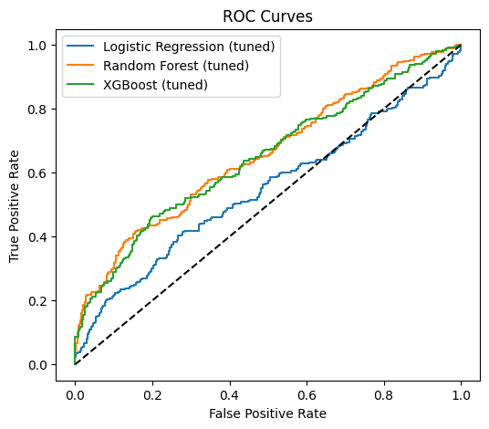
Results: ROC Curve

Slide 10
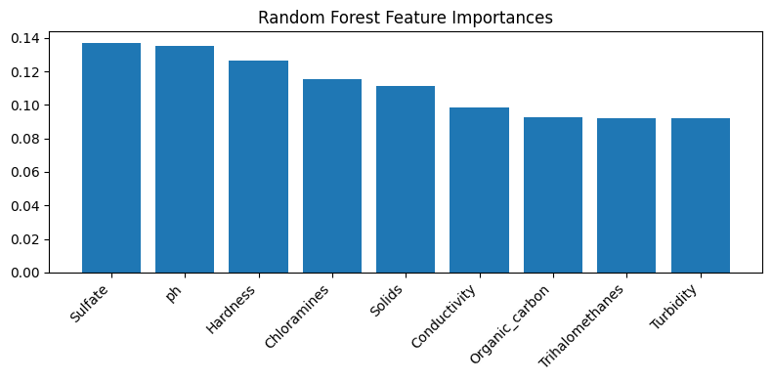
Results: Feature Importance (Random Forest)

Slide 11
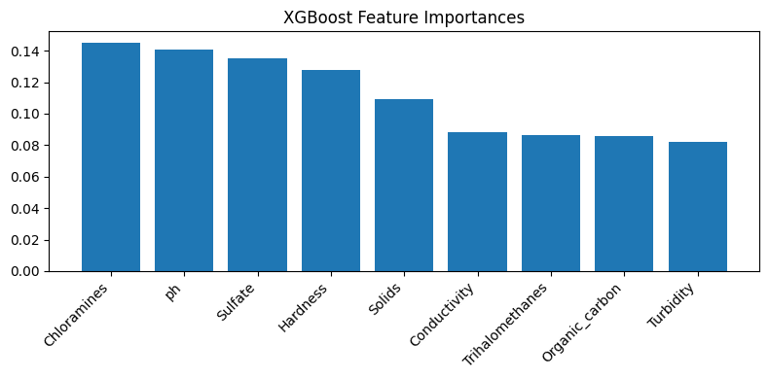
Results: Feature Importance (XGBoost)

Slide 12
Conclusion
Random Forest and XGBoost performed best with accuracy ~67%.
Top features: Sulfate, pH, Chloramines, and Hardness.
ML can assist in water quality monitoring at low cost and faster speed.
Future work: Improve dataset quality and test deep learning models.

