Slide 1
HR Analytics Dashboard
Power BI Project
Created by: Shrusti N P

Slide 2
About the Project
This HR Analytics Dashboard project was created using Power BI to analyze employee workforce data. The dashboard provides insights into employee distribution, remote work trends, hiring trends, department analysis, state-wise workforce distribution, and employee demographics.

Slide 3
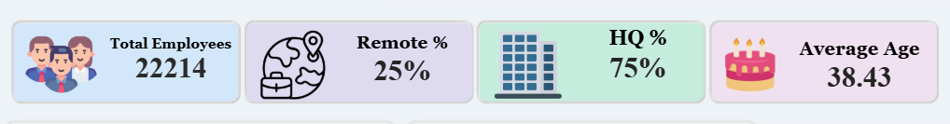
Key Performance Indicators (KPIs)
Total Employees: 22,214
Remote Employees: 25%
HQ Employees: 75%
Average Employee Age: 38.43

Slide 4
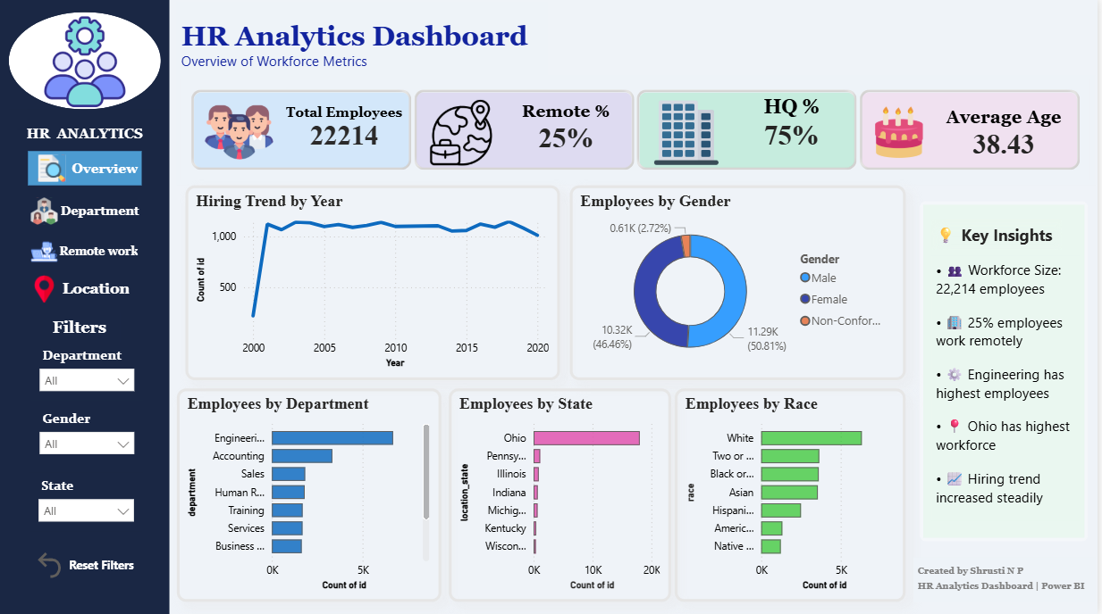
HR Analytics Dashboard Overview

Slide 5
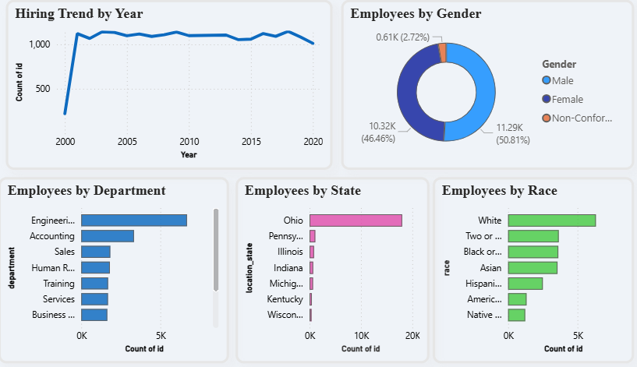
CHARTS

Slide 6
Key Insights
👥 Workforce Size: 22,214 employees
🏢 25% employees work remotely
⚙️ Engineering department has highest employees
📍 Ohio has highest workforce
📈 Hiring trend increased steadily
📊 Department-wise employee distribution is uneven, with technical departments having higher workforce strength.

Slide 7
Tools & Technologies Used
Power BI
SQL Database
Power Query
DAX Measures
Data Visualization Techniques

Slide 8
Conclusion
The HR Analytics Dashboard helps organizations analyze workforce trends, employee demographics, hiring patterns, and remote work statistics. This project supports data-driven HR decision-making and improves workforce planning.

