Slide 1
IMDB Movies Analysis Using SQL
Created by: Shrusti N P

Slide 2
Project Objective
• Analyze IMDB movie database using SQL
• Perform data retrieval and analysis
• Understand joins, filtering, aggregation, and sorting

Slide 3
Tools & Technologies Used
• MySQL
• MySQL Workbench
• SQL Queries
• Database Analysis

Slide 4
Database Information
Database Name: project_movie_database
Tables Used:
• directors
• movies

Slide 5
Directors Table Structure
Columns:
• id
• name
• gender
• uid
• department

Slide 6
Movies Table Structure
Columns:
• id
• original_title
• budget
• popularity
• revenue
• vote_average

Slide 7
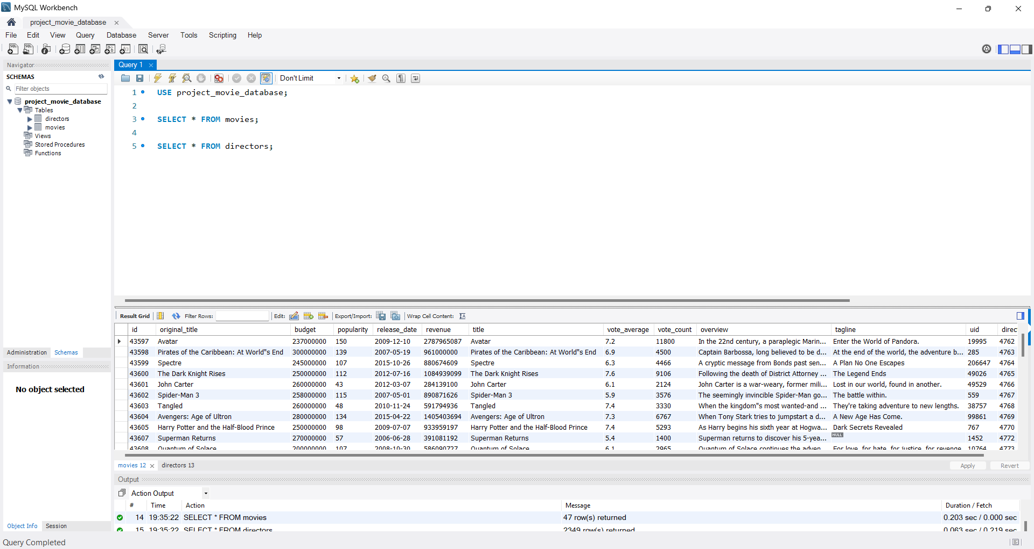
Queries 1 & 2
SELECT * FROM movies;
SELECT * FROM directors;

Slide 8
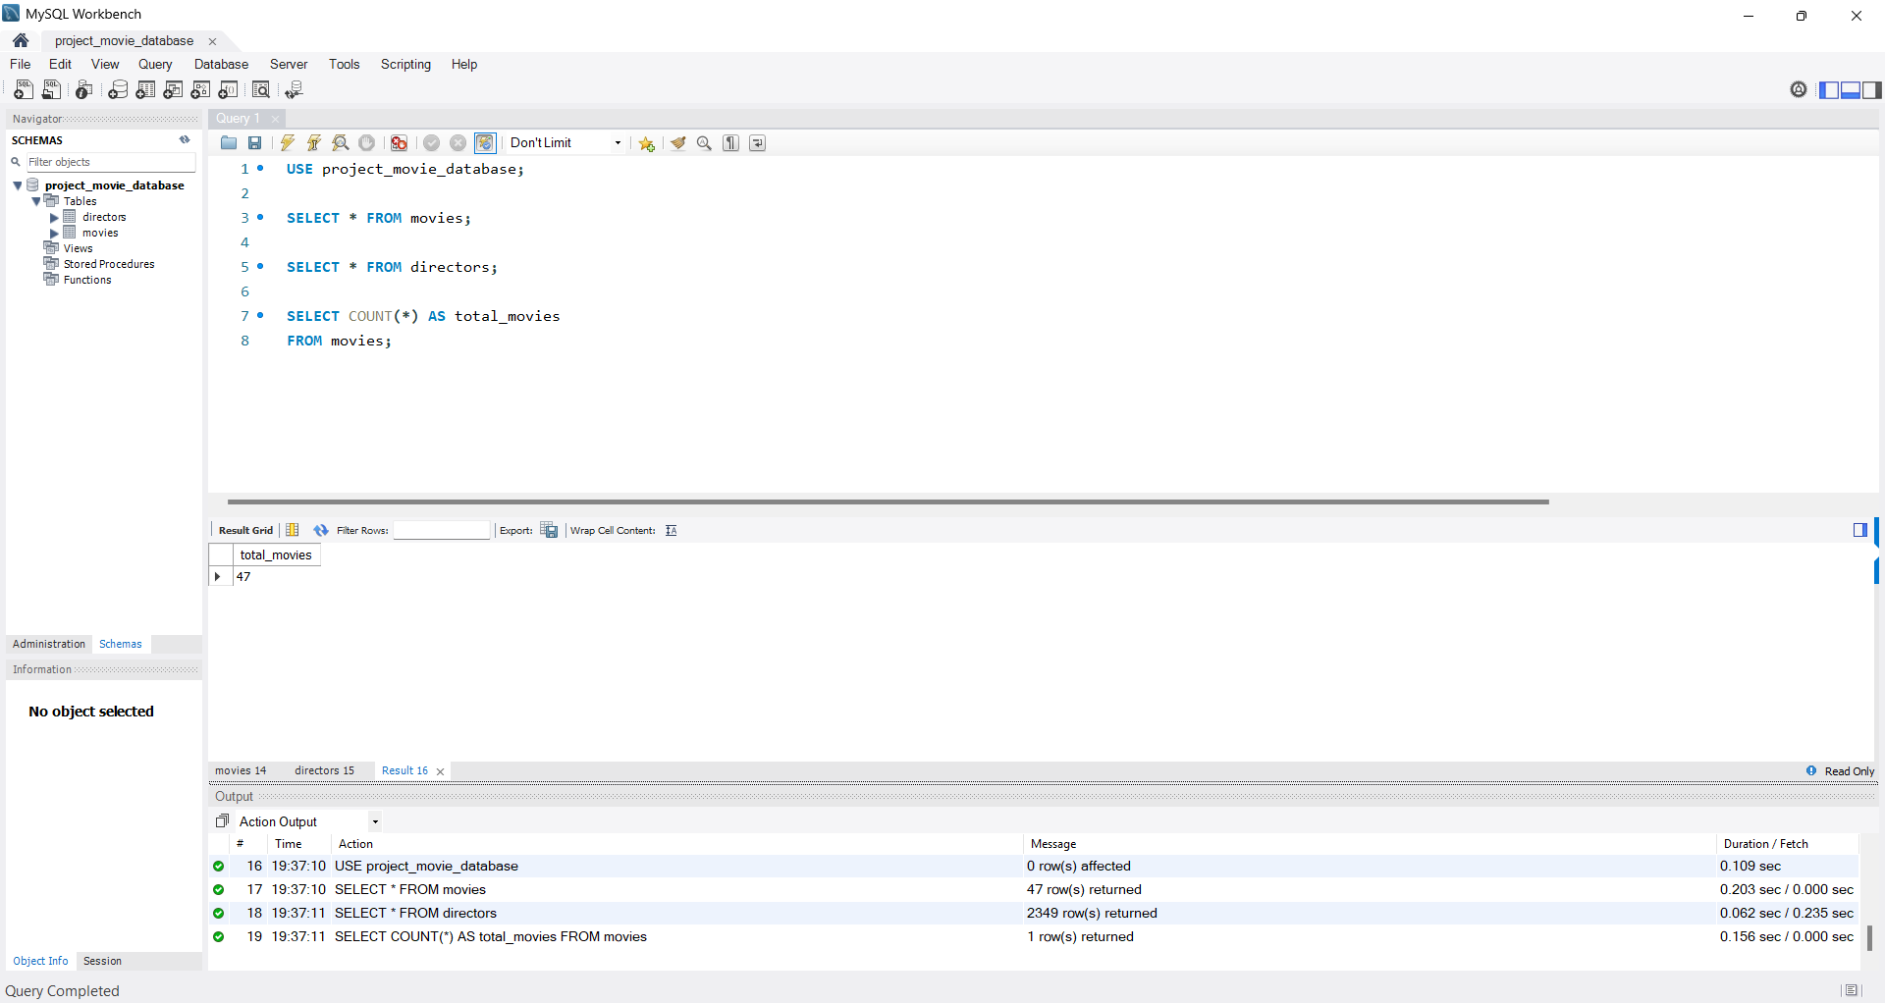
Count Total Movies
SELECT COUNT(*) AS total_movies
FROM movies;

Slide 9
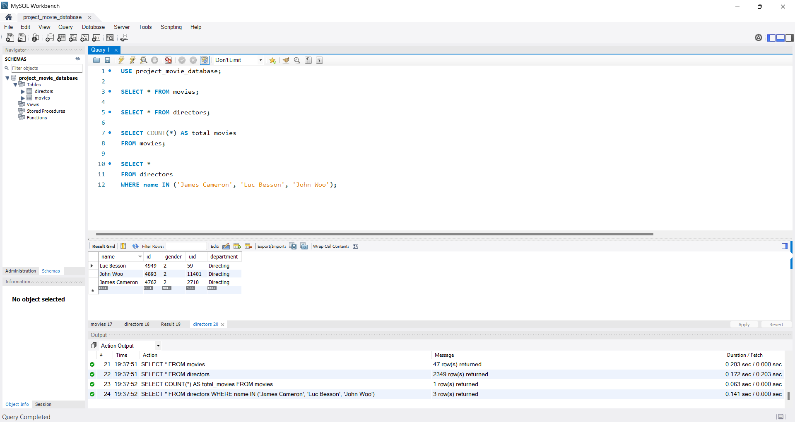
Director Filtering Queries
• Find James Cameron
• Find names starting with S
• Count female directors

Slide 10
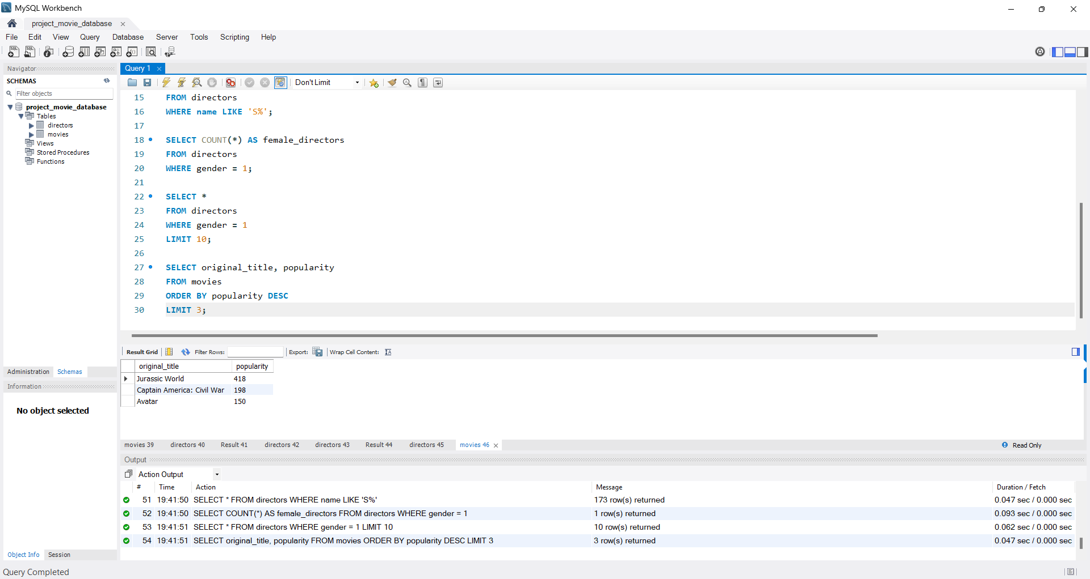
Popular & Bankable Movies
• Top 3 popular movies
• Top 3 profitable movies

Slide 11
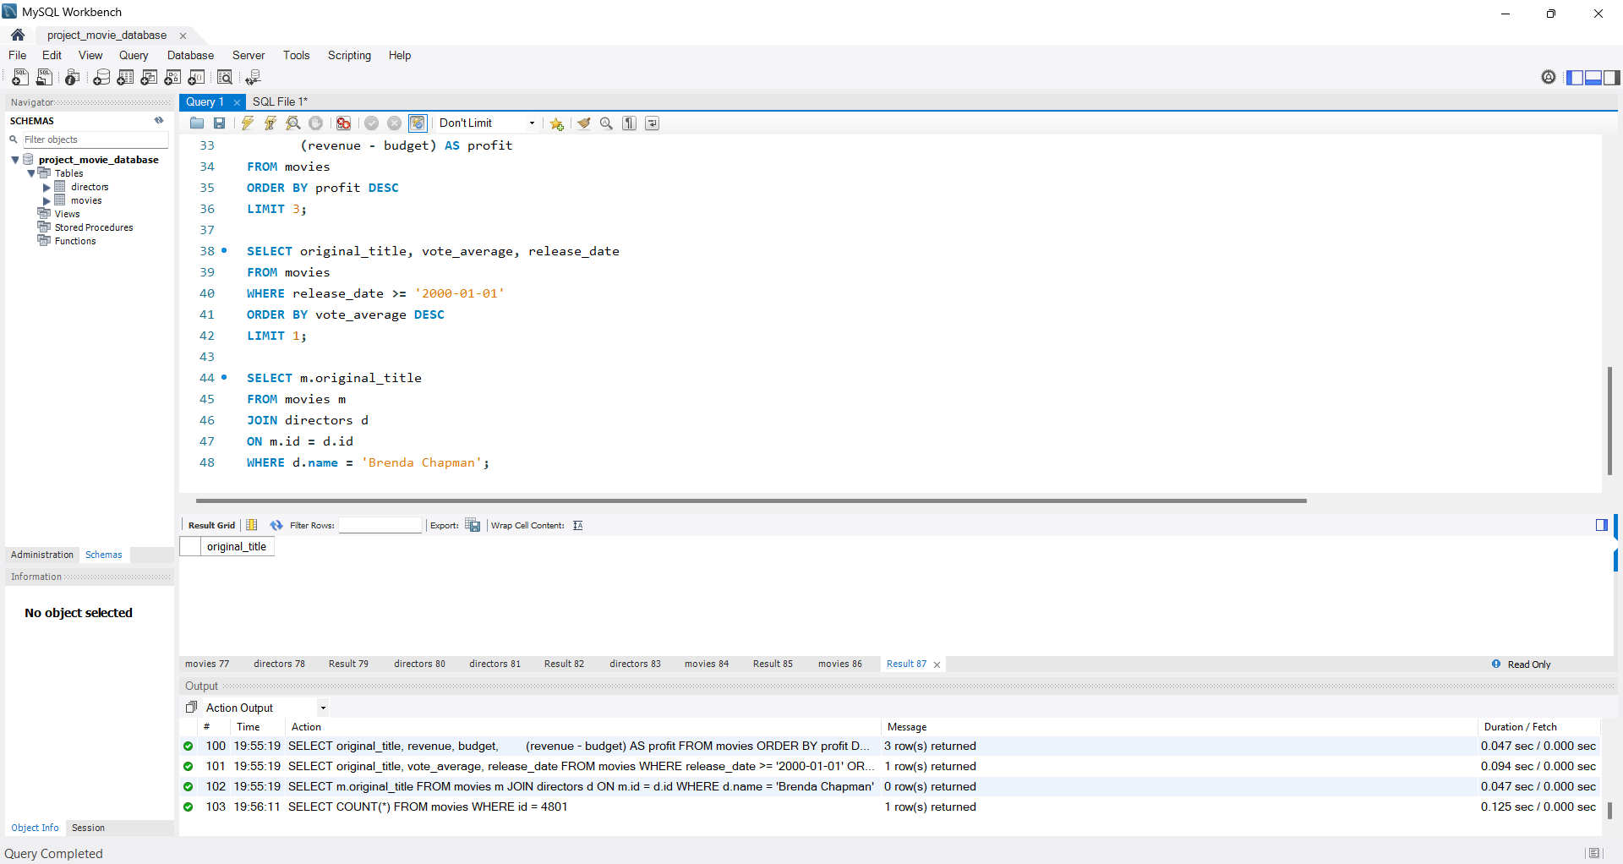
JOIN Operations
Movies directed by Brenda Chapman
No matching movie records found.

Slide 12
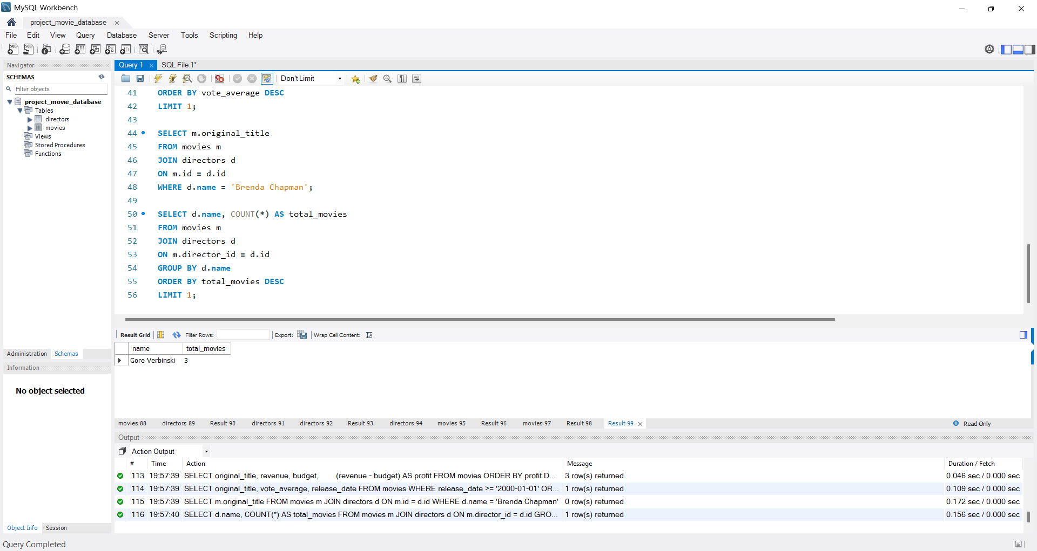
Most Successful Director
• Director with most movies
• Most bankable director

Slide 13
Key SQL Concepts Used
• SELECT
• WHERE
• JOIN
• GROUP BY
• ORDER BY
• COUNT
• SUM

Slide 14
Challenges Faced
Understanding Database Relationships
Handling NULL and Empty Results
Writing Complex SQL Queries
Identifying Correct Columns
Working with Large Datasets
Data Analysis and Interpretation

Slide 15
Conclusion
This project provided practical experience in using SQL for real-world database analysis. By working with the IMDB movie database, important SQL concepts such as SELECT, WHERE, JOIN, GROUP BY, ORDER BY, COUNT, and SUM were successfully implemented. The project improved understanding of relational databases, data retrieval techniques, and analytical problem-solving skills.

Slide 16
THANK YOU

