Slide 1

CDACL-006
Market Analysis
using SQL & Power BI
MySQL | Power BI
Prepared for DataMites Project Submission
Created by: Shrusti N P

Slide 2





Problem Statement
Why does this project exist?
Retail businesses generate millions of transactions, making manual analysis impossible.
Understanding customer purchasing behavior and loyalty patterns is a critical challenge.
Identifying top-performing products and departments requires deep data exploration.
Inventory over/under-stocking leads to revenue loss without data-driven forecasting.
Marketing spend is wasted without insights into peak purchase periods and channels.

Slide 3






Project Objectives
Identify top-performing products
Analyze department & aisle performance
Analyze customer ordering patterns
Generate actionable business insights
Measure reorder behavior & loyalty
Improve marketing strategy
Discover peak purchase periods

Slide 4
Dataset Overview
63,100+
32,000+
21
134
3M+
Customers
Products
Departments
Aisles
Transactions
Table | Description | Key Column(s)
orders | Customer orders with date/time | order_id, user_id
products | Product names & category links | product_id, aisle_id, dept_id
departments | Top-level product categories | department_id, department
aisles | Product subcategories | aisle_id, aisle
order_products_prior | Full purchase history | order_id, product_id, reordered

Slide 5
Data Model — Star Schema
orders
departments
order_products_prior
order_id, user_id
order_dow, days_since
department_id
department
FACT TABLE
products
aisles
product_id
product_name
aisle_id
aisle
⭐ Star Schema — 1 Fact Table + 4 Dimension Tables

Slide 6

SQL Analysis
Techniques Used
20
INNER JOIN / LEFT JOIN
Business Questions Solved
GROUP BY + ORDER BY
COUNT() / SUM() / AVG()
Q1 Top 10 most ordered products
DISTINCT + COUNTROWS
Q2 Customer reorder frequency
Subqueries & Derived Tables
Q3 Peak ordering hour & day of week
HAVING for filtered aggregates
Q4 Avg cart size per customer
Aliasing & CTE structures
Q5 Department-wise order share

Slide 7
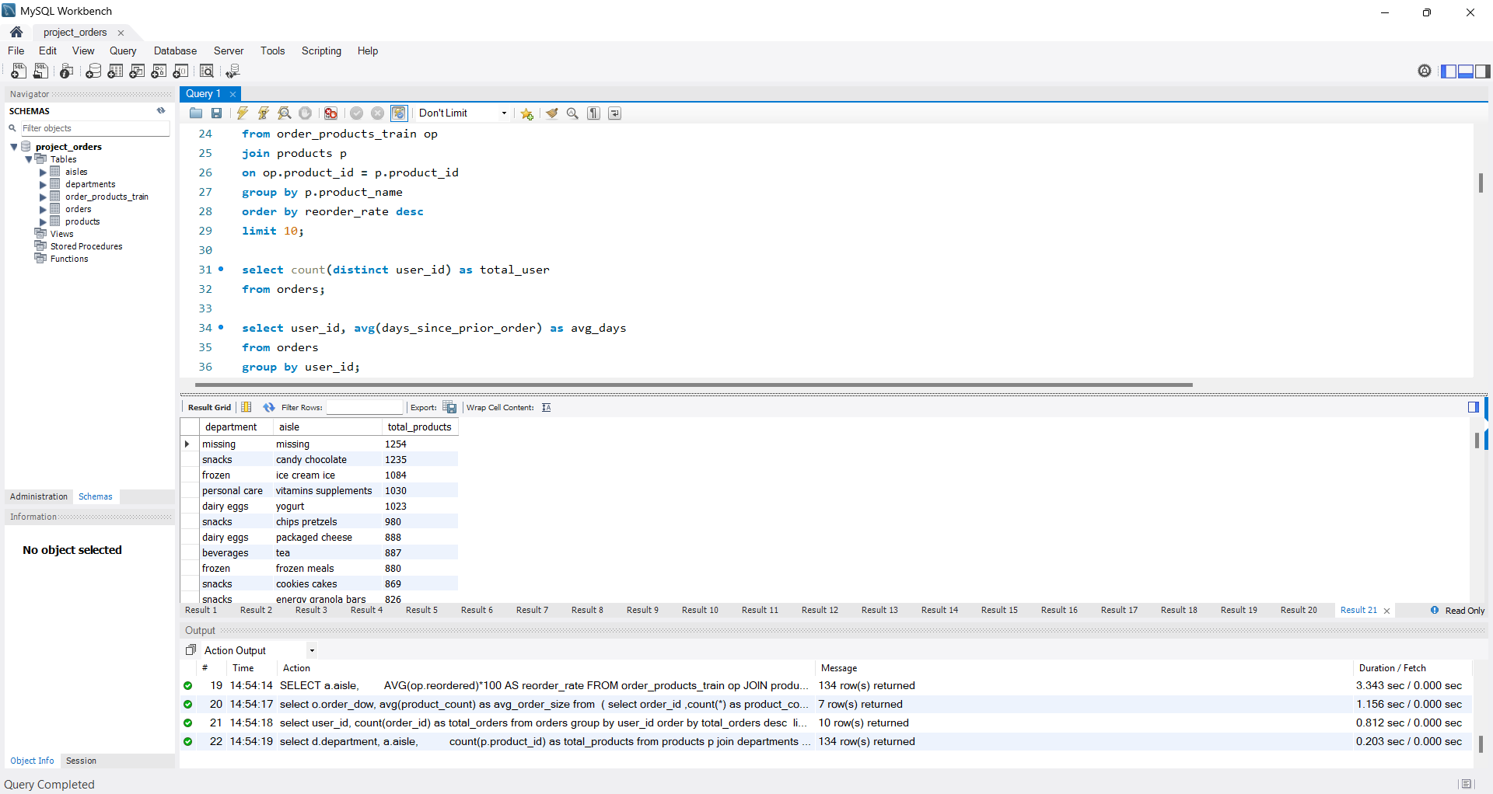

Slide 8





Executive Summary Dashboard
3.4M+
206K+
49,685
21
134
Total Orders
Total Users
Total Products
Departments
Aisles
11.1 days
Key Insights
Avg Days Between Orders
Strong customer engagement with 3.4M+ orders across 206K users
Large product catalog spanning 21 departments and 134 aisles
High transaction volume indicates active, returning customer base
📊 Screenshot: Executive Summary Dashboard (Power BI)

Slide 9
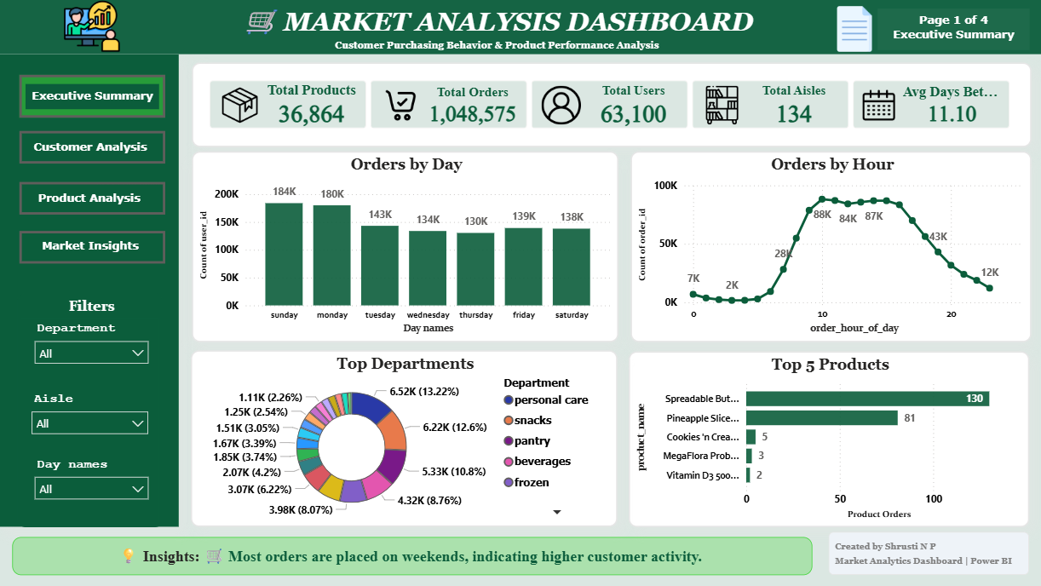

Slide 10
Customer Analysis Dashboard
206,209
High Loyalty
Total Customers
Most customers reorder within 2 weeks, indicating strong brand stickiness.
59.5%
Repeat Purchase Rate
Large Carts
~10 items
Average cart size of ~10 items suggests customers do full grocery runs.
Avg Order Size
11.1 days
Avg Days Between Orders
Engaged Base
8.4
59.5% repeat purchase rate shows sustained platform engagement.
Avg Add-To-Cart Position
📊 Screenshot: Customer Analysis Dashboard (Power BI)

Slide 11
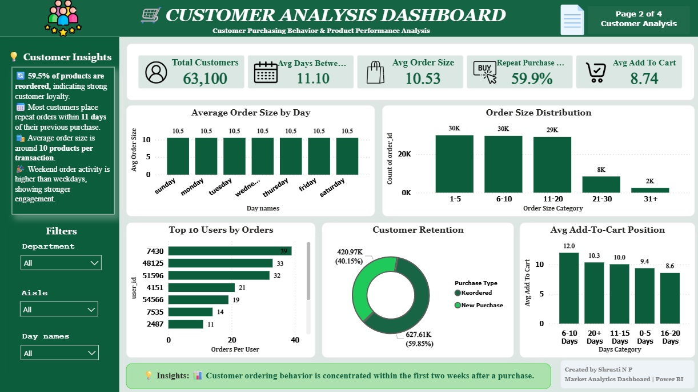

Slide 12
Product Analysis Dashboard
Produce Dominates
Produce department leads all categories by order volume.
Fresh Items Win
Fresh fruits & vegetables are the most reordered aisles.
High Reorder Rate
59.5% of all items ordered were previously bought (reorders).
Banana #1
Banana is the single most ordered product with 491K+ orders.
📊 Screenshot: Product Analysis Dashboard (Power BI)

Slide 13
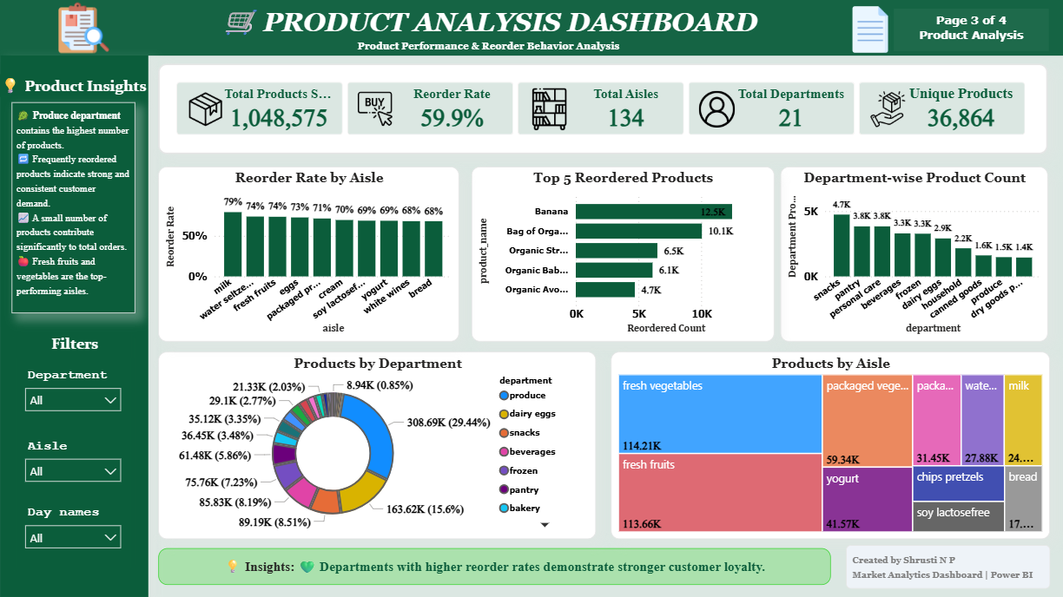

Slide 14
Marketing Insights Dashboard
10 AM
Saturday
Peak Ordering Hour
Peak Ordering Day
Banana
Produce
Most Reordered Product
Largest Department
📊 Screenshot: Marketing Insights Dashboard (Power BI)

Slide 15
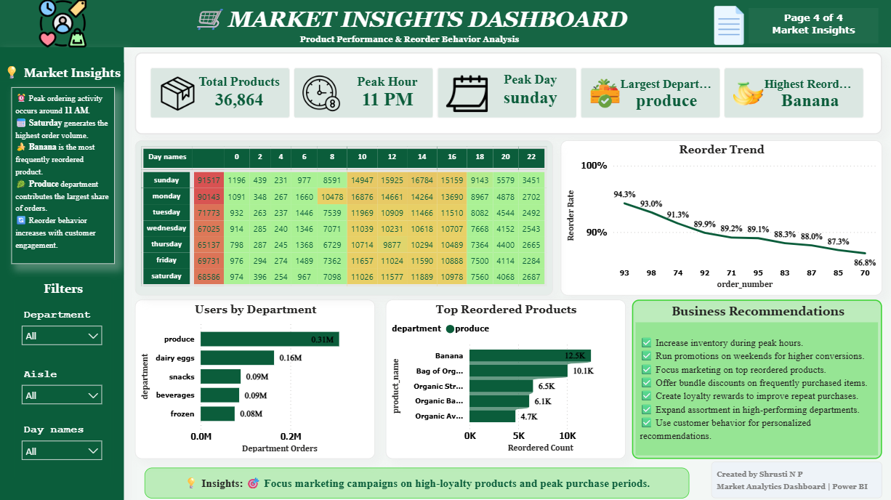

Slide 16

Key Findings
👥 Customer Findings
📦 Product Findings
Customers reorder very frequently
Produce department performs the best
Reorder Rate = 59.5% of all purchases
Banana is #1 most reordered product
Avg order size ≈ 10 products per order
Fresh produce dominates top aisles
Orders concentrated within 2 weeks
High product loyalty across categories
206K+ unique customers on the platform
Small product set drives majority of orders

Slide 17





Business Recommendations
Target Peak Windows
Launch Loyalty Programs
Personalize Offers
Schedule promotions & push notifications between 10 AM–2 PM for maximum reach.
With 59.5% reorder rate, reward programs will deepen retention further.
Use reorder history to personalize email/app recommendations per customer.
Produce-First Marketing
Optimize Inventory
Forecast with AI
Focus campaign spend on high-demand Produce items — fastest-moving category.
Increase stock buffer for top 50 products ahead of Saturday demand spikes.
Integrate demand forecasting models using order frequency patterns.

Slide 18


Challenges Faced
⚙ Technical Challenges
💼 Business Challenges
Handling 3M+ row dataset without performance degradation
Translating vague business questions into SQL KPIs
Writing efficient JOINs across 5 related tables
Choosing meaningful chart types for each metric
Creating complex DAX measures (RANKX, CALCULATE, SWITCH)
Balancing technical depth with executive clarity
Resolving row context vs. filter context errors in Power BI
Dashboard layout optimization for readability
Identifying actionable insights from raw numbers

Slide 19



Future Scope & Enhancements
Customer Segmentation
Recommendation System
Sales Forecasting
RFM analysis to group customers by recency, frequency & monetary value.
Collaborative filtering to suggest products based on purchase history.
Time-series models to predict future order volumes by product/category.
Inventory Optimization
Churn Prediction
Real-Time Dashboard
ML-based demand planning to minimize stockouts and overstock.
Identify at-risk customers using ML classifiers before they lapse.
Live streaming data pipeline with Power BI DirectQuery integration.

Slide 20

Conclusion
Successfully analyzed customer purchasing behavior across 3M+ transactions.
Identified top-performing products, aisles & departments using SQL & Power BI.
Measured customer loyalty with a 59.5% reorder rate across 206K+ customers.
Built interactive Power BI dashboards covering executive, customer, product & marketing views.
Generated actionable recommendations to improve revenue, retention & operations.
Thank You

