Slide 1
Developing or Acquiring BI Systems
Shrujan S Acharya
AIML

Slide 2
Introduction to BI Systems
Business Intelligence (BI): These are powerful tools and systems designed to transform raw, disparate data into meaningful insights, enabling organizations to make more informed and strategic decisions.
When considering a BI solution, organizations typically have three primary approaches:
Purchase
Lease
Build
Acquiring ready-made BI tools involves buying off-the-shelf software. This option often provides quick deployment and access to established features, ideal for common business needs.
Leasing, or subscribing to cloud-based BI services, offers flexibility and reduces upfront capital expenditure. It's suitable for businesses seeking scalability and continuous updates without managing infrastructure.
Developing custom BI systems allows organizations to tailor a solution precisely to their unique operational requirements and data sources. This path is chosen when off-the-shelf options don't meet specific, complex needs.

Slide 3
Vendor Tools & BI Shells
Vendors provide BI shells: pre-built frameworks with standardized features, dashboards, and reporting capabilities. These allow organizations to quickly integrate their operational data and deploy solutions without building from scratch, ideal for common BI needs.
In addition, vendors can:
Build custom BI systems tailored to specific client operational requirements and complex data sources.
Collaborate with outsourcing partners for implementation, customization, data integration, and ongoing support.
For more examples, product listings, demos & case studies, visit tdwi.org.

Slide 4
Choosing the Right Option
Selecting the optimal Business Intelligence (BI) system is a critical strategic decision for any organization. It involves evaluating various approaches against specific business needs and long-term objectives.
Alternatives:
Decision Factors:
1
Purchase
Budget
Quick setup, proven tools, potentially high upfront cost but immediate functionality.
(Cost vs. Long-term Value, TCO analysis)
Speed of Implementation
2
Lease
(Time-to-insight for critical business needs)
Flexible, lower initial cost, subscription model, often cloud-based, good for scalability.
Flexibility & Scalability
(Ability to grow with business needs and data volume)
3
Build
Tailored to exact needs, highly customizable, but requires significant internal resources and time investment.
Technical Expertise
(Internal team's capability to manage and develop)
Integration Needs
(Compatibility with existing systems and data sources)

Slide 5
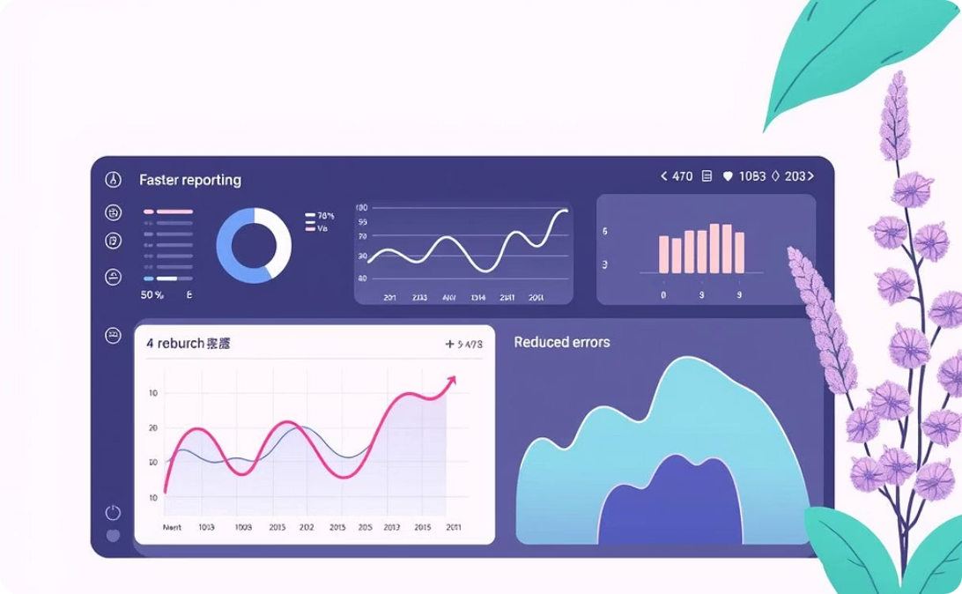


Justification & Cost–Benefit Analysis
Before adopting a Business Intelligence (BI) system, it's crucial to justify the investment. This involves analyzing both the tangible and intangible benefits, and leveraging existing examples.
Direct Benefits
Intangible Benefits
Reference Case Studies
Achieve faster reporting, reduce errors, and enable better, data-driven decisions.
Improve customer satisfaction and boost employee productivity through enhanced insights.
Utilize real-world case studies and experiences from other companies as valuable benchmarks.

Slide 6
Security & Privacy
Business Intelligence (BI) systems contain invaluable organizational assets, including highly sensitive data. Robust security and stringent privacy measures are therefore non-negotiable to protect competitive advantage and operational efficiency.
Key concerns regarding BI system security and data privacy include:
Preventing Unauthorized Access and Data Breaches
Protecting Employee and Customer Privacy
Safeguarding against cyber-attacks and data leaks is paramount. This requires robust encryption, stringent access controls, regular security audits, and intrusion detection systems to ensure data confidentiality, integrity, and availability.
Ensuring the privacy of personal information is an ethical and legal imperative. Adherence to data protection regulations (e.g., GDPR, HIPAA) is essential, necessitating practices like data anonymization and strict data governance to prevent misuse and maintain trust.
A compromise of a BI system could expose proprietary sales strategies or confidential market plans, leading to significant competitive disadvantages, reputational damage, regulatory penalties, and financial repercussions.

Slide 7

Integration Needs
BI rarely works alone → must integrate with:
Databases & Data Warehouses
ERP (Enterprise Resource Planning)
CRM (Customer Relationship Management)
E-commerce platforms
Business Partner Systems
The Internet

Slide 8

BI Tool Integration
Sometimes different BI tools need to be connected to leverage their unique strengths or to consolidate reporting across various departmental solutions.
Two approaches:
All-in-One Solution
Best-of-Breed Solution
This approach involves sourcing all BI functionalities from a single vendor. It offers a streamlined, unified platform.
This approach involves selecting specialized tools from different vendors, each excelling in a particular BI area (e.g., data visualization, ETL, predictive analytics).
Pros: Easier integration, consistent user interface, simplified vendor management, potentially lower initial setup costs.
Pros: Access to highly optimized and cutting-edge features, greater flexibility and customization, allows for mix-and-match capabilities to suit exact needs.
Cons: Can be less flexible or customizable, may lack specialized features for specific niche requirements, potential for vendor lock-in.
Cons: Can lead to complex integration challenges, higher ongoing maintenance, potential for data silos, requires stronger internal technical expertise.
The choice between these approaches depends on an organization's specific needs regarding budget, technical capabilities, desired flexibility, and the complexity of its data environment.

Slide 9
Conclusion
Business Intelligence (BI) systems are strategic assets that transform how organizations operate and compete. By providing deep data insights, BI empowers companies to make informed decisions, optimize processes, and gain a significant competitive advantage.
Successful BI implementation hinges on evaluating three critical, interconnected factors:
Budget: Consider the total cost of ownership (TCO) beyond initial investment, including licensing, maintenance, and training, to ensure a positive ROI.
Business Needs: Define specific operational and strategic requirements, identifying what data to analyze, what questions to answer, and necessary reporting/visualization levels.
Long-term Goals: The chosen BI system must be scalable and adaptable to handle future growth, increasing data volumes, new sources, and emerging analytical demands.
Final Thought: “BI is not just a technology – it is a strategy for smarter business.”
Effective BI integrates into strategic planning, transforming raw data into actionable intelligence to drive smarter decisions, foster efficiency, and unlock growth opportunities.

Slide 10





Summary
Acquisition & Development
Cost-Benefit Analysis
Security & Privacy
A thorough Cost-Benefit Analysis is essential to justify the investment, evaluating both direct and intangible benefits.
Robust Security and Privacy measures are vital to protect sensitive organizational data.
BI systems can be acquired by purchasing, leasing, or custom-building them.
Tool Selection
Seamless Integration
Organizations must choose between all-in-one unified platforms and best-of-breed specialized tools.
Seamless Integration with existing systems like databases, ERP, and CRM is crucial for effective BI.

Slide 11
Thank You

