Slide 1
Documentation bot
Team Members:
Sharan Selvaraj Raju Bondala

Slide 2
problem
All Webex spaces have numerous attached wikis and documentable pieces of information like API endpoints, PRs, Event dates, Wiki links, Contact IDs etc thrown around all over the space
When searching for an older piece of information, its hard to remember the text phrases to use to correctly seach and find it
Quickly referencing this information from a space is a common task done, but its not effective and also sometimes does not yield the results needed

Slide 3
Summary
A Webex bot that automatically converts messages from Webex spaces into Documentation pages for reference later and uses Webex Bot API, Atlassian API and ML models (Topic modelling, Text classification) for parsing messages and converting them to sections of documentation
Bot that can be added to a space.
Reads messages from the space when tagged
Classification - from Webex message text to topics for documentation, like PR, API, Event etc
Text formatting into documentation format - Takes relevant phrases alone and adds to documentation.
Updates a documentation wiki

Slide 4
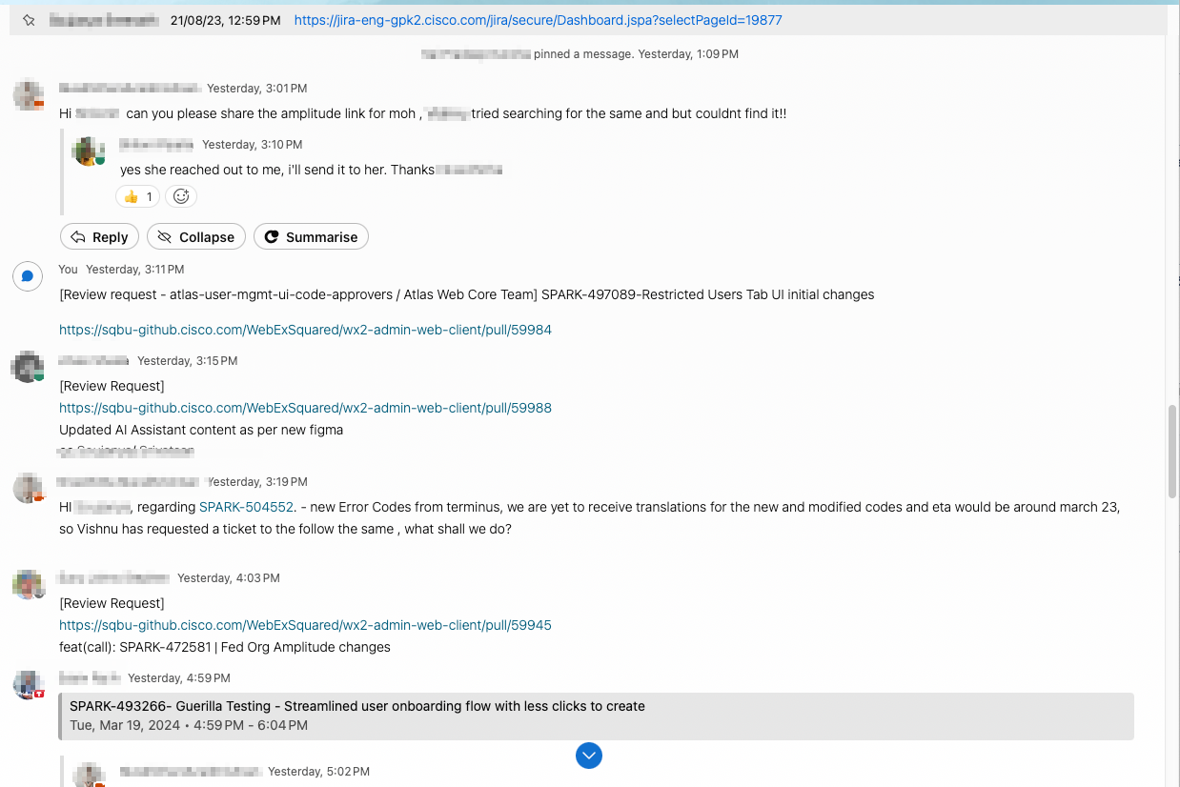
Example
Screenshot from Hubmasters space

Slide 5
Example
for attached screenshot , the bot could create documentation like:
PRs:
SPARK-XXXXXX-Restricted Users Tab UI initial changes - https://sqbu-github.cisco.com/WebExSquared/wx2-admin-web-client/pull/XXX - Person X
Updated AI Assistant content as per new figma - https://sqbu-github.cisco.com/WebExSquared/wx2-admin-web-client/pull/YYY - Person Y
ETAs:
March 23, 2024, Error Codes from terminus - Person Z
Guerilla testing wikis:
https://wiki.cisco.com/display/IPCBU/Guerilla+Testing+-+Directed+Call+Pick+up+and+Barge+In - Person Z

Slide 6
Bot framework
Bot reads any messages its tagged in and runs the text through an algorithm, and then updates a wiki or returns a message to the space itself with the model’s result
Could use something SpeedyBot (https://speedybot.js.org/) for bootstrapping a Webex Bot
Webex Bot API helps restrict the access to messages only to tagged messages – would not be a limitation if training can be done with a large dataset.

Slide 7
Topic modelling - unsupervised
Use topic modelling techniques to figure out the topics associated with a message
Example algorithms that can be used would be LDA / LSA
Unsupervised method and might not give the most desired topic, but can be a preliminary step
If topic is not satisfactory, the other option is a supervised text classification model

Slide 8
Text classification
Supervised algorithm that will take previously classified text-based dataset as input and train to predict the class or topic of any new text data it receives.
Popular algorithms include BERT-based, XLNet, SVM classifier
Models and performance references:
https://paperswithcode.com/sota/text-classification-on-mr

Slide 9
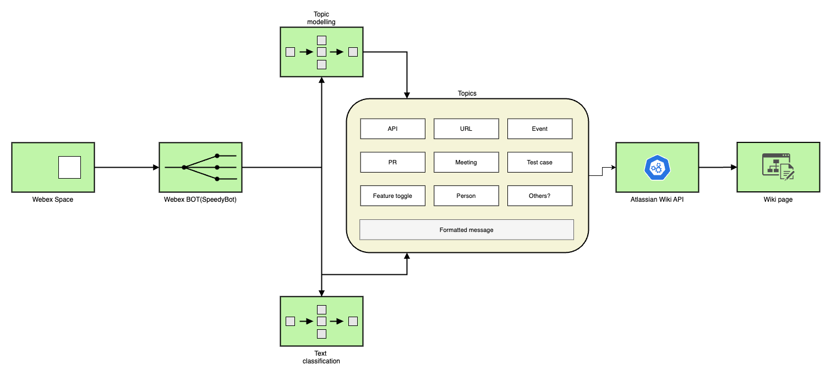
Architecture in diagram

Slide 10
Thank you!

