Slide 1
Music genre from raw audio: reproduce & extend
UE24CS352A MACHINE LEARNING · MINI-PROJECT
Reference: Sawhney, Vasavada & Wang, “Latent Feature Extraction for Musical Genres from Raw Audio”, NeurIPS 2018 workshop
Shrungashree KR · PES2UG24CS497
Shashank Verma · PES2UG24CS462
GTZAN · PyTorch
Notes:
Introduce the team and the reference paper. The task has two parts: reproduce the paper's results, then add one model the paper does not use.

Slide 2
Learn genre straight from the waveform – no MFCCs, no spectrograms
THE TASK
PART 1 · REPRODUCE
PART 2 · EXTEND
The paper's three models
One model the paper never tried
Two-layer NN baseline, a vanilla autoencoder, and the Deep Softmax Autoencoder (DSAE): an autoencoder whose 64-d bottleneck also feeds a genre classifier. Same data, split, hyperparameters and metrics.
A 1-D convolutional network on exactly the same 500-sample raw input, the same split and the same metrics, so the comparison is fair.
Paper reports 94.9 / 64.1 / 65.3 % train / dev / test accuracy for the DSAE
Notes:
The paper's goal is to learn style encodings from raw audio, using genre as the proxy. Its best model is the Deep Softmax Autoencoder, which combines reconstruction and classification losses.

Slide 3
GTZAN, 4 genres → raw-audio vectors of length 500
DATASET & PREPROCESSING
400
600k
÷ 40
20 × 500
6k/1k/1k
songs in the original run (classical, jazz, metal, pop); 399 after cleaning
samples kept at 22,050 Hz (librosa)
average pooling → 15,000 values (≈551 Hz)
segments per song, ≈0.9 s each
train / dev / test segments in the original run; 6,000 / 1,000 / 980 after cleaning
Data cleaning
No feature engineering: pooling both downsamples and regularises. The split shuffles segments, as the paper does, so pieces of one song can sit in both train and test; we test what that does later.
Every file is checked during loading; unreadable or too-short files are skipped. In our dataset copy, jazz.00054.wav was unreadable and was skipped, leaving 399 songs and 7,980 segments. The full-run results in this deck come from the original experiment, run before this cleaning step on 400 songs (8,000 segments).
src/data.py · identical to the authors' public preprocessing code
Notes:
The steps follow the paper and the authors' code. Each example is a 500-dimensional vector of pooled amplitudes. The PCA of this raw data shows no separation between genres. Cleaning: data.py checks every file while loading and skips files that fail to decode or are under 90 % of the expected length. On our dataset copy, jazz.00054.wav failed with a LibsndfileError and was skipped, leaving 399 songs and 7,980 segments (classical 2,000, jazz 1,980, metal 2,000, pop 2,000), split 6,000 / 1,000 / 980. The full-run results in this deck come from the original experiment, which was run before this cleaning step on a copy where all 400 songs loaded (8,000 segments, split 6,000 / 1,000 / 1,000). Those results were not retrained on the cleaned 7,980-segment data.

Slide 4
Three reference models and our extension
MODELS
Model | Architecture | Loss | Training
Two-layer NN | 500 → 128 (tanh) → 4 | cross-entropy | Adam 1e-4, 200 epochs
Vanilla AE | 500-256-192-128-64-128-192-256-500 | MSE | Adam 1e-4, 500 epochs
Deep Softmax AE | same AE + 64 → 32 → 16 → 4 on the bottleneck | 0.9·MSE + 0.1·CE | Adam 1e-4, 500 epochs
1-D CNN (ours) | 4 × [Conv1d k9 · BN · ReLU · pool], 32-64-128-128 ch → global avg pool → 4 | cross-entropy | Adam 1e-3, 40 epochs
Reference models: batch 512, dropout keep-prob 0.9. All models: 3 seeds; we test the checkpoint with the best dev accuracy. The CNN has 0.24 M parameters, against 0.42 M for the DSAE.
src/models.py · activations follow the authors' TensorFlow code
Notes:
Hyperparameters are taken from the paper's Figure 2 and Section 4.3. Where the paper is silent, for example the layer activations, we used the authors' public code.

Slide 5
The reproduction lands within 3–4 points
PART 1 · REPORTED VS OURS
Accuracy (%) | Train rep. | Train ours | Dev rep. | Dev ours | Test rep. | Test ours
Two-layer NN | 52.0 | 51.9 ± 0.9 | 38.1 | 39.4 ± 0.6 | 36.4 | 39.8 ± 1.3
Deep Softmax AE | 94.9 | 88.7 ± 2.4 | 64.1 | 63.0 ± 1.5 | 65.3 | 61.7 ± 1.2
Last-epoch reading
Why not identical
Reading the DSAE at epoch 500, as the paper appears to: 97.0 / 59.5 / 60.1 %. The paper's high train figure is the running, overfit training accuracy.
The paper used one random split (seeds vary ±1.5 points), an unstated stopping rule, keep-prob 0.9 in the text but 0.8 in the code, and TF1 instead of PyTorch.
These full-run results are from the original saved experiment. The cleaned-data notebook run is separate and is not a full retraining of all models.
Ours: mean ± std over 3 seeds · original experiment, 400 songs, 6,000 / 1,000 / 1,000 segment split · results/tables.md
Notes:
Both reference models reproduce closely. The baseline is slightly better than reported, and the DSAE is about 3.5 points lower on test. Explain the differences listed in the right-hand card. These are the original saved full-run results (400 songs). The short notebook runs on the cleaned data (two-layer NN 40.3 %, CNN 79.9 % after 3 epochs) are demonstrations and do not replace them.

Slide 6
Same ranking: classical easiest, metal hardest
PART 1 · PER-CLASS METRICS
DSAE, test | Prec. rep. | Prec. ours | Recall rep. | Recall ours | F1 rep. | F1 ours
classical | 0.783 | 0.764 | 0.775 | 0.770 | 0.779 | 0.766
jazz | 0.606 | 0.580 | 0.627 | 0.571 | 0.616 | 0.575
metal | 0.515 | 0.514 | 0.554 | 0.523 | 0.534 | 0.518
pop | 0.670 | 0.621 | 0.608 | 0.608 | 0.638 | 0.613
The error pattern matches too: metal ↔ pop and classical ↔ jazz are the main confusions, and the PCA of the DSAE's logits shows the same curved manifold, with pop the most spread out.
Reported = paper Table 2 · ours = mean of 3 seeds
Notes:
Every per-class number is within about 0.06 of the paper's, and the ordering of genres by F1 is identical.

Slide 7
The decoder only ever outputs zero
WHAT THE PAPER DOESN'T SAY
0.01173
0.01172
vanilla AE test reconstruction MSE
variance of the same test segments
The decoder ends in a ReLU, so it cannot output negative amplitudes (51 % of samples). We ran all 5 saved autoencoder checkpoints (1 vanilla AE, 4 DSAE runs) on all 8,000 segments: every decoder output was exactly 0. The reconstruction term is therefore a constant that adds no gradient, so the DSAE effectively trains as a deep MLP classifier, consistent with its 97 % train vs 60 % test gap.
Notes:
Evidence: src/check_decoder.py loads all five saved autoencoder checkpoints (vanilla AE seed 0; DSAE seeds 0, 1 and 2; DSAE song-level run) and runs them on all 8,000 segments of the original dataset. In every case the maximum decoder output is 0.0 and no output is non-zero, and the test reconstruction MSE equals the variance of the test segments (for example 0.01173 vs 0.01172), so the reconstruction is no better than predicting silence. The final-ReLU design comes from the authors' code. The paper presents the reconstruction loss as the key idea, but in this implementation it contributes nothing to training.

Slide 8



Raw audio needs translation invariance, which an MLP lacks
PART 2 · WHY A 1-D CNN
The problem
The fix
Fair test
A drum hit or a chord can start at any of the 500 positions. An MLP treats every position as an unrelated feature and has to relearn each pattern everywhere, so it overfits.
Convolutions share filters across time, and pooling summarises them. In effect the network learns its own filter bank from the waveform, which keeps the paper's no-feature-engineering spirit.
Same 500-sample input, the same split and seeds, and the same metrics. It is smaller than the DSAE (0.24 M vs 0.42 M parameters) and has no autoencoder.
None of the paper's experiments uses a convolutional model
Notes:
Justify the choice: it is the inductive bias the input type calls for, not a bigger model. If the panel asks about other options, XGBoost or random forest on raw samples would suffer from the same position-dependence as the MLP.

Slide 9
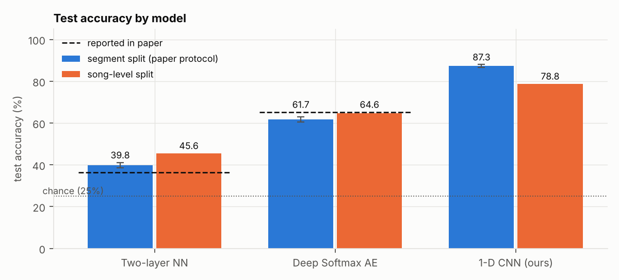
The CNN beats every reference model by a wide margin
PART 2 · RESULT
87.3 %
CNN test accuracy, ± 0.7 over 3 seeds
0.87 vs 0.62
macro-F1, CNN vs DSAE
Verdict: better, by about 25 points, with fewer parameters
Notes:
Blue bars use the paper's protocol. The orange bars are the stricter song-level split, covered two slides later. Dashed lines are the paper's reported test accuracies.

Slide 10
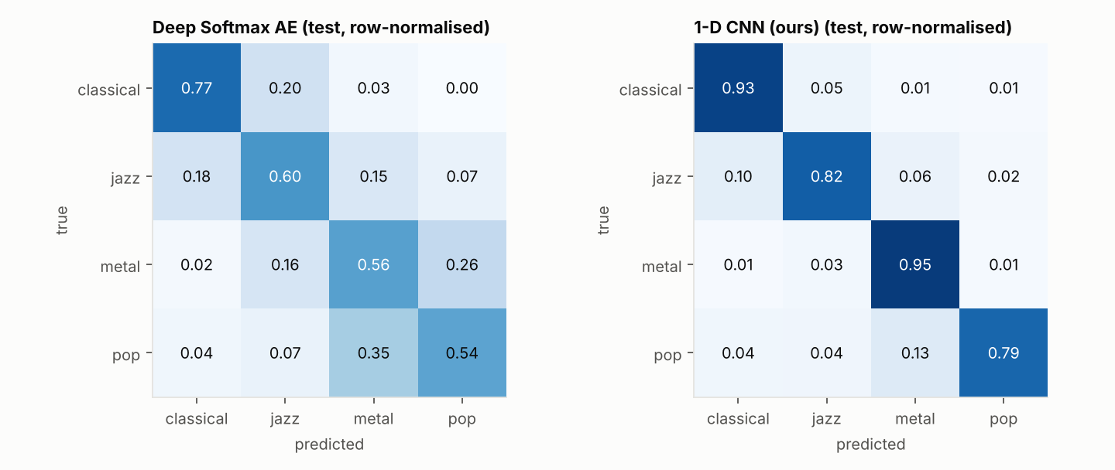
The CNN fixes the genres the paper found hardest
PART 2 · WHERE THE GAIN COMES FROM
F1 | DSAE | CNN
classical | 0.77 | 0.89
jazz | 0.58 | 0.84
metal | 0.52 | 0.88
pop | 0.61 | 0.87
Matrices: seed 0 test set · F1: mean of 3 seeds
Notes:
The DSAE's metal-pop confusion (0.26 and 0.35) almost disappears with the CNN. Pop remains the hardest genre, which agrees with the paper's observation that pop has the least distinct style.

Slide 11
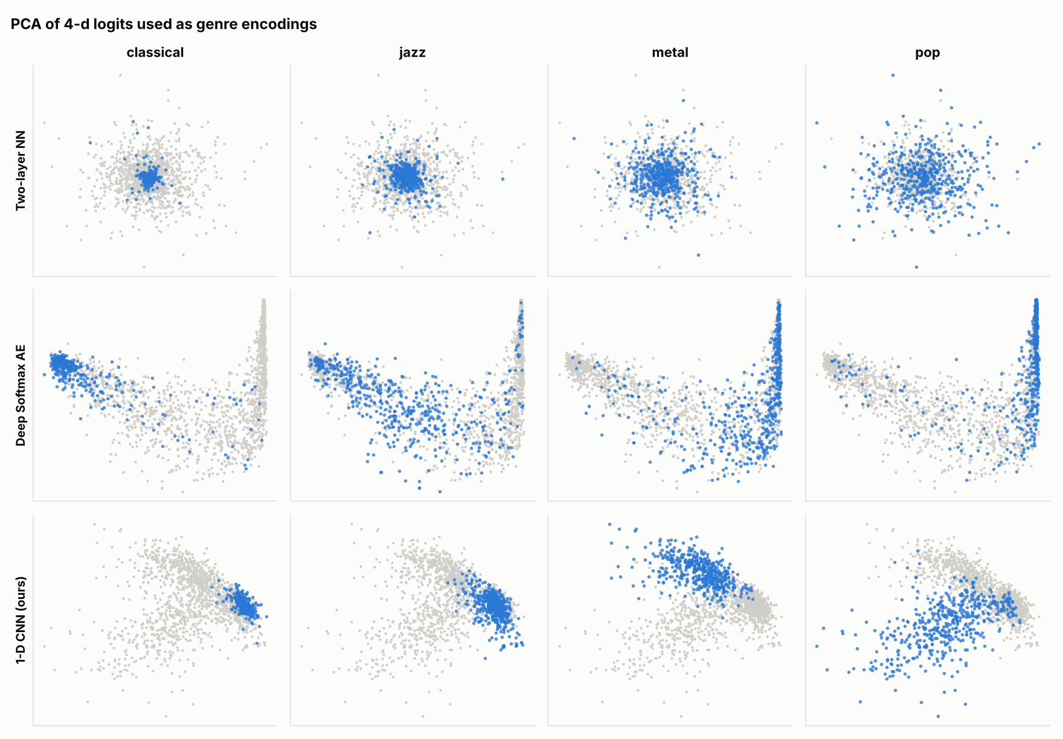
CNN encodings form four compact clusters
QUALITATIVE · PCA OF 4-D LOGITS
Two-layer NN: one overlapping blob, as the paper found.
DSAE: the same smooth curved arc as the paper's Figure 6, with classical at one end and pop spread along it.
CNN: compact, separated regions per genre; pop remains the most spread out.
Held-out dev + test segments of the original split (2,000), seed 0 · each panel highlights one genre
Notes:
This qualitative evaluation is the paper's main one. Our DSAE plot reproduces the paper's shape, and the CNN gives a much cleaner genre space.

Slide 12
With no song shared across splits, the CNN still wins
ROBUSTNESS · DATA LEAKAGE CHECK
Test accuracy (%) | Segment split (paper) | Song-level split
Two-layer NN | 39.8 | 45.6
Deep Softmax AE | 61.7 | 64.6
1-D CNN (ours) | 87.3 | 78.8
The paper's split lets segments of one song appear in both train and test. On a song-level split (75 / 12 / 13 songs per genre) the CNN drops about 8.5 points, which suggests the segment split gave it some advantage from other segments of the same songs, but it stays about 14 points ahead of the DSAE.
Song-level split: one seed, so differences of a few points for the MLPs are within noise
Notes:
This is our additional experiment, not part of the original paper. The CNN's accuracy drops on the song-level split, suggesting that the segment-level split may give it an advantage when segments from the same song appear in both training and test sets. The MLP results increase slightly in this run, but the song-level comparison uses only one seed. All numbers on this slide are from the original saved experiment (400 songs).

Slide 13
What we found
CONCLUSIONS
1
In our original saved experiment the paper reproduces: the DSAE scores 61.7 % vs 65.3 % reported and the baseline 39.8 % vs 36.4 %, with the same per-class pattern and embeddings.
2
Its reconstruction loss does nothing in the published design: the ReLU-output decoder outputs only zeros in all our saved checkpoints, so the DSAE's gain comes from its deeper encoder and classifier.
3
A small 1-D CNN on the same raw input reaches 87.3 % (78.8 % with no shared songs, one seed). For raw audio, architecture matters more than the auxiliary loss.
All figures: original saved experiment (400 songs, 8,000 segments), not a retraining on the cleaned 399-song data
Notes:
Future work: a linear decoder output so the reconstruction loss matters, a CNN autoencoder for style encodings, and all 10 GTZAN genres. All accuracy figures here are from the original saved experiment (400 songs, 8,000 segments), not from a retraining on the cleaned 399-song dataset.

Slide 14
Classify a song: 20 segments, majority vote
LIVE DEMO
$ python src/demo.py data/genres/jazz/jazz.00007.wav
two_layer_nn → classical votes [10, 6, 2, 2]
deep_softmax_ae → jazz votes [3, 17, 0, 0]
cnn1d → jazz votes [3, 17, 0, 0] p(jazz) = 0.81
Saved example output from the trained checkpoints; a live run on another song will give different votes.
Full-run results use saved checkpoints; the notebook's short training runs are illustrative runs on the cleaned dataset. Also: python src/demo.py picks a random held-out song, demo.ipynb walks through the whole project in VS Code, and python src/analyze.py rebuilds every table and figure.
Vote order: classical, jazz, metal, pop · checkpoints in results/checkpoints
Notes:
Run the demo live. Show one random song and one file the panel picks. Then walk through the code: data.py, models.py, train.py. The terminal output on the slide is a saved example; live output on other songs will differ. Full-run results use saved checkpoints; the notebook's short training runs are illustrative runs on the cleaned dataset (two-layer NN 40.3 %, CNN 79.9 % after only 3 epochs) and are not comparable to the full-run 87.3 %.

