Slide 1
Privacy-Preserving Synthetic Student
Attendance Analysis and Prediction System
A Complete Data Science Project
Data Generation · EDA · Regression · Classification
Dataset: 205 Students · 4,100 Records · Fully Synthetic
Best Models: GradientBoostingRegressor & GradientBoostingClassifier
Department: Computer Engineering & MCA | August 2026
⚠ SYNTHETIC DATA — No real student names, roll numbers, or email IDs used. | Slide 1 / 14
Notes:
Title slide. Emphasize upfront: all data is 100% synthetic. No real student info used.

Slide 2
Introduction
Why student attendance prediction matters
• Student attendance is a key indicator of academic engagement & performance
• Institutions enforce a mandatory 75% minimum for examination eligibility
• Identifying at-risk students early enables timely counseling intervention
• ML models can predict attendance status from academic & engagement features
• Real student data creates PII exposure & re-identification privacy risks
• Solution: fully synthetic data that mirrors realistic patterns ethically
⚠ SYNTHETIC DATA — No real student names, roll numbers, or email IDs used. | Slide 2 / 14
Notes:
Most colleges require 75% attendance. Early identification of defaulters is the motivation. Synthetic data solves the privacy challenge without sacrificing statistical realism.

Slide 3
Problem Statement
Two machine learning tasks defined
• Student absenteeism is often identified too late for effective intervention
• Faculty need a data-driven early-warning tool to flag at-risk students
▶ Task 1 — Regression: Predict Attendance_Percentage (continuous 0–100%)
▶ Task 2 — Classification: Predict Attendance_Status → Regular (≥75%) / Defaulter (<75%)
• Challenge: real attendance data contains PII — names, roll numbers, emails
• Solution: synthetic data preserves statistical realism without privacy cost
⚠ SYNTHETIC DATA — No real student names, roll numbers, or email IDs used. | Slide 3 / 14
Notes:
Two clear problem definitions. Regression for continuous prediction, classification for binary flag. Privacy constraint solved by synthetic data.

Slide 4
Project Objectives
1. Generate a statistically realistic, fully synthetic 205-student dataset
2. Validate with 25 automated data quality & privacy checks — all must pass
3. Perform EDA with 11 professional visualizations & correlation analysis
4. Train & compare 4 regression models → predict Attendance_Percentage
5. Train & compare 4 classification models → predict Regular / Defaulter
6. Select best models using principled metric-based criteria (not arbitrary)
⚠ SYNTHETIC DATA — No real student names, roll numbers, or email IDs used. | Slide 4 / 14
Notes:
Six objectives spanning the complete data science lifecycle. Emphasize objective 6: model selection uses RMSE for regression, F1-score + Recall for classification.

Slide 5
Synthetic Dataset Generation
data/student_attendance_205_students.csv
• 4,100 rows × 21 columns | 205 students (STU0001–STU0205)
• CE cohort (STU0001–STU0060): Third Year, Fifth Semester — seed=42
• MCA cohort (STU0061–STU0205): Final Year, Third Semester — seed=242
• 20 records/student: 5 subjects × 4 attendance periods
• Attendance rule: Regular ≥ 75% | Defaulter < 75%
• Validation: 25 checks, ALL 25 PASSED (validate_final_dataset.py)
Dataset Statistics
Mean Attendance : 68.67%
Median : 70.00%
Std Deviation : 20.21%
Regular Records : 1,834 (44.73%)
Defaulter Records: 2,266 (55.27%)
Missing Values : 0
Duplicate Rows : 0
⚠ SYNTHETIC DATA — No real student names, roll numbers, or email IDs used. | Slide 5 / 14
Notes:
Dataset built in two phases. All values from the validated CSV. 25 checks cover file existence, row counts, ID ranges, missing values, duplicate check, attendance calculation accuracy, and privacy checks.

Slide 6
Data Privacy and Ethics
Six privacy principles implemented
"This project uses a synthetic student attendance dataset created for academic demonstration. It does not contain real student names, roll numbers, email IDs, or actual attendance records of identifiable students."
• Data Minimization — no personal data collected or stored
• Full Anonymization — STU0001–STU0205; no real names or roll numbers
• No Re-identification — no mapping table created between IDs and real students
• Synthetic Labels — every file, notebook, and chart is clearly labeled SYNTHETIC
• Source Isolation — private_original_data/ never read by any project script
• No Discrimination — Defaulter label used for academic analysis only
⚠ SYNTHETIC DATA — No real student names, roll numbers, or email IDs used. | Slide 6 / 14
Notes:
Privacy is a design principle, not an afterthought. All six principles were implemented from day one. Emphasize the source isolation principle.

Slide 7
Dataset Columns — 21 Features
Feature categorization for modelling
▶ REGRESSION TARGET: Attendance_Percentage (continuous 0–100%)
▶ CLASSIFICATION TARGET: Attendance_Status (Regular / Defaulter)
CATEGORICAL PREDICTORS (5 used in models):
Gender · Department · Year · Semester · Subject
NUMERIC PREDICTORS (10 used in models):
Age · Previous_Attendance_Percentage · Assignment_Score · Internal_Marks
Study_Hours_Per_Week · Medical_Leave_Days · Travel_Distance_KM
Previous_Exam_Score · Late_Count · Online_Class_Attendance
EXCLUDED — DATA LEAKAGE: Classes_Attended · Total_Classes
(mathematically derived from Attendance_Percentage — including would be circular)
⚠ SYNTHETIC DATA — No real student names, roll numbers, or email IDs used. | Slide 7 / 14
Notes:
Classes_Attended is excluded because Attendance_Percentage = Classes_Attended / Total_Classes × 100. Including it would let the model reverse-compute the target — data leakage.

Slide 8
Data Preprocessing Pipeline
Shared by regression & classification
• Imputation — Numeric: median | Categorical: most_frequent
• Encoding — Categorical: OneHotEncoder (handle_unknown='ignore')
• Scaling — Numeric: StandardScaler (zero mean, unit variance)
• Split — 80% Train / 20% Test | random_state=42 | Stratified for classification
• Pipeline — sklearn Pipeline: Preprocessor → Estimator (single reusable object)
Pipeline Architecture:
15 Predictors → ColumnTransformer
├── Numeric Branch: SimpleImputer(median) → StandardScaler
└── Categorical Branch: SimpleImputer(most_frequent) → OneHotEncoder
→ Regressor / Classifier → Predictions
⚠ SYNTHETIC DATA — No real student names, roll numbers, or email IDs used. | Slide 8 / 14
Notes:
The Pipeline object is critical: it ensures preprocessing is fitted only on training data, preventing leakage from test data statistics.

Slide 9
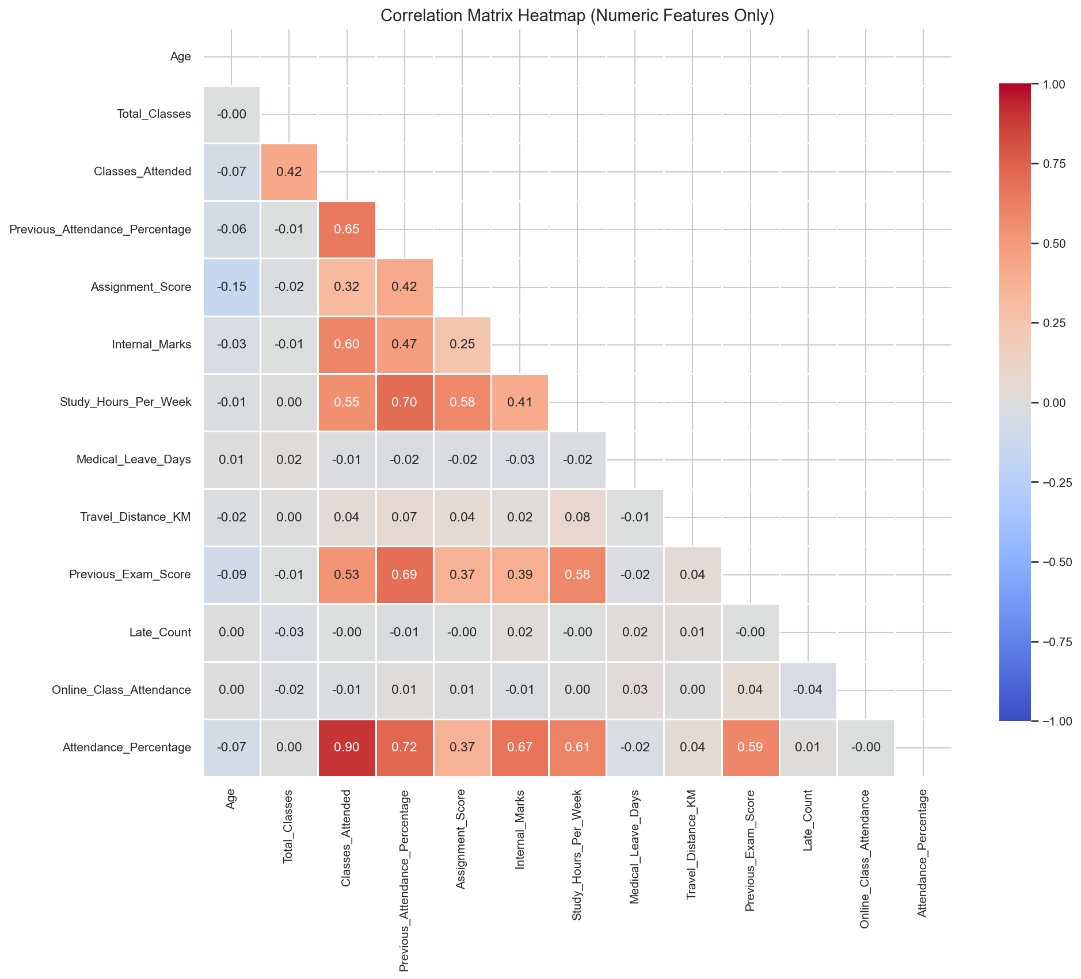
Exploratory Data Analysis
11 visualizations · Correlation analysis
• Mean: 68.67% | Median: 70.00% | Std Dev: 20.21%
• Defaulter: 2,266 records (55.27%) | Regular: 1,834 records (44.73%)
• Subject variation < 1% — attendance is student-driven, not subject-driven
• Prior behavior dominates: Previous_Attendance_Pct (r=0.72), Internal_Marks (r=0.67)
• Logistical factors: Travel_Distance_KM (r=0.04) — no meaningful correlation
⚠ SYNTHETIC DATA — No real student names, roll numbers, or email IDs used. | Slide 9 / 14
Notes:
Key EDA insight: prior academic behavior predicts current attendance. Logistical factors (travel, medical leave, late count) have near-zero correlation. Correlation ≠ causation — especially important for synthetic data.

Slide 10
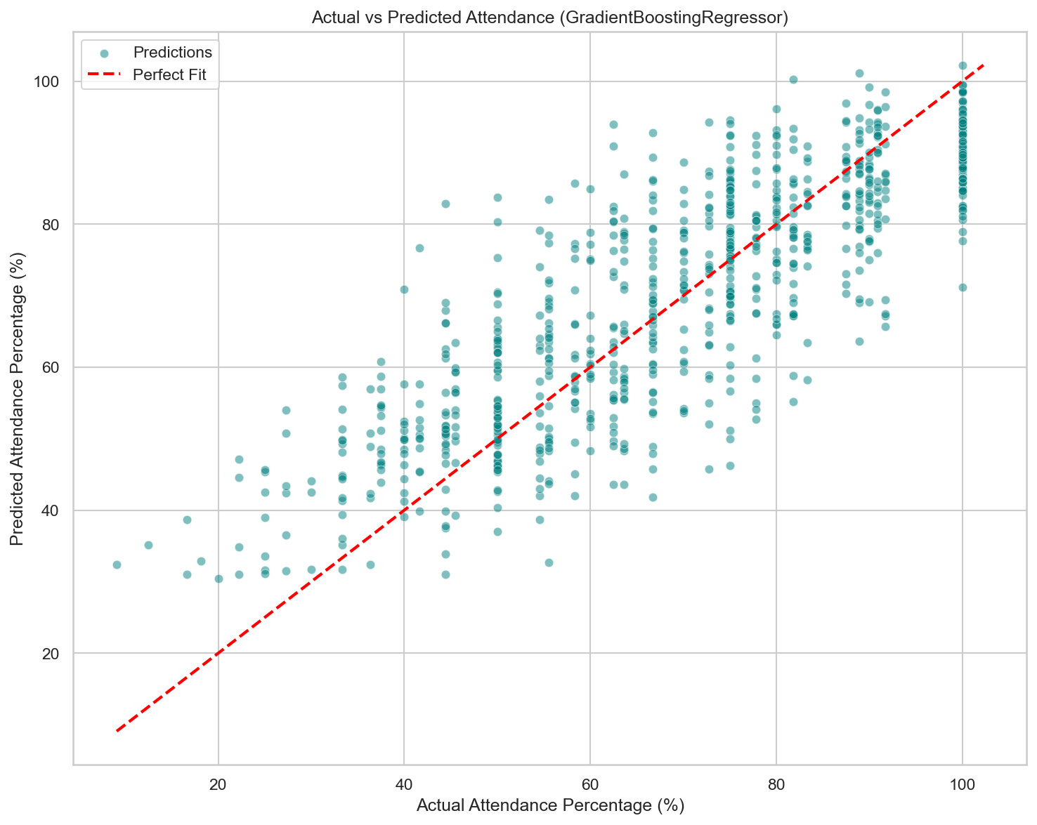
Regression Modelling
Target: Attendance_Percentage (continuous)
4 Models: LinearRegression · DecisionTree · RandomForest · GradientBoosting
Selection Criterion: Lowest RMSE + Highest R²
Model MAE RMSE R²
LinearRegression 9.3679 11.6108 0.6755
DecisionTreeRegressor 10.2138 12.8313 0.6037
RandomForestRegressor 9.1673 11.4357 0.6852
GradientBoostingRegressor 9.1786 11.3952 0.6874 ← BEST
⚠ SYNTHETIC DATA — No real student names, roll numbers, or email IDs used. | Slide 10 / 14 | Source: outputs/regression_model_results.csv
Notes:
GradientBoosting achieves lowest RMSE (11.3952) and highest R² (0.6874). R² = 0.6874 means 68.74% of variance explained. Remaining ~31% comes from features with near-zero correlation (travel, medical, late count).

Slide 11
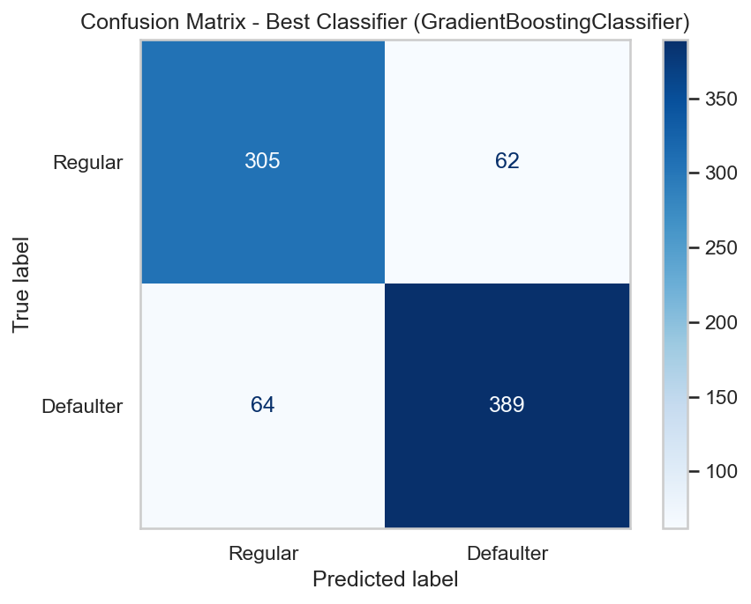
Classification Modelling
Target: Attendance_Status — Regular / Defaulter
4 Models · Selection: Highest F1-Score, then Recall (NOT accuracy alone)
Regular=0 | Defaulter=1 | Stratified 80/20 split
Model Acc Prec Recall F1 AUC
LogisticRegression 0.8390 0.8512 0.8587 0.8549 0.9246
DecisionTreeClassifier 0.8268 0.8659 0.8124 0.8383 0.8841
RandomForestClassifier 0.8451 0.8655 0.8521 0.8587 0.9276
GradientBoostingClassifier 0.8463 0.8625 0.8587 0.8606 0.9189 ← BEST
⚠ SYNTHETIC DATA — No real student names, roll numbers, or email IDs used. | Slide 11 / 14 | Source: outputs/classification_model_results.csv
Notes:
GradientBoosting selected for highest F1 (0.8606). RandomForest has higher ROC-AUC (0.9276) but lower F1 — F1 is the primary criterion for early-warning systems. Recall=0.8587 means we correctly flag ~86% of all actual Defaulters.

Slide 12
Final Model Comparison & Results
Verified from actual CSV output files
All values sourced directly from outputs/regression_model_results.csv and outputs/classification_model_results.csv — no values estimated or fabricated.
▶ BEST REGRESSION MODEL: GradientBoostingRegressor
MAE: 9.1786 | MSE: 129.8510 | RMSE: 11.3952 | R²: 0.6874
Saved: models/best_regression_model.joblib
▶ BEST CLASSIFICATION MODEL: GradientBoostingClassifier
Accuracy: 84.63% | Precision: 86.25% | Recall: 85.87%
F1-Score: 0.8606 | ROC-AUC: 0.9189
Saved: models/best_classification_model.joblib
• Gradient Boosting outperforms on both tasks
• Linear/Logistic models are competitive — confirm value of interpretable baselines
⚠ SYNTHETIC DATA — No real student names, roll numbers, or email IDs used. | Slide 12 / 14
Notes:
Consolidate results. Emphasize: GradientBoosting wins both tasks. Margin over RandomForest is small — both are strong ensemble methods. Both model pipelines are saved and ready for reuse.

Slide 13
Limitations and Future Scope
LIMITATIONS:
• Synthetic data — may not fully reflect real student behavior
• No causal analysis — correlations identified, not proven causes
• No temporal modeling — period totals, not week-by-week trends
• External factors absent: health, family, income not captured
• Retraining required before any real deployment
FUTURE SCOPE:
• Time-series LSTM for week-by-week deterioration detection
• SHAP explainability: WHY is a student flagged as Defaulter?
• Multi-class: Regular / At-Risk / Critical-Defaulter
• Streamlit dashboard for real-time teacher/HOD alerts
• Real data integration with proper institutional consent
⚠ SYNTHETIC DATA — No real student names, roll numbers, or email IDs used. | Slide 13 / 14
Notes:
The most significant limitation is synthetic data. But this is also the project's ethical strength. SHAP explainability is the most impactful near-term future scope for real institutional deployment.

Slide 14
Conclusion
Phases 0–5 Complete
• Synthetic dataset: 205 students · 4,100 records · 25/25 validation checks passed
• EDA: prior academic behavior dominates; logistical factors show near-zero correlation
• Best Regression: GradientBoostingRegressor | RMSE: 11.3952 | R²: 0.6874
• Best Classification: GradientBoostingClassifier | F1: 0.8606 | Recall: 0.8587
• Both model pipelines saved (.joblib) and ready for deployment or retraining
• Zero real student data — ethically compliant and safe for public submission
"This project demonstrates that a complete, production-quality attendance prediction system can be built ethically, using synthetic data that mirrors real-world statistical properties — without compromising any student's privacy."
⚠ SYNTHETIC DATA — No real student names, roll numbers, or email IDs used. | Slide 14 / 14 | Thank You
Notes:
Conclude with two key takeaways: (1) Technical: GradientBoosting ensemble methods consistently outperform simpler models on mixed-feature attendance data. (2) Ethical: synthetic data is a viable, responsible substitute for real student records in academic ML projects. Thank the audience and invite questions.

