Slide 1



AIRBNB
DATA ANALYSIS
USING TABLEAU

Slide 2

ABOUT
The Airbnb Data Analysis project utilizes data sourced from Kaggle to explore and anaylze key trends and insights with Airbnb properties using Tableau. Using Tableau, this project provides a comprehensive analysis of:
The types pf rooms available in different regions.
Regional distribution of properties and the areas with higher concentration of listings.
Host activity, including the number of properties managed and their availability throughout the year.
Pricing patterns, enabling a clear comparison of property costs across different region and room types.

Slide 3
SKILLS
Tableau
Tableau Public
Microsoft Excel

Slide 4
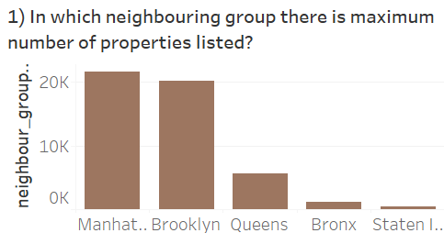

Slide 5
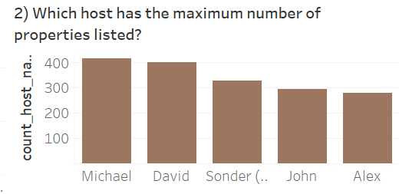

Slide 6
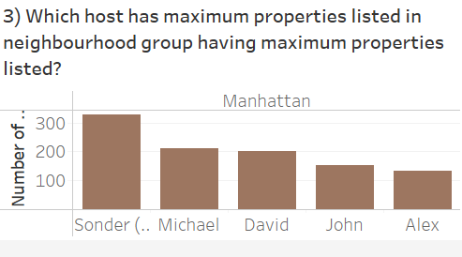

Slide 7
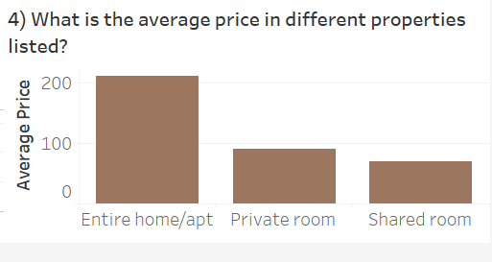

Slide 8
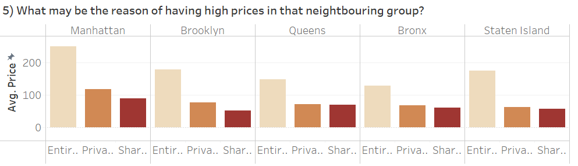

Slide 9
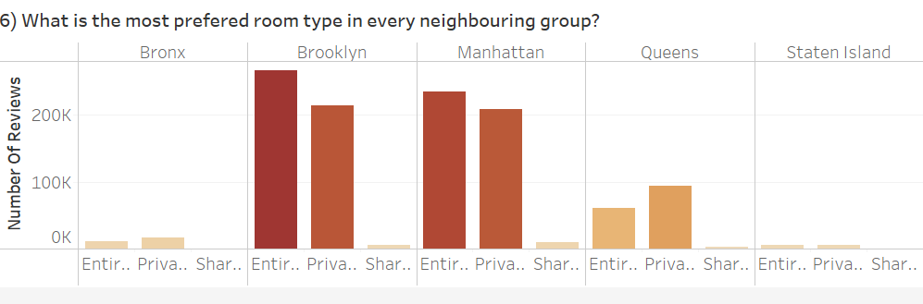

Slide 10
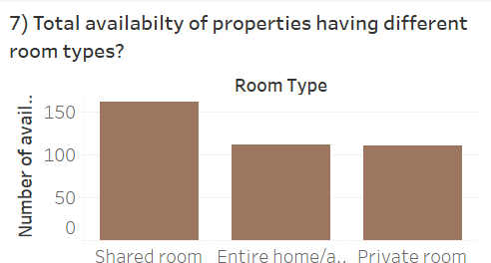

Slide 11
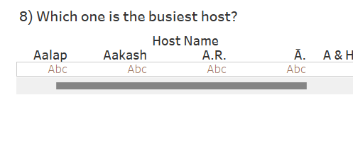

Slide 12
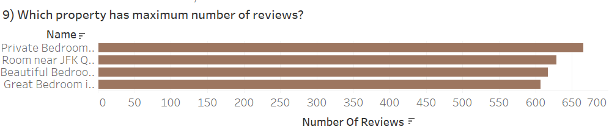

Slide 13
Thank
You

