Slide 1

SRUSHTI CONSULTING
True Faith and Dedication to Success
Human Resource Consulting Firm

Slide 2

About the Company
Shrusti Consulting is a Human Resource consulting firm focused on delivering value to clients and partners through flexible HR services based on market demand.

Slide 3
Our Approach
• People-focused HR solutions
• Strengthening human capital
• Knowledge-driven workforce
• End-to-end HR services
• Specialized for Manufacturing, Engineering, Automotive, and FMCG industries

Slide 4

Payroll Management Services
• Employee Master Data Management
• Attendance, Leave & Deductions
• Payroll Processing
• Statutory Deductions & Compliance
• Salary Disbursement
• Full & Final Settlement
• Reimbursement Processing
• Payroll Reports & MIS
• Compliance & Audit Support

Slide 5

Recruitment Support Services
• Manpower Planning Support
• Talent Sourcing & Mapping
• Candidate Screening & Shortlisting
• Interview Coordination
• Offer & Negotiation Support
• Onboarding Follow-Up
• Campus & Fresher Hiring
• Recruitment MIS

Slide 6
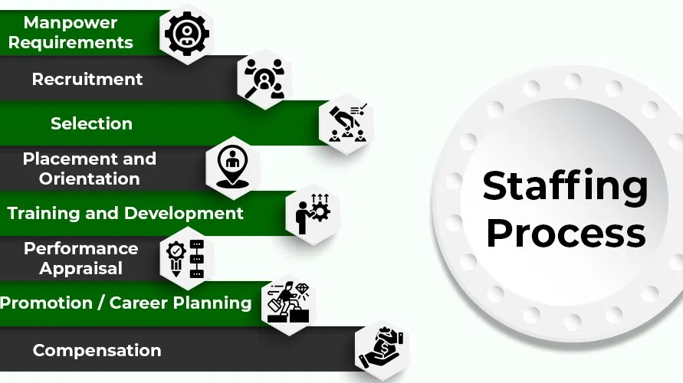
Staffing Support Services
• Temporary & Contract Staffing
• Third Party Payroll Services
• Project-based Staffing
• Blue Collar & Industrial Staffing
• White Collar Staffing
• Campus & Trade Institute Staffing
• Statutory Compliance Management

Slide 7

Statutory Compliance Services
• Labour Law Compliance
• EPF, ESI, PT & LWF Compliance
• Minimum Wage Compliance
• Statutory Records Maintenance
• Contract Labour Compliance
• Factory Licensing
• Monthly / Quarterly / Annual Returns
• Audit & Inspection Support

Slide 8
Thank You
Shrusti Consulting
True Faith and Dedication to Success

