Slide 1


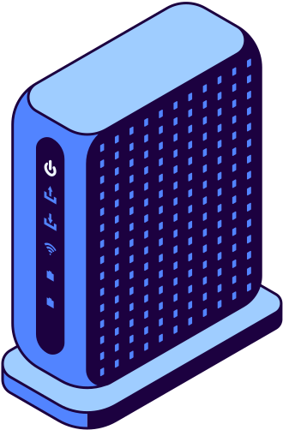
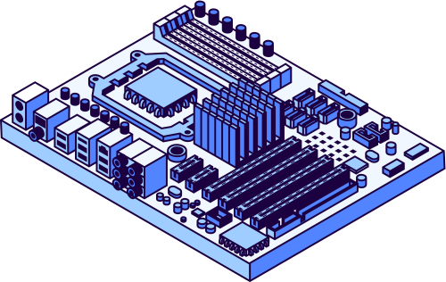


EMERGILANE
AN ADAPTIVE EMERGENCY CORRIDOR CUM TRAFFIC INTELLIGENCE SYSTEM

Slide 2



Project Overview
A smart traffic management system that prioritizes emergency vehicles at intersections using real-time detection and signal control. Dynamically overrides traffic lights and applies priority logic to handle multiple vehicles. Built using ESP32 and Bluetooth communication, it ensuring faster and conflict-free clearance. Designed as a scalable solution for smart city infrastructure.

Slide 3
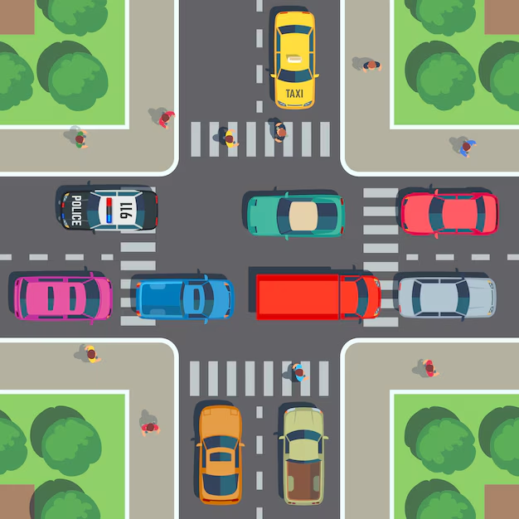
Critical Challenge in Urban Traffic
Emergency vehicles often get delayed at traffic intersections due to congestion and fixed-timer signals. These systems cannot adapt to real-time situations or prioritize urgent vehicles. The problem becomes worse when multiple emergency vehicles arrive simultaneously, with no mechanism to decide priority. This leads to critical delays, increasing the risk to lives and public safety.

Slide 4
Objective of our Project
Efficiently manage traffic flow at intersections using a smart control system
Provide immediate priority and clear passage for emergency vehicles
Pre-clear the lane before the emergency vehicle arrives to prevent blockage
Implement a priority mechanism to handle multiple emergency vehicles simultaneously without conflict

Slide 5
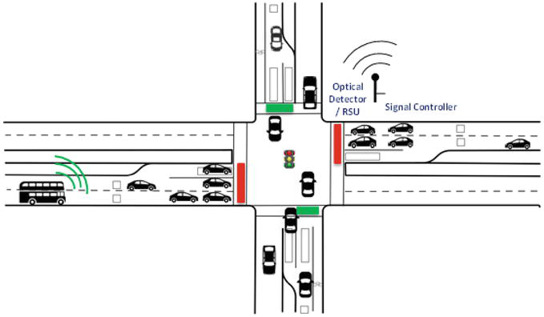
Proposed Solution
Implemented using an ESP32 microcontroller to control traffic signals
Emergency vehicles transmit Bluetooth signals via mobile devices
ESP32 detects signals and identifies the approaching direction
Traffic lights are overridden in real-time through programmed logic
Priority is determined using seriousness, signal strength and detection timing.
System ensures lane clearance and sequential vehicle handling through embedded control logic

Slide 6
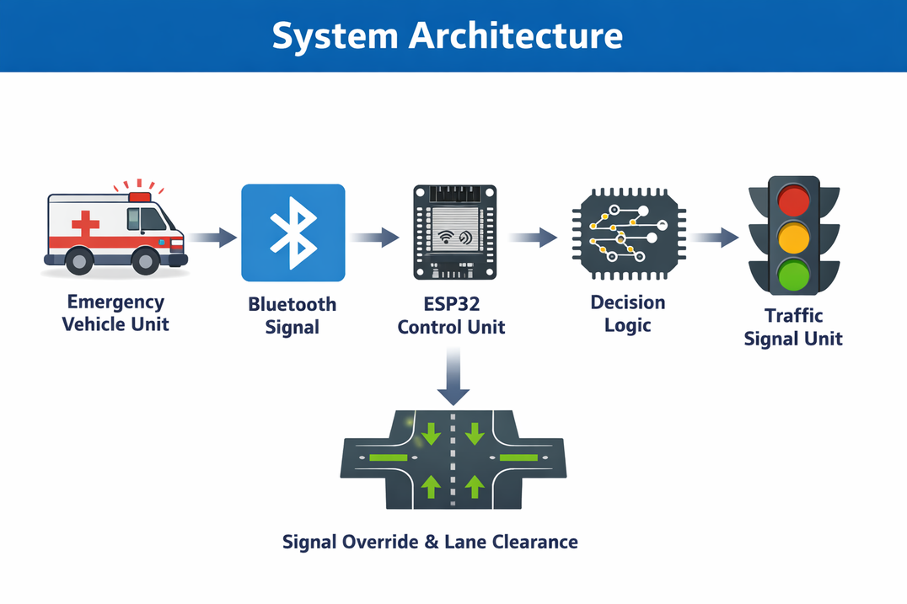
System Architecture
System Architecture:
Emergency Vehicle Unit: Mobile device transmitting Bluetooth signal
Communication Layer: Bluetooth interface for real-time signal detection
Control Unit: ESP32 microcontroller processes inputs and applies logic
Decision Module: Priority algorithm based on signal strength & timing
Traffic Signal Unit: LED-based signals controlled by ESP32
Output Action: Dynamic signal override and lane clearance at intersection

Slide 7
Priority Logic:
--Emergency Severity Level (Highest Priority): Critical cases are always prioritized first
--Distance to Intersection: Among same severity, the closer vehicle gets priority
--Pre-Clearance Status: Routes that can be cleared faster are preferred
--Arrival Timing: Used as a final tie-breaker if conditions are equal

Slide 8
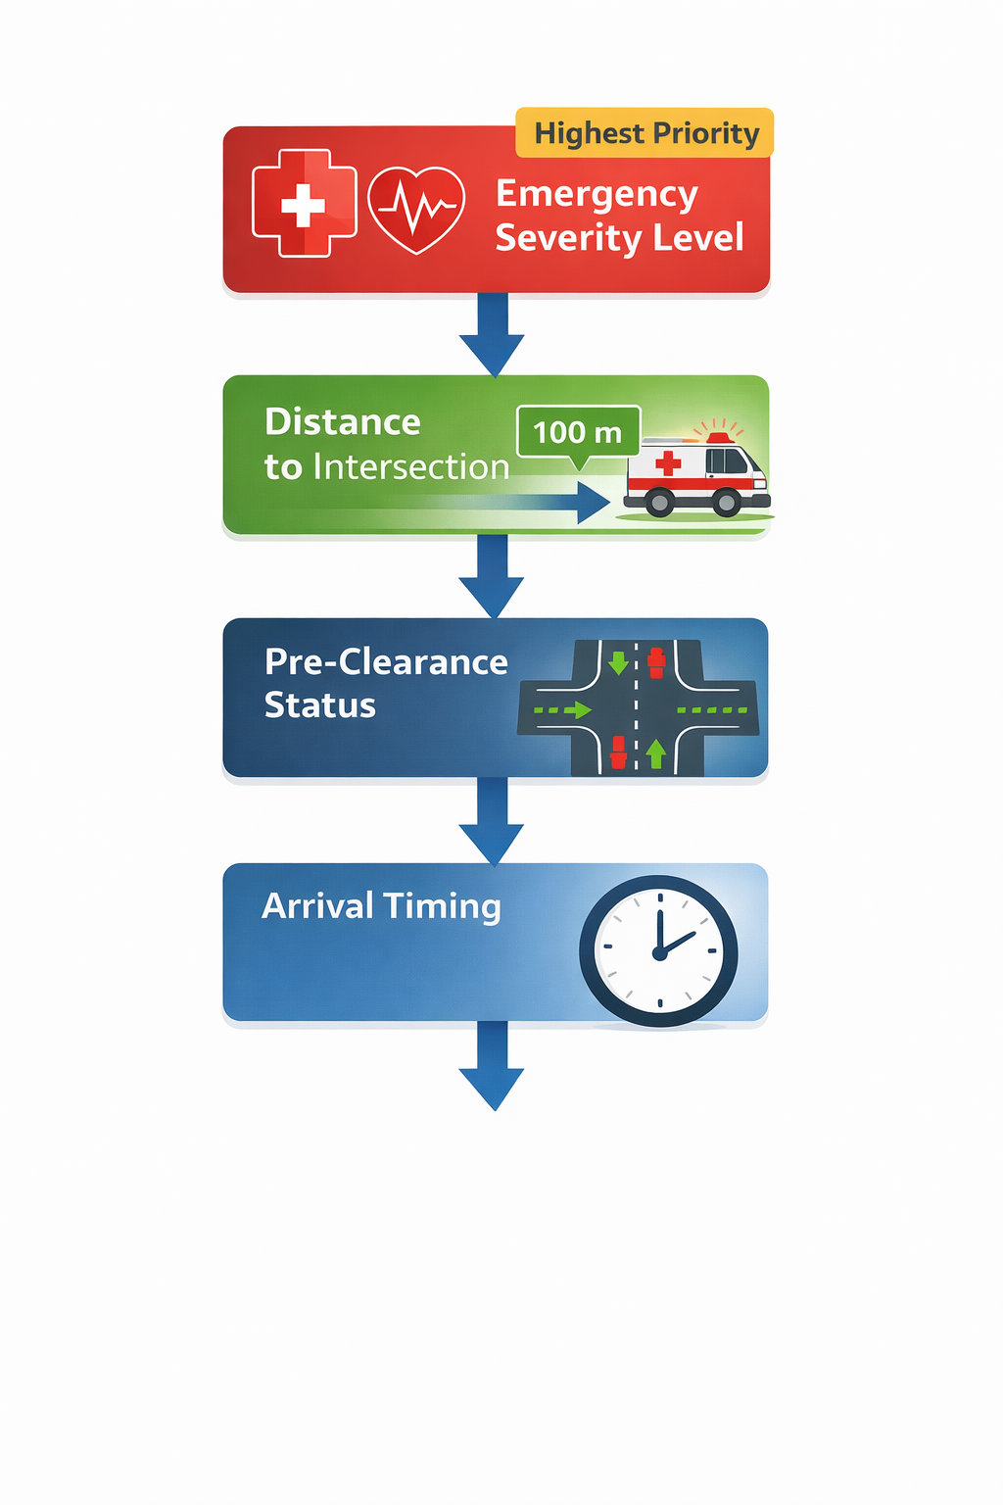

Slide 9
TECH STACK USED:
1.Arduino IDE
2.Streamlit
3.nRF connect’
Python

