Slide 1
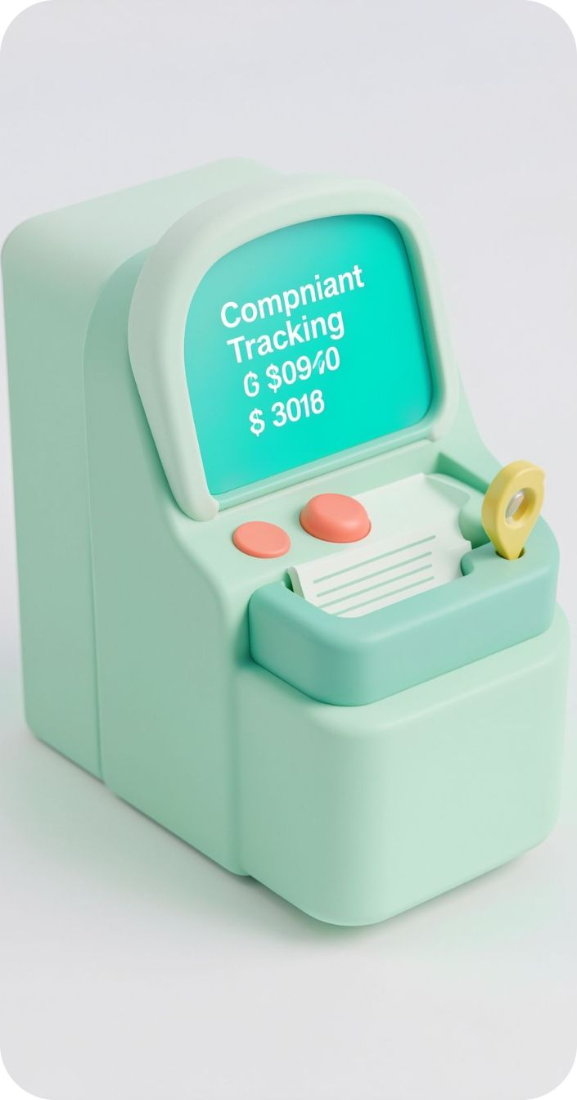

PROBLEM STATEMENT 78
HACKATHON PROTOTYPE
SafeTrack
Smart Online Complaint Tracking and Emergency Escalation System
A secure platform to submit, track, and manage complaints with voluntary location sharing and emergency support.
Team: Pragna Sree Allu · B.Shruthi · B.Indu · R.Lekha Reddy
Web Development · MERN Stack · Social Impact & Public Safety

Slide 2




WHY IT MATTERS
THE GAP
Complaint handling is hard to see, hard to trust, and harder to escalate
Hard to see
Sensitive by design
Traditional processes can create delays and limited status visibility.
Sensitive complaints need confidentiality, careful access control, and clear guidance.
Hard to trust
Accountable records
Judges should see the gap: transparency for users, organized records for authorities, and safety-aware handling for urgent reports.
People may not know whom to contact when an incident is urgent.
Manual records make tracking, accountability, and prioritization difficult.

Slide 3







THE PLATFORM
One platform connects visibility, safety guidance, and authorized case management
Visibility & access
Safety guidance
Case response
Unique complaint ID; Pending → In Progress → Resolved tracking; QR tracking, timelines, and feedback. English, Telugu, and Hindi interfaces.
Direct phone link to India’s emergency number 112. Police automation only through an authorized, configured service with confirmed success. Voluntary current-location sharing or a manual incident address; evidence uploads; privacy-aware reporting.
Priority classification; escalation reminders; overdue tracking; feedback. Admin analytics; role-based access; duplicate detection with human review.

Slide 4
THE JOURNEY
A visible, permission-aware case timeline
Input | Register, choose an available reporting option, add category/details, and optionally share location or evidence.
Processing | Validate data, authenticate permissions, and store the complaint and history in MongoDB.
Algorithm | Categorize, assign priority, generate an ID, check possible duplicates, and apply escalation rules.
Output | Return the complaint ID, timeline, status updates, and relevant notifications to the user dashboard.
AUTHORIZED STAFF
EMERGENCY BOUNDARY
Review cases, record actions, and flag high-priority complaints.
Direct 112 call link; location sharing is voluntary.

Slide 5

THE BUILD
A practical MERN architecture with explainable safety logic
STACK & ARCHITECTURE
EXPLAINABLE SAFETY LOGIC
Frontend: React.js, Vite, TypeScript, Tailwind CSS, Recharts
Backend: Node.js + Express.js REST APIs
Data & security: MongoDB/Mongoose, JWT, bcrypt, Zod validation, role-based access
Rule-based priority and overdue escalation.
AI-assisted categorization only when configured.
Duplicate detection with human review.
THEORETICAL COMPLEXITY
ARCHITECTURE FLOW
ID lookup ≈ O(1) average
Sort N complaints O(N log N)
Simple text scan ≈ O(N × L)
React Frontend → Express REST API → MongoDB Database
Theoretical estimates, not measured benchmarks.

Slide 6
Demo the journey with sample data — then prove the test surface
DEMO JOURNEY
TESTING CHECKLIST
Registration form → user dashboard → complaint timeline → optional location sharing → admin dashboard → emergency SOS link.
Registration · login · complaint creation · tracking · status updates · role permissions · location permissions · emergency contact links
ILLUSTRATIVE RECORD · SAMPLE ONLY
RESULTS TO VERIFY
ST-2026-001
[Measured response time] · [Test pass rate] · [Other verified result]
Category: Public Safety · Status: In Progress · Priority: High
Location: User-provided sample location · Time: Sample timestamp
IMPACT
Better visibility, more organized case management, faster identification of urgent reports, and improved accountability and accessibility. Label all records and metrics as sample until verified.

Slide 7


NEXT HORIZON · TRUST BEFORE SCALE
Build trust now; scale safety responsibly next
Prototype scope
Next
Complaint submission and tracking; role-based dashboards; emergency guidance. During the demo, mark completed versus planned features.
After authorization: verified police/government APIs; configured SMS, email, or push notifications; AI categorization evaluated with human review.
Trust
Scale
Stronger evidence protection; audit monitoring; security/privacy/usability testing; expanded accessibility and language support.
Indexes, pagination; secure cloud deployment, monitoring, backups, access logging; support for more institutions and complaint categories.
SafeTrack aims to make complaint handling more transparent, accessible, and safety-focused.

