Slide 1
Artificial Intelligence
Project: Artificial Neural Networks
Submitted By:
Shruthi Madishetty
Stephanie Duckworth
Submitted To:
Dr. Omar El Ariss

Slide 2
Abstract
Summary:
Created Artificial Neural Network(ANN) Architecture
Model Creation , Training the Model
Image Classification based on inputs
Statistics of various Training methods/values and disaster calculation.
Selection of wrong No. of “Hidden Layers”
Creating “Custom Dataset” and Classification based on “pixel distribution”
Classifying our own images

Slide 3
Introduction
Artificial Neural Network(ANN) Simple Architecture.
Key Components
Some of the algorithms used
Code Implementation and Distribution

Slide 4
Neural Networks
Artificial Neural Networks (ANN) or Connectionist Systems are inspired by Biological Neural Networks.
ANN is a machine learning approach that models Human Brain that consists of No. of Artificial Neurons.
Group of nodes interconnected and form layers, to

Slide 5

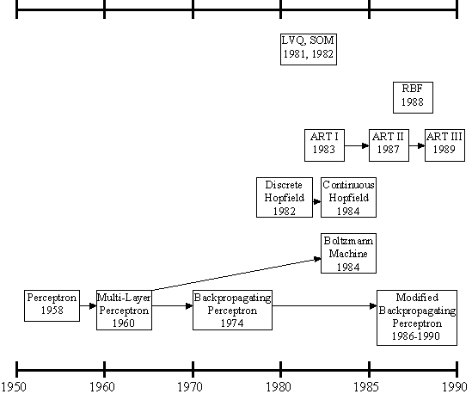
History

Slide 6
Key Components:
Neurons:
These are Building blocks of NN.
Cells / Perceptron / Units or Nodes(Technical Terms)
Operations of Neuron:
Receives input from many other neurons.
changes its internal state (activation) based on the current input.
sends one output signal to many other neurons, possibly including its input neurons (recurrent network).

Slide 7
Key Components:
Layers:
Input Layer
Output Layer
Hidden Layer(s)
Operations / Algorithms:
Activation function
Feed Forward
Back Propagation
Calculating Loss

Slide 8
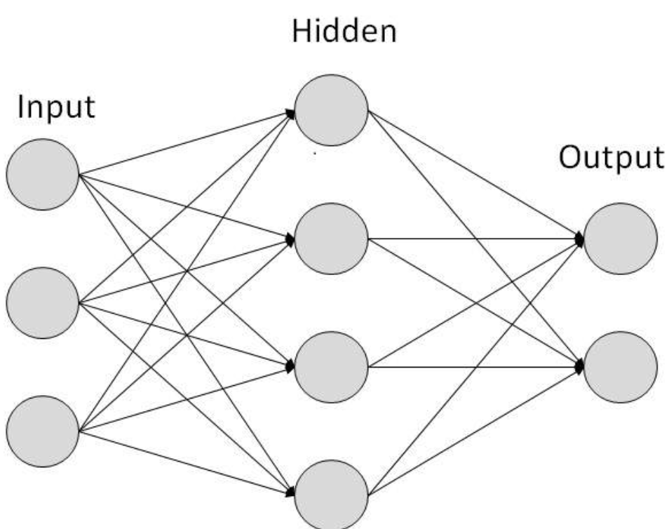
Simple Architecture

Slide 9
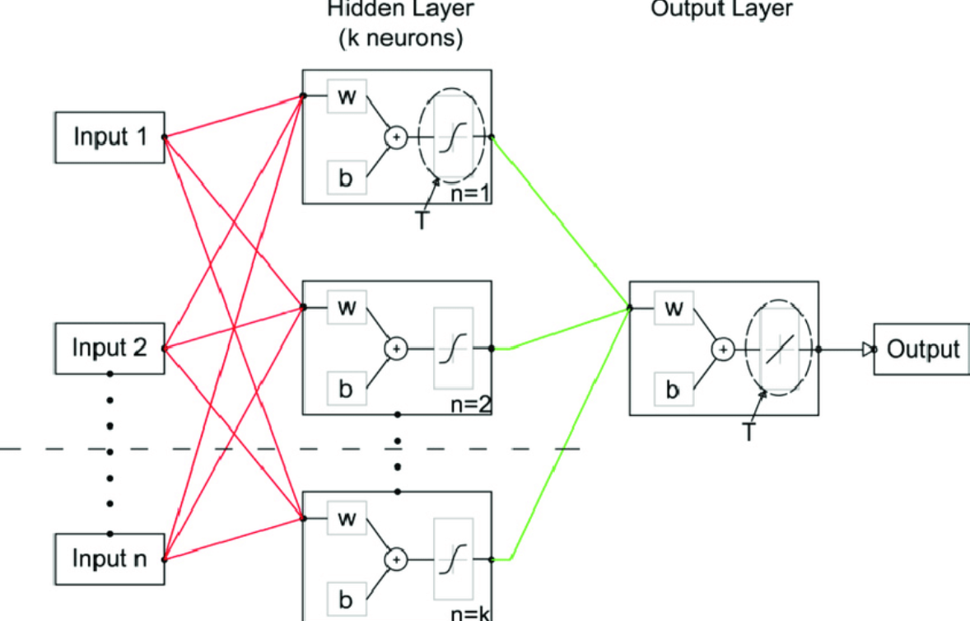
With Weights, Bias and Activation

Slide 10
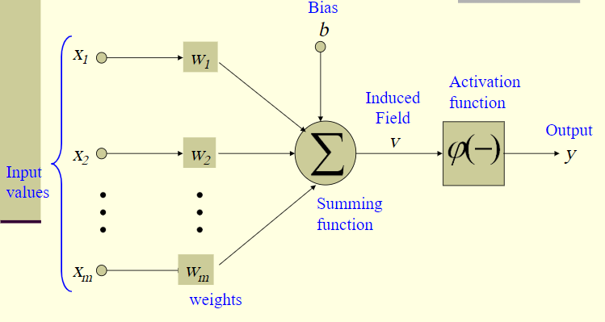
Neuron Diagram

Slide 11

Attributes Of Neuron:
Inputs : X1, X2, X3………..Xm
Weights: W1, W2, W3………….Wm
Bias: b
Summing function : ∑ = X₁w₁+X₂w₂ + ….+X_{m}w_{m} = y
Induced Field: V = y + b
Activation Function: Choice of Activation Function determines the Neural Model.
Ex : Step Function, Ramp Function, Sigmoid Function, Gaussian Function.
For Sigmoid function.

Slide 12
Common Configurations:
Selecting “Hidden Layers”.
Selecting No. of “neurons” in each Hidden Layer.
Feed Forward Neural Networks (FFNN)
Back propagation or Loss calculation Algorithms.

Slide 13
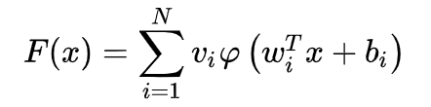
Feed Forward Neural Network
Each node is connected to Every node in next layer.
There is no connection between the nodes in same layer.
Starting from Input Layer , forward through all the Hidden Layers till we reach Output Layer.
Calculate the sum of weights , bias and forward to the connected output nodes.

Slide 14
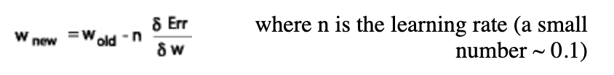
Back Propagation
It’s a Training Algorithm. (Training = Adjusting weights)
Consists of these steps
FFNN
Calculate the error
Back propagate to the back layers
Finetune this recursively till we reach expected Output values.
Adjusting weights with formula

Slide 15
Implementation
Step | Example
1. Set the research goal. | To predict how heavy traffic will be on a given day.
2. Make a hypothesis. | Weather forecast is an informative signal.
3. Collect the data. | Collect historical traffic data and weather on each day.
4. Test your hypothesis. | Train a model using this data.
5. Analyze your results. | Is this model better than existing systems?
6. Reach a conclusion. | Should (not) use this model to make predictions, because of X, Y, and Z.
7. Refine hypothesis and repeat. | Time of year could be a helpful signal.
Scientific Method
Machine Learning
Appropriate Approach?
Neural Network

Slide 16
Implementation
Type of ML Problem | Description
Classification | Pick one of N labels
Regression | Predict numerical values
Clustering | Group similar examples
Association rule learning | Infer likely association patterns in data
Structured output | Create complex output
Ranking | Identify position on a scale or status
Machine Learning
Classification Problem
Training Set
Testing Set
Supervised
Training Set Labels

Slide 17
Related Work
Real Time applications:
Foreign Exchange System in Citi Bank in London
Medical report analysis
Detection of cancer cells.
Detecting explosions in suitcases.
Credit card fraud detection

Slide 18
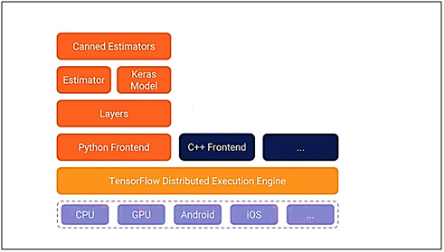
Related Work
Framework
TensorFlow
Keras
High-level API
User Friendly
Common Use Cases

Slide 19
Data Collection
Label | Class
0 | T-shirt/top
1 | Trouser
2 | Pullover
3 | Dress
4 | Coat
5 | Sandal
6 | Shirt
7 | Sneaker
8 | Bag
9 | Ankle boot
Fashion MNIST
Low Resolution
Grayscale
28x28 pixels array
Value – [0,1,2,…,255]

Slide 20
Method
Transform data for the ML problem
a clear description of your algorithm

Slide 21
Results
Training Results
Classification Results

Slide 22
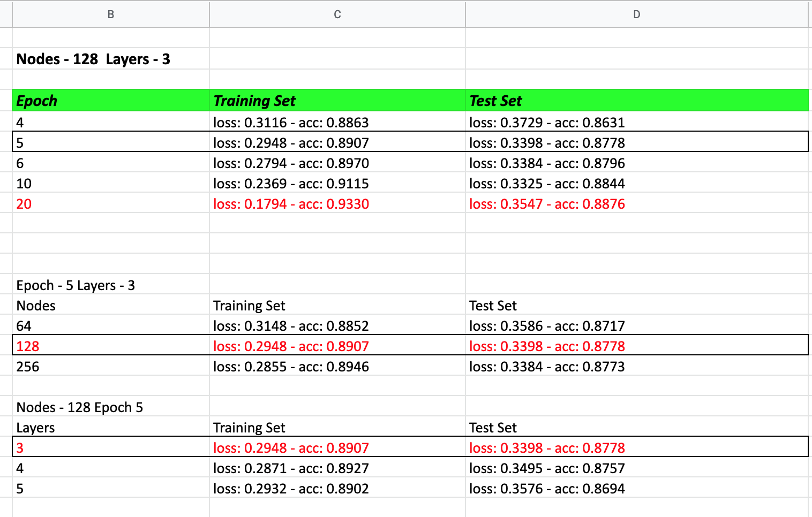
Statistics – Model Training:

Slide 23
References
Intellipaat, “TensorFlow and its Installation on Windows,” Intellipaat. [Online]. Available: https://intellipaat.com/tutorial/machine-learning-tutorial/tensorflow-andits-installation-on-windows/#_tensor_flow_archi.
https://www.tensorflow.org/guide/keras

Slide 24
Questions?

