Slide 1
Introduction
Objective
Help authorities to reduce the accidents
Effectively prevent serious accidents and injuries

Slide 2
Data Preprocessing
Converting all the object type to numerical type
Data missing values are replaced with most frequent used value
Merge similar cases

Slide 3
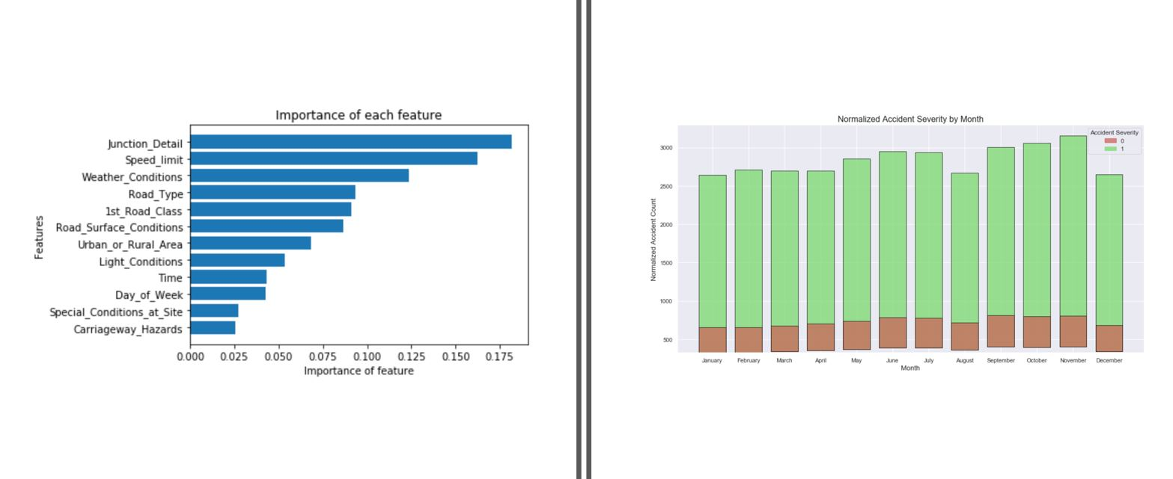
Data Visualization

Slide 4
Algorithms
K nearest neighbor
Random forest
Logistic regression
Decision tree

Slide 5
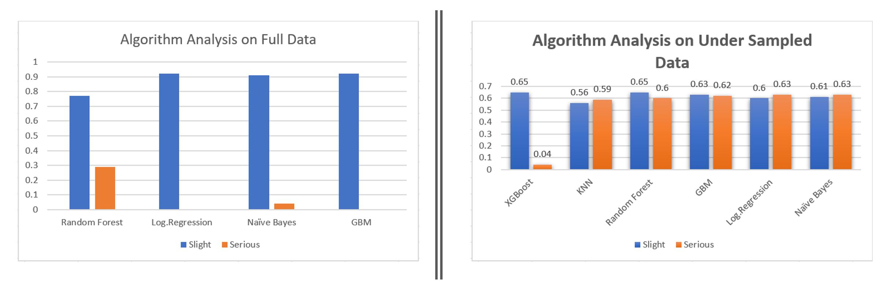
Comparison analysis

Slide 6
Conclusion
Evident that the weather has an impact on the accidents along with the driver’s state of mind while driving the vehicle.

