Slide 1
Team Orion
Ayan Agayeva, Berenice Moreno-Perez, Montana Nicholson, Shruthika Uduthuri
April 3, 2026
ORION
Capstone
Project Demo
CS451R_Software_Engineering_Capstone

Slide 2
Team Orion
Team & Responsibilities
AA
BM
MN
SU
Ayan Agayeva
Berenice Moreno-Perez
Montana Nicholson
Shruthika Uduthuri
Front-End Developer & Project Manager
Database Architect
Backend Developer w/ API Focus
Backend Developer w/ LLM Focus
Leads UI development and project coordination. Builds the React interface and manages sprint planning.
Designs the database schema, manages data models, and ensures efficient and scalable data storage.
Builds the server-side logic and RESTful API endpoints that connect the frontend to the database.
Builds the back-end of the application and integrates large language model capabilities.

Slide 3
Team Orion
Application Overview
Orion is a role-based household budgeting platform designed for families, partners, and roommates to collaboratively manage their finances in a single shared environment. Built with React and an API-ready architecture, Orion is designed to scale from a local prototype to a fully cloud-backed application.
Dashboard
Transactions
Categories
Real-time financial overview — total income, expenses, net savings, budget utilization, and spending by category.
Add and track income and expense entries with type, amount, category, date, and description fields.
Create and manage custom budgeting categories. Transactions auto-reassign when a category is removed.
Savings Goals
Household System
API-Ready Architecture
Define savings targets, contribute funds, and track cumulative progress toward each goal.
Create or join a shared household via generated join codes. Assign roles: Admin, Partner, Roommate, Child.
Layered design isolates the UI from the API layer — backend integration requires no frontend rewrites.
3

Slide 4
Team Orion
User Types & Benefits
Admin
Partner
Roommate
Child
Full household control
Shared financial tracking
Expense coordination
Financial literacy
Full household management
Add and manage own transactions
Track personal expenses
View personal savings goals
Invite members via join codes
View shared household dashboard
View shared household expenses
Track progress toward targets
Manage all categories & transactions
Contribute to savings goals
Add to shared categories
Limited read-only access
Complete financial dashboard
Manage personal categories
Contribute to savings goals
Builds early financial habits
Set & track household savings goals
4

Slide 5
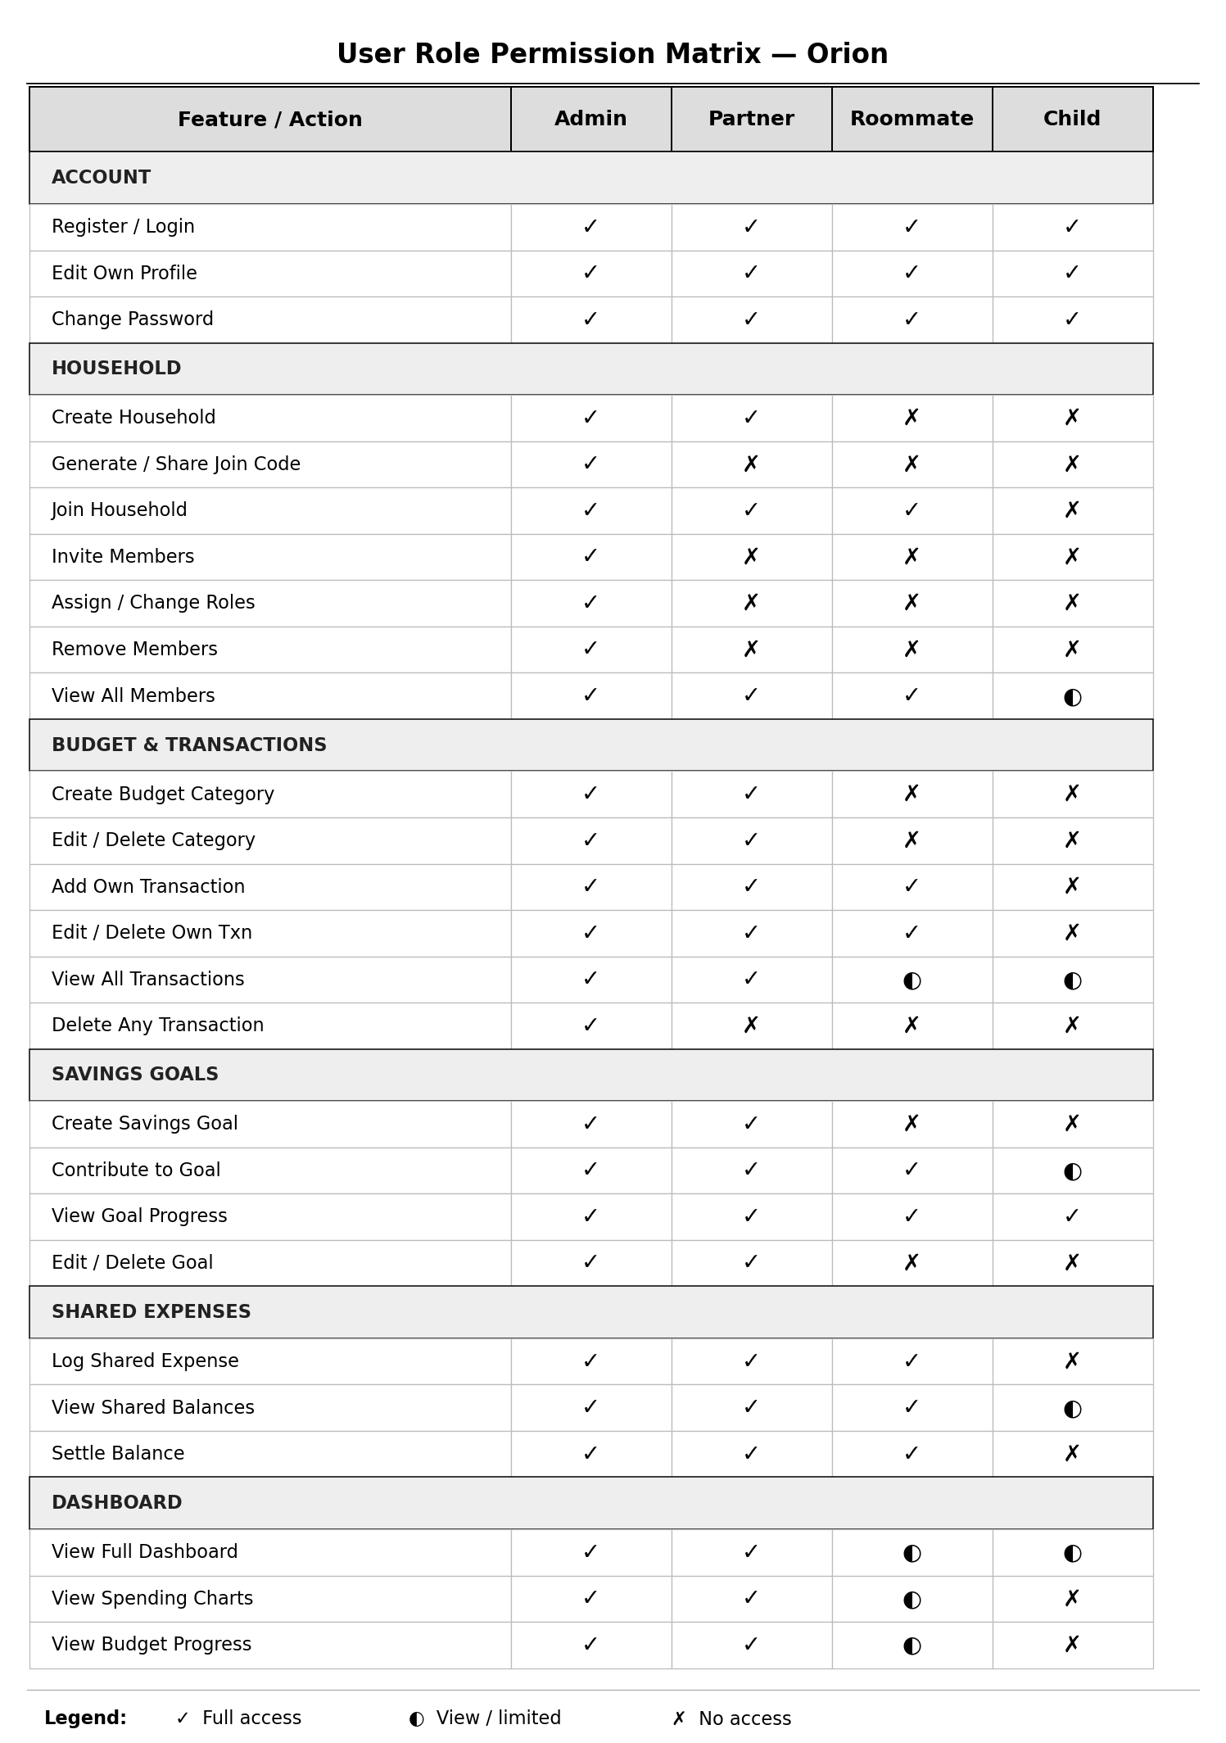
Team Orion
User Role Permission Matrix
Who can do what — access levels by household role
5

Slide 6
Team Orion
Technical Overview
Tech Stack
Architecture
Frontend
React 18 + Vite
UI Pages
Dashboard · Transactions · Categories · Savings · Household
Routing
React Router
↓
Components
State
useOrionStore (custom React hook)
SummaryCards · CategoryBreakdown · RecentTransactions · SavingsGoals
↓
Persistence
localStorage → PostgreSQL (planned)
API Layer
services/api.js — simulated REST endpoints
Styling
Inline styles, component-scoped
↓
Shared Store
API Layer
services/api.js — REST-ready endpoints
useOrionStore.js — global React state
LLM
Budget intelligence (planned)
↓
LocalStorage
Auth
Role-based authentication (planned)
categories_v1 · transactions_v1 · goals_v1
5

Slide 7
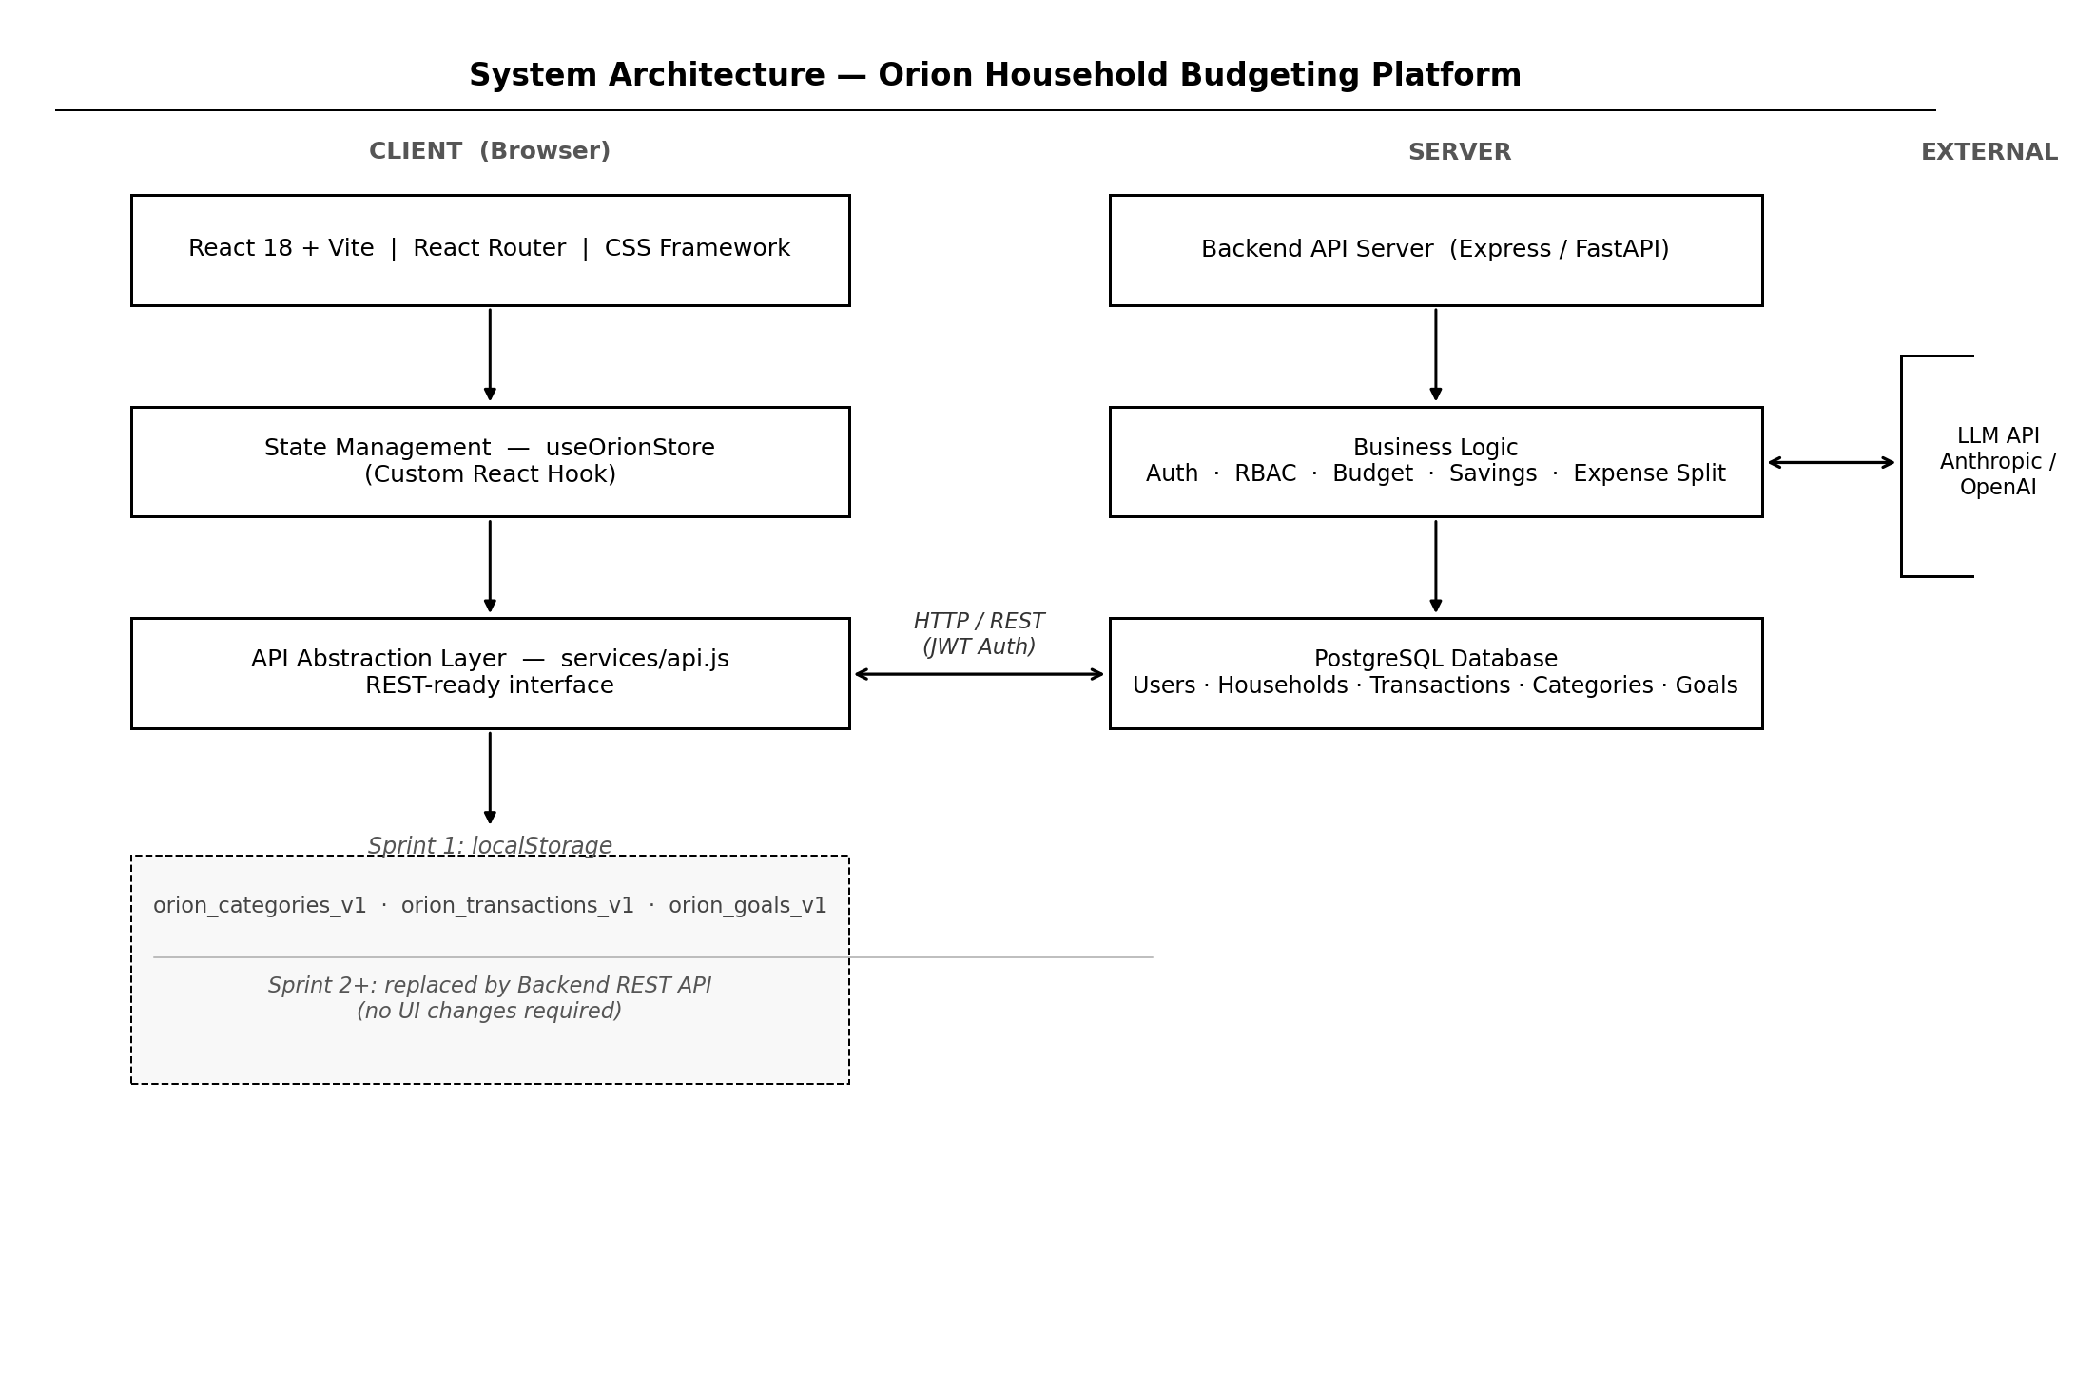
Team Orion
System Architecture Diagram
Full-stack layers — client, server, data, and external integrations
7

Slide 8
Team Orion
Prototype Demonstration
Implemented — Sprint 1
Coming Soon — Design Mockups
Dashboard
Authentication
Financial overview — income, expenses, net savings, utilization.
Login, registration, and session management.
Transactions
LLM Insights
Add and remove transactions with full metadata fields.
AI-powered budget recommendations.
Categories
Analytics Charts
Create/delete custom categories with auto-reassignment.
Spending trends and visual reports.
Savings Goals
Define goals, contribute funds, track progress.
Database Backend
PostgreSQL with full multi-user persistence.
Household System
Create, join, and assign roles within a shared household.
Mobile Layout
Data Persistence
Responsive design for phones and tablets.
Data survives page refresh via localStorage.
Figma screens available for all unimplemented features.
6

Slide 9
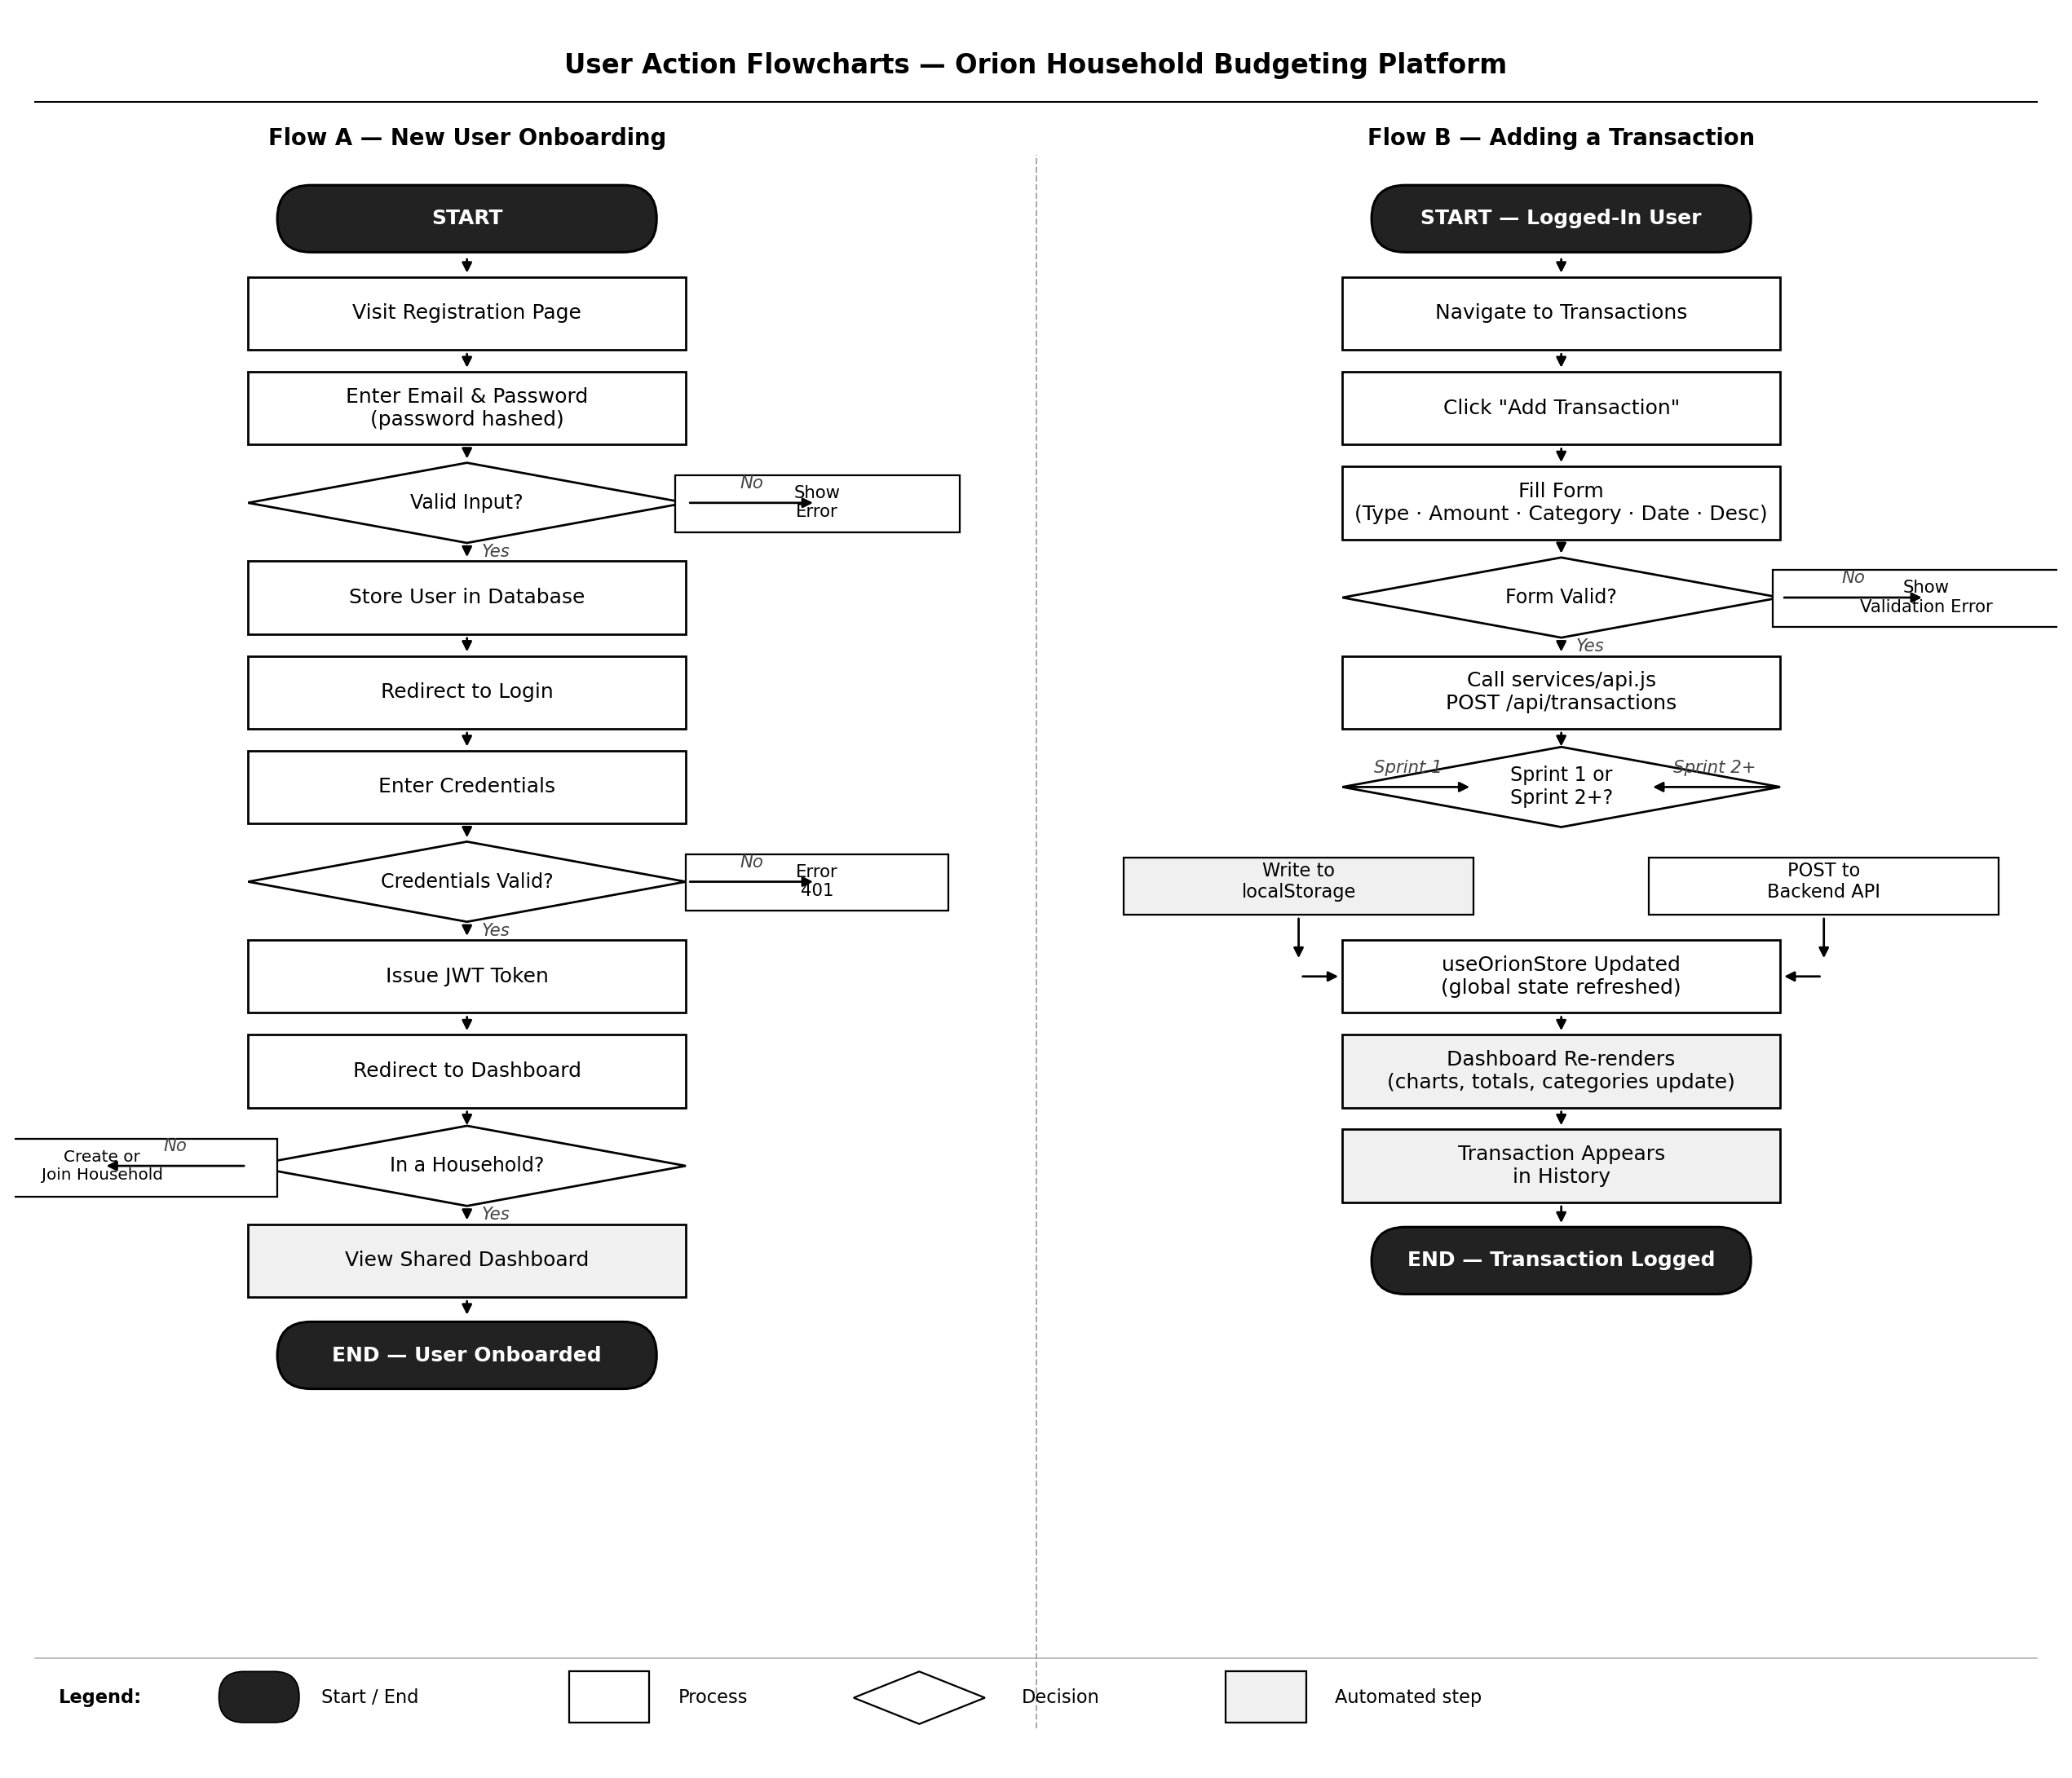
Team Orion
User Action Flowcharts
Flow A: New user onboarding · Flow B: Adding a transaction
9

Slide 10
Team Orion
Documentation Review
Requirements
Design Document
User Stories
Functional & non-functional requirements
Application architecture diagram
Stories for all 4 user roles
User role definitions and permissions
Component hierarchy & data flow
Acceptance criteria per story
Sprint 1 scope and acceptance criteria
Database schema (ER diagram)
Priority ranking (MoSCoW)
API Specification
Test Plan
Project Docs
Endpoint definitions (GET/POST/PATCH/DELETE)
Unit test coverage targets
Codebase README & setup guide
Request & response schemas
Integration test scenarios
Sprint retrospectives
Auth flow (planned)
Manual QA checklist
Tech stack decision log
7

Slide 11
Team Orion
Ayan Agayeva, Berenice Moreno-Perez, Montana Nicholson, Shruthika Uduthuri
April 3, 2026
Thank You
Questions?
Ayan Agayeva · Berenice Moreno-Perez · Montana Nicholson · Shruthika Uduthuri
CS451R_Software_Engineering_Capstone | April 2026

