Slide 1
Cloud Computing Lab (SS 2016) Niharika Mittal Shreyas Bettadapura Shruthi Kukillaya
Assignment 1

Slide 2








Architecture Diagrams
1.2.a
TIER 1
TIER 2
TIER 3
www.ITBlog.com
Browser
Amazon EC2 instance
Amazon EC2 instance
RDS DB instance
Browser
Amazon Route 53
Elastic Load Balancing
Availability Zone 1
Availability Zone 1
Browser
Amazon EC2 instance
Amazon EC2 instance
RDS DB instance standby)
Multi-Zone Auto Scaling group
Availability Zone 2
media.ITBlog.com
Amazon CloudFront
Amazon S3

Slide 3




1.2.b
EC2 Instances (Job Manager)
EC2 Instances (worker)
Availability Zone #1
Client
Processing
Upload
SQS Input Queue
SQS Output Queue
SQS Input Queue
SQS Output Queue
Amazon DynamoDB
Amazon Route 53
Elastic Load Balancing
Mobile client
EC2 Instances (Job Manager)
EC2 Instances (worker)
Availability Zone #2

Slide 4
1.2.c
Elastic Load Balancing
EC2 instance
EC2 instance
security group
security group
Multi-Zone Auto Scaling group
security group
security group
Availability Zone #1
Availability Zone #2

Slide 5




1.2.d
Client
EC2 instance
Client
Elastic Load Balancing
security group
Amazon S3
Spot Instances
Auto Scaling group
Client
Availability Zone
Amazon Elastic Map Reduce

Slide 6

1.2.e
TIER 1
TIER 2
LOAD
Browser
Javascript SDK
Browser
Amazon DynamoDB
Browser

Slide 7
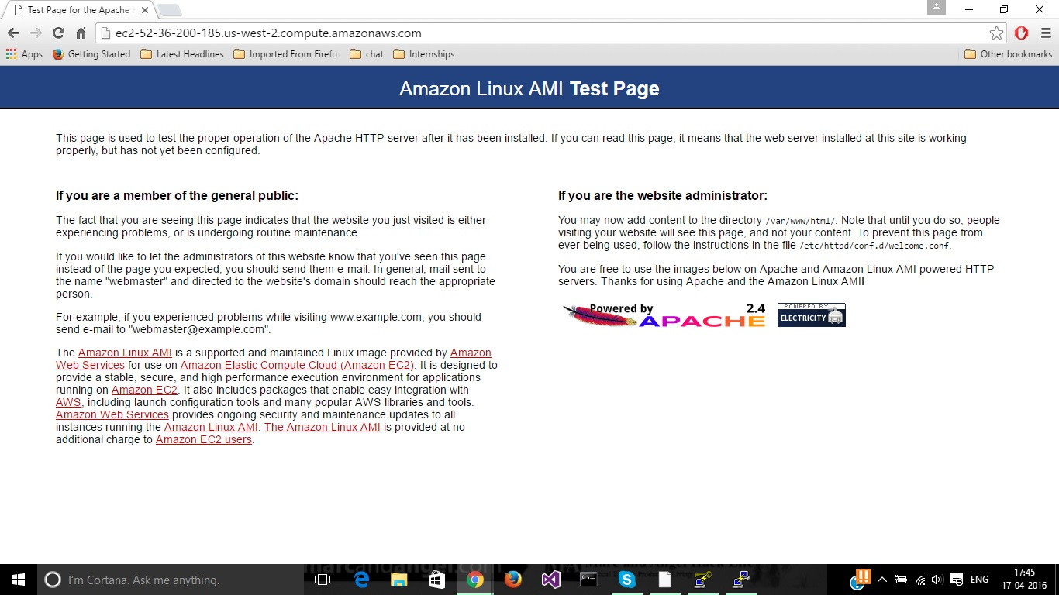
1.3

Slide 8
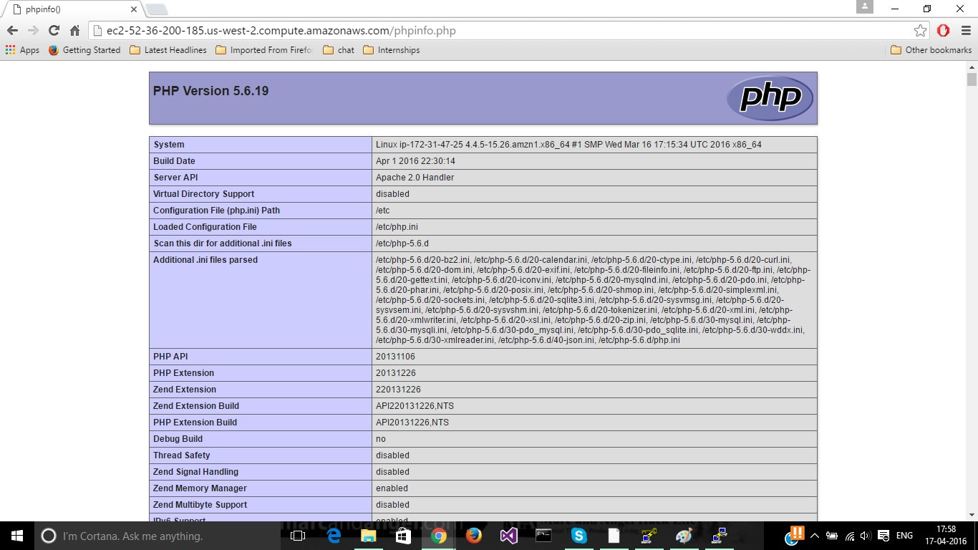

Slide 9
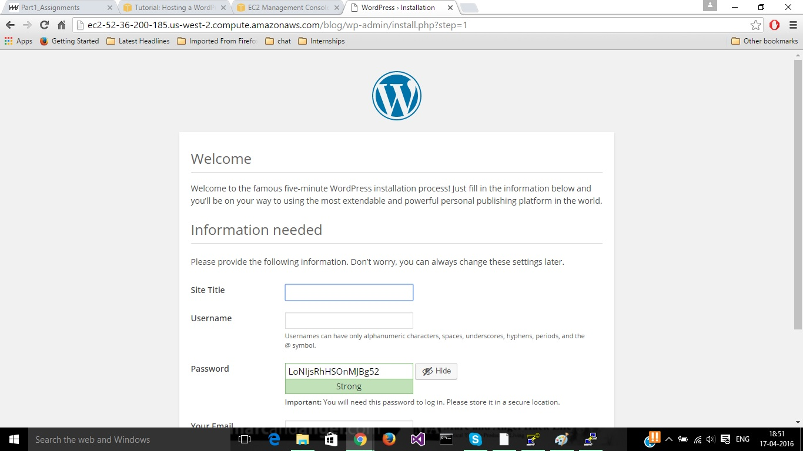

Slide 10
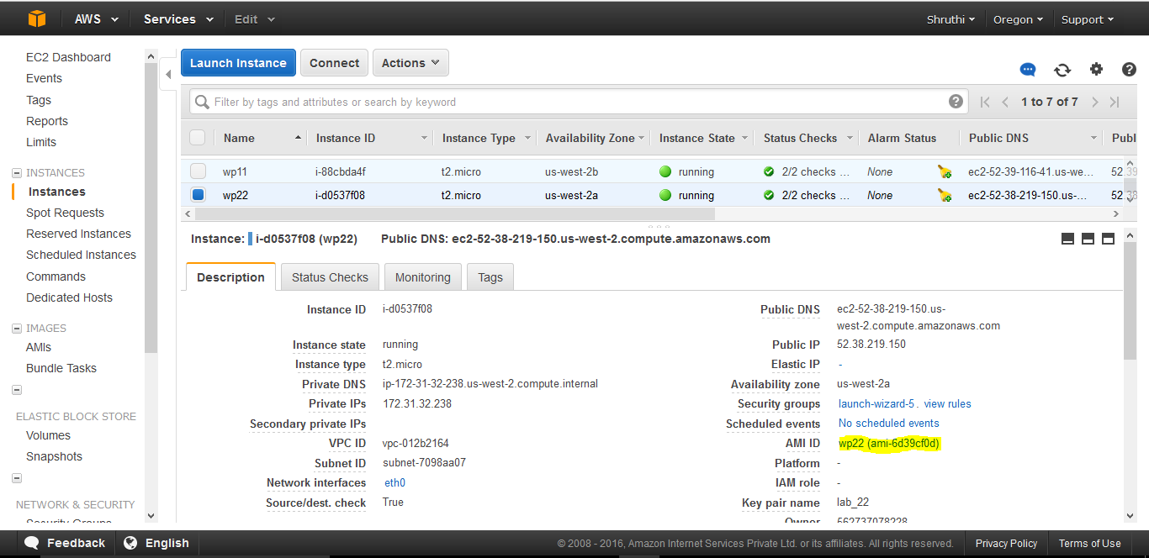
1.4

Slide 11
1.4
Steps were followed to create a elastic load balancer (ELB) and instances to be associated with the load balancer was specified.
It does not make sense to load balance between WordPress instances which have separate database in the background. Reason is each of the instances are served with different separate database and thereby do not have data in common.

Slide 12
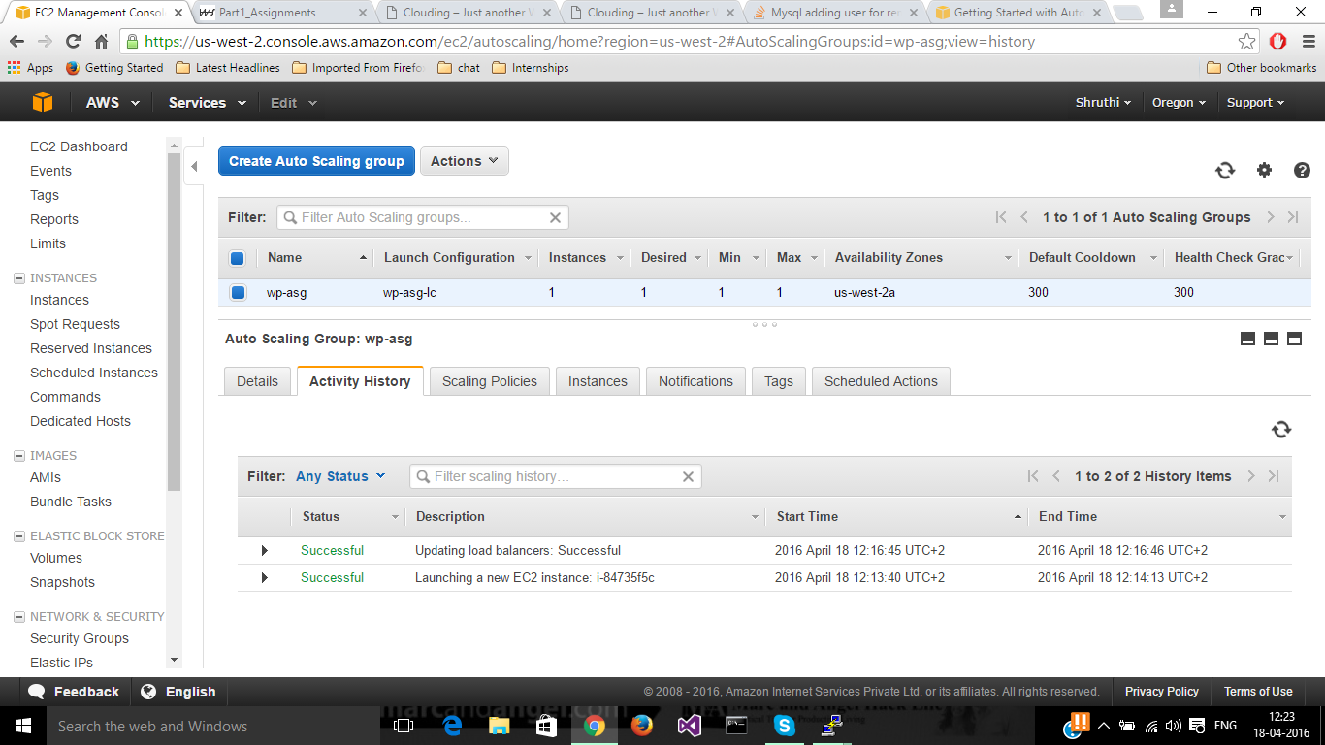
1.5

Slide 13
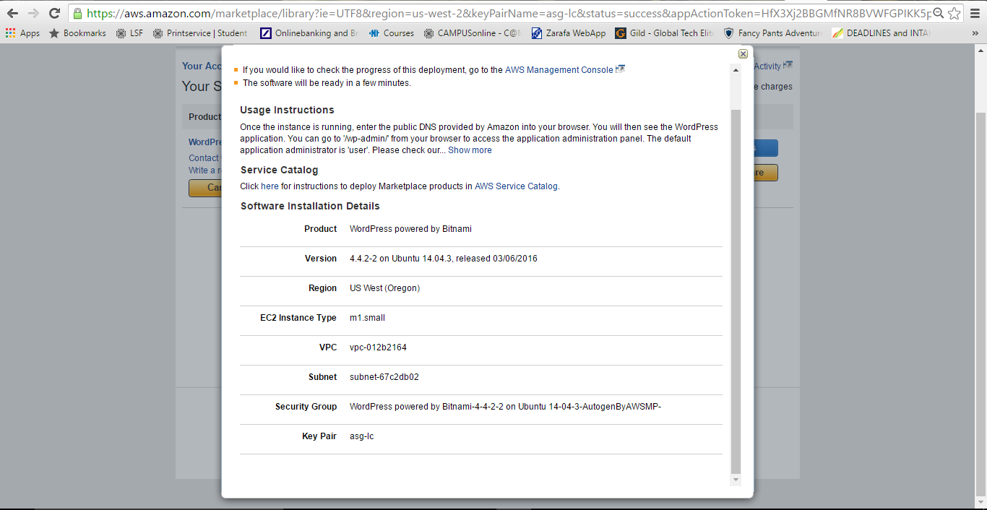
1.6
Bitnami WordPress AMI for running WordPress on Amazon EC2

Slide 14
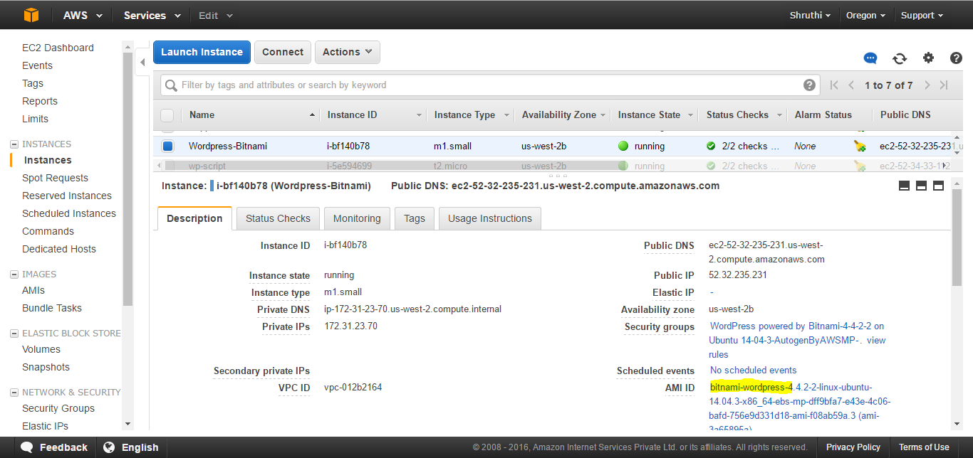

Slide 15
1.7
WordPress instance on EC2 from a container image using Docker
Create an EC2 instance and connect to it
Install docker: sudo yum install docker
We make use of the WordPress pre-configured image available in Docker Hub (Repository). Run the following command: docker run --name dwordpress -e WORDPRESS_DB_HOST=52.38.117.248:3306 -e WORDPRESS_DB_USER=wordpress-user -e WORDPRESS_DB_PASSWORD=*** -e WORDPRESS_DB_NAME=wordpress- db --expose 8080 -p 8080:80 --net=host -d wordpress

Slide 16
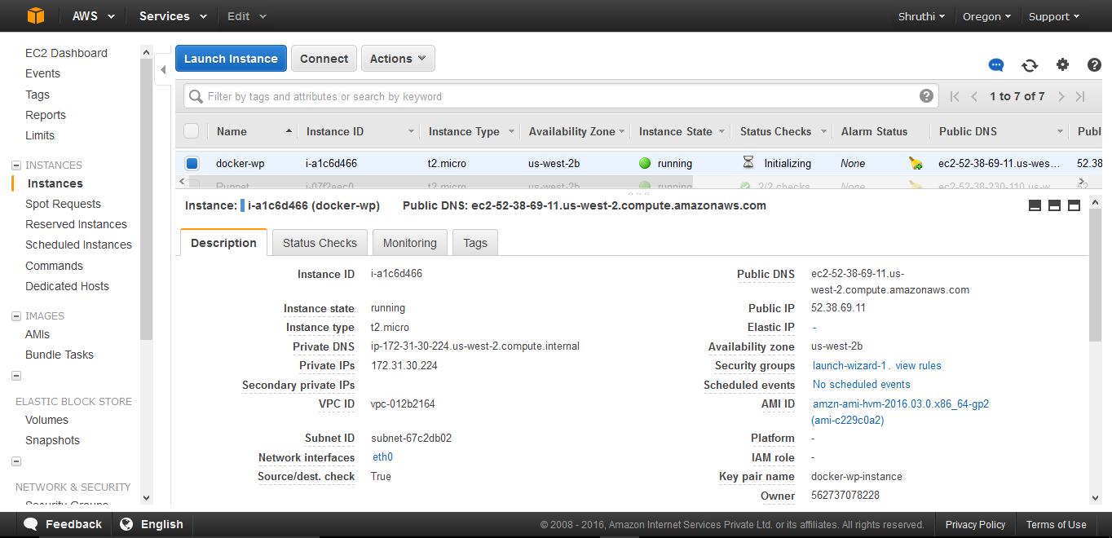

Slide 17
1.8
Resorted to shell scripting.
Video & README for further reference

