Slide 1
Foodzone.
Manthena shruthi,
Batch1.

Slide 2
Home page.
About page.
Menu page.
Gallery page.
Contact page.

Slide 3
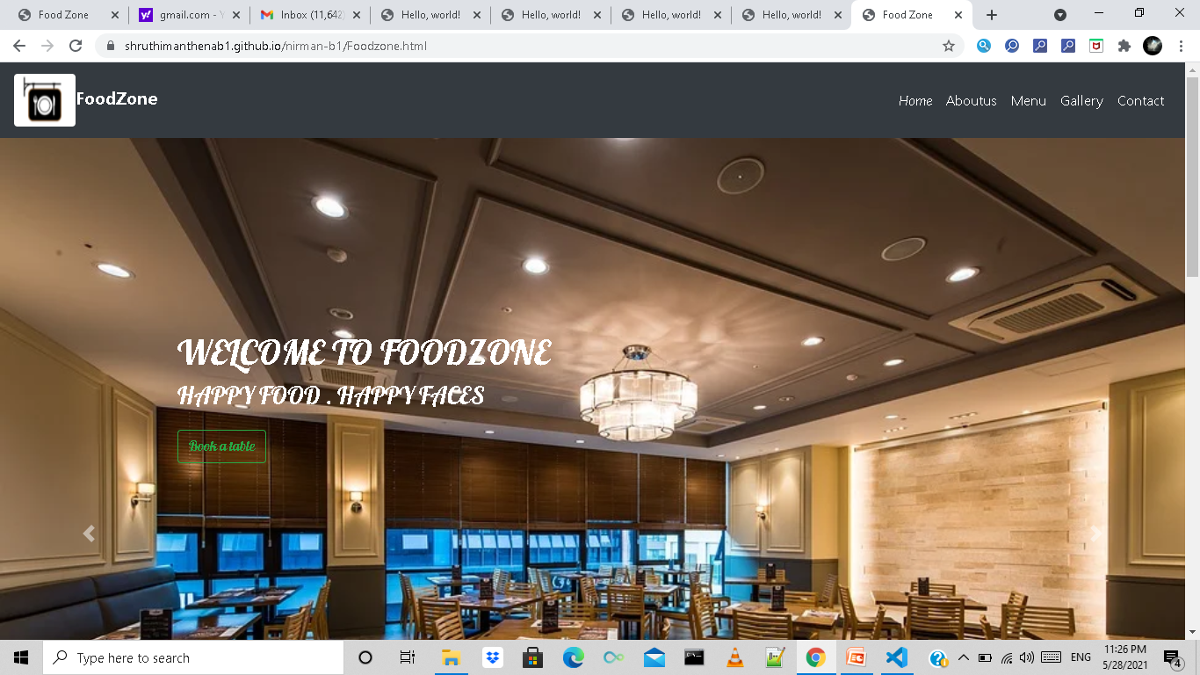
Home Page
Services:
Buffet.
Take Away.
Online Delivery.

Slide 4
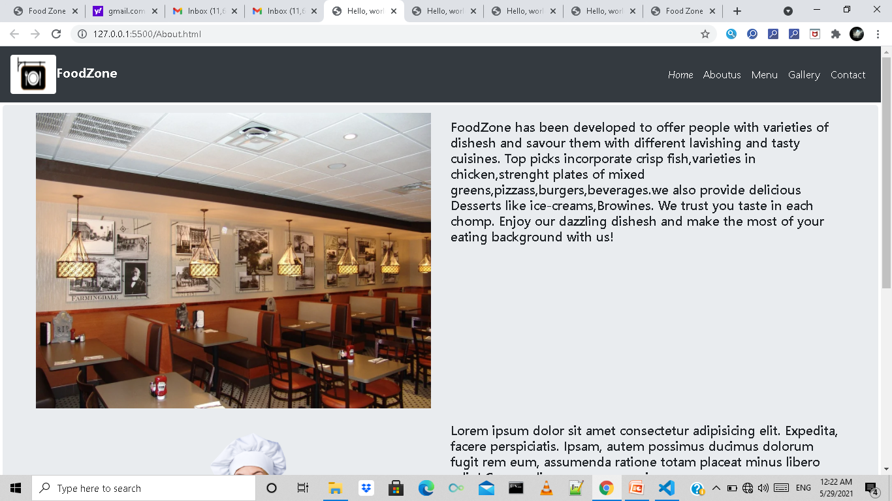
About Page
About our Restaurant.

Slide 5
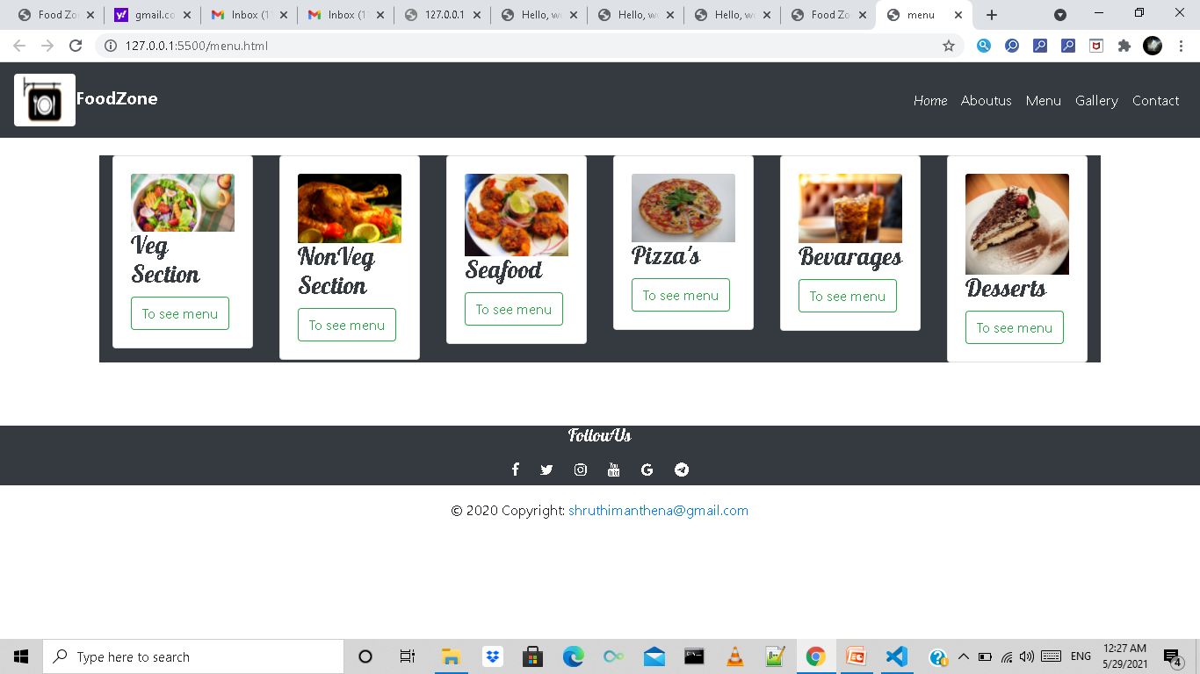
Menu Page
veg.
Non-veg.
Sea food.
Beverages.
Pizza’s.
Desserts.

Slide 6
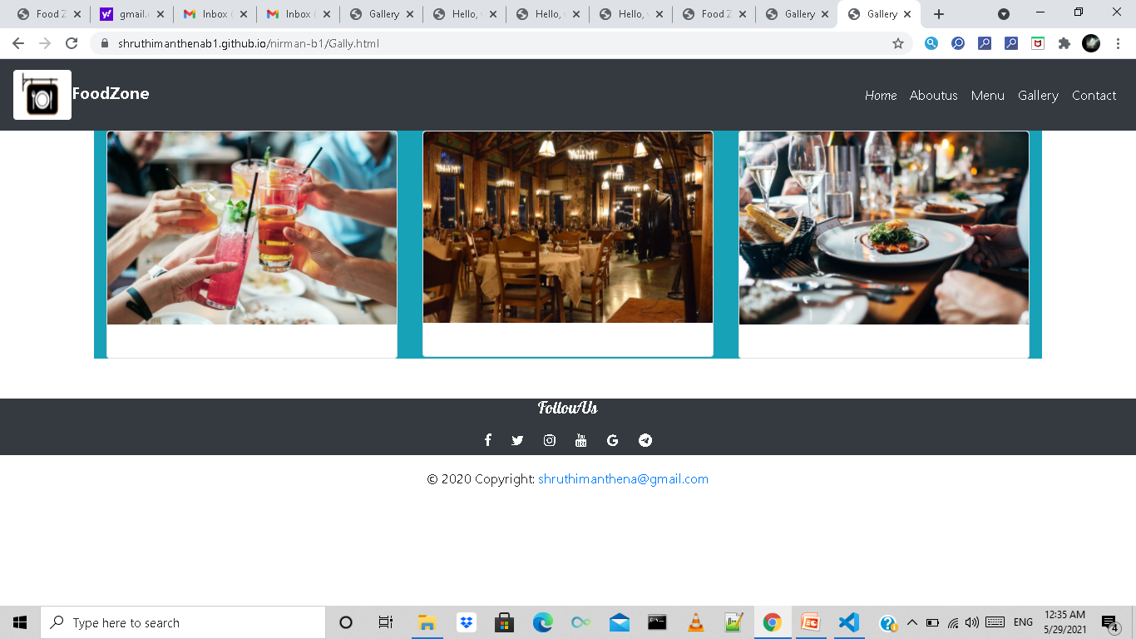
Gallery Page
Images.

Slide 7
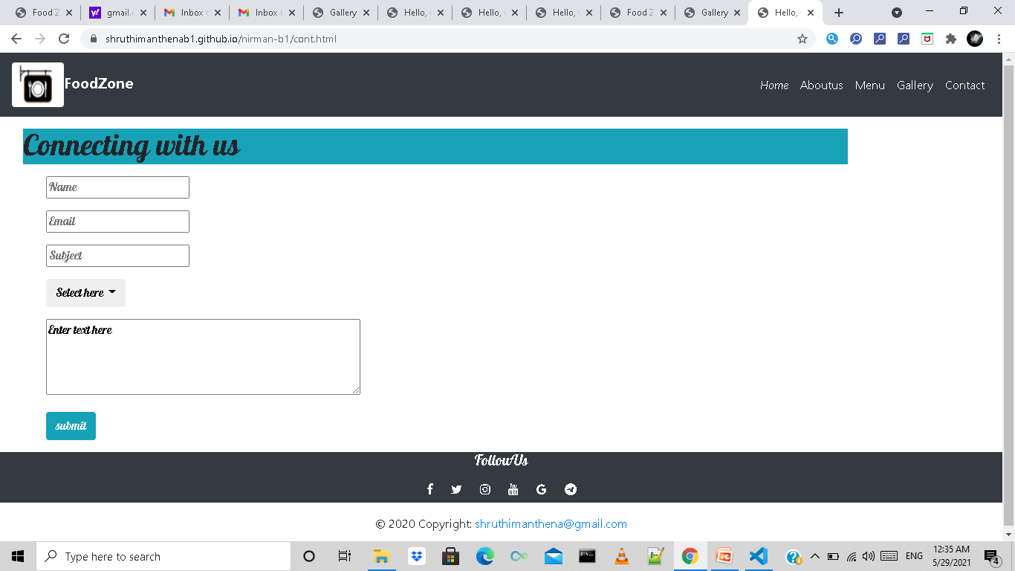
Contact Page
Connecting with us.

Slide 8
Thank you

