Slide 1

SCHOOL OF COMPUTER SCIENCE & IT
DAVV, INDORE
JOB PORTAL
Master of Computer Application -Semester IV Jan - May, 2024
UNDER THE GUIDANCE OF
Ms. Tarjani Sevak
SUBMITTED BY:
Gourav Prajapat(1911219)
Shruthi Mohan (1911246)

Slide 2
TABLE OF CONTENTS:
Introduction
Hardware & Software Requirements
Use Case Diagram
Database Design
Activity Diagram
Output Screenshots

Slide 3
INTRODUCTION
Aim:
The primary aim of this project is to develop a comprehensive and user-friendly Job Portal that facilitates efficient job search and recruitment processes for applicants, recruiters, and administrators.
Scope:
The Job Portal project aims to address the challenges faced by job seekers during their job search. It will have different dashboards for applicants, recruiters, and administrators, each with its own features. The project will include important functions like login security, posting jobs, tracking applications, and collecting feedback. By listening to users and making improvements over time, the portal hopes to become a trusted tool for finding jobs easily, helping both applicants and recruiters in the tough job market.

Slide 4
Objective:
The objectives of this project are to transform the job search experience for applicants and recruiters alike, by developing a seamlessly integrated platform.
To create a centralized platform where applicants can easily discover, search, and apply for relevant job opportunities.
To provide recruiters with a dedicated dashboard to post job openings, manage applications, and streamline the hiring process.
To implement robust user authentication and administrative controls to ensure data security and reduce spam.
To develop a responsive and intuitive user interface that offers a seamless experience across various devices.
To incorporate features like customized dashboards, advanced search filters, and feedback systems to enhance user experience and platform credibility.

Slide 5
HARDWARE & SOFTWARE REQUIREMENTS
Hardware requirements:
Processor: Intel Core i5 or equivalent AMD processor
RAM: 8GB or less
Storage: At least 256GB SSD
Network: Ethernet port for wired connection or Wi-Fi capability
Software Requirements:
Front end: React.js, Tailwind CSS, Vite.js
Backend: Node.js
Database: MongoDB Atlas
Operating System : Windows
Web Browsers : Chrome, Firefox, Safari, Edge
Integrated Development Environment (IDE) : Visual Studio Code
Node.js and npm (Node Package Manager): for backend development

Slide 6
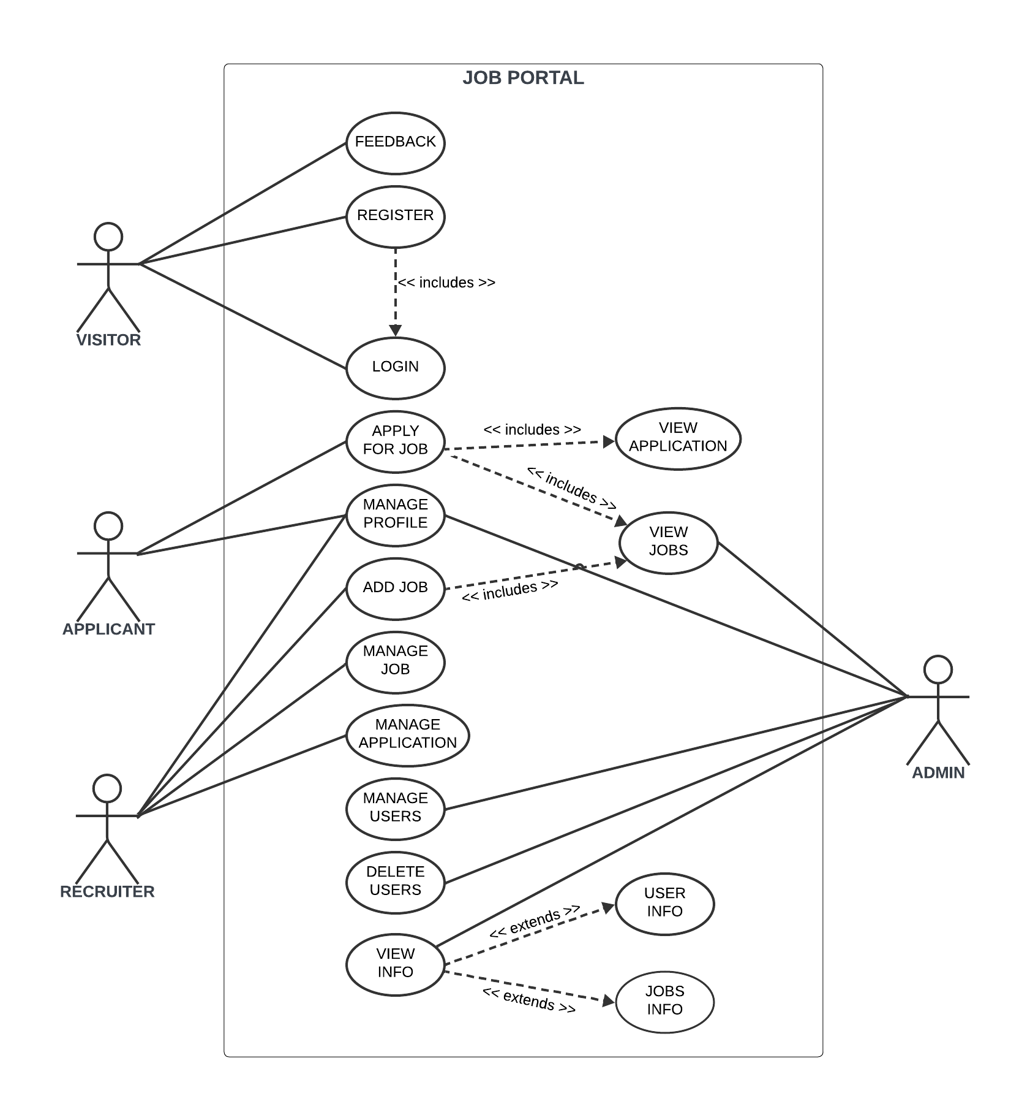
USE CASE DIAGRAM

Slide 7
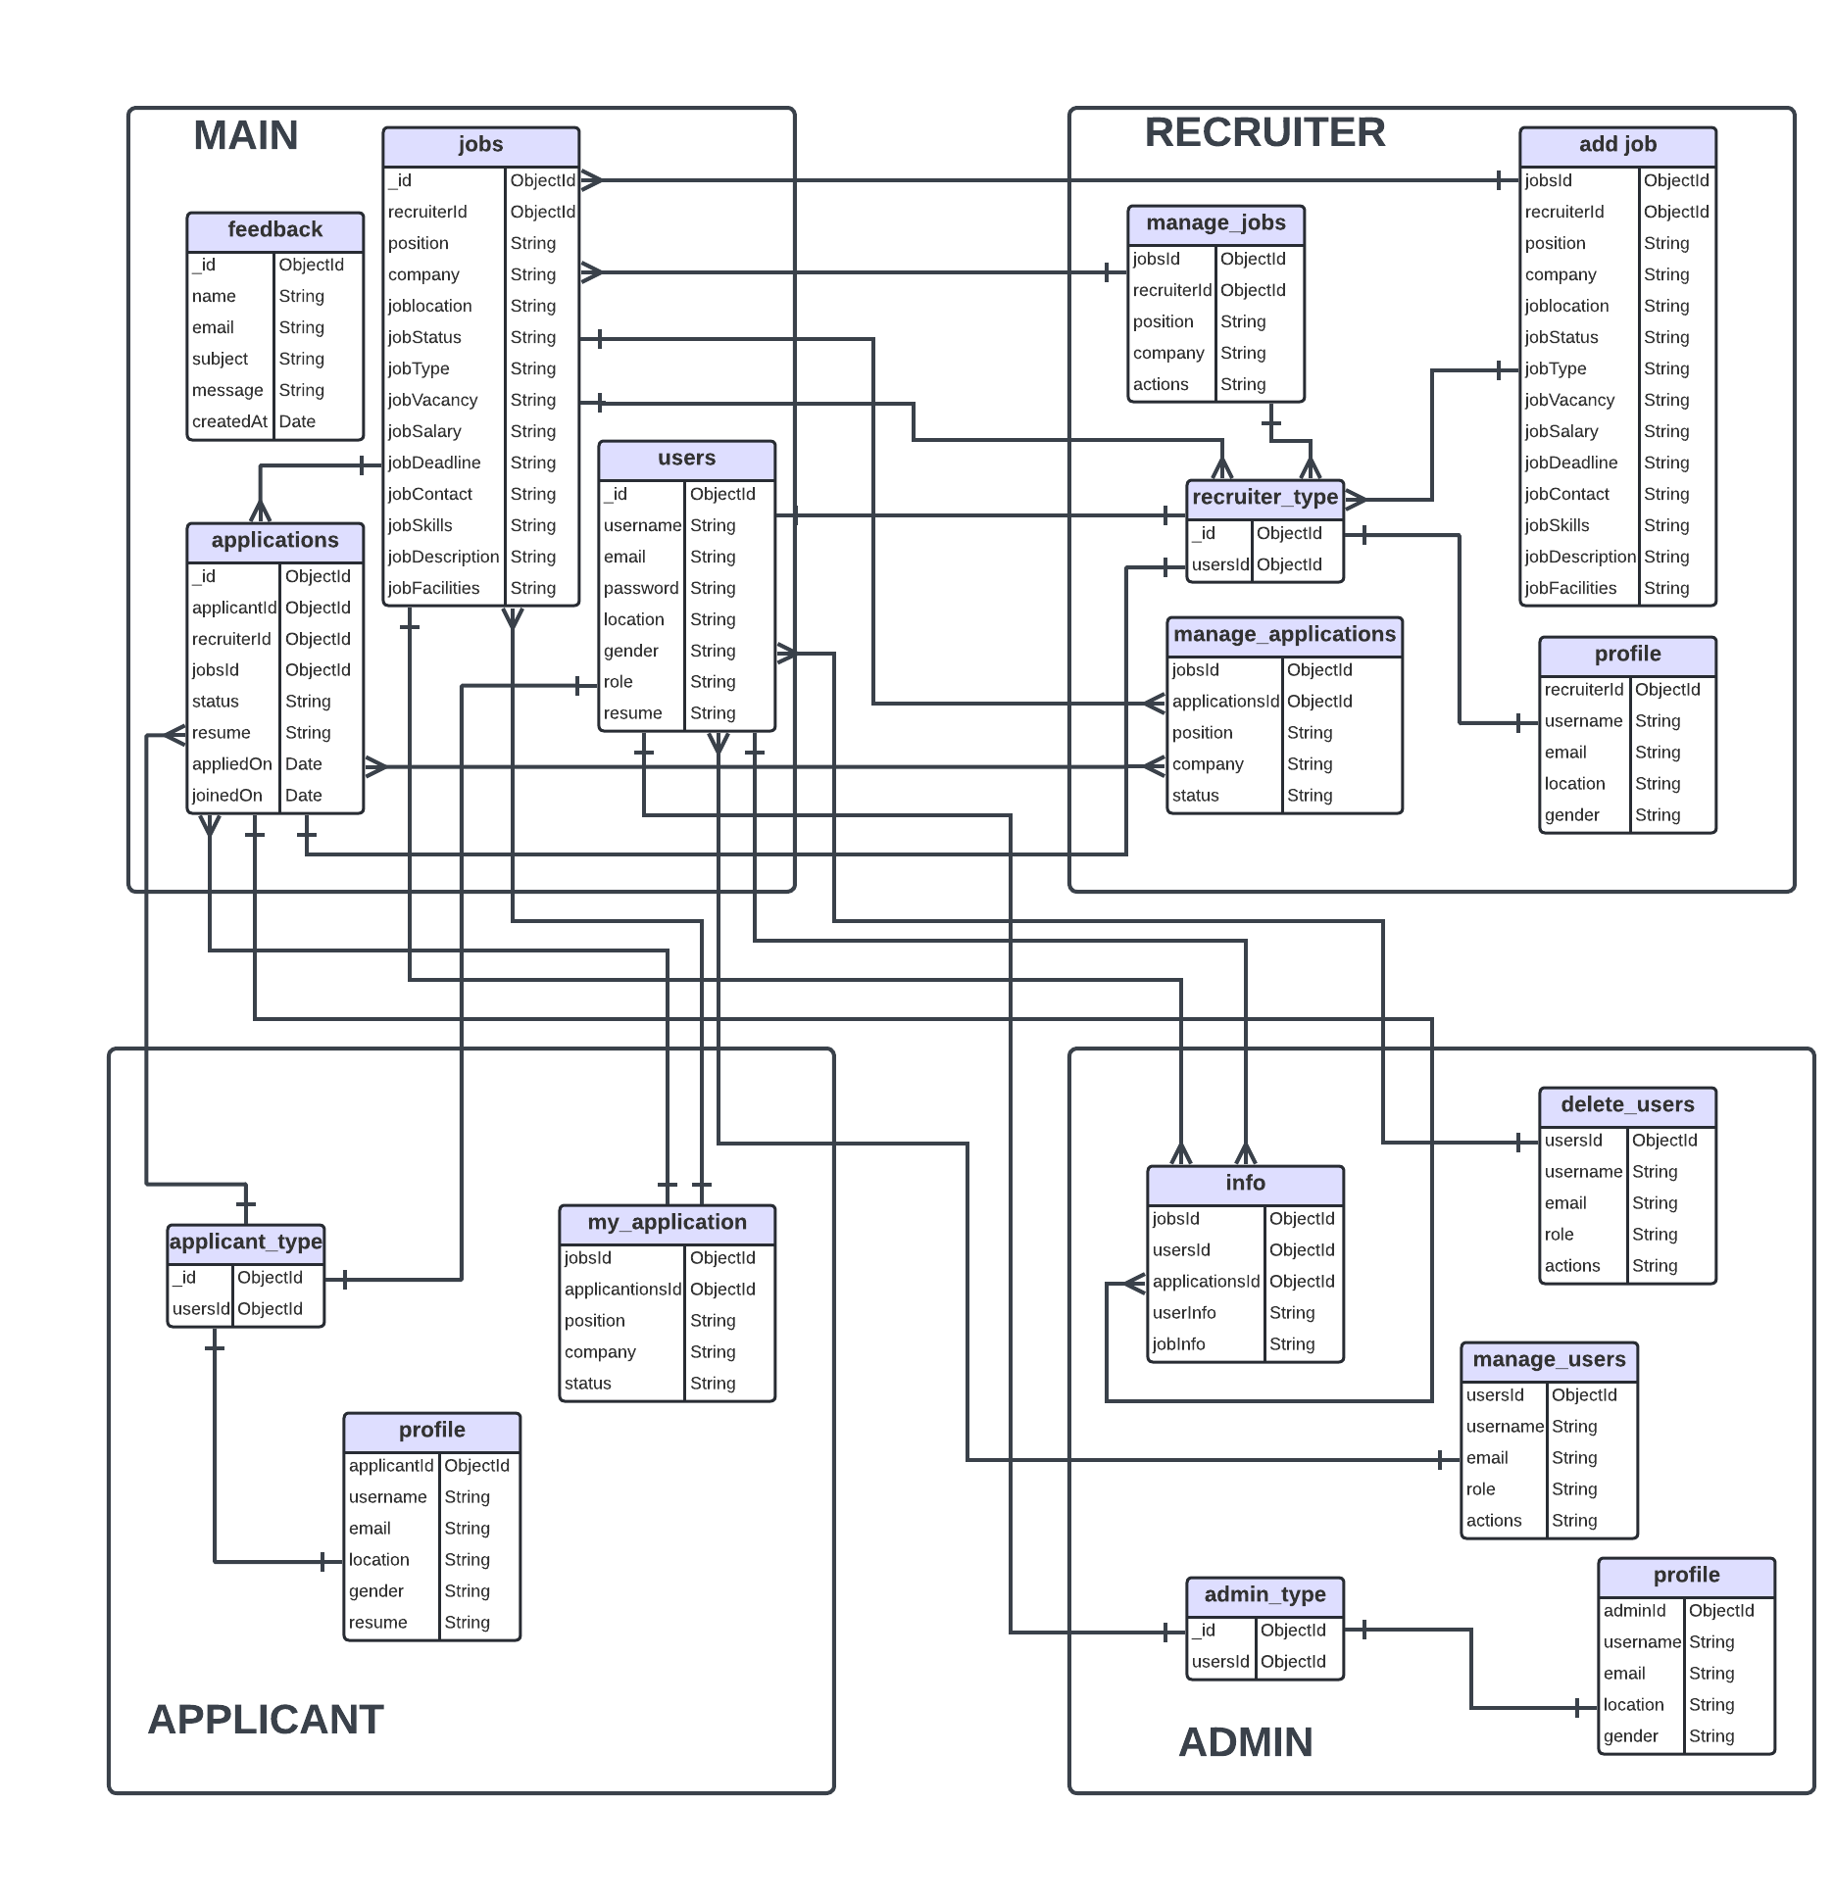
DATABASE DESIGN

Slide 8
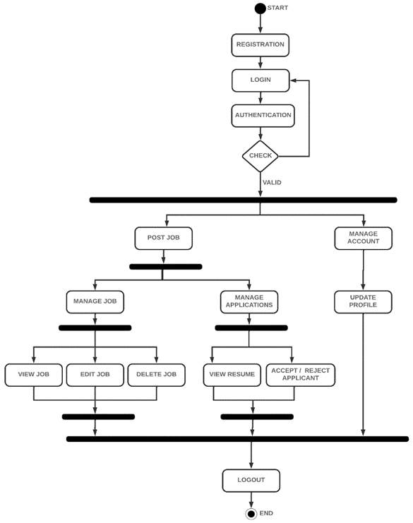
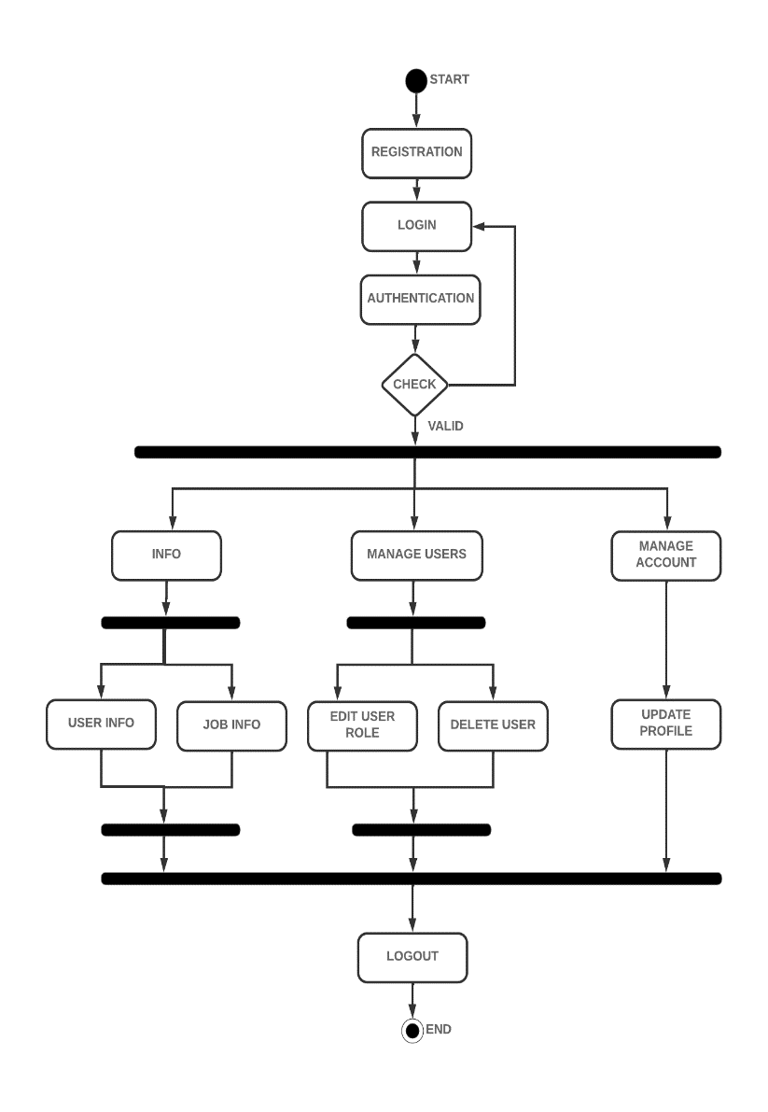
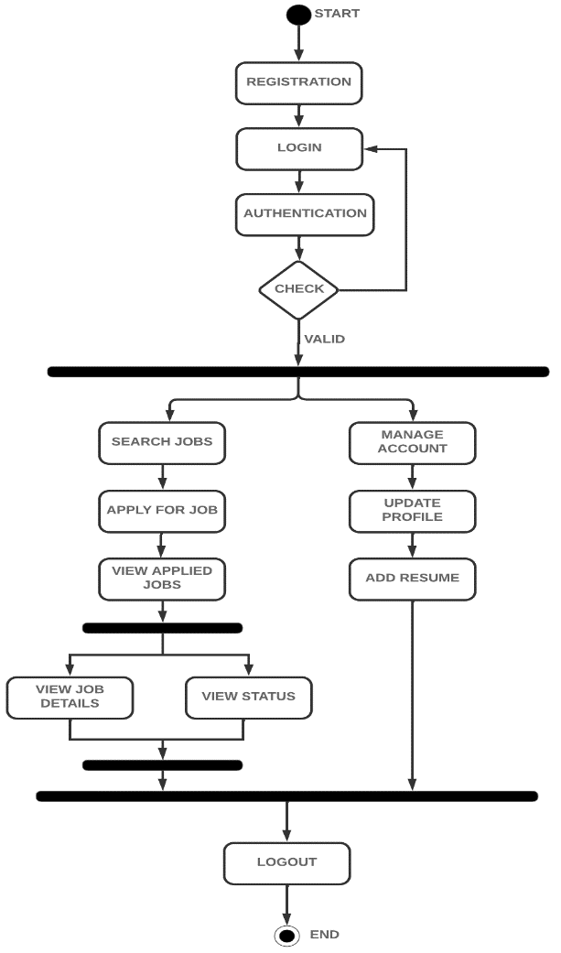
ACTIVITY DIAGRAM
Applicant
Recruiter
Admin

Slide 9
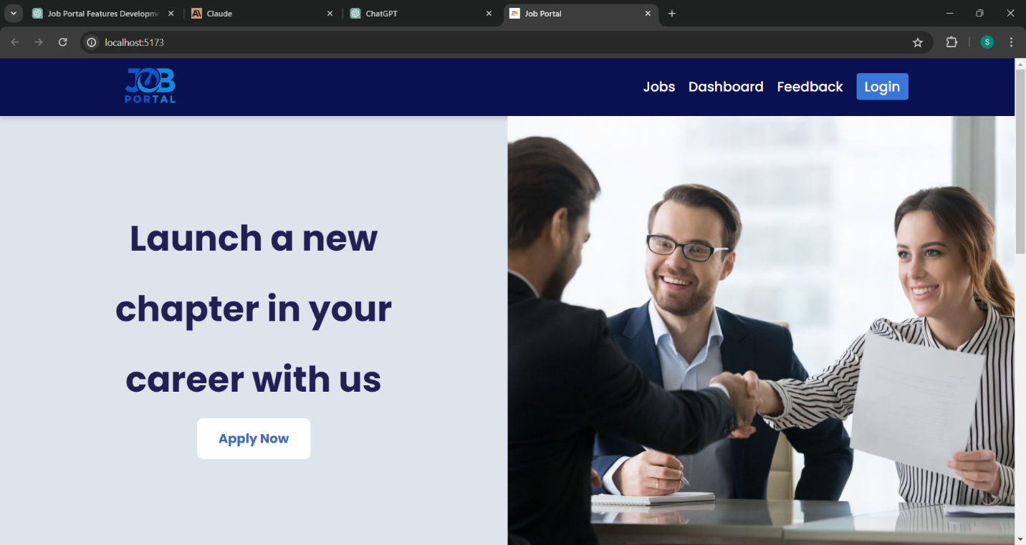
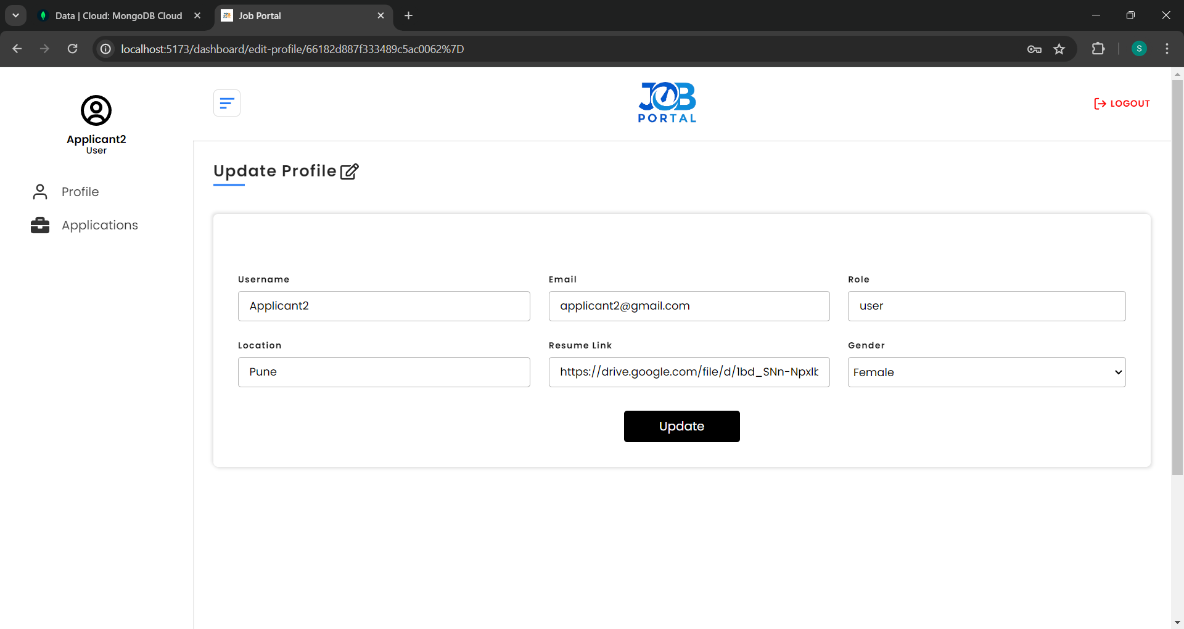
OUTPUT SCREENSHOTS
Home Page
Update Profile Page

Slide 10
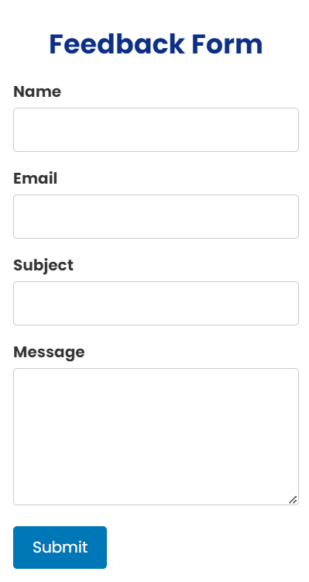
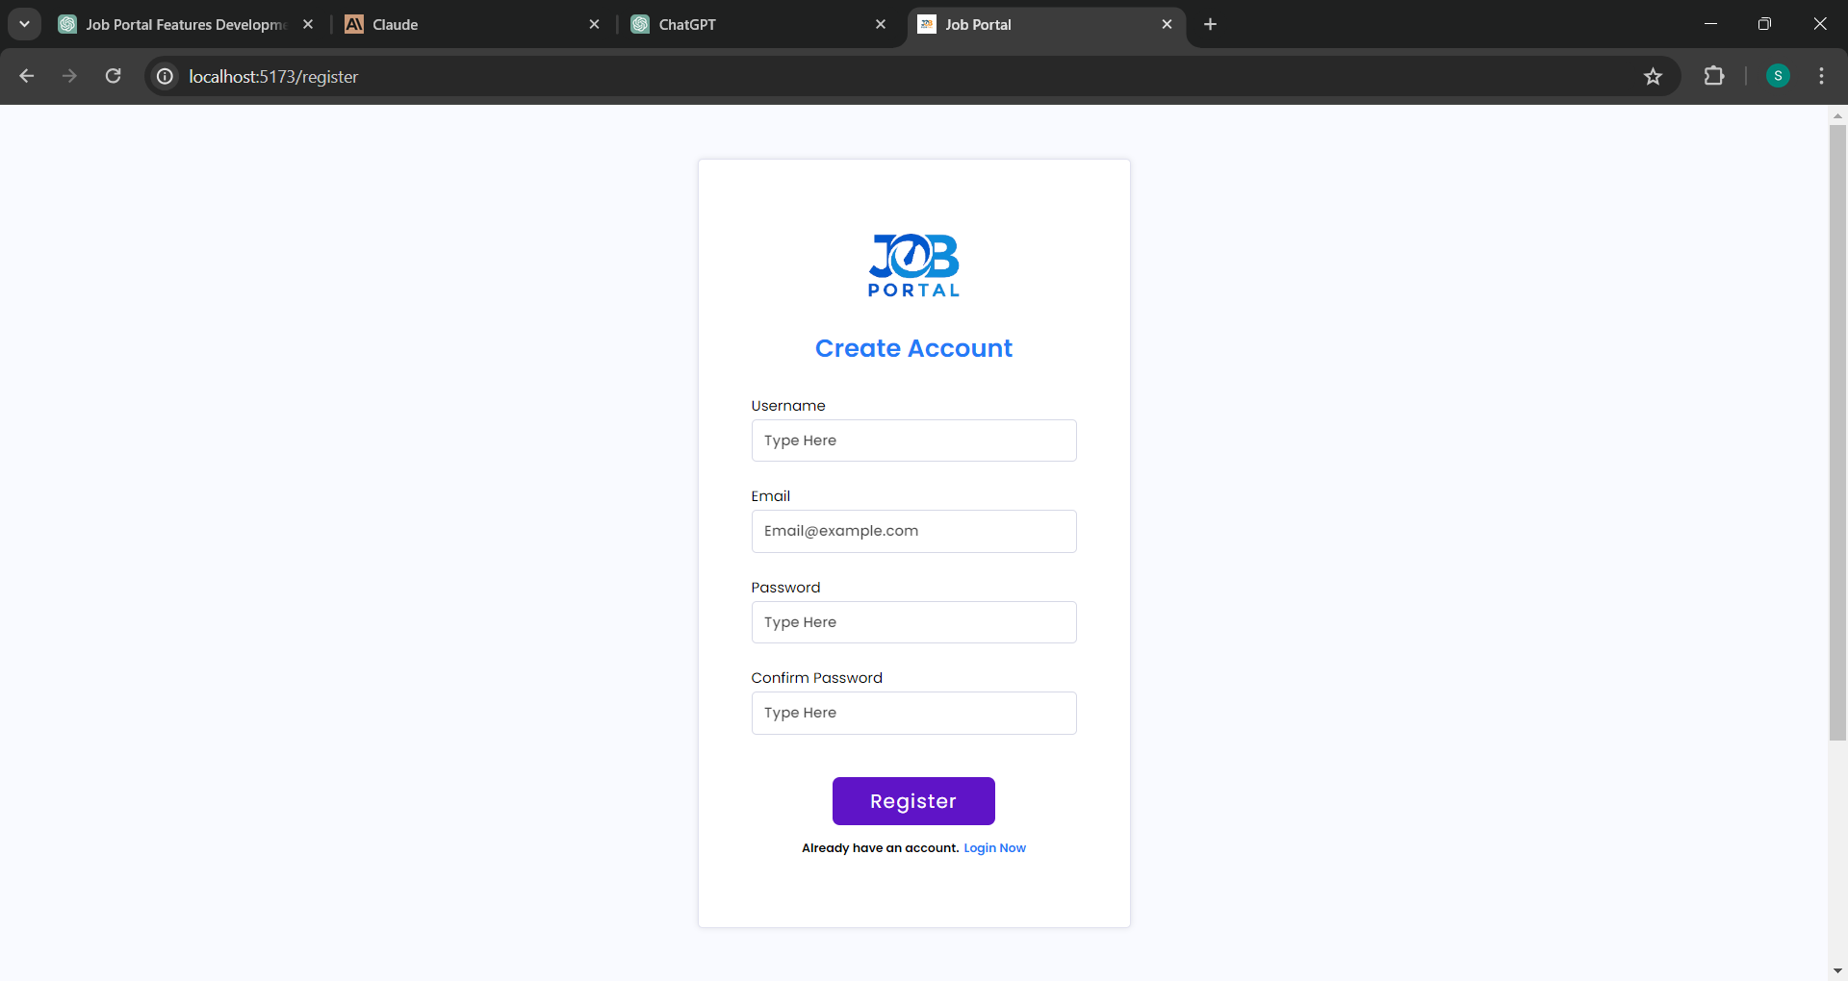
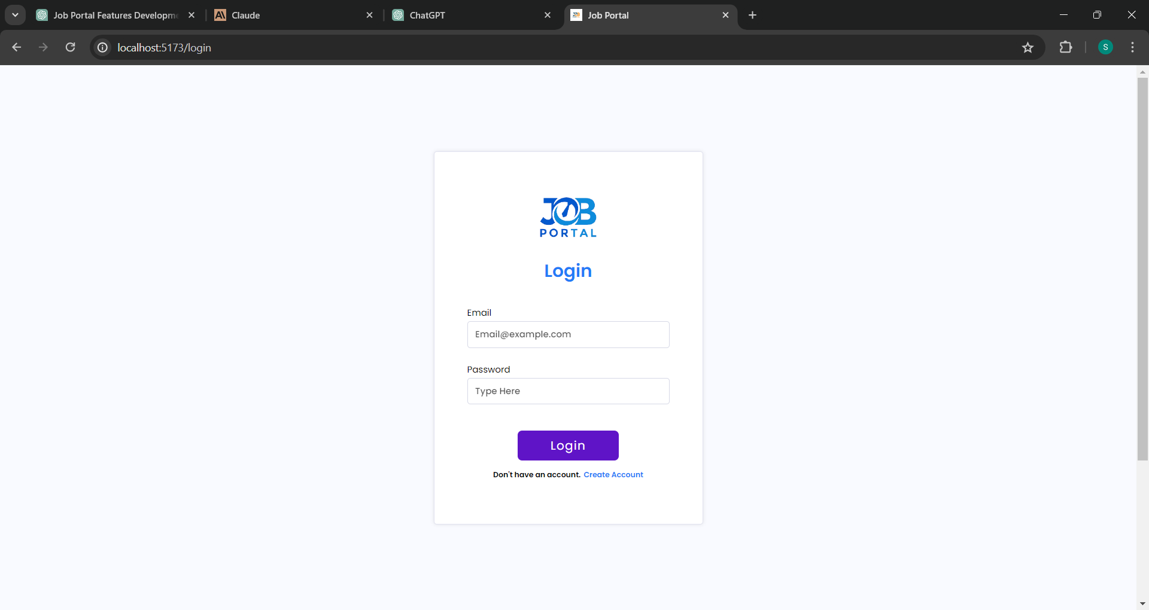
Feedback Form Page
Register Page
Login Page

Slide 11
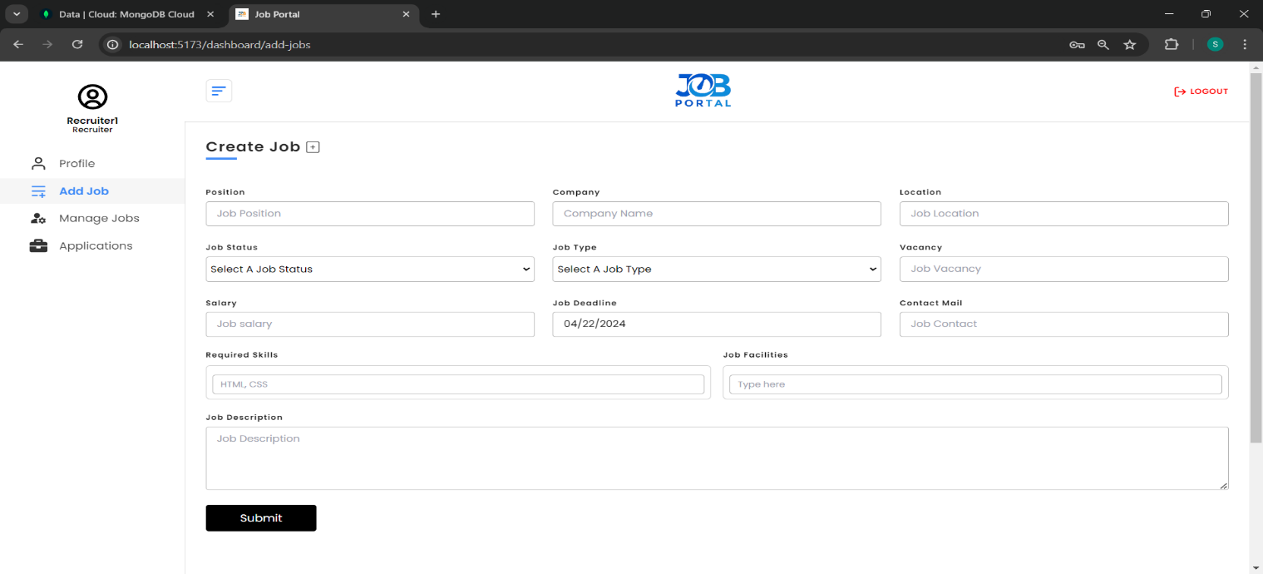
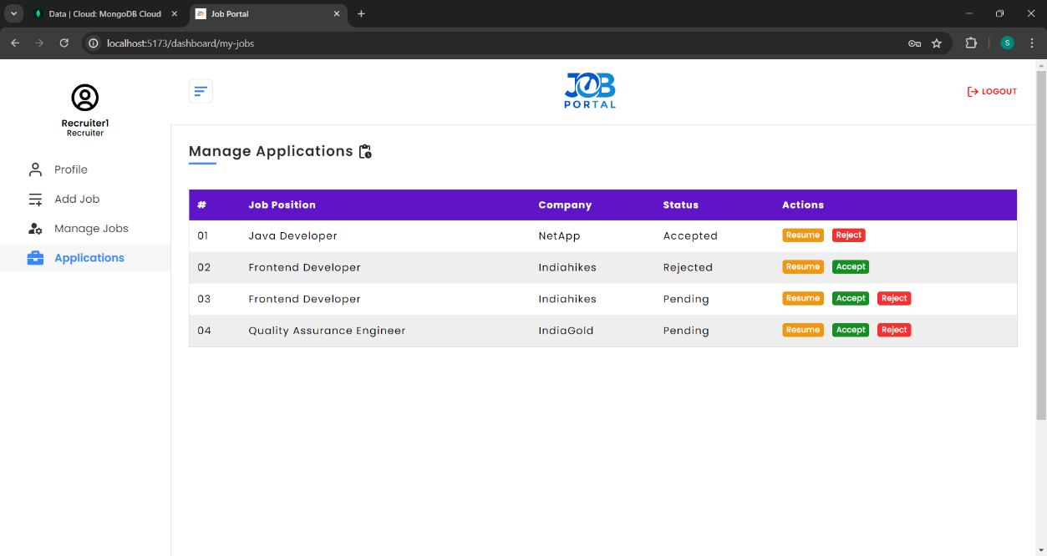
Add Job Page
Manage Applications Page

Slide 12
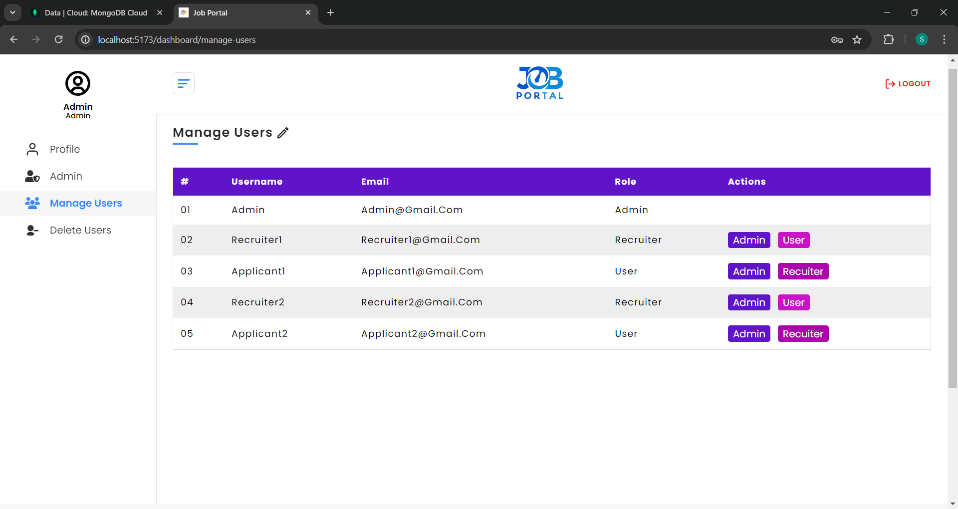
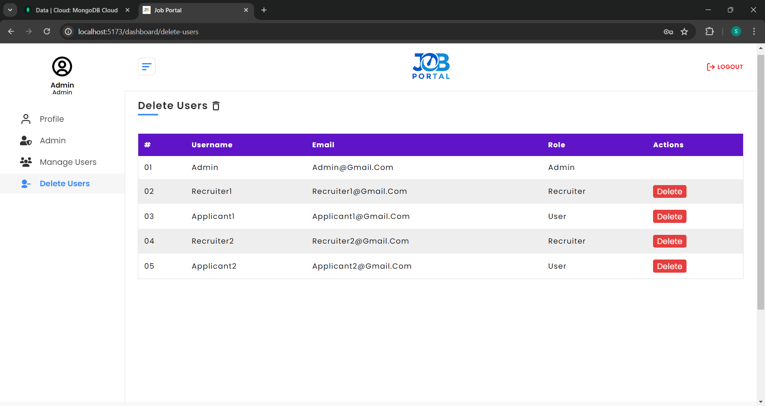
Manage Users Page
Delete Users Page

Slide 13
THANK YOU

