Slide 1
Biba Integrity Model
Presented by:
Nathan Balon
Ishraq Thabet

Slide 2
Computer Security
Computer security is concerned with three aspects:
  Confidentiality: preventing/detecting/deterring the improper discloser of information.
  Integrity: preventing/detecting/deterring the improper modification of data.
  Availability: preventing/detecting/deterring the improper denial of service provided by the system.

Slide 3
Security Model
A security policy governs a set of rules and objectives need by an organization.
A security model can be used by an organization to help express the policy or business rules to be used in a computer system.
There are two types of models that can be used: discretionary access control and mandatory access control.

Slide 4
Bell-LaPadula Model
The Bell-LaPadula model is one of the first models that was created to control access to data.
The properties of the Bell-LaPadula model are:
  The simple security property which is “no read up”
  The star property which is “no write down”.
A problem with this model is it does not deal with the integrity of data.
The star property makes it is possible for a lower level subject to write to a higher classified object.

Slide 5
Biba Integrity Model
The Biba integrity model was published in 1977 at the Mitre Corporation, one year after the Bell La-Padula model was published.
The primary motivation for creating this model is the inability of the Bell-LaPadula model to deal with integrity of data.
The Biba model addresses the problem with the star property of the Bell-LaPadula model, which does not restrict a subject from writing to a more trusted object.

Slide 6
Integrity
Integrity refers to the trustworthiness of data or resources.
Integrity is usually defined in terms of preventing improper or authorized change to data.
There are three main goals of integrity:
  Preventing unauthorized users from making modifications to data or programs.
  Preventing authorized users from making improper or unauthorized modifications.
  Maintaining internal and external consistency of data and programs.

Slide 7
Integrity Levels
Integrity levels are defined by labels, consisting of two parts:
  a classification
  a set of categories.
Integrity levels are given to the subjects and objects in the system.
Integrity labels tell the degree of confidence that may be placed in the data.

Slide 8
Classification of Integrity
A classification is an element of hierarchical set of elements.
It consists of these elements:
  Crucial (c)
  Very Important (VI)
  Important (I)
The relationship of elements is:
  C > VI > I

Slide 9
Set Categories
The set of categories contained in the label will be a subset of all the sets in the system.
The classification of the set of categories is non-hierarchical.

Slide 10
Example of Set Categories
An example of two categories are category X = {Detroit, Chicago, New York} and category Y = {Detroit, Chicago}.
In this case X ≥ Y (X dominates Y), because Y is a subset of X.
If there were to be a third compartment Z containing {Detroit, Chicago, Miami}. Compartment Z and X in this case are non-comparable because the third element of the set is different.

Slide 11
Integrity Levels
Each integrity level will be represented as L = (C, S) where:
  L is the integrity level
  C is the classification
  S is the set of categories.
The integrity levels then form a dominance relationship.
Integrity level L₁ = (C₁, S₁) dominates (≥) integrity level L₂ = (C₂, S₂) if and only if this relationship is satisfied:
  C₁ ≥ C₂ and S₁ ⊇ S₂

Slide 12
Subjects and Objects
Like other models, the Biba model supports the access control of both subjects and objects.
  Subjects are the active elements in the system that can access information (processes acting on behalf of the users).
  Objects are the passive system elements for which access can be requested (files, programs, etc.).
Each subject and object in the Biba model will have a integrity level associated with it.

Slide 13
Access Modes
The Biba model consists of the following access modes:
  Modify: the modify right allows a subject to write to an object. This mode is similar to the write mode in other models.
  Observe: the observe right allows a subject to read an object. This command is synonyms with the read command of most other models.
  Invoke: the invoke right allows a subject to communicate with another subject.
  Execute: the execute right allows a subject to execute an object. The command essentially allows a subject to execute a program which is the object.

Slide 14
Biba Policies
The Biba model is actually a family of different policies that can be used.
The goal of the model is to prevent the contamination of “clean” high level entities from “dirty” low level entities.
The model supports both mandatory and discretionary policies.
The Mandatory Policies:
  Strict Integrity Policy
  Low-Watermark Policy for Subjects
  Low-Watermark Policy for Objects
  Low-Watermark Integrity Audit Policy
  Ring Policy
The Discretionary Policies:
  Access Control Lists
  Object Hierarchy
  Ring

Slide 15
Strict Integrity Policy
The Strict Integrity Policy is the first part of the Biba model. The policy consists of:
  Simple Integrity Condition: s ∈ S can observe o∈ O if and only if i(s) ≤ i(o) (“no read-down”).
  Integrity Star Property: s ∈ S can modify o∈ O if and only if i(o) ≤ i(s) (“no write-up”).
  Invocation Property: s₁ ∈ S can invoke s₂ ∈ S if and only if i(s₂) ≤ i(s₁).

Slide 16
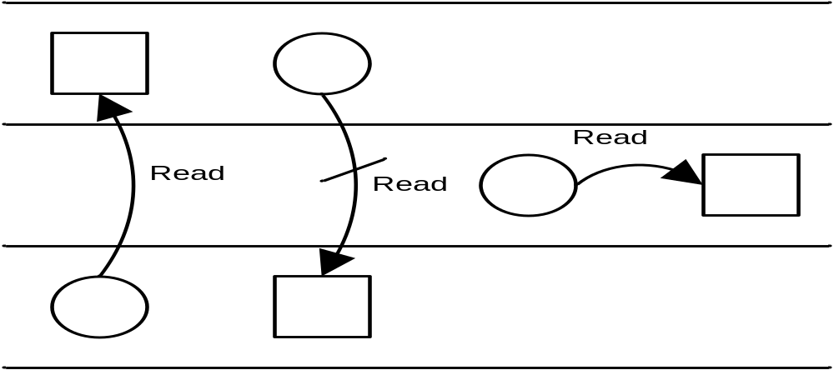
Simple Integrity Condition
“No Read-Down”
circle = subject, square = object

Slide 17
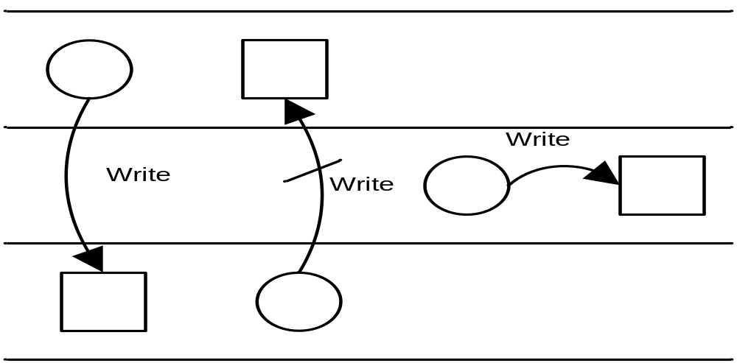
Integrity Star Property
“No Write-Up”
circle = subject, square =object

Slide 18
Strict Integrity Policy
When most people refer to the Biba model they are actually referring to the strict integrity model.
This policy is the most common policy that used from the model.
The strict integrity policy enforces “no write-up” and “no read-down” on the data in the system, which is the opposite of the Bell-LaPadula model.
This policy restricts the contamination of data at higher level, since a subject is only allowed to modify data at their level or at a lower level.

Slide 19
Strict Integrity Policy
The “no write-up” is essential, since it limits the damage that can be done by malicious objects in the system. For instance, “no write-up” limits the amount of damage that can be done by a trojan horse in the system. The trojan horse would only be able to write to objects at it integrity level or lower. This is important because it limits the damage that can be done to the operating system.
The “no read-down” prevents a trust subject from being contaminated by a less trusted object.

Slide 20
Low-Watermark Policy for Subjects
The low-watermark policy for subjects is a relaxed “no read-down”.
The low-watermark policy for subjects contains these following rules:
  Integrity Star Property: s ∈ S can modify o∈ O if and only if i(o) ≤ i(s) (“no write-up”).
  A subject may examine any object. If s ∈ S examines o ∈ O then i′(s) = min(i(s),i(o)), where i′(s) is the subjects integrity level after the read.
  Invocation Property: s₁∈ S can invoke s₂ ∈ S if and only if i(s₂) ≤ i(s₁).

Slide 21
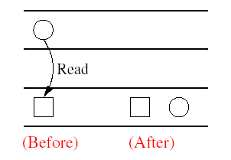
Low-watermark Policy for Subjects
circle = subject, square = object

Slide 22
Low-Watermark Policy for Subjects
The low-watermark policy for subjects does nothing to restrict a subject from reading objects.
The low-watermark policy for subjects is a dynamic policy, because it lowers the integrity level of a subject based on what objects are observed.
This policy is not without it shortcomings, one problem with this policy is that if a subject observes a less trusted object, it will drop the subjects integrity level to that of the object. Then later, if the subject needs to legitimately observe other objects, it may not be able to do so because the subjects integrity level has been lowered. The effect of this would be denial of service depending on the timing of the submissions.

Slide 23
Low-Watermark Policy for Objects
The low-watermark policy for objects is a relaxed “no write-down”.
The following rules make up the low-watermark for objects policy:
  s ∈ S can modify any o ∈ O regardless of integrity level.
  If s ∈ S modifies o ∈ O then i′(o) = min(i(s),i(o)), where i′(o) is the objects integrity level after it is modified.

Slide 24
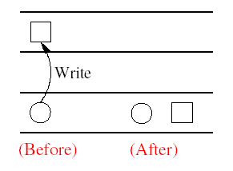
Low-Watermark Policy for Objects
circle = subject, square = object

Slide 25
Low-Watermark Policy for Objects
The low-watermark policy for objects is also a dynamic policy, similar to the low-watermark policy for subjects.
The disadvantage of this policy is it does nothing to prevent an un-trusted subject from modify a trusted object. In reality policy is not very practical.
The policy provides no real protection in a system. The policy simply lowers in the trust placed in the objects. If a malicious program was inserted into the computer system it could modify any object in the system. This model would just lower the integrity level of objects that have become contaminated.

Slide 26
Low-Watermark Integrity Audit Policy
The low-watermark integrity audit policy consists of the following rules:
  Any subject may modify any object, regardless of integrity levels.
  If a subject modifies an object at higher integrity level (a more trusted object), it results in the transaction being recorded in an audit log.
The drawback to this policy is it does nothing to prevent an improper modifications of an object. This policy is similar to the low-watermark for objects policy, except in this case the objects integrity level is not lowered, it is recorded.
This policy simply records that an improper modification took place.

Slide 27
Ring Policy
The ring policy is the last mandatory policy in the Biba model. Integrity labels used for the ring policy are fixed similar to those in the strict integrity policy.
The Ring Policy consists of the following rules:
  Any subject can observe any object, regardless of integrity levels.
  Integrity Star Property: s ∈ S can modify o∈ O if and only if i(o) ≤ i(s) (“no write up”).
  Invocation Property: s₁ ∈ S can invoke s₂ ∈ S if and only if i(s₂) ≤ i(s₁).

Slide 28
Ring Policy
The Ring Policy allows any subject to observe any object. This policy is only concerned with direct modification.
The drawback to this policy is it allows improper modifications to indirectly take place.
A subject can read a less trusted object. Then the subject could modify the data it observed at its own integrity level.
An example of this would be a user reading a less trusted object, then remember the data that they read and then at a later time writing that data to an object at their own integrity level.

Slide 29
Current implementations of the Biba Model
One instance of where the Biba model is currently used is in FreeBSD 5.0.
The TrustedBSD MAC framework is a new kernel security framework that is an extension of FreeBSD 5.0.
The Biba Integrity Model is supported by a module called mac_biba.ko.
The integrity levels are defined for subjects and objects in a configuration file.
The Biba policy in FreeBSD 5.0 provides support for both hierarchical and non-hierarchical labeling of all system objects with integrity data. FreeBSD 5.0 also supports the strict enforcement of information flow to prevent the corruption of high integrity objects by low integrity subjects

Slide 30
Advantages and Disadvantages
Advantages:
  The Biba model is it simple and easy to implement.
  The Biba model provides a number of different policies that can be selected based on need.
Disadvantages:
  The model does nothing to enforce confidentiality.
  The Biba model doesn’t support the granting and revocation of authorization.
  To use this model all computers in the system must support the labeling of integrity for both subjects and objects. To date, there is no network protocol that supports this labeling. So there are problems with using the Biba model in a network environment.

Slide 31
Biba Conclusion
The Biba model is actually a family of different models that can be selected.
The model should be combined with another model, because it does not provide confidentiality. A model such as the Bell-LaPadula should be used to complement it.
The Lipner model is one such model that has be developed to meet these requirements, it in turn combines both the Bell-LaPadula and Biba models together.

Slide 32
References
Bishop, M. Computer Security: Art and Science, Addison Wesley,
Boston, MA. 2003.
Blake, S. “The Clark-Wilson Security Model”
http://www.lib.iup.edu/comscisec/SANSpaper/blake.htm
Castano, S. (et. al). Database Security, Addison Wesley,
Harlow, England. 1995.
Cohen, F. “Models of OS Protection”
http://www.all.net/books/ ip/Chap3-3.html
Frost, J. “Access Control 2: Lecture Notes” http://cob.isu.edu/cis410/week3.htm
Landwehr, C. “Formal Models for Computer Security”, Computing Surveys, Vol. 13, No. 3, September 1981.
Stallings, W. Cryptography and Network Security: Principles and Practices
(3rd Edition) ,Prentice Hall, Upper Saddle River, NJ. (2003).
RFC 1457. “Security Label Framework for the Internet”
http://www.ietf.org/rfc/rfc1457.txt
Watson, R. (et. al) “The TrustedBSD MAC Framework: Extensible Kernel Access Control for FreeBSD 5.0”. Usenix Annual Technical
Conference, 2003.

Slide 33

Question?!

