Slide 1
CS5573 Introduction to Information Security and Assurance
Information Assurance

Slide 2
Information Assurance
Consider the statement “I was assured about the strength of computer science degree of UMKC.”
The use of the term “assured” is based on a number of parameters:
(a) I trust the source who assured me,
(b) because of trustworthiness of the source, I believe in the strength of UMKC CS degree, and
(c) the information is trustworthy.
So the first key word is “trust” that generates assurance. We define trust in this context.

Slide 3
Information Assurance
Definition 1. Trust is a strong indication that an entity (organization, action, etc.) satisfies or meets a given set of requirements. It makes the entity trustworthy, thus, it is a measure of trustworthiness.
Discussion: Just calling something “trusted” or “trustworthy” does not make it so. The entity must satisfy a set of criteria. For example, trust and trustworthiness in computer system must make sure that (a) it never crashes, (b) it can never be hacked, (c) it can never malfunction, (d) it offers best performance, and so on. One can identify a large number of such criteria but in practice a small subset is enough to establish trust on the system. The other thing to note is that these parameters are always an operation or action. The criteria “color” or “size” may not help in establishing trust.

Slide 4
Information Assurance
Information assurance refers to the ability to preserve the quality and security of information. It differs from security assurance, because the focus is on the threats to information and the mechanism used to protect information and not on the correctness, consistency, or completeness of the requirements and implementation of those mechanisms.
We begin from the basic introduction to those components (object and process) that must be managed to establish assurance.

Slide 5
Information Assurance
Organizations must answer the question; “What information to protect or secure?” when they deal with their information. Although, answer depends very much on organization’s needs, the main objective remains the same. Some of the typical information types that an organization tries to protect are:
Record of failed projects
Expertise of its employees
Design blue-prints
Salary and raises of its employees
Source code of software programs
Etc.

Slide 6

Information Assurance
In general any information that can be used against the organization needs to be protected. To understand clearly the value of information, it must be recorded carefully. This recording process is called “baselining.” The end product or the result of baselining is an information catalogue which is usually referred to as “baseline”. Figure below illustrates the simple process
Information Baselining

Slide 7

Information Assurance
When the information value parameter (defines information usefulness) is taken into consideration in baselining then the baseline contains valuable information repository.
Valuable information in the baseline

Slide 8
Information Assurance
Baseline is a dynamic compilation because the value of the information changes over time and is unpredictable. For consistency preservation, therefore, two operations are required (a) application of consistency criteria and (b) the consistency criteria must be kept up to date. The consistency criteria are tightly linked to business case and the dynamics of the organization.

Slide 9
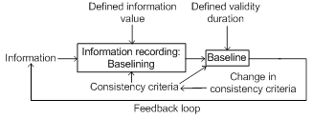
Information Assurance
Figure below represents an important task that is usually referred to as “asset management.” The first task of asset management is to identify and categorize information to be protected.
Information consistency preservation

Slide 10
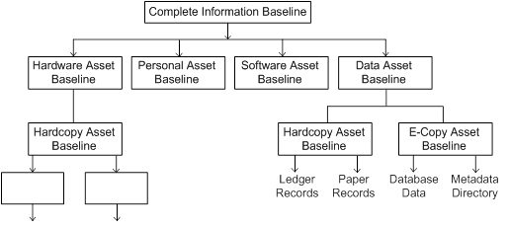
Information Assurance
A hierarchical categorization and identification is one of the best ways and it is commonly used. An example of such categorization is given in the Figure below.
A generic baseline hierarchy

Slide 11
Information Assurance
The height of a baseline hierarch depends on (a) information category, (b) size of information granularity (e.g., hardcopy asset baseline), and (c) uniqueness.
Note that each baseline may require different security scheme. It can be defined in terms of the following six interdependent activities: (a) Process implementation, (b) Asset identification, (c) Control of change, (d) status accounting, (e) Asset evaluation, and (f) Version management.

Slide 12
Information Assurance
Process implementation
This task is responsible for putting in place a number of activities that assures that (a) the baseline is self-protected, (b) in case of system failure due to any disaster the baseline information can be recovered, (c) the baseline consistency is maintained, (d) the baseline information is up to date, and (e) risk management facility is active.

Slide 13
Information Assurance
Asset identification
This task is responsible for identifying information useful and important (now and in the future) to the organization. It makes sure that such information is included in the baseline. Since the baseline contents continuously change and the mode of change depends on the health of the organization, it makes sure that changed, modified, or new information is included in the baseline. It is possible that some information, which was important some time ago, may no longer be useful to the organization. This task makes sure that stale information is removed from the baseline and existing information remain fully connected. The information category that asset identification identifies is effectively represented hierarchically as illustrated in Figure A generic baseline hierarchy.
.

Slide 14
Information Assurance
Control of change
Makes sure that the changes to baseline because of (a) organizational change, (b) functional change, and (c) hierarchy change in the organization are reflected in the baseline. For example, if a software company acquires a hardware company then in the original baseline this must be represented correctly, even if they maintain their separate entity. Control of change involves a number of verifications that depends on the policies of the organization to some extent.

Slide 15
Information Assurance
Control of change
The control process must (a) validate the change, (b) authenticate the change, (c) maintain integrity, (d) implement the change on time, and (e) maintain an up to date audit trail. It is important to get authorization that may come from a team or from an individual to make the changes. At any time if a change profile is needed, the audit log should provide the information. For this reason, every activity on the baseline must be recorded clearly.
This audit log could be a part of the database log. This approach has a number of advantages. In case of a database system failure, the audit log can be used to recover the history of baseline changes to maintain consistency

Slide 16
Information Assurance
Status accounting
This task is responsible for maintaining the status of the information base (baseline). The status of a baseline indicates its evolving image. It maintains running documentation of all asset baselines and performs the routine reporting activities necessary to transmit the knowledge to the appropriate managers. From implementation point of view it can be a part of audit log.

Slide 17
Information Assurance
Asset evaluation
This task is responsible for assuring the operational integrity of baseline. This is necessary because the baseline changes continuously. A change in one component of a baseline may or may not impact other components. In the presence of an impact it makes sure that the affected component is modified/revised accordingly. The result of any activity of asset evaluation is reported to a committee or to a designated individual. Consider the case of candidate key and foreign key combination in a relational database. If there is a change in a relation (insert, delete, or modify a set of tuples), say Employee, then appropriate changes have to be made to all relations that are connected with Employee. This is referred to as referential integrity that must be maintained to preserve database consistency.

Slide 18
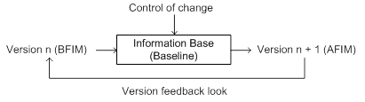
Information Assurance
Version management
This task is responsible for managing the versions of a baseline. We can understand the version in terms of BeFore Image (BFIM) and AFter Image (AFIM) of a baseline.
Version management
An organization must keep all baseline versions for two reasons (a) for self-evaluation and (b) for strategic planning. A self-evaluation is done using all BFIMs. The strategic planning is done using AFIMs. The set of BFIMs forms a data warehouse for the organization.

Slide 19
The Need for Assurance
Manufacturers of a system always overrate their product capability including security. For example, operating systems, critical applications, and computer systems are often marketed as "secure," whereas in reality they have serious flaws that undermine their security features, or they are used in environments other than those for which their security features were developed. Accidental or unintentional failures of computer systems, as well as intentional compromises of security mechanisms, can lead to security failures.
There are nine types of problem sources in computer systems. Assurance addresses each of these problem sources (except for natural causes.)

Slide 20
The Need for Assurance
Assurance techniques can detect security design flaws, allowing their correction prior to costly development and deployment of flawed systems and take care of the following:
Requirements definitions, omissions, and mistakes (design assurance)
System design flaws (design assurance)
Willful system misuse (design assurance)

Slide 21
The Need for Assurance
Implementation assurance takes care of the following:
Hardware implementation flaws, such as wiring and chip flaws
Software implementation errors, program bugs, and compiler bugs
Hardware, communication, or other equipment malfunction

Slide 22
The Need for Assurance
Maintenance and upgrades take care of the following:
Evolution, maintenance, faulty upgrades, and decommissions
Usage policy takes care of item
Willful system misuse
Protection from environmentally induced problems takes care of
Environmental problems, natural causes, and acts of God
Operational assurance policy takes care of items
System use and operation errors and inadvertent mistakes
Willful system misuse

Slide 23
The Need for Assurance
Example 1:
The space shuttle Challenger exploded on January 28, 1986, killing everyone on board. An essential failure was a decision to take shortcuts to meet an accelerated launch schedule. Among other steps, several sensors were removed from the booster rockets. The sensors might have enabled analysts to detect that the cold weather was affecting the booster rockets adversely and to delay the launch. Better assurance techniques might have detected the possible effects of removing the sensors, as well as other problems in the design of the booster rockets.

Slide 24
The Need for Assurance
Example 2:
Three patients died from a radiation overdose attributed to a Therac 25 computer-based electron accelerator radiation therapy system. The flaws in the system resulted from two flaws in the design of the system's software and the removal of a hardware safety interlock. Assurance techniques would have detected the flaws in the software's design, and ongoing assurance techniques would have detected the removal of the interlock.

Slide 25
The Need for Assurance
Example 3:
Although the most significant root cause of the Three Mile Island nuclear failure was a hardware problem (nonstandard instruments were used to measure core temperature), design and software problems contributed significantly. When the temperature rose very high, the system printed a string of question marks rather than the measured temperature. In addition, the intended, rather than the actual, valve settings were displayed. Assurance techniques would have detected these software flaws. Sometimes safety and security measures can backfire. Assurance techniques highlight the consequences of these errors.

Slide 26
The Need for Assurance
Example 4:
The Bell V22 Osprey is a high-technology helicopter. After a fifth Osprey had crashed, an analysis traced the cause to a failure to collect for malfunctioning components. The Osprey implemented a majority-voting algorithm, and the cross-wiring of two roll-rate sensors allowed two faulty components to outvote the third, correctly functioning, component. Although assurance techniques might not have prevented the incorrect voting, they would have emphasized the results that could have occurred if faulty components overrode the correctly functioning components.

Slide 27
The Need for Assurance
Example 5:
When bugs were found in the trigonometric functions of the Intel 486 chip, Intel's public reputation was damaged, and replacing the chips cost Intel time and money. As a result, Intel began using high-assurance methods to verify the correctness of requirements in their chip design.

Slide 28
Assurance Throughout the Life Cycle
Different assurance techniques apply to different stages of system development. For this reason, it is convenient to classify assurance into policy assurance, design assurance, implementation assurance, and operational or administrative assurance.
Policy assurance is based on a rigorous evaluation of the requirements. Completeness and consistency are demonstrated by identifying security threats and objectives and by showing that the requirements are sufficient to counter the threats or meet the requirements.

Slide 29
Assurance Throughout the Life Cycle
Definition 2. Policy assurance is the evidence establishing that the set of security requirements in the policy is complete, consistent, and technically sound.
This process is usually iterative because assurance steps identify flaws that must be connected. When this happens, the affected steps must be rechecked

Slide 30
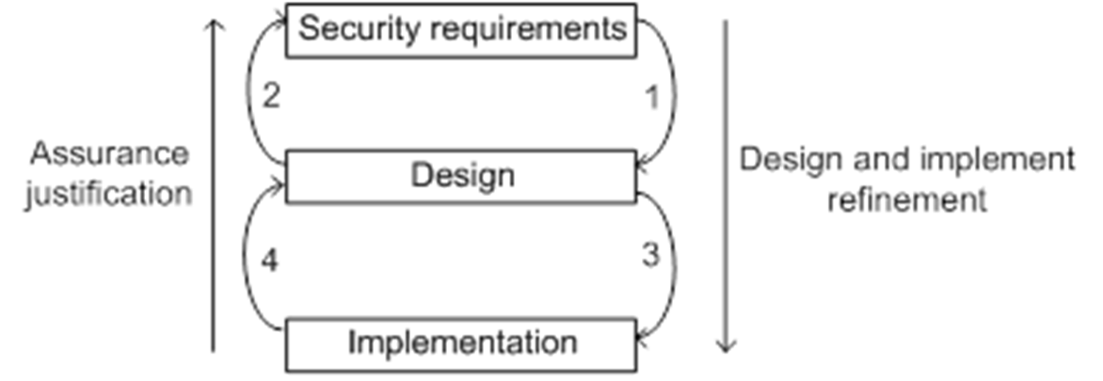
Assurance Throughout the Life Cycle
Example: If assurance step 4 of the figure indicates a flaw in the implementation, the implementation will have to be adjusted and the affected parts of step 4 redone. If this flaw in the implementation in turn indicates a flaw in the design, the design must be adjusted, causing steps 1 ,2, 3, and 4 to be revisited. On rare occasions, a flaw in the implementation or design may point to a flaw in the requirements. Assurance must continue throughout the life of the system because maintenance and patching usually affect the system design and implementation.

Slide 31
Assurance Throughout the Life Cycle
Definition 3. Design assurance is the evidence establishing that a design is sufficient to meet the requirements of the security policy.
Design assurance includes the use of good security engineering practices to create an appropriate security design to implement the security requirements. It also includes an assessment of how well the system design meets the security requirements

Slide 32
Assurance Throughout the Life Cycle
Definition 4. Implementation assurance is the evidence establishing that the implementation is consistent with the security requirements of the security policy.
In practice, implementation assurance shows that the implementation is consistent with the design that design assurance showed was consistent with the security requirements found in the security policy. Implementation assurance includes the use of good security engineering practices to implement the design correctly, both during development and through the maintenance and repair cycles.

Slide 33
Assurance Throughout the Life Cycle
Definition 5. Operational or administrative assurance is the evidence establishing that the system sustains the security policy requirements during installation, configuration, and day-to-day operation.
One fundamental operational assurance technique is a thorough review of product or system documentation and procedures, to ensure that the system cannot accidentally be placed into a insecure state. This emphasizes the importance of proper and complete documentation for computer applications, systems, and other entities

Slide 34
Risk Management
A company’s database transmits salary information over the network to print employees’ salary checks. The risk of unauthorized changes in the data occurs in three places: (a) on the database systems, (b) on the network, and (c) on the printing system. This implies that the risk is a function of environment.
Attackers from outside the company are able to hack the network. If the company is not able to protect itself then employees may lose faith in the company. The company may not be able to hire new qualified employees because it is unable to meet its own deadline.
This makes the risk analysis an important task for information assurance.

Slide 35
Risk Management
One of the important aspects of information assurance is to anticipate and manage risks.
Risk management is the process of identifying, assessing, prioritizing, and addressing risk.
Positive risk: It benefits an organization. Thus, the risk management philosophy simultaneously does the following:
(a) minimizes the effect of negative risk (e.g., installs surge protector to minimize damage to electronic equipment)
(b) maximize the effects of positive risks (e.g., install useful free software from the web after virus scan.)
To manage risks satisfactorily, we need to understand risk and threat clearly. They can be defined as follows.

Slide 36
Risk Management
Risk
A risk is the possibility that a threat is capable of exploiting a known weakness or vulnerability.
Discussion: Risk is the probability that a hazard will turn into a disaster. Vulnerability and hazards are not dangerous, taken separately. But if they come together, they become a risk or, in other words, the probability that a disaster will happen. For example, your neighbor brought two alligators and tied them in his front yard. You are afraid of alligators so this act of your neighbor created a risk for you.

Slide 37
Risk Management
Risk
A threat is a possibility of something bad happening - an event that has some sort of negative impact.
Discussion: The situation or possibility can be created by nature or by somebody or by something. For example, misplacing or losing your driver’s license. This may create a situation (threat) where you are likely to lose your privacy. Similarly if a bank loses its customer’s credit card information their confidentiality is compromised. For example, the presence of these alligators next to your house is a risky situation that creates a threat to your life. Thus,
Risk = Threats × Vulnerability

Slide 38
Risk Management
Risk assessment: It identifies specific vulnerabilities and the threats that could exploit them
The assessment process has two components (a) risk classification and (b) risk response
Risk classification
Risk identification
Risk estimation

Slide 39
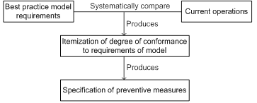
Risk Management
Risk identification
It is a range-finding activity. It identifies potentially harmful risks. A gap analysis is an ideal way to do the identification.
Gap analysis: This analysis identifies the gaps between the best practice specified in the model and the current operations. This process is illustrated in Figure below

Slide 40
Risk Management
Risk identification
Discussion: An event is only a risk if there is a degree of uncertainty associated with it. When identifying project risks, make sure that you describe the risk itself and neither the cause nor the effect.

Slide 41
Risk Management
Risk identification: Examples
Consider the implementation of a project. The value of money will change during the execution of the project. This is certain from experience. But by how much? This cannot be accurately answered by anybody so it is uncertain. For this reason this is a risk but this may be negligible if the project is short.

Slide 42
Risk Management
Risk identification: Examples
Consider a software utility project. A new software module has been developed that you must install at branches of your office (many PCs). However, not all offices have the storage capacity required by this module. We consider the following questions:
Q: Is it a risk because you have to install?
A: No, that is a requirement.
Q: Is it a risk that an office will end up without this module?
A: No, that is the effect, relative to this project. It could be a risk for a project dependent on this software
Q: Is it a risk that the module may fail to install?
A: Yes, that is the uncertainty.
Q: Is it a risk if you completely trust an insider of a company for dealing with confidential information?
A: ?.

Slide 43
Risk Management
Practice
Perform a gap analysis between data management through a database system and through a file system. (Hint: Ideal system – Database system. Your current system – File system.)

Slide 44
Risk Management
Risk Estimation
Risk estimation is the mechanism to measure and quantify each potential risk. It quantifies duration, intensity, magnitude, and reach of the potential consequences of a risk in quantifiable or dollar value (monetary) terms.
It determines the probability and impact of all threats that have been identified through risk identification. It provides the data for the analysis and decision making about the form of the response. That is, any number of countermeasures might be appropriate to a given vulnerability.

Slide 45
Risk Management
Risk Estimation
Quantitative factors: These are necessary for risk estimation. Some of the important factors are affected assets, potential threat duration, and the severity of adverse impact.
Making the business case: Since the adverse impact of threats cost money, it is important to factor applicable return on investment (ROI) issues into the eventual security response. One obvious reason for that is to ensure that the countermeasure does not cost more than the harm the threat would cost.
Trade-offs: Cost benefit and likelihood of occurrence have to be balanced when formulating a security response.

Slide 46
Risk Management
Risk Estimation
Making a practical decision: Note that the cost of risk estimation and the cost of the damage (trade-offs) are the driving parameters for risk management. That is, the estimated expense of maintaining a countermeasure over one year (Annual Loss Exposure: ALE) is evaluated against the costs that would be incurred if the threat were to happen. If the expense is greater than any possible harm, then the countermeasure is not included in the security response. For example, if a small fire can be extinguished by a portable fire extinguisher then there is no need to call the fire-fighters. The formula for determining annualized loss exposure (ALE) is:
ALE =
Annual cost of deployment –
(Annual rate of occurrence × Cost per occurrence)

Slide 47
Risk Management
Risk Estimation
Degree of certainty: Decision makers must have confidence in the method of risk assessment.
The risk mitigation report: The outcome of the strategy formulation phase is a report that is distributed to people charged with the responsibility for implementing the risk mitigation strategy. The mechanism for communicating information about risk is risk mitigation report. It specifies the steps selected for each risk and itemizes the countermeasures that will be implemented as well as the parties in the organization who will be responsible for accomplishing each task.

Slide 48
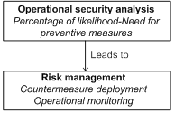
Risk Management
Risk Estimation
Operational security analysis: Decides deploy or not to deploy a countermeasure (Figure below.)
Operational security analysis

