Slide 1
SNORT (an open source network IPS)
www.snort.org

Slide 2
Snort
Snort can be configured to run in three modes:
Sniffer mode - reads the packets off of the network and displays them in a continuous stream on the console (screen).
Command: “snort -i <interface> -dev”
Packet Logger mode - logs the packets to disk.
Command: “snort -i <interface> -dev –l ./log”
Network Intrusion Detection System (NIDS) mode - performs detection and analysis on network traffic.
Command: “snort -i <interface> -c C:\Snort\etc\snort.conf -A fast”

Slide 3
SNORT Rules
alert icmp 192.168.1.4 any -> $HOME_NET any (msg: “Testing ICMP"; sid:1000001; )
alert tcp any any -> any 80 (msg: “Web Service"; sid:1000002; )
Rule Format: Rule Header (Rule Options)

Slide 4
Sample alert.ids file
06/08-13:24:15.169847 [**] [1:1000001:0] Testing ICMP [**] [Priority: 0] {ICMP} 8.18.45.80 -> 10.205.1.16
06/08-13:24:16.167148 [**] [1:1000001:0] Testing ICMP [**] [Priority: 0] {ICMP} 8.18.45.81 -> 10.205.1.16
06/08-13:24:18.525330 [**] [1:1000001:0] Testing ICMP [**] [Priority: 0] {ICMP} 204.76.187.75 -> 10.205.1.16
06/08-13:24:20.125623 [**] [1:1000001:0] Testing ICMP [**] [Priority: 0] {ICMP} 204.76.187.75 -> 10.205.1.16
06/08-13:24:20.167328 [**] [1:1000001:0] Testing ICMP [**] [Priority: 0] {ICMP} 8.18.45.81 -> 10.205.1.16
06/08-13:24:20.169314 [**] [1:1000001:0] Testing ICMP [**] [Priority: 0] {ICMP} 8.18.45.80 -> 10.205.1.16

Slide 5
Rule Header
Action Protocol Src_IP Src_Port Direction Dest_IP Dest_Port
Eg: alert tcp any any -> 204.76.182.0/24 80

Slide 6
Rule Header
Action:
alert - generate an alert using the selected alert method, and then log the packet.
log - log the packet (This writes pcap format of the traffic that caused the alert)
pass - ignore the packet
activate - alert and then turn on another dynamic rule
dynamic - remain idle until activated by an activate rule , then act as a log rule

Slide 7
Rule Header
Action:
drop (inline mode) - drop the packet and log the packet
reject (inline mode) - drop the packet, log it, and then send a TCP reset if the protocol is TCP or an ICMP port unreachable message if the protocol is UDP.
sdrop (inline mode) - drop the packet but do not log it.

Slide 8
Rule Header
Protocol:
TCP
UDP
ICMP
IP

Slide 9
Rule Header
Source/Destination IP addresses:
Should use CIDR notation x.x.x.x/24
Use the 'any' keyword to match any address
Use the logical not operator '!' to match all addresses but the one you enter
Use snort.config variables!
$HOME_NET
$EXTERNAL_NET

Slide 10
Rule Header
Source/Destination Port numbers:
Use the 'any' keyword to match any ports
Use snort.conf variables
$HTTP_PORTS
You can also add your own variables to snort.conf
Use the logical not operator '!' to match all ports but the one you enter.

Slide 11
Rule Header
Source/Destination Port numbers:
Examples:
Single port – ’80’
All ports – ‘any’
All ports except 21 - ‘!21’
Range of ports (port 1 threw port 1024) - ‘1:1024 ‘
Ports less than or equal to 6000 - ‘:6000 ‘
Ports greater than or equal to 500 - ‘500:’

Slide 12
Rule Header
Direction of the flow:
Coming from source going to destination , use ‘- >’
Traveling in either direction, use ‘< >’
NOTE: There is no ‘< -’ operator.

Slide 13
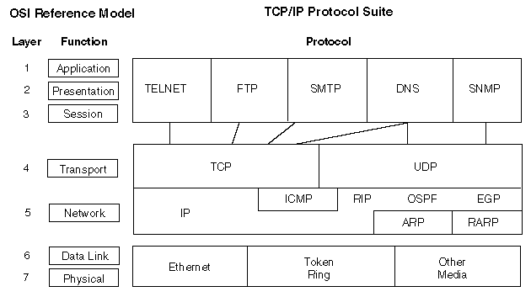
TCP/IP Protocol Suite

Slide 14
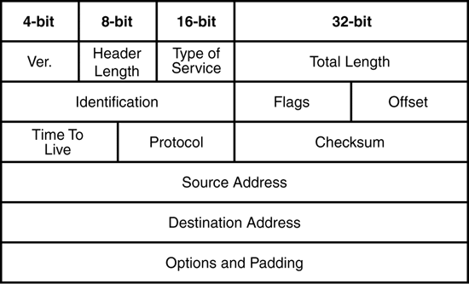
IP Header

Slide 15
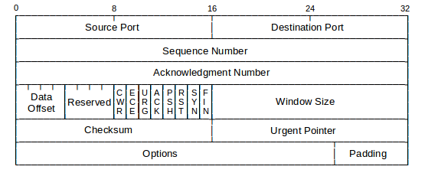
TCP Header

Slide 16
Rule Options
Enclosed in parenthesis: ( )
Keyword:Value pairs
Each packet attribute is separated by a semicolon (;)
semicolon needs to be included even at the end of the options string.
Eg: (keyword:value;)
There are Four categories of rule options:
General, Payload, Non-Payload and Post Detection

Slide 17
For more details, refer Snort Manual
(available in blackboard)

