Slide 1
Dynamo: Amazon’s Highly Available Key-value Store
ID2210-VT13
Slides by Tallat M. Shafaat

Slide 2
Dynamo
An infrastructure to host services
Reliability and fault-tolerance at massive scale
Availability providing an ”always-on” experience
Cost-effectiveness
Performance

Slide 3
Context
Amazon’s e-commerce platform
  Shopping cart served tens of millions requests, over 3 million checkouts in a single day
Unavailability == $$$
No complex queries
Managed system
  Add/remove nodes
  Security
  Byzantine nodes

Slide 4
CAP Theorem
Only two possible at the same time
  Consistency
  Availability
  Partition-tolerance
Dynamo, target applications:
  Availability and Parition-tolerance
  Eventual consistency

Slide 5
Clients view on Consistency
Strong consistency.
  Single storage image. After the update completes, any subsequent access will return the updated value.
Weak consistency.
  The system does not guarantee that subsequent accesses will return the updated value.
  Inconsistency window.
Eventual consistency.
  Form of weak consistency
  If no new updates are made to the object, eventually all accesses will return the last updated value.

Slide 6
Eventual consistency
Causal consistency
Read-your-writes consistency
...
Inconsistent copy 1
Consistent data
Consistent data
Inconsistent copy 2
Reconciliation
Inconsistent copy 3

Slide 7
Requirements
Query model
  Simple read/write operations on small data items
ACID properties
  Weaker consistency model
  No isolation, only single key updates
Efficiency
  Tradeoff between performance, cost efficiency, availability and durability guarantees

Slide 8
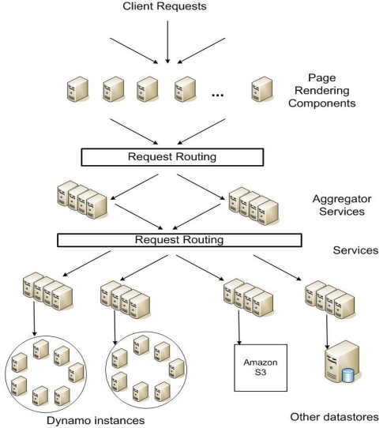
Amazon Store Architecture

Slide 9
Design considerations
Conflict resolution
  When
  Who
Scalability
Symmetry
Decentralization
Heterogeneity

Slide 10
The big picture
Easy usage
Load-balancing
Replication
Eventual consistency
High availability
Easy management
Failure-detection
Scalability

Slide 11
Easy usage: Interface
get(key)
  return single object or list of objects with conflicting version and context
put(key, context, object)
  store object and context under key
Context encodes system meta-data, e.g. version number

Slide 12
Data partitioning
Based on consistent hashing
Hash key and put on responsible node
15
0
1
14
2
13
3
12
4
11
5
10
6
9
7
8

Slide 13
Load balancing
Load
  Storage bits
  Popularity of the item
  Processing required to serve the item
  …
Consistent hashing may lead to imbalance

Slide 14
Load imbalance (1/5)
Node identifiers may not be balanced

Slide 15
Load imbalance (2/5)
Node identifiers may not be balanced

Slide 16
Load imbalance (3/5)
Node identifiers may not be balanced
Data identifiers may not be balanced
node
data

Slide 17
Load imbalance (4/5)
Node identifiers may not be balanced
Data identifiers may not be balanced
Hot spots
tallat-song4.mp3
tallat-song3.mp3
tallat-song1.mp3
tallat-song2.mp3
britney.mp3
node
data

Slide 18
Load imbalance (5/5)
Node identifiers may not be balanced
Data identifiers may not be balanced
Hot spots
Heterogeneous nodes
node
data

Slide 19
Load balancing via Virtual Servers
Each physical node picks multiple random identifiers
  Each identifier represents a virtual server
  Each node runs multiple virtual servers
Each node responsible for noncontiguous regions

Slide 20
Virtual Servers
How many virtual servers?
  For homogeneous, all nodes run log N virtual servers
  For heterogeneous, nodes run clogN virtual servers, where ‘c’ is
    small for weak nodes
    large for powerful nodes
  Move virtual servers from
  heavily loaded physical
  nodes to lightly loaded
  physical nodes

Slide 21
Replication
Successor list replication
  Replicate the data of your N closest neighbors for a replication factor of N
Node 11
Node 10
Node 5
Data: 12, 13, 14, 15, 0
15
0
1
Node 0
Node 11
Node 10
14
2
Data: 1, 2, 3
13
3
Node 10
Node 5
Node 3
12
4
Data: 11
Node 3
Node 0
Node 11
11
5
Data: 4, 5
Node 5
Node 3
Node 0
10
6
Data: 6, 7, 8, 9, 10
9
7
8

Slide 22
The big picture
Easy usage
Load-balancing
Replication
Eventual consistency
High availability
Easy management
Failure-detection
Scalability

Slide 23
Data versioning (1/3)
Eventual consistency, updates propagated asynchronously
Each modification is a new and immutable version of the data
  Multiple versions of an object
New versions can subsume older versions
  Syntactic reconciliation
  Semantic reconciliation

Slide 24
Data versioning (2/3)
Version branching due to failures, network partitions, etc.
Target applications aware of multiple versions
Use vector clocks for capturing causality
  If causal, older version can be forgotten
  If concurrent, conflict exists requiring reconciliation
A put requires a context, i.e. which version to update

Slide 25
Data versioning (3/3)
write handled by Sx
Client C1 writes new object
  say via Sx
C1 updates the object
  say via Sx
C1 updates the object
  say via Sy
C2 reads D2 and updates the object
  Say via Sz
Reconciliation
D1 ([Sx,1])
write handled by Sx
D2 ([Sx,2])
write handled by Sy
write handled by Sz
D3 ([Sx,2], [Sy,1])
D4 ([Sx,2], [Sz,1])
reconsiled and written by Sx
D5 ([Sx,3], [Sy,1], [Sz,1])

Slide 26
Execution of operations
put and get operations
Client can send the request
  to the node responsible for the data
    Save on latency, code on client
  to a generic load balancer
    Extra hop

Slide 27
Quorum systems
R / W : minimum number of nodes that must participate in a successul read / write
R + W > N (overlap)
R=3, W=3, N=5
R=4, W=2, N=5

Slide 28
put (key, value, context)
Coordinator generates new vector clock and writes the new version locally
Send to N nodes
Wait for response from W-1 nodes
Using W=1
  High availability for writes
  Low durability

Slide 29
(value, context) ← get (key)
Coordinator requests existing versions from N
Wait for response from R nodes
If multiple versions, return all versions that are causally unrelated
Divergent versions are then reconciled
Reconciled version written back
Using R=1
  High performance read engine

Slide 30
The big picture
Easy usage
Load-balancing
Replication
Eventual consistency
High availability
Easy management
Failure-detection
Scalability

Slide 31
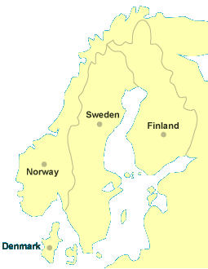
Handling transient failures
1
1’
A managed system
Which N nodes to update?
Say A is unreachable
’put’ will use D
Later, D detects A is alive
  send the replica to A
  remove the replica
Tolerate failure of a data center
  Each object replicated across multiple
  data centers
1
1’
A
B
1
C
1’
D
1’

Slide 32
Handling permanent failures (1/2)
Anti-entropy for replica synchronization
Use Merkle trees for fast inconsistency detection and minimum transfer of data
1
5
Data items: D2, D3, D4, D5
Hash
Hash
Hash
Hash
Hash
Hash
Hash
D2
D3
D4
D5

Slide 33
Handling permanent failures (2/2)
Nodes maintain Merkle tree of each key range
Exchange root of Merkle tree to check if the key ranges are up-to-date
1
1’
1
1’
A
B
C
1

Slide 34
Quorums under failures systems
Due to partitions, quorums might not exist
Create transient replicas
Reconcile after partition heals
R=3, W=3, N=5

Slide 35
Membership
A managed system
  Administrator explicitly adds and removes nodes
Receiving node stores changes with time stamp
Gossiping to propagate membership changes
  Eventually consistent view
  O(1) hop overlay
    log(n) hops, e.g. n=1024, 10 hops, 50ms/hop, 500ms

Slide 36
Failure detection
Passive failure detection
  Use pings only for detection from failed to alive
  A detects B as failed if it doesnt respond to a message
  A periodically checks if B is alive again
In the absense of client requests, A doesn’t need to know if B is alive
  Permanent node additions and removals are explicit

Slide 37
Adding nodes
A new node X added to system
X is assigned key ranges w.r.t. its virtual servers
For each key range, it transfers the data items
Node A
Node G
Data: (A, X]
X=Data\(X,B)
Data=Data\(A,X)
Drop G
X
Node A
Node G
A
B
Data: (A, B]
G
X=B\(X,B)
B=B\(A,X)
Drop A
C
Node B
Node A
Data: (B, C]
F
E
D
Node C
Node B
Data: (C, D]

Slide 38
Removing nodes
Reallocation of keys is a reverse process of adding nodes

Slide 39
Implementation details
Local persistence
  BDS, MySQL, etc.
Request coordination
  Read operation
    Create context
    Syntactic reconciliation
    Read repair
  Write operation
    Read-your-writes

Slide 40
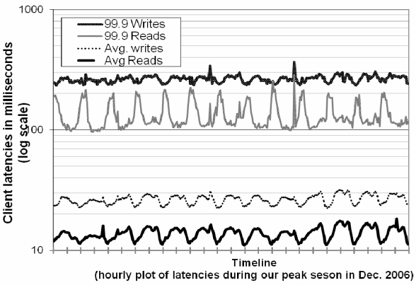
Evaluation

Slide 41
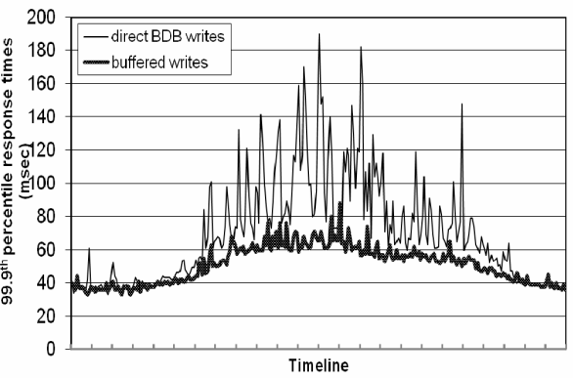
Evaluation

Slide 42
Partitioning and placement (1/2)
Data ranges are not fixed
  More time spend to locate items
  More data storage needed for indexing
Inefficient bootstrapping
Difficult to archive the whole data
A
H
B
G
C
F
E
D

Slide 43
Partitioning and placement (2/2)
Divide data space into equally sized ranges
Assign ranges to nodes
A
H
B
G
C
F
D
E

Slide 44
Versions of an item
Reason
  Node failures, data center failures, network partitions
  Large number of concurrent writes to an item
Occurence
  99.94 % one version
  0.00057 % two versions
  0.00047 % three versions
  0.00009 % four versions
Evaluation: versioning due to concurrent writes

Slide 45
Client vs Server coordination
Read requests coordinated by any Dynamo node
Write requests coordinated by a node replicating the data item
Request coordination can be moved to client
  Use libraries
  Reduces latency by saving one hop
  Client library updates view of membership periodically

Slide 46
End notes
Peer-to-peer techniques have been the key enablers for building Dynamo:
”... decentralized techniques can be combined to provide a single highly-available system.”

Slide 47
References
Dynamo: amazon's highly available key-value store, Giuseppe DeCandia et. al., SOSP 2007.
Bigtable: A Distributed Storage System for Structured Data, Fay Chang et. al., OSDI 2006.
Casandra - http://cassandra.apache.org/
Eventual consistency - http://www.allthingsdistri buted.com/ 2008/12/eventually_consistent.html
Key values stores, No SQL

