Slide 1
Propel GO
A new gaming experience to Propel Students

Slide 2
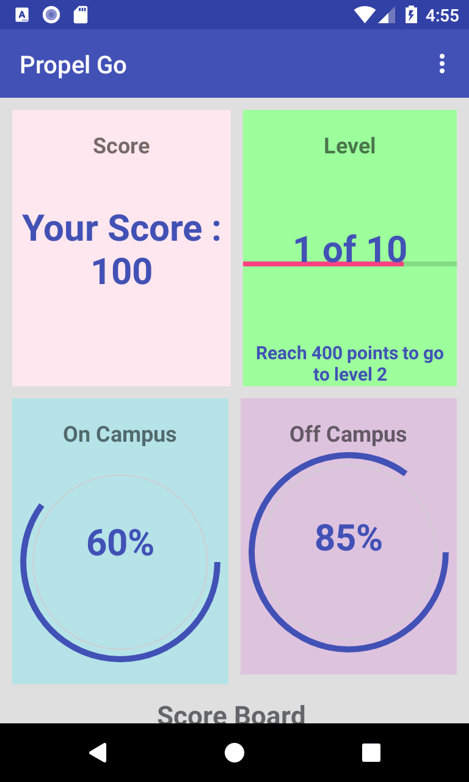


Functional Requirement
To make use of augmented reality and develop a game that encourages students to engage with campus life and with their communities which includes On-Campus Activities and Off-Campus Activities

Slide 3
Objectives:
Students should be using the library, gym, eating in the cafeteria, going to Mind Body Connection, or going to talks, plays, or sporting events etc. which are On-Campus activities
Students must be able to register their participation for Off-Campus activities like Volunteering, taking the bus, working, applying for jobs etc. by taking a photo and submitting.
Goal: Use the game to prompt them for productive things to do on campus and Off Campus

Slide 4
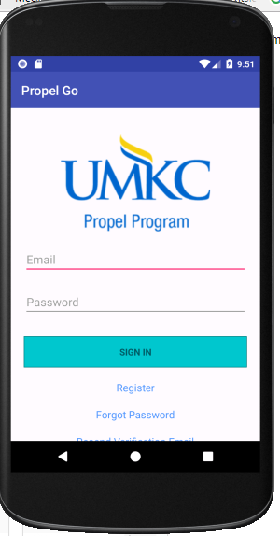
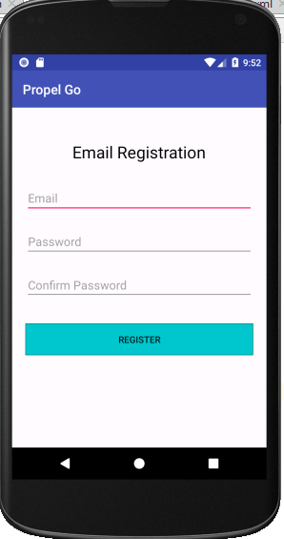
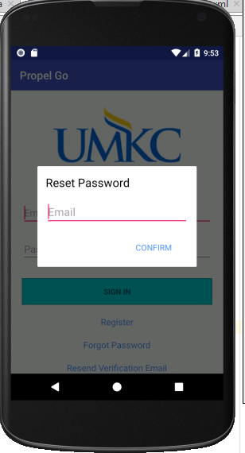
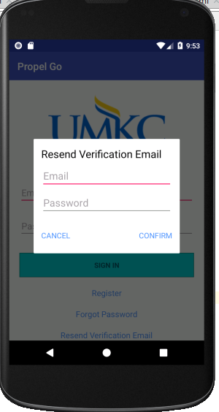
Registration and Login

Slide 5
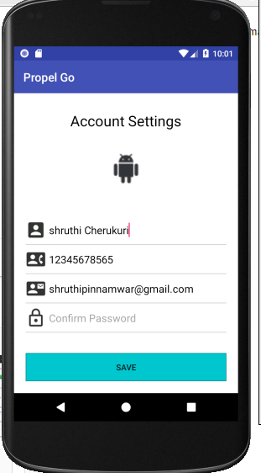
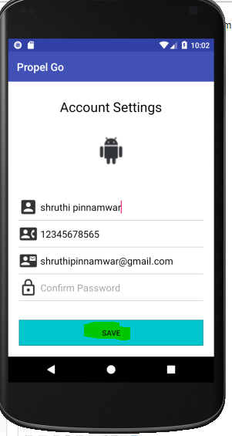
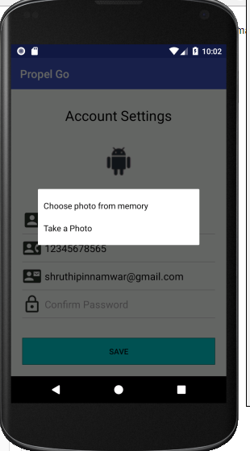
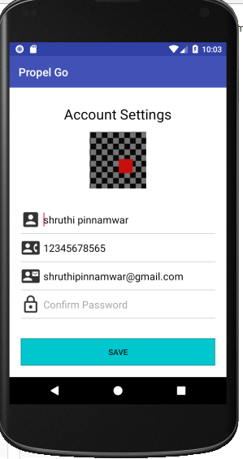
Account Settings

Slide 6
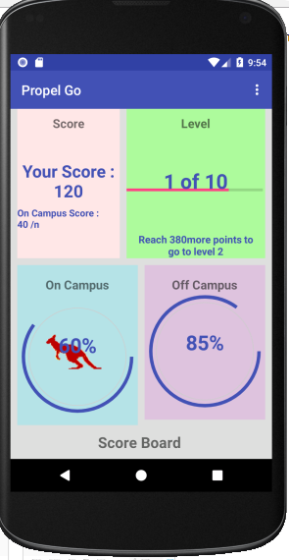
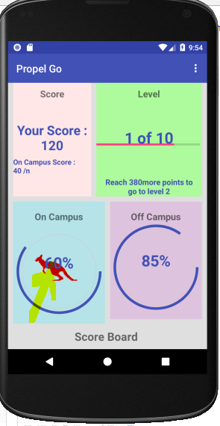
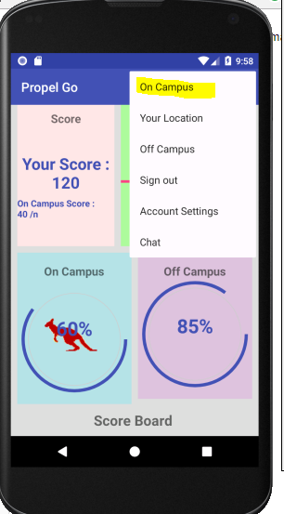
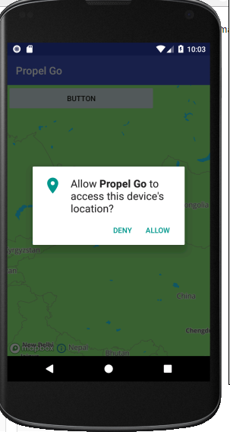
On Campus Activities

Slide 7
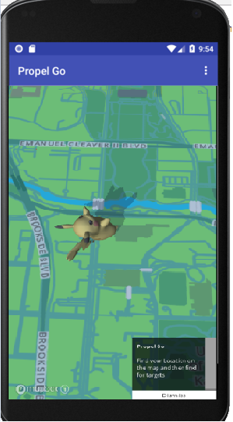
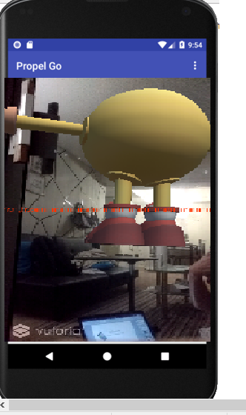

Slide 8
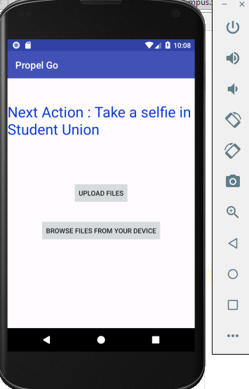
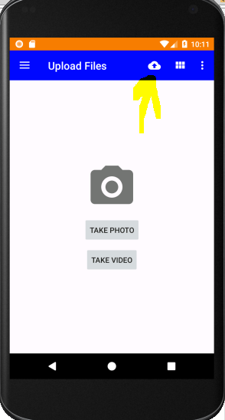
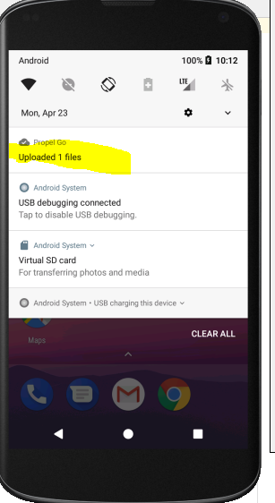
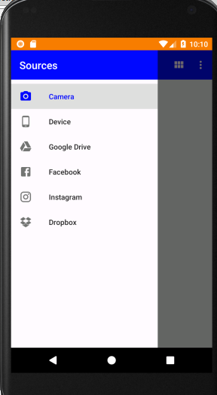
Off Campus Activities

Slide 9
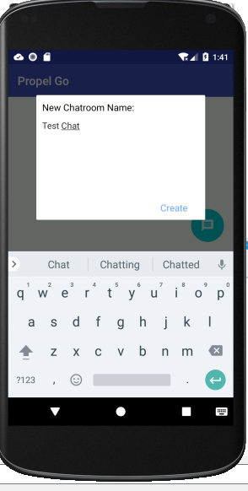
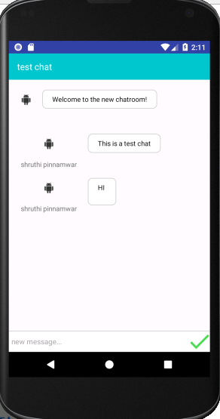
Chatroom

Slide 10
Off-Campus Activity
After the student logs in to the application, he has a choice to choose between OnCampus and OffCampus activities.
This overall functionality is implemented using SQLite database where in we have created an internal db file for each of the category.
If the student wants to play a quiz, he has to choose the offCampus activity which will take him to the quiz application.
After the timer is out, for that particular category score is displayed on the screen with a remark of his performance like Excellent, Average, Poor. Student has also the option to look at his overall statistics( score from each category) on all the categories that are available on the quiz.

Slide 11
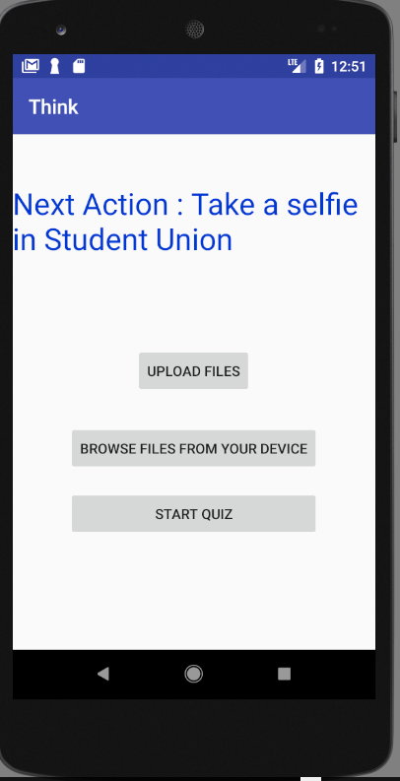
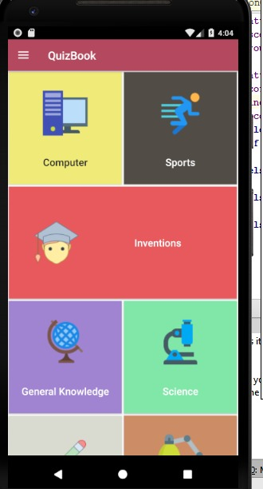
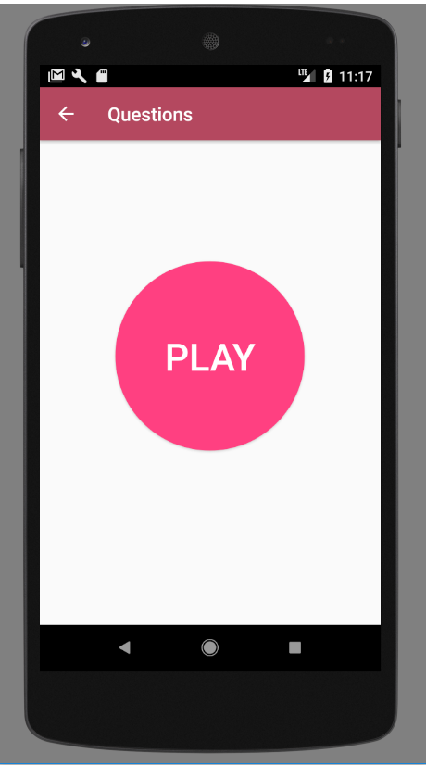
Off-Campus Quiz

Slide 12
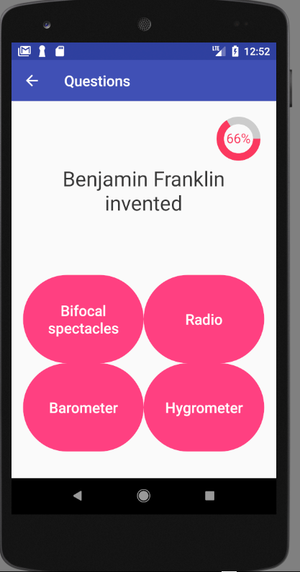
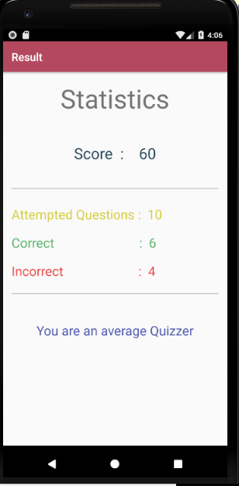
Quiz Questions & Final Result Display

Slide 13
Thank You

