Slide 1
HadoopDB: An Architectural Hybrid of MapReduce and DBMS Technologies for Analytical Workloads
Sharath Koppu, Aravind Sheri, Harish Chandra, Archana

Slide 2
Introduction
Analytical data management applications are rapidly increasing in the production environment
The amount of data that needs to be analyzed is exploding, requiring hundreds to thousands of machines to work in parallel to perform the data analysis
Also, many enterprises are moving away from deploying analytical databases on high end machines towards cheaper, lower end in a shared nothing MPP architecture

Slide 3
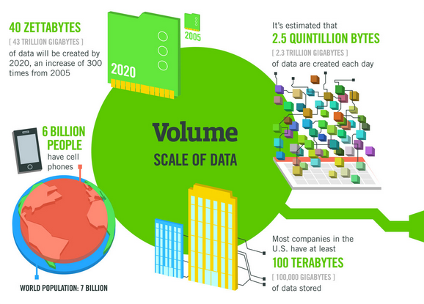
Data is exploding

Slide 4
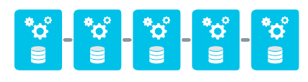
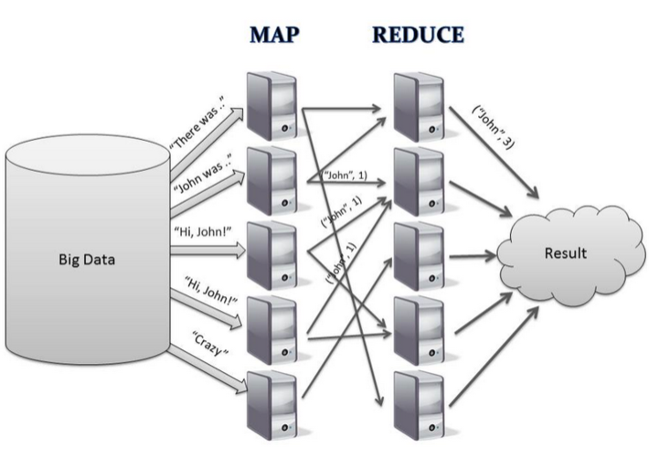
Background and Shortfalls
Two approaches to solve the problem:
Parallel databases
MapReduce based systems

Slide 5
A New Breed of DBMS Systems
Most systems are being implemented on shared-nothing systems, as they are believed to scale the best
Large scan operations, multidimensional aggregation, and star schema joins are easy to implement in a parallelized shared-nothing system

Slide 6
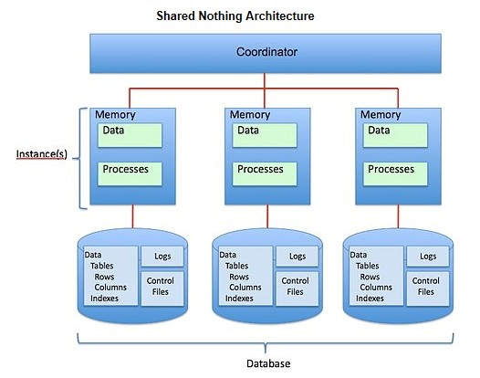
Shared nothing Architecture
A collection of independent, possibly virtual, machines, each with local disk and local main memory, connected together on a high-speed network

Slide 7
Parallel Databases
Scale very well in tens of nodes (near linear is not uncommon)
Few exist in the hundreds range
None exist that range in the thousands
One main reason is due to failure rate
Parallel databases are built assuming failure is rare
Second – They assume that hardware is homogenous
Third – Few applications exists that need more than a few dozen nodes

Slide 8
Map Reduce
MapReduce (or one of its open source versions such as Hadoop) can operate easily on thousands of nodes, and can do so quite successfully, and can be obtained for less money than a parallel database
MapReduce can even process structured data like parallel databases can
Unfortunately, MapReduce is an order of magnitude slower at process structured data than parallel databases
- Caused by the fact that MapReduce does not use indexing and databases will to reduce search time (D. DeWitt and M. Stonebraker. MapReduce: A major step backwards. DatabaseColumn Blog)
- MapReduce also lacks many other features that databases have, such as bulk loading, views, and integrity constraints

Slide 9
Desired Properties for Data Analysis
Performance – Computing the results of a query faster
Fault Tolerance – Rescheduling parts of query execution in the case of node failures
Ability to run in heterogenous environment – Getting the same performance from all machines is difficult
Flexible query interface – Should support ODBC/JDBC and user defined functions

Slide 10
Parallel DBMS (Massively ParalleProcessing)
Local (to node) storage
Multiples nodes, each independent
Workload is distributed across multiple instances
Each node/host has an instance of the DB deployed
Standard SQL99 and relational properties
Data partitioned over multiple nodes
Decades of performance enhancing techniques:
including indexing, compression, materialized views, result caching, and I/O sharing.

Slide 11
Parallel DBMS
Pros:
Parallel databases can achieve
Especially high performance with proper tuning and deployment automation
Flexible query interface (since support SQL, ODBC, UDFs) – even for distributed workloads
Cons:
Can do better on fault tolerance and resiliency to h/w failures
Inability to handle heterogeneous environment in an optimized way (ie., does not take advantage of machine configurations – runs all workloads homogenously

Slide 12
Map Reduce
MapReduce processes data distributed (and replicated) across many nodes in a shared-nothing cluster via three basic operations
A set of Map tasks are processed in parallel by each node in the cluster without communicating with other nodes
Data is repartitioned across all nodes of the cluster
A set of Reduce tasks are executed in parallel by each node on the partition it receives.
The nodes that’d run the task is determined at runtime

Slide 13
Map Reduce

Slide 14
Map Reduce
Pros:
Fault tolerance [by detecting and reassigning Map tasks of failed nodes to other nodes in the cluster
Heterogeneous environment via redundant task execution
Flexible query interface
Cons:
Performance

Slide 15
HadoopDB Inspiration is to combine the two!
 | Performance * | Fault Tolerance | Heterogeneous | Flexible Query Interface
Parallel DBMS
MapReduce
➔ HadoopDB

Slide 16

Basic Design Idea
Connect multiple single-node database systems using Hadoop.
Queries are parallelized across nodes using the MapReduce
Framework.
DB
DB
DB
DB
DB

Slide 17
Achievement of Properties
HadoopDB achieves fault tolerance and operability in heterogeneous environment is achieved by inheriting the scheduling and job tracking implementation from Hadoop
Performance of parallel databases is achieved by doing much of the query processing inside of the database engine.

Slide 18
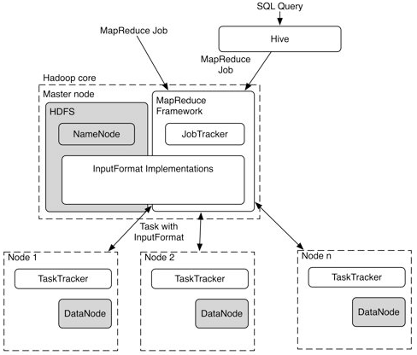
Hadoop Recap

Slide 19
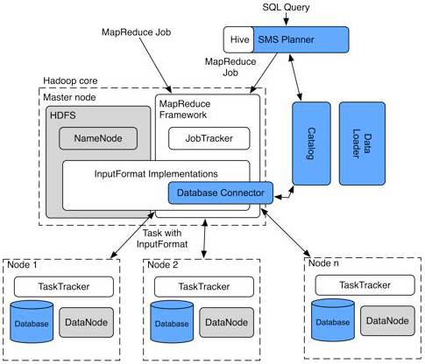
HadoopDB Architecture

Slide 20
HadoopDB Components
Database Connector
Catalog
Data Loader
SQL to M-R to SQL (SMS) Planner

Slide 21
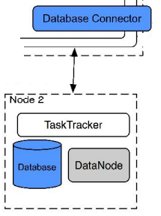
Database Connector
Interface between independent database on the nodes and Task Trackers
Each M-R job supplies the connector with an SQL query and connection parameters
Database connector is responsible for:
1. Connecting to the database
2. Executing the SQL query
3. Returning results as key-value pairs
In this framework, the databases are data sources similar to data blocks in HDFS

Slide 22
Catalog
Maintains metainformation (connection parameters and metadata) about databases
Connection Parameters: database location, driver class and credentials
Metadata: datasets in the cluster, replica locations and partitioning properties
Stored as an XML file in HDFS
JobTracker and TaskTrackers access this information to schedule tasks and process data

Slide 23
Data Loader
Responsibilities:
a. Globally repartition data
b. Breaking single-node data into small chunks
c. Bulk loading single-node databases with the chunks
Components:
i. Global Hasher
ii. Local Hasher

Slide 24
Data Loader
HDFS
Local File System
}
Local Hasher
Local Hasher
Chunks
copy
repartition
HDFS
Global Hasher
repartition
Raw Files

Slide 25
SMS Planner
SQL MapReduce SQL
Extends Hive, an SQL like query processor built on top of Hadoop.
It process the query in a series of phases
1.Parser
2.Semantic Analyzer
3.logical plan generator
4.Optimizer
5.Physical plan generator

Slide 26
SMS Planner
Consider the following query:
SELECT YEAR(saleDate), SUM(revenue)
FROM sales GROUP BY YEAR(saleDate);
Hive processes the above SQL query in a series of phases:
Parser : transforms the query into abstract syntax tree.
Semantic analyzer : connects to hive internal catalog called metastore, to retrieve schema.

Slide 27
SMS Planner
Logical plan generator : Generates a query plan i.e., DAG of relational operators.
Optimizer : Restructures the query plan to create more optimized plan. The key function of the optimizer is to breakup the plan into Map or Reduce phases.
Physical plan generator : Converts logical query plan to physical executable MapReduce jobs.

Slide 28
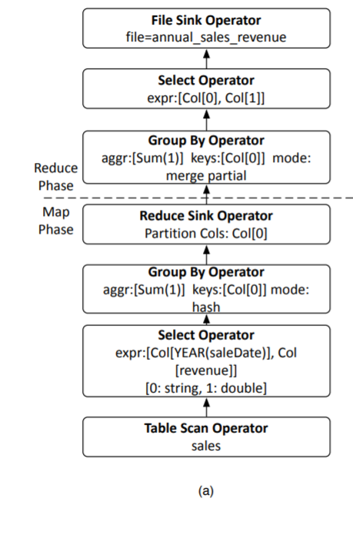

Slide 29
SMS Planner
The SMS planner modifies Hive in two main areas.
Before the query execution, the Metastore is updated with reference to database tables.
After the physical plan generation and before the MapReduce jobs, two passes are performed over the physical plan
The partitioning keys used by the Reduce Sink (Repartition) operators are determined
The DAG is traversed, all operators until the first repartition operator with a partitioning key different from the database’s key are converted into one or more SQL queries and pushed into the database layer.
,

Slide 30
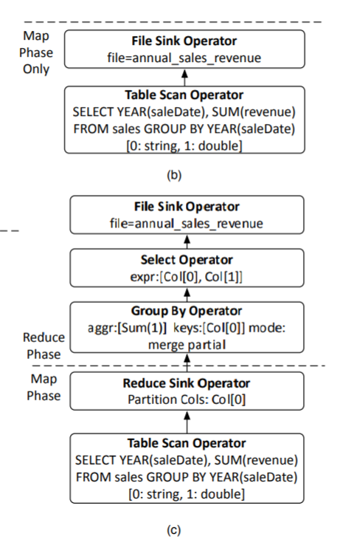
SMS Planner
In the above GroupBy query SMS produces one of two different plans
If the sales table is partitioned by YEAR(saleDate), it produces the query plan in Fig.(b): this plan pushes the entire query processing logic into the database layer.
Otherwise, SMS produces the query plan in Fig.(c) in which the database layer partially aggregates data and eliminates the selection and group-by operator used in the Map phase of the Hive generated query plan

Slide 31
Summary
Hadoop is used :
To store the data using the HDFS file system
For task scheduling, Hadoop’s JobTracker is used to schedule Map and Reduce tasks on the nodes
As network communication layer to transfer the intermediate results of SQL query computations between nodes
An SQL Query is initially broken down in to a batch of MapReduce jobs and then scheduled using Hadoop
HadoopDB doesn’t replace Hadoop. They both coexist providing the analyst to choose the appropriate one.

Slide 32
Comparsion
Parallel Databases
High performance and efficiency
Bad scores in fault tolerance and run in heterogeneous environment
Few known deployments over 100 nodes
MapReduce-based systems
Designed to scale over 1000 of nodes
Fault tolerant and capable to run in heterogeneous environment
Biggest issue with MapReduce is performance

Slide 33
BenchMarks
HadoopDB
MapReduce Implementation
Vertica
DBMS-X

Slide 34
Hardware Configuration
Environment:
Amazon EC2 “large” instances
Each instance
7.5 GB memory
2 virtual cores
850 GB storage
64 bits Linux Fedora 8

Slide 35
BenchMarked Systems
Hadoop
256MB data blocks
1024 MB heap size
132 MB Buffer space
2 mappers and 1 reducer on each node
HadoopDB
Similar to Hadoop conf.
PostgreSQL 8.2.5
No compress data

Slide 36
Contd..
Vertica
New parallel database (column store)
Attributes are stored seperately
Used a cloud edition
All data is compressed
DBMS-X
Comercial parallel row based.
Run on EC2 (not cloud edition available)

Slide 37
Contd..
Scalability:
HadoopDB and Hadoop take advantage of run time scheduling by splitting data
Parallel databases restart entire query on node failure or wait for slowest node
Results are stored in:
HDFS for Hadoop and HadoopDB
Shell commands to files for parallel database

Slide 38
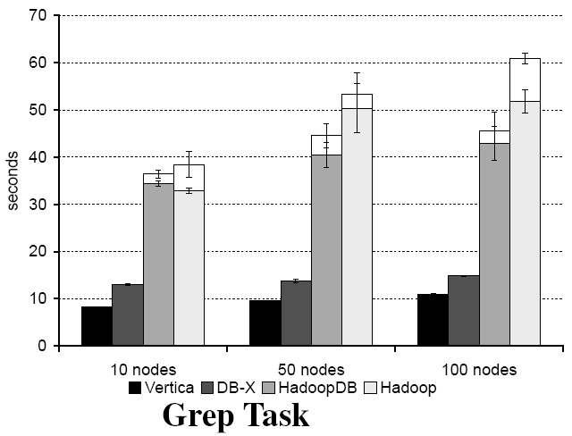
Grep Task
Full table scan , highly selective filter
Random data , no room for indexing
Hadoop overhead overweighs query processing time in single node database
SELECT * FROM Data WHERE field LIKE ‘%XYZ%’ ;

Slide 39
Conclusions
HadoopDB
Fault Tolerance: In the presence of node failures, Hadoop reschedules the tasks and completes the query
Hadoop redundantly executes tasks of straggler nodes thus reducing effect of slow nodes on query time
PostgreSQL is not a column-store and hence a drawback for Hadoop DB
In the event of data explosion and using several hundreds of nodes scalability comes in to picture
Parallel Databases
In case of node failures unfinished queries are aborted and query processing is restarted
There is no way to counter the slow node’s effect on overall query time
Parallel databases like Vertica achieve much better performance due to column store and data compression
Parallel databases are not scalable

Slide 40
References
http://db.cs.yale.edu/hadoopdb/hadoopdb.pdf
Youtube

Slide 41


