Slide 1

Storm @ Twitter Authors: Ankit Toshniwal, Siddarth Taneja, Amit Shukla, Karthik Ramasamy, Jignesh M. Patel*, Sanjeev Kulkarni, Jason Jackson, Krishna Gade, Maosong Fu, Jake Donham, Nikunj Bhagat, Sailesh Mittal, Dmitriy Ryaboy
Presentation by: Nagarjuna, Prathyusha, Amulya, Bhavesh, Bhanu

Slide 2

Abstract
This paper describes :
The usage of Storm at Twitter.
Architecture of Storm and its methods for distributed scale-out and fault-tolerance.
How queries (aka. topologies) are executed in Storm.
Present results from an empirical evaluation demonstrating the resilience of Storm in dealing with machine failures.

Slide 3
History
Storm was initially created by Nathan Marz at BackType, and BackType was acquired by Twitter in 2011.
At Twitter, Storm has been improved in several ways, including scaling to a large number of nodes, and reducing the dependency of Storm on Zookeeper.
Twitter open-sourced Storm in 2012, and Storm was then picked up by various other organizations.
More than 60 companies are either using Storm or experimenting with Storm. Some of the organizations that currently use Storm are: Yahoo!, Groupon, The Weather Channel, Alibaba, Baidu.

Slide 4
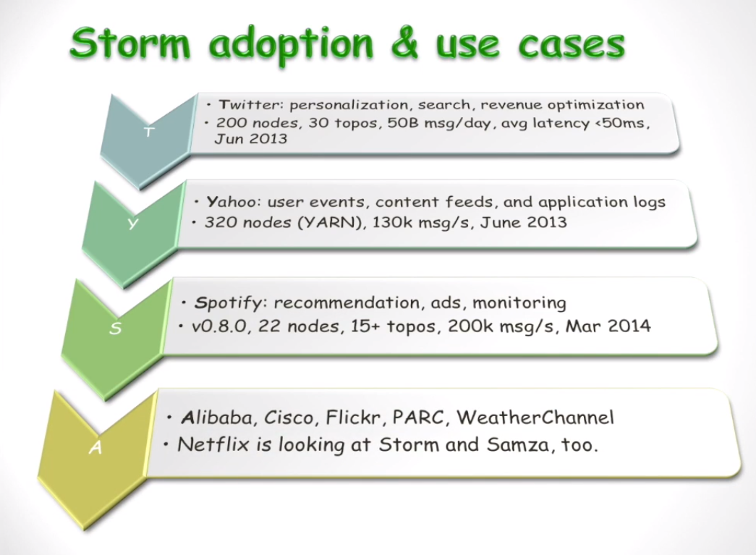
Use cases

Slide 5
Introduction
Many modern data processing environments require processing complex computation on streaming data in real-time.
Apache Storm is a task parallel, free and open source distributed realtime computation system.
Storm makes it easy to reliably process unbounded streams of data, doing for realtime processing at Twitter.
Storm is simple, can be used with any programming language.

Slide 6
Five characteristics that make Storm ideal.
Fast – benchmarked at processing one million+ 100 byte messages per second per node
Scalable – with parallel calculations that run across a cluster of machines.
Fault-tolerant – when workers die, Storm will automatically restart them. If a node dies, the work will be restarted on another node.
Reliable – Storm guarantees that each unit of data (tuple) will be processed at least once or exactly once. Messages are only replayed when there are failures.
Easy to operate – standard configurations are suitable for production on day one. Once deployed, Storm is easy to operate.

Slide 7
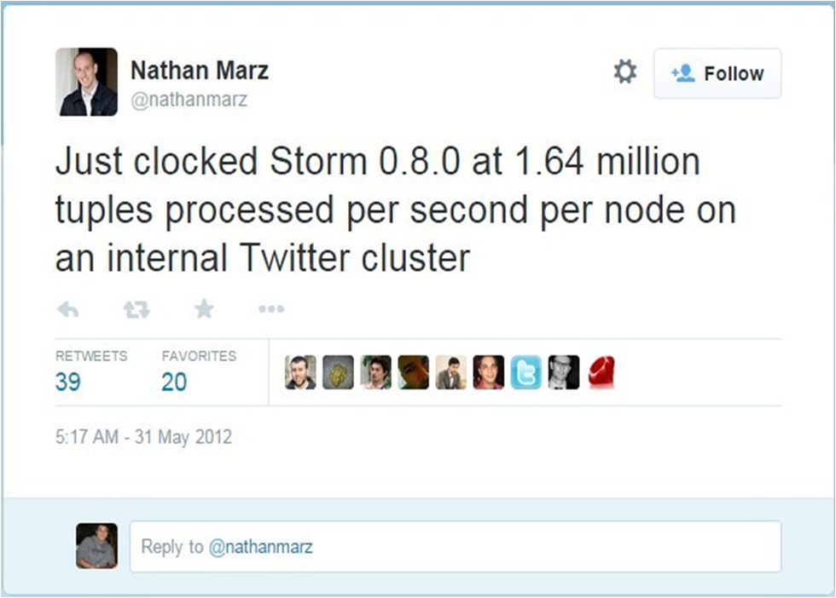
Tweet from Nathan Marz (31 May 2012)

Slide 8
Data Model and Execution Architecture
An Apache Storm cluster is superficially similar to a Hadoop cluster.
There are two kinds of nodes in a Storm cluster: master node and worker nodes.
Master Node (Nimbus)
Worker Nodes (Supervisor)
The basic Storm data processing architecture consists of streams of tuples flowing through topologies.
A topology is a graph of computation and is implemented as DAG (directed acyclic graph) data structure.

Slide 9
Contd..
Streams represent the unbounded sequences of tuples (collection of key-value pairs).
A spout is the entry point in a Storm topology. It represents the source of data in Storm.
All processing in topologies is done in bolts. Bolts can do anything from filtering and functions to aggregations, joins, talking to databases, and more. Bolts can do simple stream transformations.

Slide 10
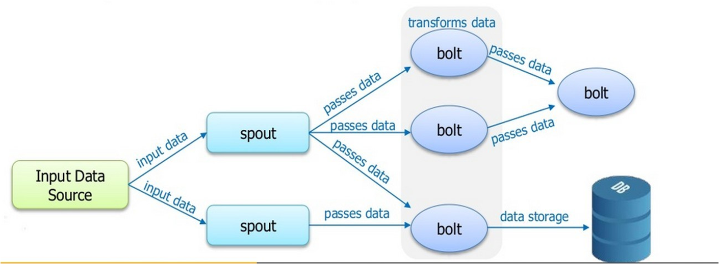
Storm Topology

Slide 11
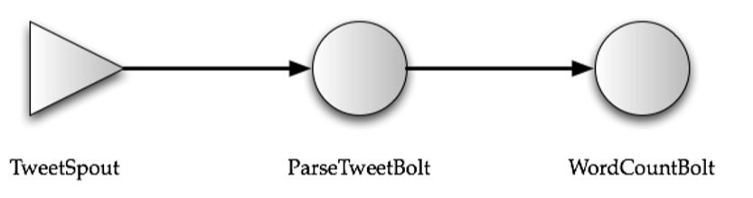
Tweet Word Count topology
The Tweet Spout may pull tuples from Twitter’s API.
The ParseTweet Bolt breaks the Tweets into words.
The WordCount Bolt receives these 2-ary tuples and aggregates the counts for each word.

Slide 12
Storm Overview
Storm runs on a distributed cluster, and at Twitter often on another abstraction such as Mesos.
There are 2 kinds of nodes on a storm cluster: Master Node
Worker Node
The Master node runs a daemon called ‘Nimbus’.
Each worker node runs a daemon called the ‘Supervisor

Slide 13
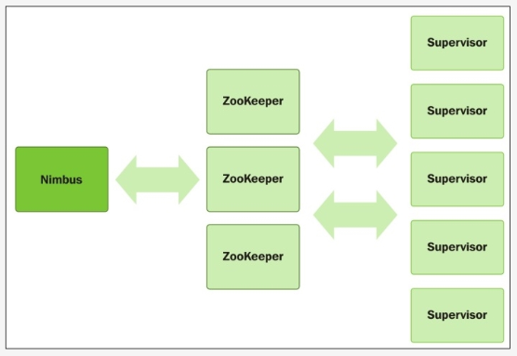
Architecture of Storm

Slide 14
Some important terms used in Storm:
Topology: It is the top level abstraction that you submit to storm clusters for execution.
Tuples: An ordered list of elements.
Streams: Sequence of tuples.
Spouts: These are sources of streams in a computation.
Bolts: These process input streams and produce output streams.

Slide 15
Understanding the Parallelism of Storm Topology:
What makes a running Topology:
Worker Processes,
Executors,
Tasks
A worker process belongs to a specific topology and may run one or more executors for one or more components of this topology.
An executor is a thread that is spawned by a worker process. It may run one or more tasks for the same component.
A task performs the actual data processing.

Slide 16
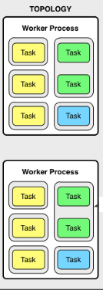
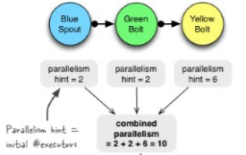
Example of a Running Topology:

Slide 17
Partitioning Strategies:
Shuffle Grouping: It randomly partitions the tuples.
Fields Grouping: It hashes on a subset of the tuple attributes/fields.
All Grouping: It replicates the entire stream to all the consumer tasks.
Global Grouping: It sends the entire stream to a single bolt.
Local Grouping: It sends tuples to the consumer bolts in the same executor.

Slide 18
Storm Internals:
Nimbus and Zookeper:
Nimbus is an Apache Thrift service and Storm topology definitions are Thrift objects
To submit a job to the Storm cluster (i.e. to Nimbus), the user describes the topology as a Thrift object and sends that object to Nimbus.
A popular method for generating Storm topologies at Twitter is by using Summingbird.
Summingbird is a general stream processing abstraction, which provides a separate logical planner that can map to a variety of stream processing and batch processing systems.
Summingbird provides a powerful Scalaidiomatic way for programmers to express their computation and constraints.
It can perform a number of optimizations.
Queries expressed in Summingbird can be automatically translated into Storm topologies.
It can also generate a MapReduce job to run on Hadoop.

Slide 19
Contd..
Nimbus uses a combination of the local disk(s) and Zookeeper to store state about the topology.
Currently the user code is stored on the local disk(s) of the Nimbus machine, and the topology Thrift objects are stored in Zookeeper.
All coordination between Nimbus and the Supervisors is done using Zookeeper.
Nimbus and the Supervisor daemons are fail-fast and stateless, and all their state is kept in Zookeeper or on the local disk(s).
If the Nimbus service fails, then the workers still continue to make forward progress. In addition, the Supervisors restart the workers if they fail.
Also, if running topologies experience machine failures, then they cannot be reassigned to different machines until Nimbus is revived.

Slide 20
Supervisor
It receives assignments from nimbus and creates workers based on the assignment
It also monitors the health of the workers
It produces 3 events in three main threads
Heart beat in main thread
Synchronize supervisor in event manager thread
Synchronize process event in process event manager thread

Slide 21
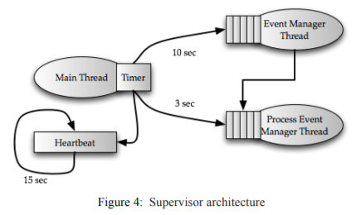
Cntd..
Heart Beat:
This event is scheduled to run every 15 seconds and its purpose is to report nimbus whether supervisor is alive or not
Synchronize Supervisor:
Executed for every 10 seconds
This event is responsible for managing the changes in existing assignments
Synchronize Process:
Runs for every 3 seconds
This is responsible for managing worker process
It reads worker state and classify them as either valid, time out, not started, disallowed
valid- provides heartbeat in specified time frame
Timeout- when it did not provide heart beat in specified time frame
Not started- when the worker is yet to be started or when worker from one supervisor moved to another
Disallowed- If the topology is broken then we call that worker as disallowed

Slide 22
Workers and Executors
We have different executors in workers which can run several tasks
At present, a task is strictly bounded to an executor because the assignment is currently static
An interesting direction for future work is to allow dynamic reassignment

Slide 23
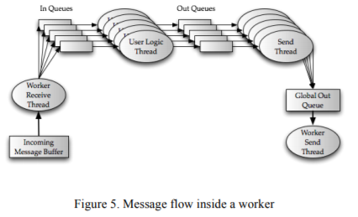
Cntd..
This worker receiver thread serves as a demultiplexing point for all the incoming inputs and are arranged in queues based on respective task identifier
The user logic thread takes all the incoming tuples from the queue, runs the actual task and generated output tuple
This output tuples are placed in out queues
Now the executor send thread that collects all the tuples from the out queue and puts them in global transfer queue

Slide 24
Processing Semantics
Storm attaches a randomly generated 64bit message to each new tuple that passes through the system
When the tuple finally leaves a topology, list of tuple ids is also retained with the output

Slide 25
Cntd..
Drawback:
It leads to large memory usage especially for complex topologies
To avoid this problem, storm uses a novel implementation using bitwise XORS
Storm provides guarantee about the data it process
It provides two types of semantic guarantees
At least once
At most once

Slide 26
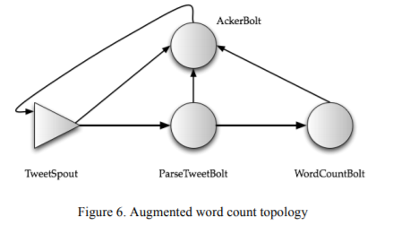
At least once
If XORed checksum =0 then that tuple has been successfully processed
It is possible that due to failure, some of the XOR checksum will never go to zero. To handle such cases, the we initially assigns a timeout parameter
If the XOR checksum does not become zero before the timeout, then the tuple is considered as failed

Slide 27
At most Once
The tuple entering the system is either processed once or not at all
Storm achieves at most once semantics when the acking mechanism is disabled for the topology

Slide 28
Storm in use @twitter
In this section we are going to discuss how storm is used in twitter
Topics to be discussed are:
Operational Overview
Storm Visualization Operations
Operational Stories

Slide 29
1. Operational Overview
Storm runs on several hundreds of servers at twitter, hundreds of topologies runs on these clusters.
Many terabytes of data flows through the Storm clusters every day, generating several billions of output tuples.
Storm topologies are used by a number of groups inside Twitter, including revenue, user services, search, and content discovery.
Also used for simple things like Filtering and Aggregating the content and complex things like running machine learning algorithms like clustering.

Slide 30
2. Storm Visualization Operations
Logs from Storm are continuously displayed using a rich visualization developed in-house.
All the metrics collected at each spout or bolt are sent to metrics bolt.
This bolt in turn writes the metrics to Scribe, which routes the data to a persistent key value store.
For each topology, a dashboard is created using this data for visualizing how this topology is behaving.
The rich visualization is critical in assisting with identifying and resolving issues that have caused alarms to be triggered

Slide 31
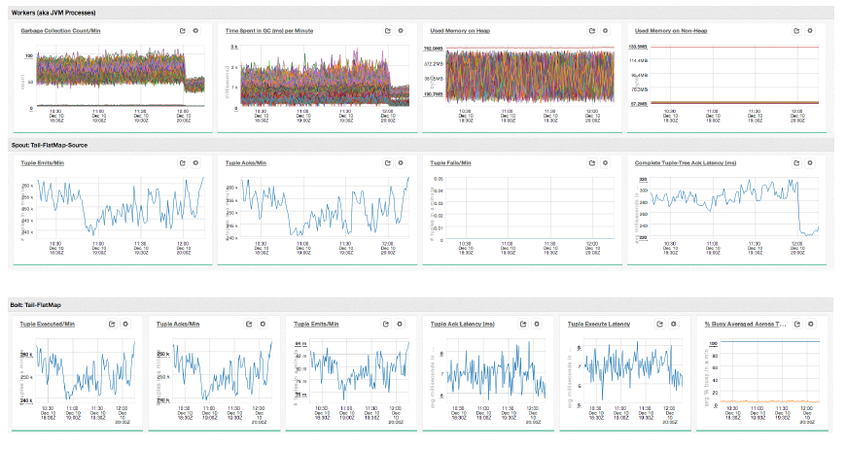
Storm Visualization

Slide 32
3. Operational Stories
Here we present three Storm-related operational scenarios/stories.
Overloaded Zookeeper
Storm Overheads
Max Spout Tuning

Slide 33
a) Overloaded Zookeeper
Storm uses Zookeeper to keep track of state information.
Here, we are going to see how to configure Zookeeper with storm.
The first configuration that we tried is to use an existing Zookeeper cluster at Twitter that was also being used by many other systems inside Twitter. We quickly exceeded the amount of clients that this Zookeeper cluster could support, which in turn impacted the uptime of other systems that were sharing the same Zookeeper cluster.

Slide 34
Overloaded Zookeeper Cont.…
Our second configuration of a Storm cluster was identical to the first one, except with dedicated hardware for the Zookeeper cluster.
While this significantly improved the number of worker processes and topologies that we could run in our Storm cluster.
If we exceeding this(3000 workers per cluster) number of workers, then we began to witness worker processes being killed and relaunched by the scheduler
Every worker process will have zknode(ZooKeeper Node) which must be written every 15 sec, otherwise Nimbus deems that the worker is not alive and reschedules that worker onto a new machine.

Slide 35
Overloaded Zookeeper Cont.…
In our third configuration of a Storm cluster, we changed the Zookeeper hardware and configuration again: We used database class hardware with 6x 500GB SATA Spindles in RAID1+0 on which we stored the Zookeeper transaction log, and a 1x 500GB spindle (no RAID) on which we stored the snapshots.
This third configuration scaled to approximately 1200 workers. If we exceeded this number of workers, once again we started to see workers being killed and restarted

Slide 36
b) Storm Overheads
At one point there was some concern that Storm topologies that consumed data from a Kafka queue (i.e. used Kafka in the spouts) were underperforming relative to hand-written Java code that directly used the Kafka client.
The concern began when a Storm topology that was consuming from a Kafka queue needed 10 machines in order in order to successfully process the input that was arriving onto the queue at a rate of 300K msgs/sec.
If fewer than 10 machines were used, then the consumption rate of the topology would become lower than the production rate into the queue that the topology consumed. At that point, the topology would no longer be real-time.

Slide 37
Storm Overhead Cont.…
In first experiment we wrote a Java program that did not use Storm.This program would use the Kafka Java client to consume from the same Kafka cluster and topic as the Storm topology, using just a “for loop” to read messages as fast as possible. This program was able to consume input at a rate of 300K msgs/sec, and process data in real-time while running on a single machine with CPU utilization averaging around 700%
The second experiment was to write a Storm topology that had a similar amount of logic/functionality as the Java program. This topology had 10 processes, and 38threads per process. This topology was also able to consume at the rate of 300K msgs/sec, and process the data in real-time while running on a single machine.
For the third experiment we took the same topology from experiment two, but now enabled message reliability. This topology needs at least 3 machines in order to consume input atthe rate of 300K msgs/sec. Additionally it was configured with 30 JVM processes (10 per machine), and 5 threads per process. The average CPU utilization was 924% as reported by top. These experiments give a rough indication of the CPU costs of enabling message reliability relative to the CPU costs associated with deserializing messages

Slide 38
Storm Overhead Cont.…
These experiments mitigated the concerns regarding Storm adding significant overhead compared to vanilla Java code that did the same computation, since when both applications provided the same message reliability guarantees, they had roughly the same CPU utilization.
These experiments did bring to light that the Storm CPU costs related to the message reliability mechanism in Storm are nontrivial, and on the same order as the message deserialization costs

Slide 39
c) Max Spout Tuning
Storm topologies have a max spout pending parameter. The maxspout pending value for a topology can be configured via the “topology.max.spout.pending” setting in the topology configuration . This value puts a limit on how many tuples can be in flight, The need for this parameter comes from the fact that Storm uses ZeroMQ [25] to dispatch tuples from one task to another task.
If the consumer side of ZeroMQ is unable to keep up with the tuple rate, then the ZeroMQ queue starts to build up
To avoid this pathological failure case, Storm allows the user to put a limit on the number of tuples that are in flight in the topology
One of the problems that Storm users continually face is in coming up with the right value for this max spout pending parameter. A very small value can easily starve the topology and a sufficiently large value can overload the topology with a huge number of tuples to the extent of causing failures and replays

Slide 40
Max Spout Tuning Cont.…
To alleviate this problem, at Twitter we have implemented an auto-tuning algorithm for the max spout pending value which adjusts the value periodically to achieve maximum throughput in the topology.
The algorithm works as follows:
a) The spout tasks keep track of a metric called “progress.” This metric is an indicator of how much data has been successfully processed for this spout task.
b)We have a pluggable implementation of the max spout parameter “tuner” class that does auto-tuning of the max spout pending values. The two APIs that the default implementation support are:
void autoTune(long deltaProgress), which tunes the max
spout pending value using the progress made between the last call to autoTune()
long get(), which returns the tuned max spout pending value

Slide 41
Max Spout Tuning Cont.…
c)Every “t” seconds (in our case the default value for t is 120seconds), the spout calls autoTune and provides it the progress that the spout has made in the last t seconds.
d)The tuner class records the last “action” that it took, and given the current progress value what actions it could take next. The action value affects the max spout pending value, and the possible values are: Increase, Decrease, or No Change
If the last action is equal to No Change, then
(i) If this is the first time that auto tuning has been invoked, then set action to Increase, and increase the max spout pending value.
(ii) If the last delta progress was higher than the current delta progress, then set action to Decrease and decrease max spout pending.
(iii) If the last delta progress is lower than the current delta progress, then set action to Increase and increase max spout pending.
(iv) If the last delta progress is similar to the current delta progress, then set action to No Change and increment a counter by 1, which states how many consecutive turns we have spent in this No Change state. If that counter is equal to 5 then set action to Increase, and increase the max spout pending value.

Slide 42
Max Spout Tuning Cont.…
If the last action is equal to Increase, then
(i) If the last delta progress was higher than the current delta progress, then set the action to Decrease, and decrease the max spout pending value.
(ii) If the last delta progress is lower than the current delta progress, then set the action to Increase, and increase the max spout pending value.
(iii) If the last delta progress is similar to the current delta progress, then set the action to No Change, and restore the max spout pending value to the value that it had before the last increase was made

Slide 43
Max Spout Tuning Cont.…
If the last action is equal to Decrease, then
(i) If the last delta progress is lower than the current delta progress, then set the action to Increase, and increase the max spout pending value.
(ii) For any other case, set the action to No Change.

Slide 44


