Slide 1

Pregel: A System for Large-Scale Graph Processing
Presentation by
Ruthvic Punyamurtula
Navya Pillala
Sravya Reddy Bokka
Rajeswari Devi Namana

Slide 2
Abstract
Practical computing problems based on graphs
Each graph - billions of vertices and edges
Process : Sequence of iterations
Each vertex can receive messages sent in previous iteration
Send messages to other vertices over edges
Modify its own state
Vertex centric approach is flexible in expressing other algorithms

Slide 3
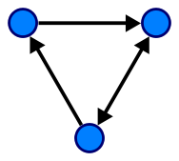
Introduction
Internet made web graph a popular object for analysis and research
What is a web graph ?
The webgraph is a directed graph, whose vertices correspond to the pages of the
WWW
Directed graph : Edges point towards the vertices
(Image Ref : https://en.wikipedia.org/wiki/Directed_graph)
Past Research : transport routes, paths of disease outbreak, published citation relationships - were based on graph analysis

Slide 4
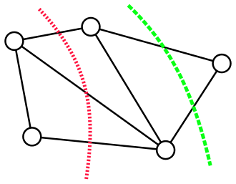
Introduction - Ctd..
Also used shortest path, variations in page rank
Graph computing problems
Ex : Minimum cut - the smallest total weight
of the edges which if removed would disconnect
the source from the sink.
Processing large graphs is challenging
Poor memory access https://en.wikipedia.org/wiki/Minimum_cut
Little work per vertex
Locality issue - increases probability that a machine can fail

Slide 5
Introduction-Ctd..
No scalable general-purpose system for implementing graph algorithms
Implementation of such algorithm requires :
Crafting an infrastructure that can implement each new algorithm or graph
Relying on existing computing platforms
Ex : MapReduce
Using a single-computer graph based library - BGL, GraphBase etc.,
Using existing parallel graph systems - Parallel BGL
These only address graph processing but not fault tolerance

Slide 6
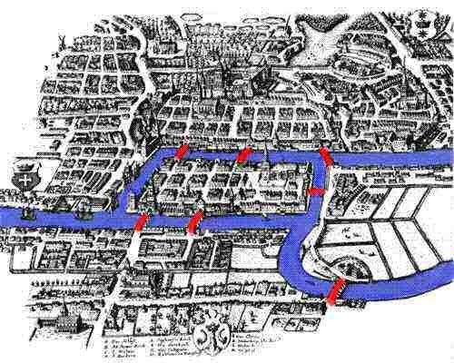
Pregel
What is Pregel ?
Origin of Graph theory
https://www.maa.org/press/periodicals/convergence/leonard-eulers-solution-to-the-konigsberg-bridge-problem
Features
Scalable
Fault-tolerant
Flexible API

Slide 7
The C++ API
Creating a Pregel program typically involves subclassing the predefined Vertex class.
• The user overrides the virtual Compute() method. This method is the function that is computed for every active vertex in supersteps.
• Compute() can get the vertex’s associated value by GetValue() or modify it using MutableValue()
• Values of edges can be inspected and modified using the out-edge iterator.

Slide 8
The C++ API – Message Passing
Each message consists of a value and the name of the destination vertex.
–The type of value is specified in the template parameter of the Vertex class. Any number of messages can be sent in a superstep.
–The framework guarantees delivery and nonduplication but not in-order delivery. A message can be sent to any vertex if it’s identifier is known.

Slide 9
The C++ API – Pregel Code
Pregel Code for finding the max value Class MaxFindVertex :
public Vertex { public: virtual void Compute(MessageIterator* msgs)
{
int currMax = GetValue();
SendMessageToAllNeighbors(currMax);
for ( ; !msgs->Done(); msgs->Next())
{
if (msgs->Value() > currMax) currMax = msgs->Value();
} if (currMax > GetValue())
*MutableValue() = currMax;
else VoteToHalt();
} };

Slide 10
The C++ API – Combiners
Sending a message to another vertex that exists on a different machine has some overhead.
However if the algorithm doesn’t require each message explicitly but a function of it (example sum) then combiners can be used.
This can be done by overriding the Combine() method.
-It can be used only for associative and commutative operation.

Slide 11
Example: Say we want to count the number of incoming links to all the pages in a set of interconnected pages. In the first iteration, for each link from a vertex(page) we will send a message to the destination page. Here, count function over the incoming messages can be used a combiner to optimize performance.
In the MaxValue Example, a Max combiner would reduce the communication load.

Slide 12
The C++ API – Aggregators
They are used for Global communication, monitoring and data. Each vertex can produce a value in a superstep S for the Aggregator to use.
The Aggregated value is available to all the vertices in superstep S+1. Aggregators can be used for statistics and for global communication.
Can be implemented by subclassing the Aggregator Class Commutativity and Assosiativity required.

Slide 13
Example:
Sum operator applied to out-edge count of each vertex can be used to generate the total number of edges in the graph and communicate it to all the vertices.
- More complex reduction operators can even generate histograms.
In the MaxValue example, we can finish the entire program in a single superstep by using a Max aggregator.

Slide 14
Topology Mutation
Compute() can be used to modify a graph topology i.e by sending messages, issuing requests to add/delete vertices or edges.
Mutations become effective in the superstep after the requests are issued.
Multiple requests to add/delete same vertex/edge in same superstep cause conflicts.
To deal with these, we have 2 mechanisms:
•Partial ordering
•User defined handlers.

Slide 15
Topology Mutation Continued..
This partial ordering of mutations can yield deterministic results
• removals taking place before additions
• removal of edges before vertices
•addition of vertices before edges.
Any conflicts remaining conflicts are solved by the user-defined handlers.
•System randomly picks one request arbitrarily
•If there is any special need user can specify it in ‘Vertex’ subclass.

Slide 16
Input and Output
File formats for graphs are text file, a set of vertices in a relational database, or rows in Bigtable.
Pregel provides flexibility by allowing its users to
Decouple the task of interpreting an input file as a graph.
And, output can be generated in an arbitrary format and stored in most suitable for that application
Pregel library provides both readers and writers for commonly used file formats and users can also subclass the abstract base classes.

Slide 17
Implementation of Pregel
Pregel is designed for Google cluster architecture where each cluster has enormous number of PC’s arranged in racks.
Clusters are distributed geographically but are interconnected.
Pregel execute on cluster management where the jobs are scheduled to optimize resource allocation, sometimes killing instances or moving them to other machines.
Pregel stores persistent data on a distributed file system like GFS Or Bigtable and temporary data on local disk.

Slide 18
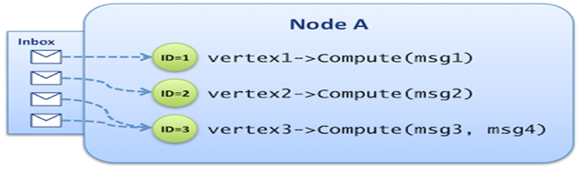
Basic Architecture
The Pregel library divides a graph into partitions, based on the vertex ID, each consisting of a set of vertices and all its out-going edges.
The default function is hash(ID) mod N, where N is the number of partitions.
Vertices are assigned based on the vertex ID which makes it possible to know which partition it belongs.
https://blog.octo.com/en/introduction-to-large-scale-graph-processing/

Slide 19
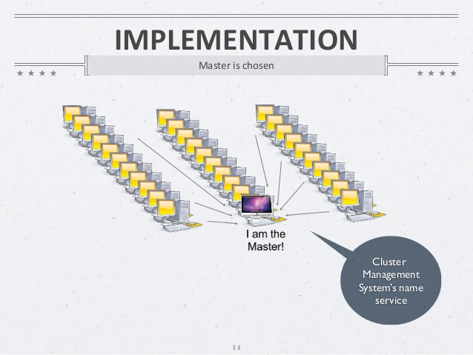
Execution of Pregel
Many copies of the user program begin executing on a cluster of machines. One of these copies acts as the master.
https://www.slideshare.net/juliaproskurnia/pregel
But the master is not assigned any portion of the graph, instead is responsible for coordinating worker activities.

Slide 20
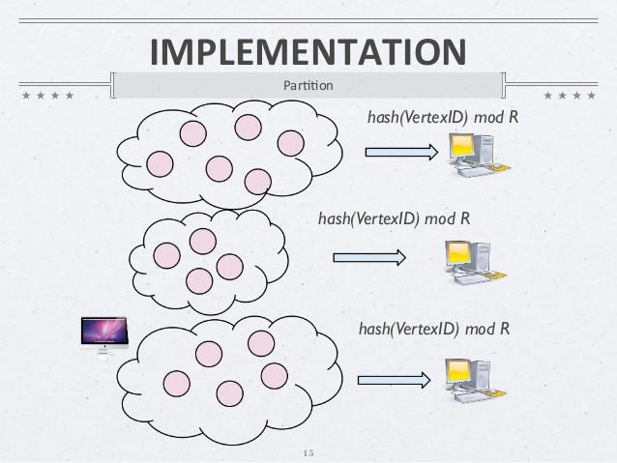
Execution of Pregel Contd..
2. The master determines how many partitions the graph will have and assigns one or more partitions to each worker machine.
Each worker is then responsible for
maintaining the state of its partition of
the graph.
Executing compute() on its vertices
Managing the messages to and from
other workers.
https://www.slideshare.net/juliaproskurnia/pregel

Slide 21
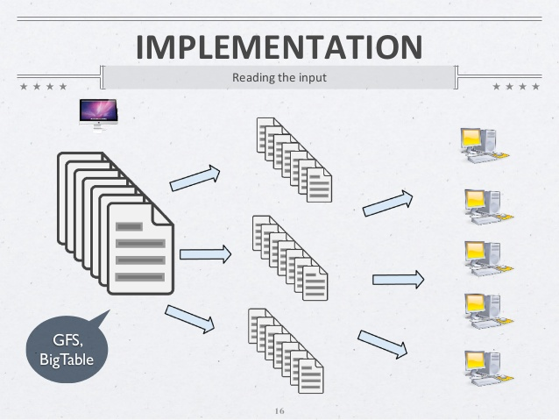
Execution of Pregel Contd..
3. The master assigns a portion of the user’s input to each worker. The input is treated as a set of records, each of which contains an arbitrary number of vertices and edges.
https://www.slideshare.net/juliaproskurnia/pregel
After the input has finished loading, all vertices are marked as active.

Slide 22
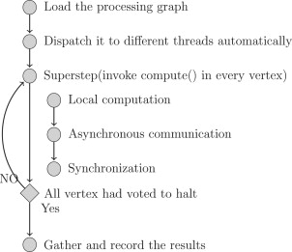
Execution of Pregel Contd..
4. The master instructs each worker to perform a superstep.
The worker loops through all its active vertices using one thread for each partition
Invokes compute() for each vertex , delivering messages sent in the previous superstep.
Messages are sent asynchronously to enable
overlapping of computation and communication.
After the worker is finished it tells the master how
many vertices will be active in the next superstep.
The steps are repeated as long as there are active vertices.
Once all the vertices vote to halt, master instructs each
worker to save its state of graph.

Slide 23
Fault tolerance
Checkpointing is used to achieve fault tolerance in pregel.
Master uses a “ping” messages to detect worker failures.
If no message is heard from the worker, master marks that worker process as failed.
If a worker does not receive a ping message after a specified interval,the worker process terminates itself.
When more than one worker fail, the current state of the partitions assigned to these workers is lost. And the master reassigns that partition to other available workers by reloading their state from the most recent checkpoint.

Slide 24
Worker Implementation
A worker contains a mapping of vertex id to vertex state for its portion of the complete graph.
The vertex state would comprise of:
Current value
Outgoing edges
Queue containing incoming messages
A flag marking whether it is in the active state
Two copies of queue and flag are maintained, one for the current superstep and one for the next superstep.

Slide 25
Master Implementation
The master coordinates the workers by maintaining a list of currently alive workers - having unique identifiers, their addressing information and which portion of the graph has been assigned to them.
The master sends the same request to every worker and waits for a response.
If any worker fails, the master enters recovery mode. Otherwise, it proceeds to the next superstep.
It also maintains statistics about progress of computation and the state of the graph.
To enable user monitoring, the master runs an HTTP server that displays this information.

Slide 26
Worker Implementation Continued..
While sending a message to another vertex, the worker checks if the destination vertex is on the same machine.
If yes, it places the message directly on the receiver's queue instead of sending it via the network.
In case the vertex lies on the remote machine, the messages are buffered and sent to destination worker as a single network message.
If a combiner is specified, it is applied to both the message being added to the outgoing message queue and to the message received at the incoming message queue.

Slide 27
Aggregators
Workers combine all the values supplied to an aggregator, by all the vertices in a superstep, into a single local value. At the end of the superstep, the workers perform the tree-based reduction on the local value and deliver the global values to the master.
The tree-based reduction is better than pipelining with a chain of workers as it allows for more parallelization.

Slide 28
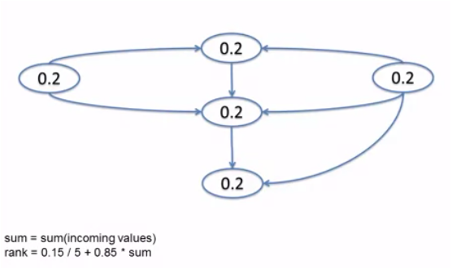
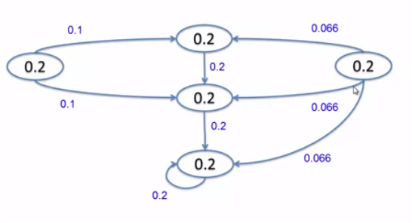
Application: Page Rank
1/(no. Of vertices) = 0.2 -> initial rank
Reference: https://www.youtube.com/watch?v=X8z_MOU5N00
Notes:
1/(no. Of vertices =0.2 -> initial rank)

Slide 29
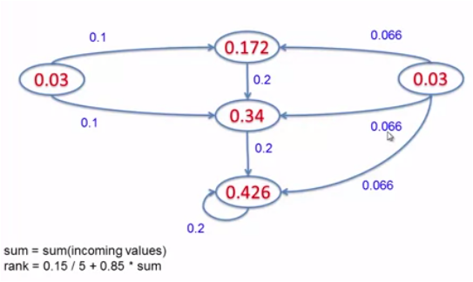
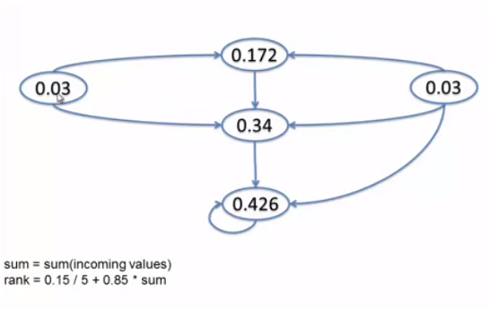
Page Rank Continued ..

Slide 30
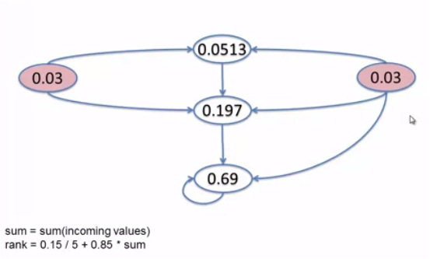
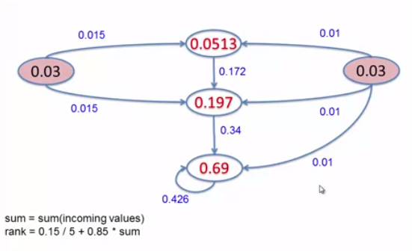
Page Rank Continued ..

Slide 31
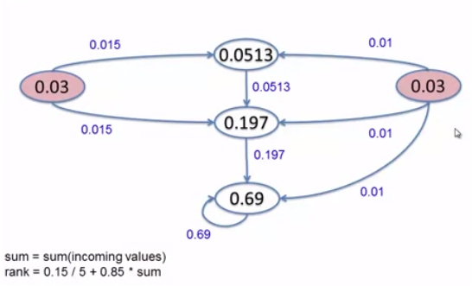
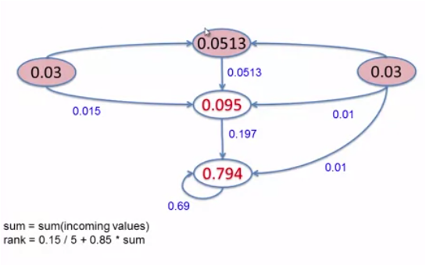
Page Rank Continued ..

Slide 32
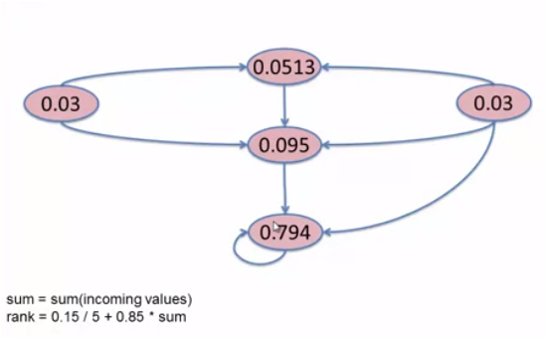
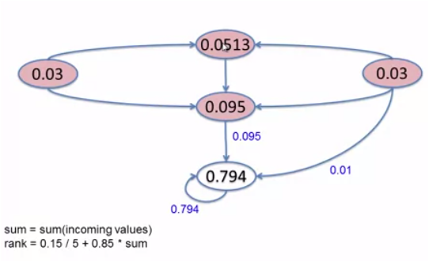
Page Rank Continued ..

Slide 33
Limitations & Conclusion:
One obvious limitation is that the entire computation state resides in main memory.
Secondly, Pregel is designed around sparse graphs and performance will take a hit in case of dense graphs where a lot of communication takes place between vertices.
The paper counters this by arguing that realistic dense graphs and algorithms with dense computation are rare.
Moreover, communication in such dense networks can be reduced by using aggregators and combiners.
An add-on would be to support dynamic partitioning of graph based on message traffic to minimize communication over the network.

Slide 34


