Slide 1
The Impact of Generative AI on Academic Performance and Student Well-being
A Data-Driven Analysis of 50,000 Students
Notes:
Hello everyone. Today I will be walking you through my capstone data analysis project, exploring how Generative AI tools like ChatGPT are fundamentally changing the modern university experience.

Slide 2
The Core Question
Does AI actually improve student grades?
What is the hidden cost of AI reliance on mental health?
Which students are most at risk of skill loss?
Notes:
Our goal was to cut through the hype. We didn't just want to know if students use AI, we wanted to prove mathematically whether it was helping them or hurting them in the long run.

Slide 3
Data Engineering & Architecture
Data Source: 50,000 student records (Kaggle).
Python (Pandas): Handled nulls, standardization, and feature engineering.
SQL (SQLite): Database creation and querying demographic trends.
Power BI: Interactive dashboarding and visual storytelling.
Notes:
To ensure data integrity, I processed 50,000 raw records using Python and Pandas, engineered a custom 'GPA Growth' metric, and built a relational SQL database before creating our Power BI dashboard.

Slide 4
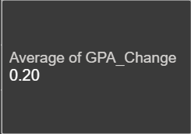
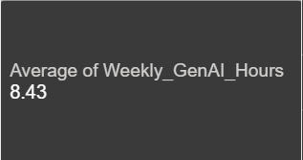

Key Findings at a Glance
Notes:
If you only take one thing away from this presentation, it is this: AI is a double-edged sword. While it saves time, heavy reliance correlates with a severe spike in exam anxiety and a drop in skill retention.

Slide 5
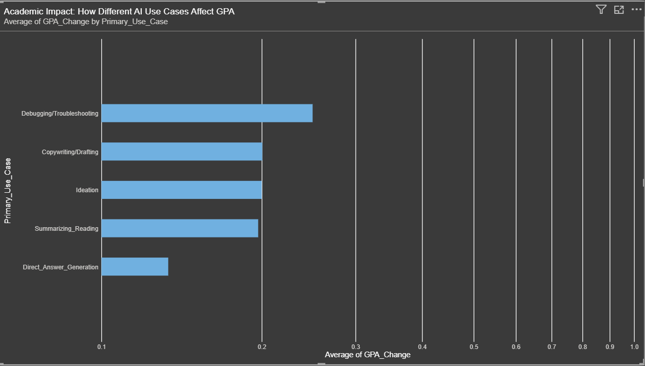
AI as a Tutor vs. An Answer Key
Notes:
Not all AI usage is equal. As you can see here, students who use AI as a tutor—for debugging and troubleshooting—saw the highest GPA growth (+0.25). Students who use it to directly generate answers saw the lowest growth.

Slide 6
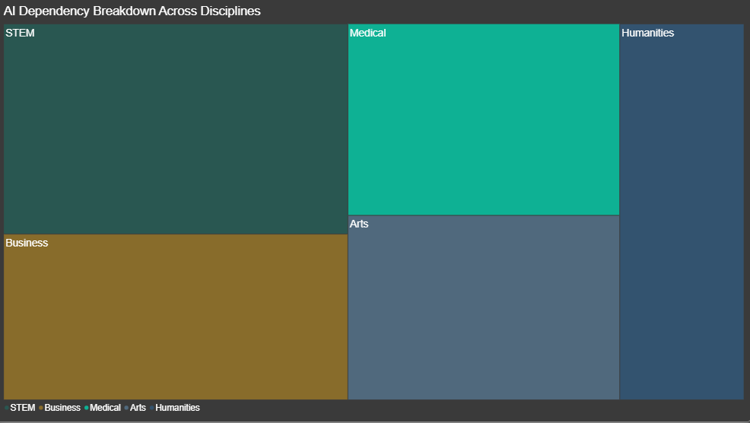
Which Majors Rely on AI the Most?
Notes:
We wanted to know who is driving this trend. The data clearly shows that STEM and Business majors are adopting AI at a vastly higher rate than Humanities students.

Slide 7
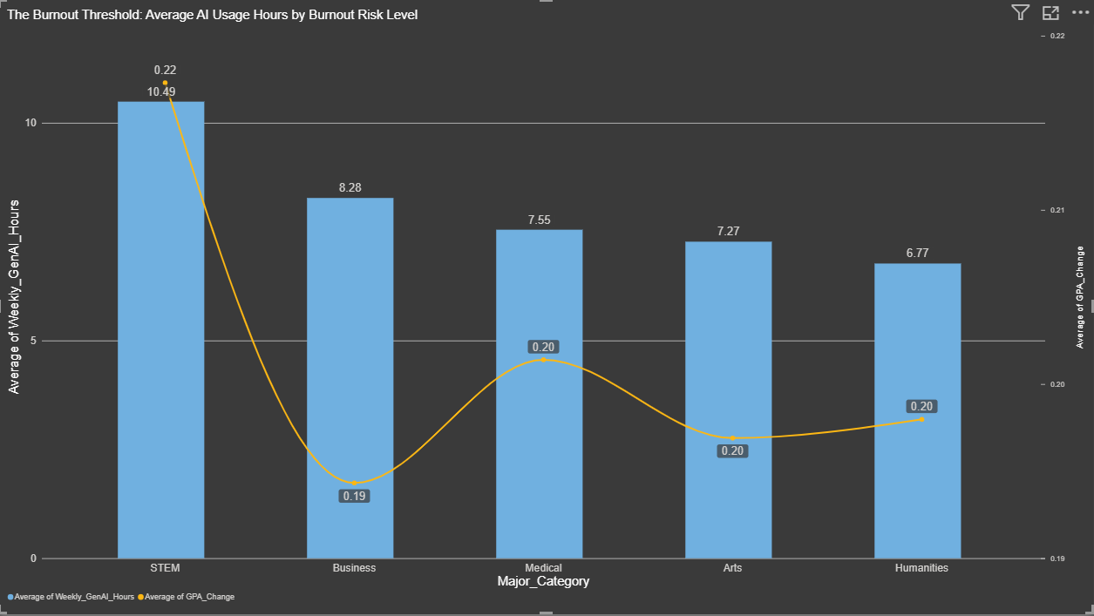
Does AI Save Time or Increase Burnout?
Notes:
You would assume AI saves time and reduces burnout. The data shows the exact opposite. Students claiming the highest levels of Burnout are actually the ones spending the most weekly hours using Generative AI.

Slide 8
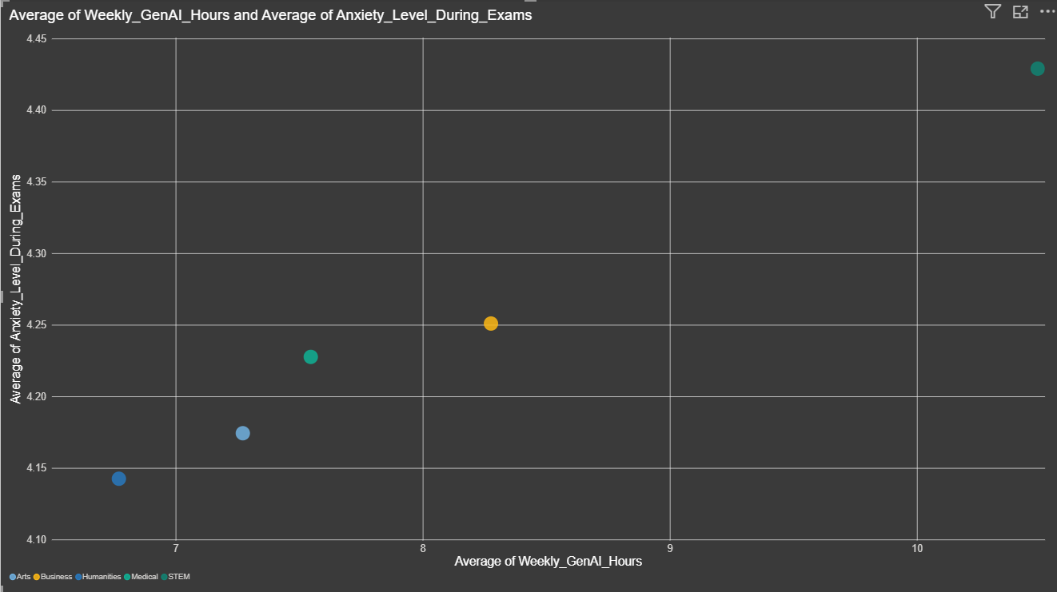
The Cost of Over-Reliance
Notes:
This scatter plot maps out our majors. Notice how STEM is pushed to the top right? They spend the most hours on AI, but they also report the absolute highest levels of Anxiety during closed-book exams.

Slide 9
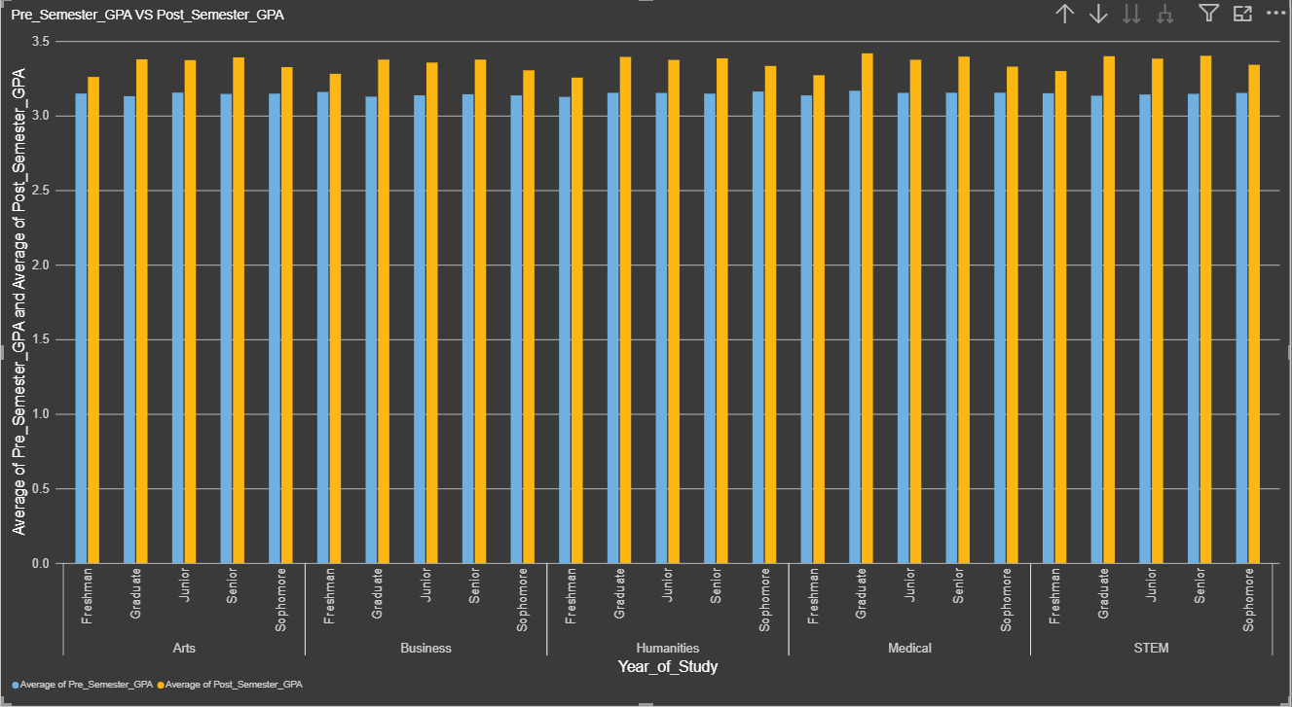
Pre-Semester vs. Post-Semester GPA
Notes:
Here is the ultimate proof. When we compare where students started versus where they ended, we can see that moderate AI users see a healthy bump in their GPA, while heavy AI users plateau.

Slide 10
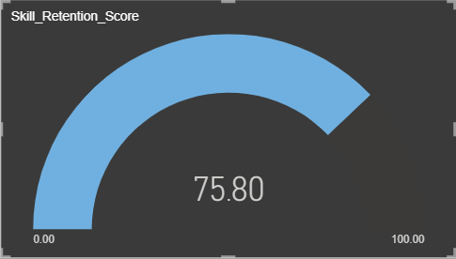
The Skill Retention Crisis
Notes:
Even if GPAs go up slightly, we have a looming crisis. Our Gauge chart shows that heavy AI users are suffering from poor skill retention. They are passing the class, but they are forgetting the material immediately after.

Slide 11
DASHBOARD DEMO
Notes:
Even if GPAs go up slightly, we have a looming crisis. Our Gauge chart shows that heavy AI users are suffering from poor skill retention. They are passing the class, but they are forgetting the material immediately after.

Slide 12
Where Do Universities Go From Here?
Don't Ban It, Teach It: Universities must mandate 'Prompt Engineering' classes to teach students how to use AI for ideation, not direct answers.
Rethink Exams: High exam anxiety proves students feel unprepared without their AI tools. Assessments must adapt to test critical thinking.
Notes:
Based on the data, banning AI doesn't work. Universities must instead pivot to teaching students how to use it safely, prioritizing AI as a tutor rather than an answer key.

Slide 13
Bringing it all together
The GPA Illusion: AI boosts grades, but at the cost of skill retention.
The Stress Factor: High usage hours directly correlate with high exam anxiety.
The Usage Divide: AI policies must adapt differently for STEM vs. Humanities.
Notes:
Thank you for your time. I would now like to open the floor to any questions, or I can run a live demonstration of the Power BI dashboard filtering features.

Slide 14
Thank YOU
SCRUM GROUP 6
Allen Lazarus
Brandon Moorcroft
Daniel Dehinbo
Guruvendra Singh
Jie Zhao Yang
Philbert Fontenelle
Priya Raja
Shruthi Ramesh
Notes:
Thank you for your time. I would now like to open the floor to any questions, or I can run a live demonstration of the Power BI dashboard filtering features.

