Slide 1

Online Book Store Application
Group-16:
-Eravelly Ashwitha
-Chenreddy Joshnavi
-Thileti Sai Sruthi
-Singireddy Sahithi

Slide 2
Introduction
The Online Bookstore application is a powerful tool for bookstore managers seeking to efficiently manage book inventory.
It seamlessly integrates a book review feature, allowing managers to gain valuable insights into customer views regarding the available books.
Through this application, managers can efficiently track and record sales transactions while maintaining accurate inventory data.

Slide 3
Actors
Store Manager
Their primary goal is to streamline inventory management and sales processes effectively.
Customers
Customers are able to give the reviews on the books they have purchased.
Review Analyst
The primary goal of the review analyst is to have a look at all the reviews and analyze them.

Slide 4
Classes
ListBooksForm
Displays a list of available books.
Implements a ListBox for book information and buttons for interaction.
Book Class
Represents a book with properties such as Title, Author, Price, and Quantity.
Overrides the ToString method for formatted book representation.
ReviewForm
Allows users to review and view books.
Utilizes ComboBox for book selection, ListBox for existing reviews, and TextBox for entering new reviews.

Slide 5
UI Initialization
The UI elements, including labels, textboxes, buttons, etc., are created and styled in the `InitializeUI` method.
Background image enhances the visual appeal of the application.
Code Organization
Emphasizes modular and organized code structure, enhancing readability and maintainability.

Slide 6
Target Audience
The primary user of the Amazon Bookstore application is the bookstore manager. This application empowers them with the capability to manage the entire inventory efficiently, keeping book data accurate, and streamlining sales processes.

Slide 7
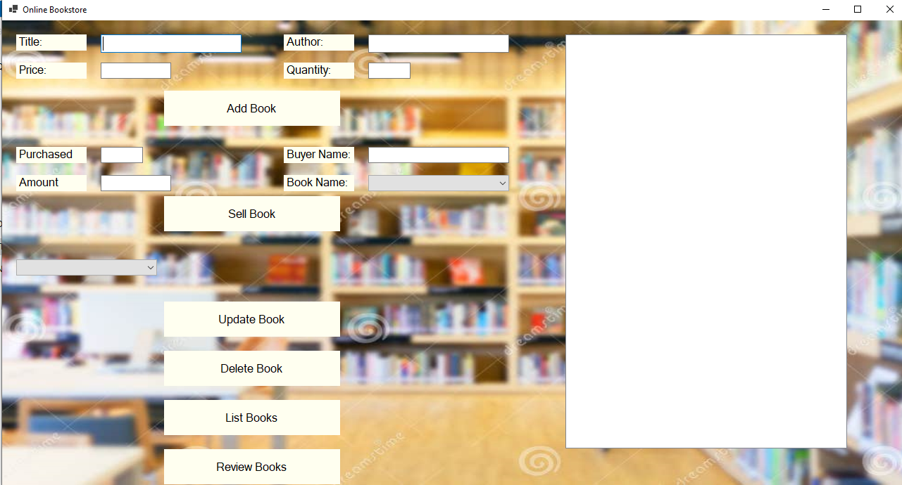
An overview of the interface:

Slide 8
Functionality Highlights:
Reading Book Data:
Utilizes the InitializeBooksFromTxt method to read book data from a text file (books.txt).
Ensures graceful handling of file exceptions.
UI Elements:
Dynamically creates and styles UI elements in the InitializeUI method.
Background image sourced from [URL] enhances the aesthetic appeal.

Slide 9
Functionality Highlights:
Book Operations:
Implements functionality for adding, updating, and deleting books with corresponding buttons.
Validates and parses user input for accuracy.
Selling Books:
Enables the sale of books with quantity and amount validation.
Updates book quantities and provides sale details.

Slide 10
Functionality Highlights:
Listing and Reviewing Books:
Allows users to list all books and review individual books.
ListBooksForm and ReviewForm facilitate these functionalities.

Slide 11
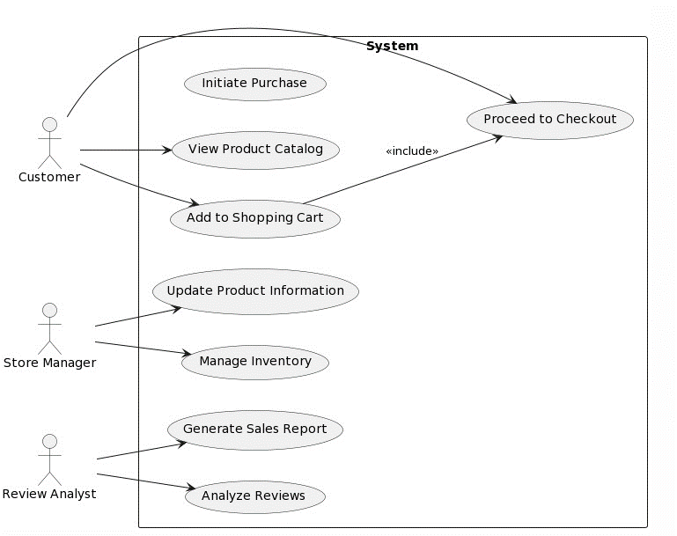
Use case diagram

Slide 12
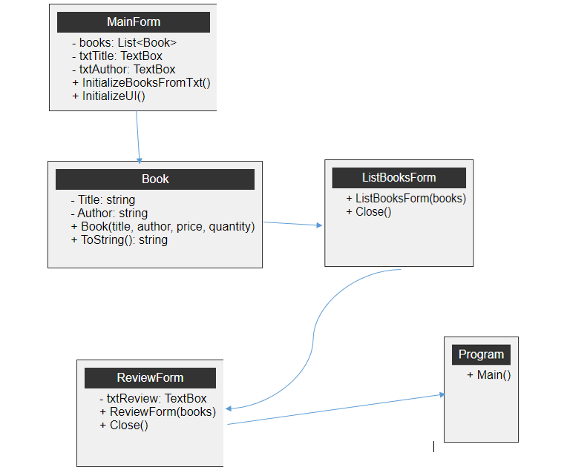
Class diagram

Slide 13
Book Selling Process In Detail
Sell Book Button:
Utilizes the "Sell Book" button to initiate the book selling process.
Validates user inputs, including sell quantity and amount paid.
Stock Verification
Checks if there is enough quantity in stock to fulfill the sale.
Prevents sales that exceed available stock.

Slide 14
Book Selling Process In Detail
Quantity and Amount Calculation
Updates the quantity of the selected book after a successful sale.
- Calculates the remaining amount based on the sale.
Sale Details
Displays a message box with detailed sale information, including the buyer's name and remaining amount.

Slide 15
Review and Feedback System
ReviewForm
Presents the `ReviewForm` that allows users to review and view books.
Utilizes a ComboBox for book selection, a ListBox for existing reviews, and a TextBox for entering new reviews.
Save Review Button
Implements the "Save Review" button to save user reviews.
Validates input and saves reviews to a text file (`reviews.txt`).

Slide 16
Review and Feedback System
Existing Reviews
Displays existing reviews for the selected book in the `ListBox`.
Reviews are retrieved from the `reviews.txt` file.
Feedback Mechanism
Encourages users to share their thoughts and opinions on books.
Provides an interactive way for users to engage with the application.

Slide 17
Conclusion
In conclusion, we've covered a robust online bookstore application with a modular code structure, ensuring easy maintenance and scalability. The user-centric features, like book reviews, provide a dynamic and engaging experience. Looking ahead, there are exciting opportunities for improvement—integrating a database, user authentication, UI enhancements, data analytics, and mobile adaptation. This application serves as a strong foundation for continuous growth. Thank you for joining us on this journey, and we welcome any questions or feedback.

Slide 18
Thank you:)

