Slide 1
St. Louis Housing Appraisal Analysis
Shruthi Sreenivasa Murthy

Slide 2
Agenda
Project Goal
Data
Overview
Variables
Methodology
Comprehensive Model
Individual School District Models
Modeling Results
Recommendations

Slide 3
Project Goal
Build a model for St. Louis City homes that generates an appraisal value closest to the actual recorded values.
Highlight homes whose fitted value from the model is beyond +/- 20% of the recorded appraisal value.
Recommend district(s) with significant outliers that should be re-appraised.

Slide 4
Data: Overview
Data: St. Louis County Residential Property Assessment Data (2008)
Population: 228,154 homes
21 School Districts represented
Includes homes built between 1900 to 2008.
Average appraised home value: $192,589.
Average Home Size: 1563 sqft
Average Lotsize: 9,380 sqft
88% of homes are single story.
60% of homes are Ranch style.

Slide 5
Data: Overview
Average number of bedrooms is 3, and average of total rooms in the home is 6.
93% of homes have Central AC.
96% of homes use gas as their primary fuel source.
87% of homes are rated between fair and very good (fair, average, good, very good) on their physical condition (CDU).
91% of homes are rated as Grade C or D, a measurement of the construction quality

Slide 6
St. Louis County Residential Property Assessment Data (2008)
By School District
Gathered from http://revenue.stlouisco.com/ias

Slide 7
Data: Variables
Number of stories (1-3)
Style of the home (Split Foyer, Split Level, Ranch, Contemporary, Old Style, Bunglow, Colonial, Capecod)
Year home was built
Total number of rooms [and] bedrooms
Total number of bathrooms [and] half bathrooms
Heating Type (none, basic, central AC)
Fuel Type (none, gas, electric, oil, wood, solar)
Heating System (none, warmair, electric, hotwater, radiant)

Slide 8
Data: Variables
Wood burning Fireplace
Square footage of home
Grade (X,A,B,C,D,E) – Construction Quality
CDU (unsound, poor, very poor, fair, average, good, very good, excellent) – Condition of the property
Lotsize
21 School Districts (Affton, Bayless, Brentwood, Clayton, Parkway, Rockwood, Ferguson/Florissant, Hancock, Jennings, Kirkwood, Ladue, Maplewood/Richmond Heights, Mehlville, Normandy, Pattonville, University City, Valley Park, Webster, Wellston, Lindbergh, Hazelwood)

Slide 9
Methodology
Goal: To create a model(s) that provides an appraisal estimate that is the same as, or close, to the actual recorded value.
Constructed Regression Models to estimate the appraised values using…
Consolidated Model (All school districts represented in one model)
School District Specific Model (A single school district represented per model)
Removed variables not included in sample (ie. If a school district has no 3 story homes, that variable was removed from that dataset)
Reviewed N-1 variables in model and systematically adjusted for significance to provide the best fit.

Slide 10
Methodology
Ran all models, fit the data with the logic of the model and compared the estimated values to the actuals.
Reviewed outliers to understand cause
Outlier: Homes that were either more than 20% over or more than 20% less than the recorded appraised value.

Slide 11
Modeling Results
Comprehensive Model
25.9% of homes (59,135) were outliers, more than +/- 20% difference in the estimated vs appraised value.
74.1% of homes (169,021) were within 20% of the appraised price.
School District Specific Model
15.9% of homes (36,378) were outliers, more than +/- 20% difference in the estimated vs appraised value.
84.1% of homes (191,778) were within 20% of the appraised value.
School District specific models reduced the number outliers by 38.5%, reducing the total% of outliers from 25.9% to 15.9%.

Slide 12
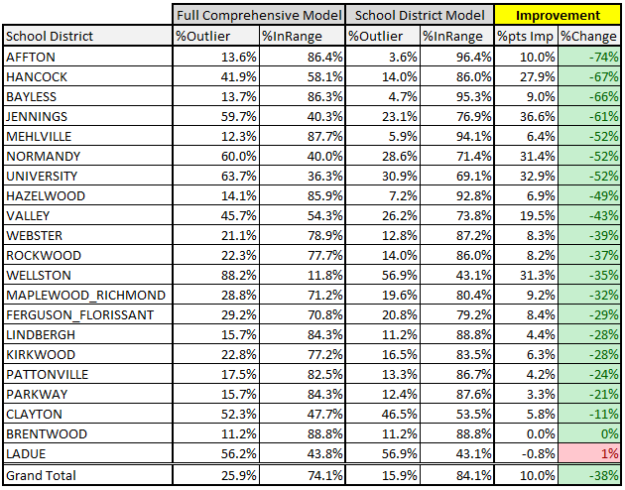
Modeling Results

Slide 13
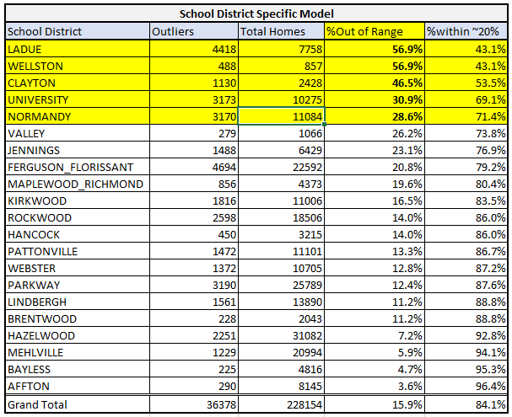
Recommendations

Slide 14
Recommendations
Recommend focusing on top 5 districts that have the highest percentage of outliers.
Ladue: 12% of outliers (549) were rated Grade A or X.
Wellston: 32% of outliers (157) were Ranch homes, and 33% (160) had a CDU rating of fair. Of the 157 Ranch homes, 140 of them had a fair rating.
University City: 26% of outliers (840) had basic heat and 17% (536) had a CDU rating of poor. 204 of the homes with basic heat had a rating of poor.
Normandy: 20% of outliers (641) had a CDU rating of poor or unsound.
Clayton: There was an even split in characteristics of a home that was in range and out of range. Suggest spot checking some of the outliers as there may be an additional unaccounted for variable causing the discrepancy.

Slide 15
Thank you!
Any questions?

