Slide 1

CECS 550 – Pattern Recognition
Team Members:
Ashwanth Kumar Alagesan
Madhana Mohit Konduru
Dharaneeswar Reddy Rami Reddy
Shruthi Venkatachalam
Sai Abhijyan Tanikella
Professor: Dr. Mahshid Fardadi
Date: 05 - 03 - 2023

Slide 2

AGENDA
Introduction
Problem statement
DATA
Data Pre-Processing
Exploratory Data Analysis (EDA)
Feature Engineering
Feature Ranking
Modeling

Slide 3

Problem Statement
In this project, we are provided a dataset with information on promotional shopping events from an e-commerce platform. The task is to design a system that will increase the ROI (in other words, you need to predict the probability that these new buyers would purchase items from the same merchants again within six months), reduce promotional costs, and identify one-time buyers
NEED FOR REPEAT BUYER PREDICTION MODEL:
Businesses constantly struggle to understand customer needs, loyalty, and behavior. These businesses have a stockpile of data about the customer's activity. They try to devise a promotions sale or loyalty program using this data. Unfortunately, most customers only seek deals and what is profitable, so they end up as single-time buyers. So the business needs to identify loyal customers who have repeatedly bought items and tailor the deals based on their information to gain profits

Slide 4
Data
Data Fields | Definition
user_id | A unique id for the shopper.
age_range | User' s age range: 1 for <18; 2 for [18,24]; 3 for [25,29]; 4 for [30,34]; 5 for [35,39]; 6 for [40,49]; 7 and 8 for >= 50; 0 and NULL for unknown.
gender | User's gender: 0 for female, 1 for males, 2 and NULL for unknown.
merchant_id | A unique id for the merchant.
label | Value from {0, 1, -1, NULL}. ' 1' denotes ' user_id' as a repeat buyer for ‘merchant_id' while ' 0' is the opposite. ' -1' represents that ' user_id' is not a new customer of the given merchant, thus out of our prediction. However, such records may provide additional information. ' NULL' occurs only in the testing data, indicating it is a pair to predict.
activity_log | Set of interaction records between {user_id, merchant_id}, where each record is an action represented as ' item_id:category_id:brand_id:time_stamp:action_type' . ' #' is used to separate two neighboring elements. Records are not sorted in any particular order.
The Given Data consists of user activity over the e-commerce platform for the last six months
Data Range Assigned for us : 801 -960
Given the two data formats, we have decided to work with data format 2.

Slide 5
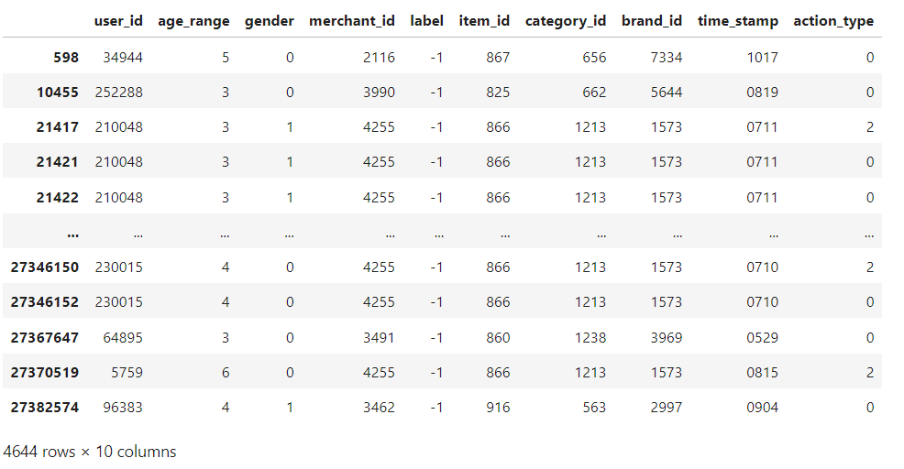
Data Preprocessing
During the pre-processing phase, we performed the following steps:
Replaced null and unknown values with their respective numeric encoding.
Split the activity_log column at every occurrence of the "#" symbol.
Separated the features encoded in the activity_log by the ":" symbol.
Filtered the data based on the assigned item_id values for our group (group 6: item_id: 801-960).
Created a copy of the pre-processed data and transformed it into Data_format_1, which we believed would be useful for feature engineering.

Slide 6
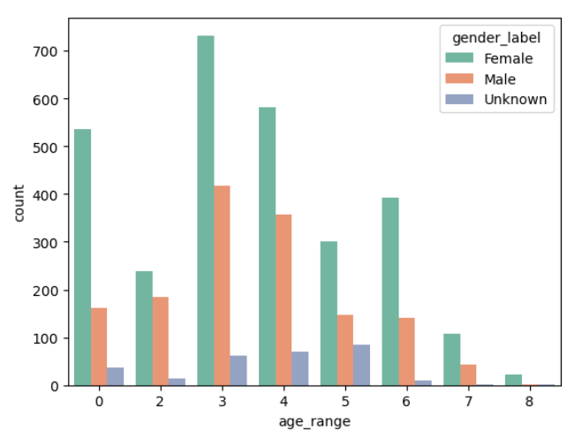
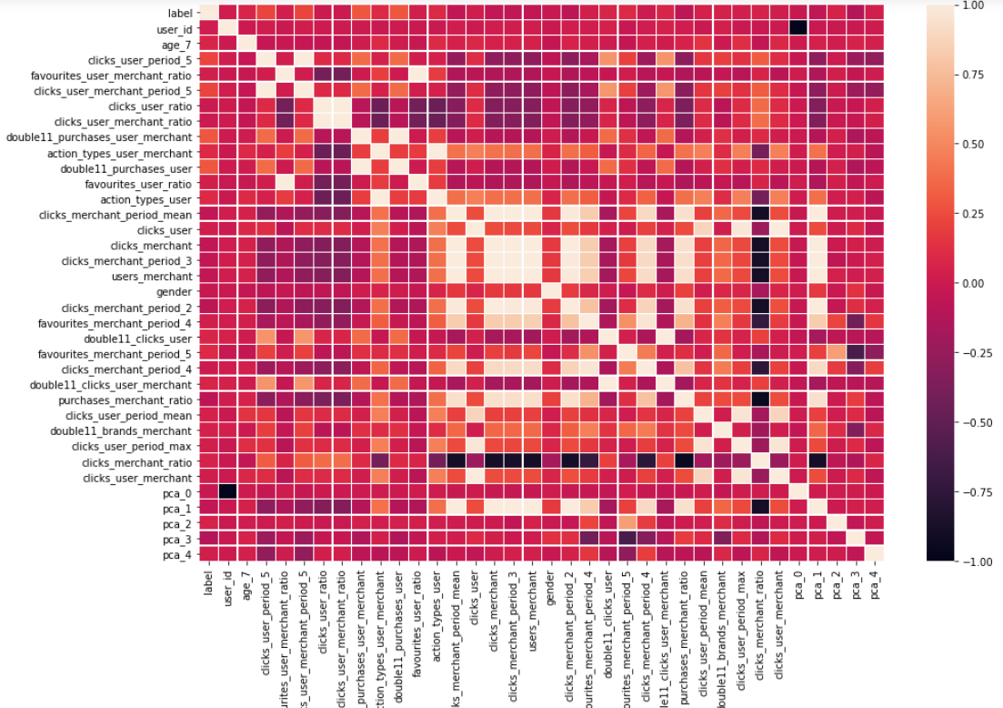
Exploratory Data Analysis (EDA)
1. Explored gender distribution of data by age groups and found most females belonged to age group three. Added to that, we found age groups three, four, and five have almost equal numbers of unknown observations
2. Created a correlation plot to perform data statistics.
Fig: 1
Fig: 2

Slide 7
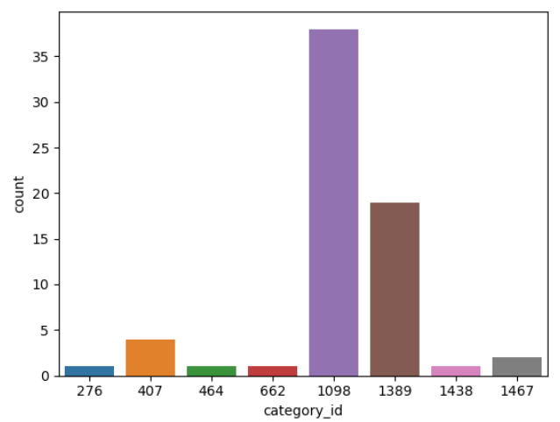
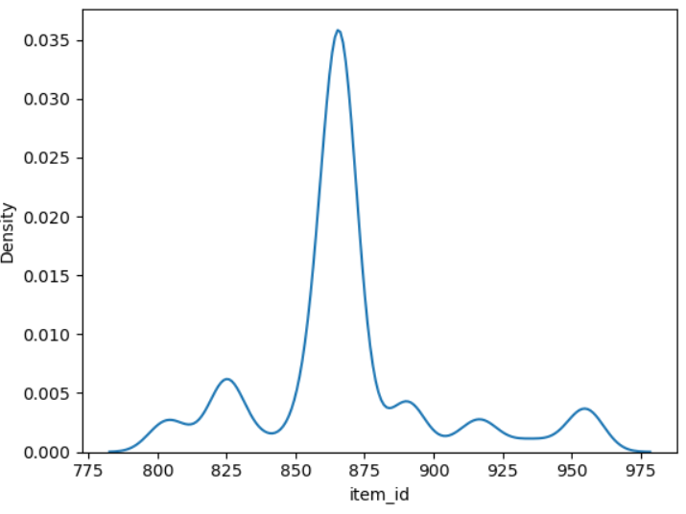
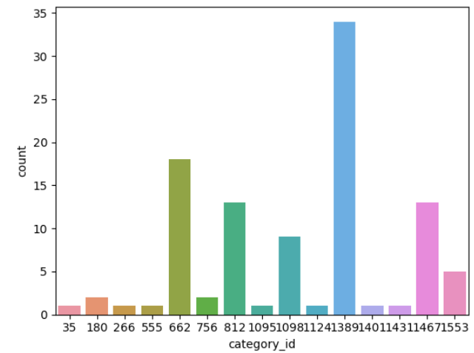
Fig: 3
Fig: 5
Fig: 4
3. Observed that most sales happened on promotion days and visualized how brands, users, and items worked together.
4. Plotted the popularity of items among users.

Slide 8
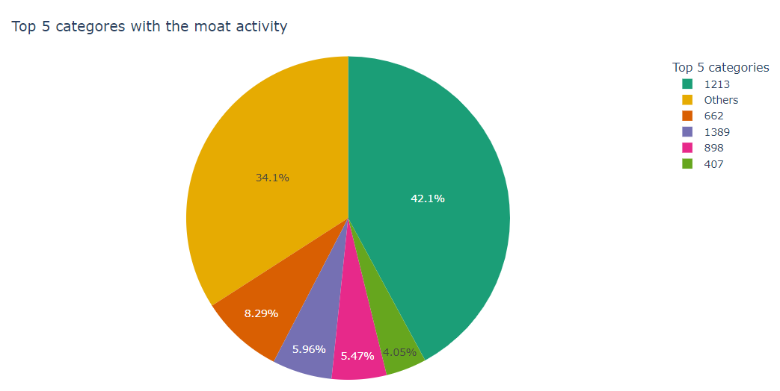
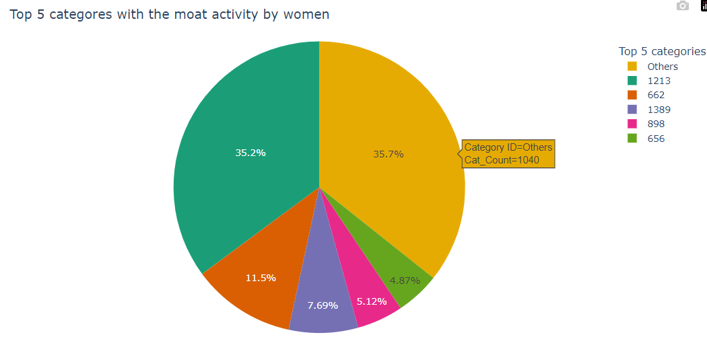
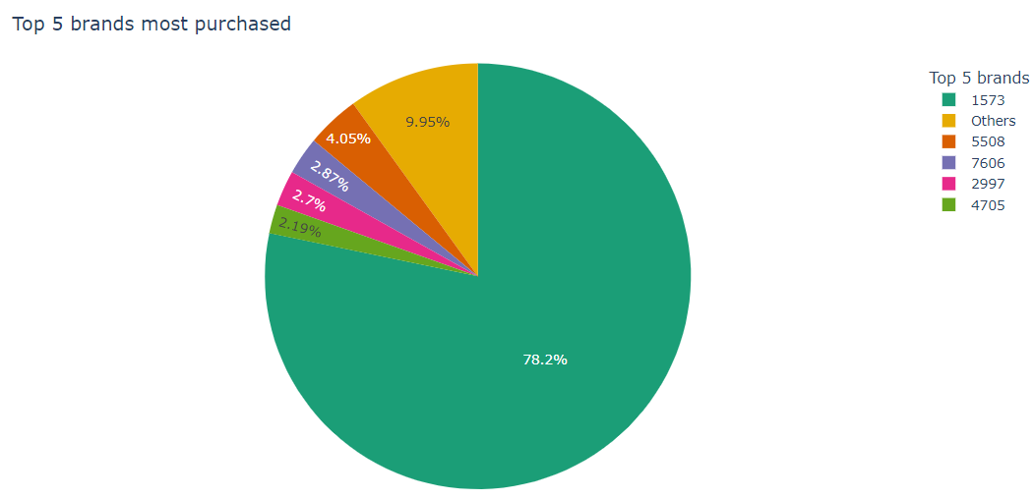
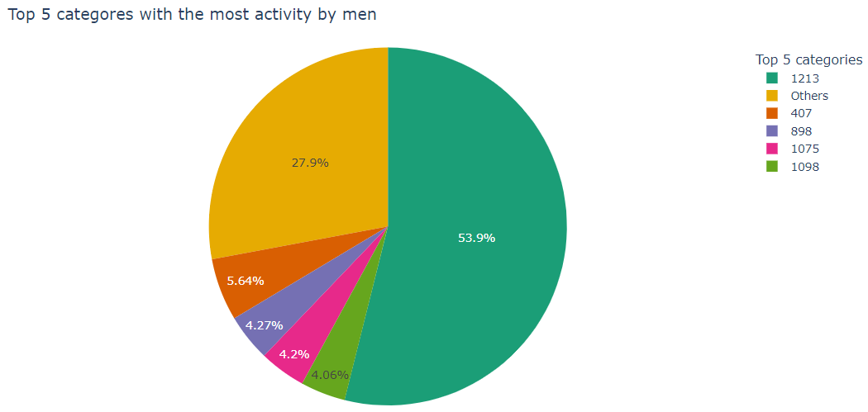
Fig: 6
5. Categorized overall activity by gender using pie charts.
CONCLUSION
We Realized that data was oriented in three perspectives: user, merchant, and user-merchant pair perspectives, which revolved around actions performed by the users..
Fig: 7
Fig: 8
Fig: 9

Slide 9
Feature Engineering
We used the Processed dataset to engineer a total of 153 features based on the basic user-merchant logic. The features can be classified into various categories such as time-related features, count features, action count features, ratio of actions features, monthly features and double 11 Features.
Time-related features
Time period
Interval
Count Features:
Count features User Perspective
Count Features Merchant Perspective
Count Features User-Merchant Perspective
Action Count Features:
Action count Features user Perspective
Action count Features merchant Perspective
Action count Features user-merchant Perspective

Slide 10
Feature Engineering
Ratio of actions Features:
ratio of actions from the user perspective:
ratio of actions from the merchant perspective:
ratio of action for a given user
ratio of action for a given merchant
ratio of action type for user-merchant pair
Monthly Features
User’s Perspective:
Clicks user period max:
Clicks user period mean:
Multivariate response variable user perspective:
Merchant’s Perspective
Clicks merchant period max
Clicks merchant period mean:
Double 11 Features

Slide 11

Feature Ranking
In our project we used three methods for feature ranking, and we chose the best performing one.
A regression model,
SHAP, and
random forest regressor
These models were used to generate feature lists. The features from the random forest regressor produced the best results when tested with various models, so they were chosen for the final prediction task.

Slide 12
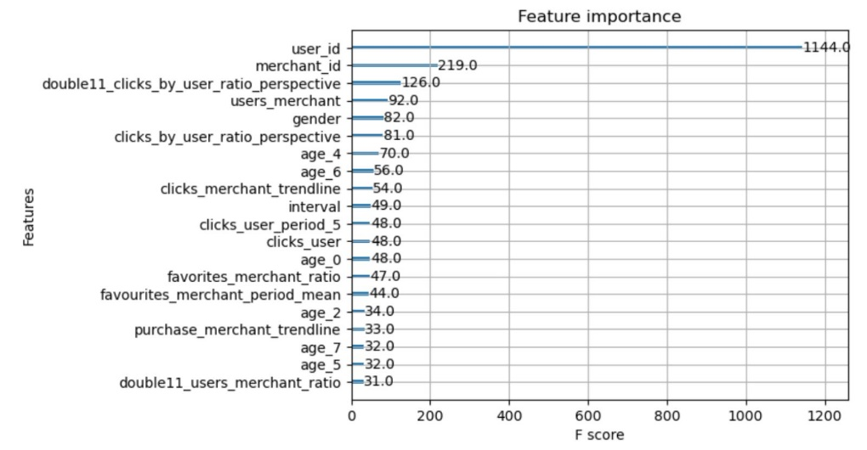
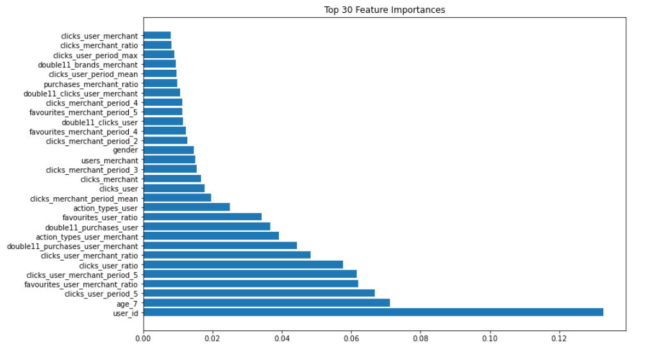
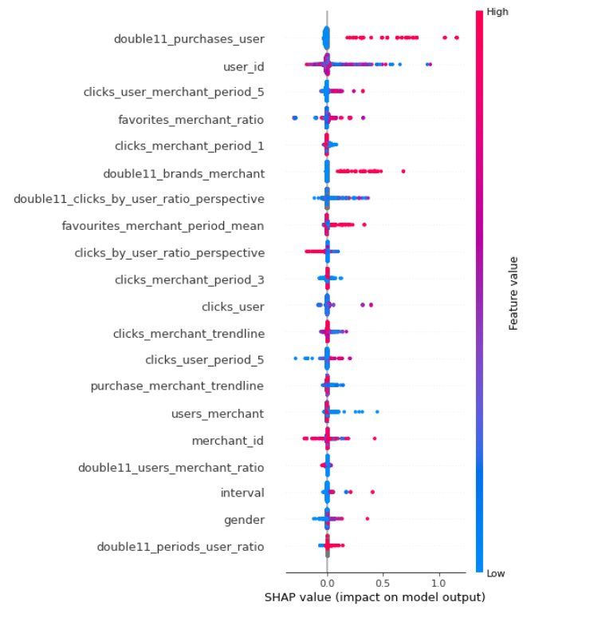
Results Of Feature Ranking
Features using Regression model
Features using Random forest regressor
Features using SHAP

Slide 13
Modeling
In our project we experimented with different machine learning models and evaluated their performances.
Random Forest
Bayes Classifier
Non-Parametric Models (KNN and Parzen Window)
CNN and RNN
The random forest model was used as the baseline model, which achieved 89% accuracy.
The Bayes classifier was then used but it underperformed compared to the baseline model, achieving an accuracy of 0.63.
Non-parametric models like KNN and Parzen windows were also used and analyzed. The KNN model was evaluated with four distance measures. The Parzen window model was also analyzed.

Slide 14
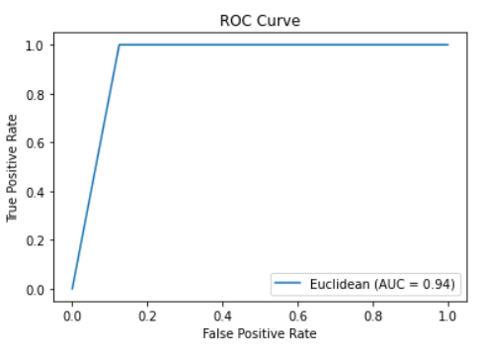
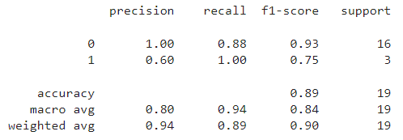
Baseline Model (Random Forest)
In the feature ranking phase, we used three methods to list the importance of features, and Random forest Regressor was one of the methods used. Hence, we decided to start with the random forest model as our baseline model and compare this model with the classic machine learning models. The random forest model was able to achieve an accuracy of 89 percent on the reduced features and PCA data. The picture below provides the performance report and ROC curve of Random Forest.

Slide 15
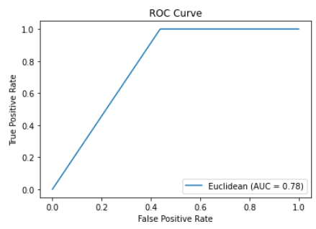
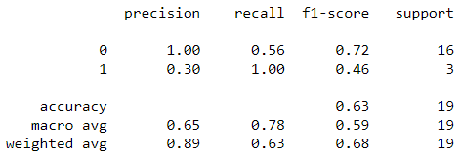
2. Bayes Classifier
After looking at the random forest model, we started with a Bayes classifier. A grid search was conducted to test which hyperparameter yielded the best results. Also, five-fold cross-validation was done. After these steps, the modeling and prediction were performed, in which the model gave an accuracy of 0.63. As you can see, it underperformed compared to our baseline model. The picture below provides the performance report and ROC curve of Naïve Bayes

Slide 16
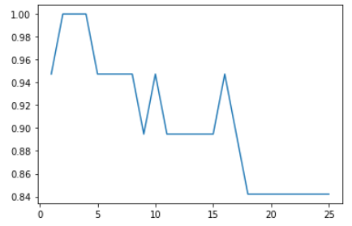
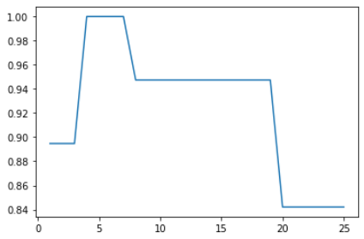
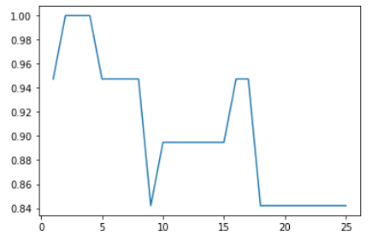
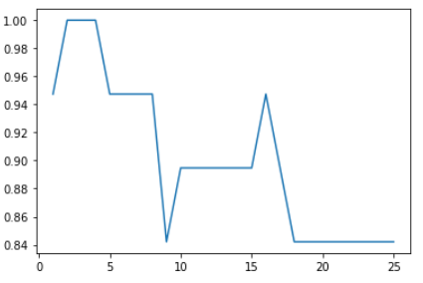
3. K- Nearest Neighbours
Euclidean
Hamming
Manhattan
The next step was to use non-parametric models like KNN and parzen windows and analyse the model's performances. So, we started with kNN. kNN can be performed with four distance measures: Euclidean, Manhattan, Hamming, and cosine. We used grid search on all these to determine an optimal number of neighbours to achieve the best results. The pics below depict the accuracy of the kNN model with respect to the number of neighbours on the x-axis.
Cosine

Slide 17
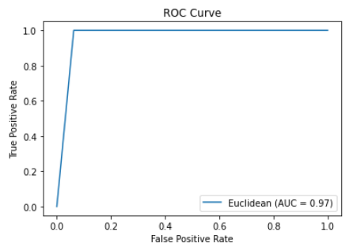
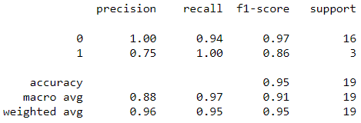
Performance Evaluation (KNN)

Slide 18
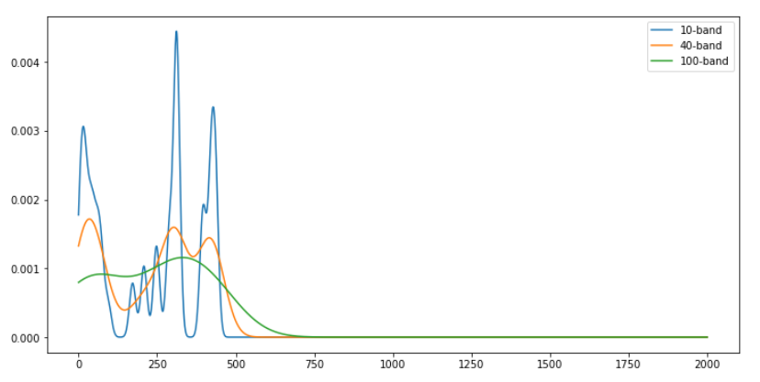
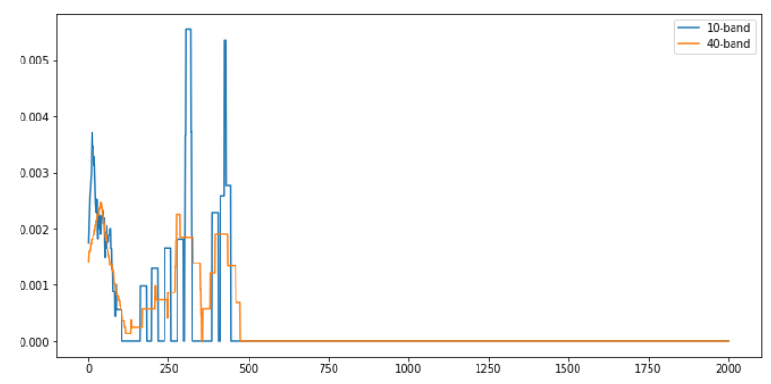
Parzen Window
Parzen windows model is introduced as our next model, and "clicks_merchant" is chosen as the density feature.
Kernel density estimation (KDE) is a proper statistical procedure since it makes no assumptions about the form or distribution of the data. In other words, it is non-parametric, and its probability density estimations depend exclusively on the qualities seen in the data.
On the other hand, Parametric approaches make assumptions about the underlying distribution of the data, such as assuming a normal distribution.

Slide 19
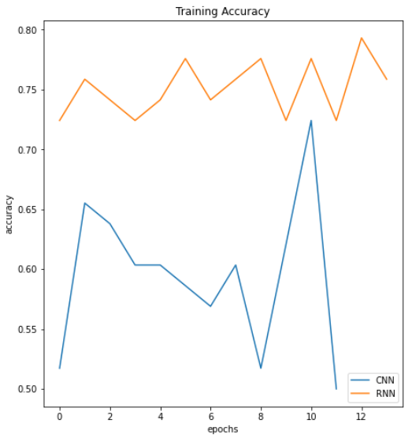
CNN and RNN
Neural networks (CNN and RNN) was also used to check if it could perform better and improve label value prediction.
CNN and RNN achieved an accuracy of 0.73 and 0.84 respectively, as shown in the graph.

Slide 20
Conclusion and Insights:
Our project aimed to predict customer loyalty based on the user activity data and given below are our conclusions and insights based on our analysis.
Several machine learning models were explored, including Bayes classifier, KNN, Parzen windows, random forest, and neural networks (CNN, RNN).
Among our tests KNN had the best accuracy rate of 0.94, followed by random forest with 0.89. Thus, we believe non-parametric methods might be the best approach for this data, according to our analysis.
Loyalty may not necessarily translate to higher interest in special events or promotions. (based on analysis of customer behavior on Double 11 Day and the period in which Double 11 Day occurs).
Click-merchant ratio and frequent browsing with a single merchant were strong indicators of customer loyalty.
Merchants who offer a limited number of brands tended to have more loyal customers, indicating a preference for a focused selection of products from a trusted source.

Slide 21
REFERENCES:
· https://www.kaggle.com/code/residentmario/kernel-density-estimation-with- ted-talks
· https://machinelearningmastery.com/what-is-imbalanced-classification/
· Repeat Buyer Prediction for E-commerce
https://dl.acm.org/doi/10.1145/2939672.2939674
· https://www.researchgate.net/publication/305998405_Repeat_Buyer_Predictio n_for_E-Commerce
· https://ieeexplore.ieee.org/document/8955625

