Slide 1
Optimise Diagnosis of Depression based on Hypertension and Sleep Apnea Factors
Group 7
Priyanka Bhyregowda, Ann Maria John, Madhulika Dutta, Shruti Badrinarayanan

Slide 2
Motivation
“About 21 million adults in the U.S. (8.4%) have experienced a major depressive episode” - WHO
National Health and Nutrition Examination Survey (NHANES) Data was pooled from the 2005-2008 and 2015-2020 study cycles (5 phases)
Original data encompasses information about depression risk along with many health indicators in the form of questionnaire responses
Total of 28 .csv files containing information on participant demographics, depression, sleep disorder, and hypertension is considered for the study.

Slide 3
Depression Prevalent: Common depression symptoms like lack of interest and feeling down were reported by a significant portion of participants, though at lower intensity levels.
Sleep Issues: Sleep disturbances (trouble sleeping or sleeping too much) appeared relatively common among respondents.
Hypertension Concerns: Many respondents take medication for high blood pressure, indicating its prevalence within the dataset.
Diverse Dataset: Participants with various backgrounds.
Sleep Apnea and Hypertension: Majority reported not having sleep apnea (21,754 out of 24,108), and a majority are taking medication for high blood pressure (23,163 out of 24,108), which suggested a potential area of interest in exploring the relationship between hypertension and sleep apnea.
Lifestyle Factors: Most not current drinkers or smokers, which provides an interesting perspective on lifestyle factors that could be associated with depression, sleep apnea, and hypertension.

Slide 4
Data Pre-processing

Slide 5
Hidden Feature Extraction
Feature ‘Sleep Apnea’
Extracted from ‘how often do you snore’ and ‘how often do you snort/stop breathing’
Feature ‘Total Score’
Extracted from PHQ-9 which has 4 point Likert scale
Feature ‘Depression Category’
Extracted from ‘Total Score’ : >= 10 - severe; >=5 - mild; no
Extracted from ‘Thought you would be better off dead’

Slide 6
Insignificant columns were dropped
Missing value imputation
Numerical features - median
Categorical and discrete features - mode
Outlier detection
IQR method
Feature encoding
Ordinal features - Label encoding
Nominal features - One-hot encoding

Slide 7
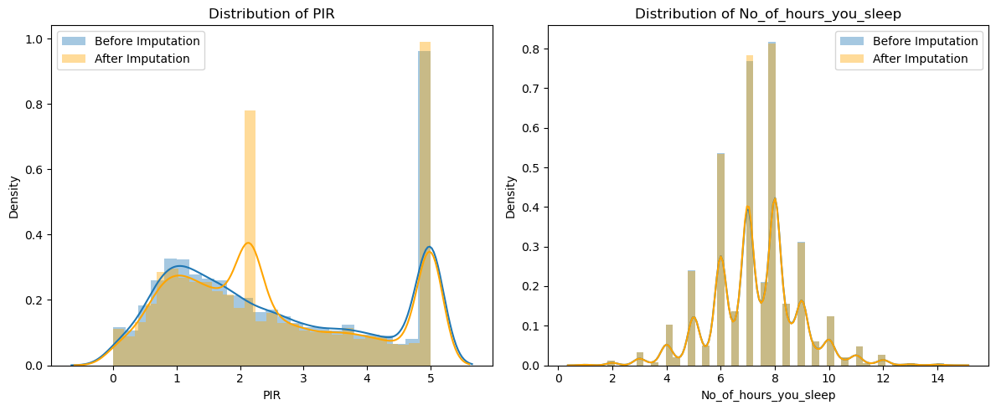

Slide 8
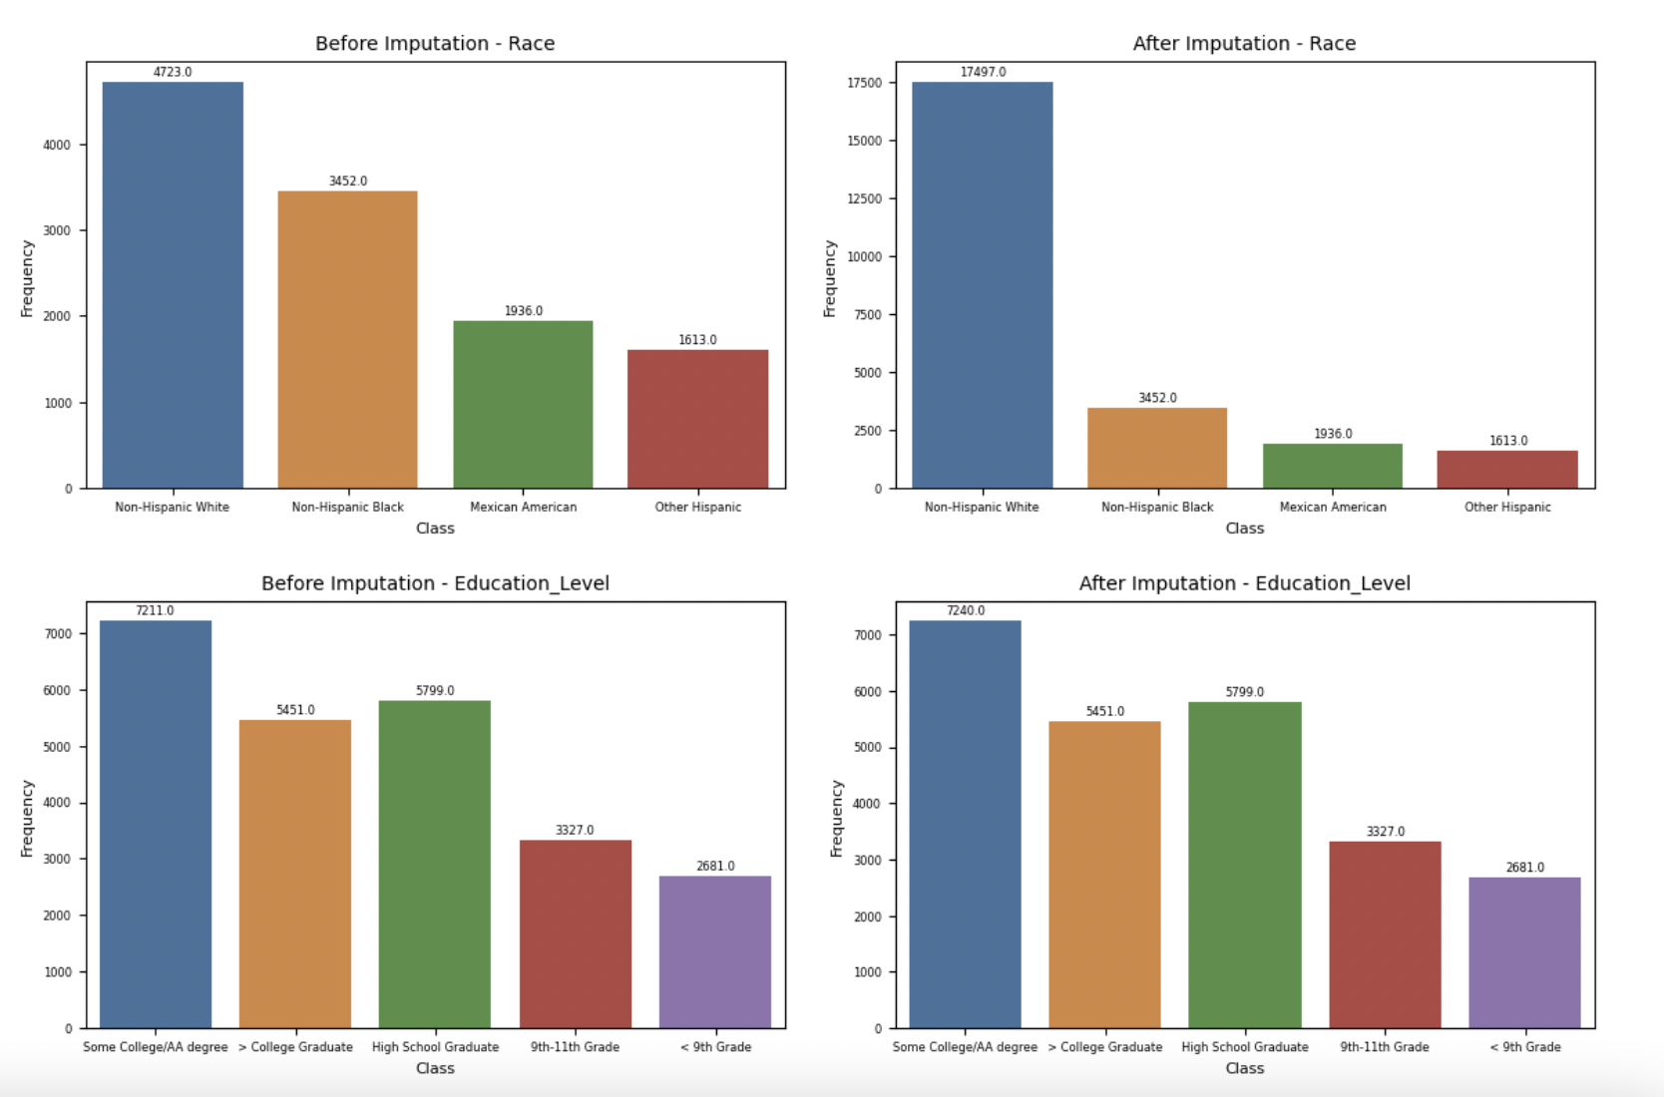

Slide 9
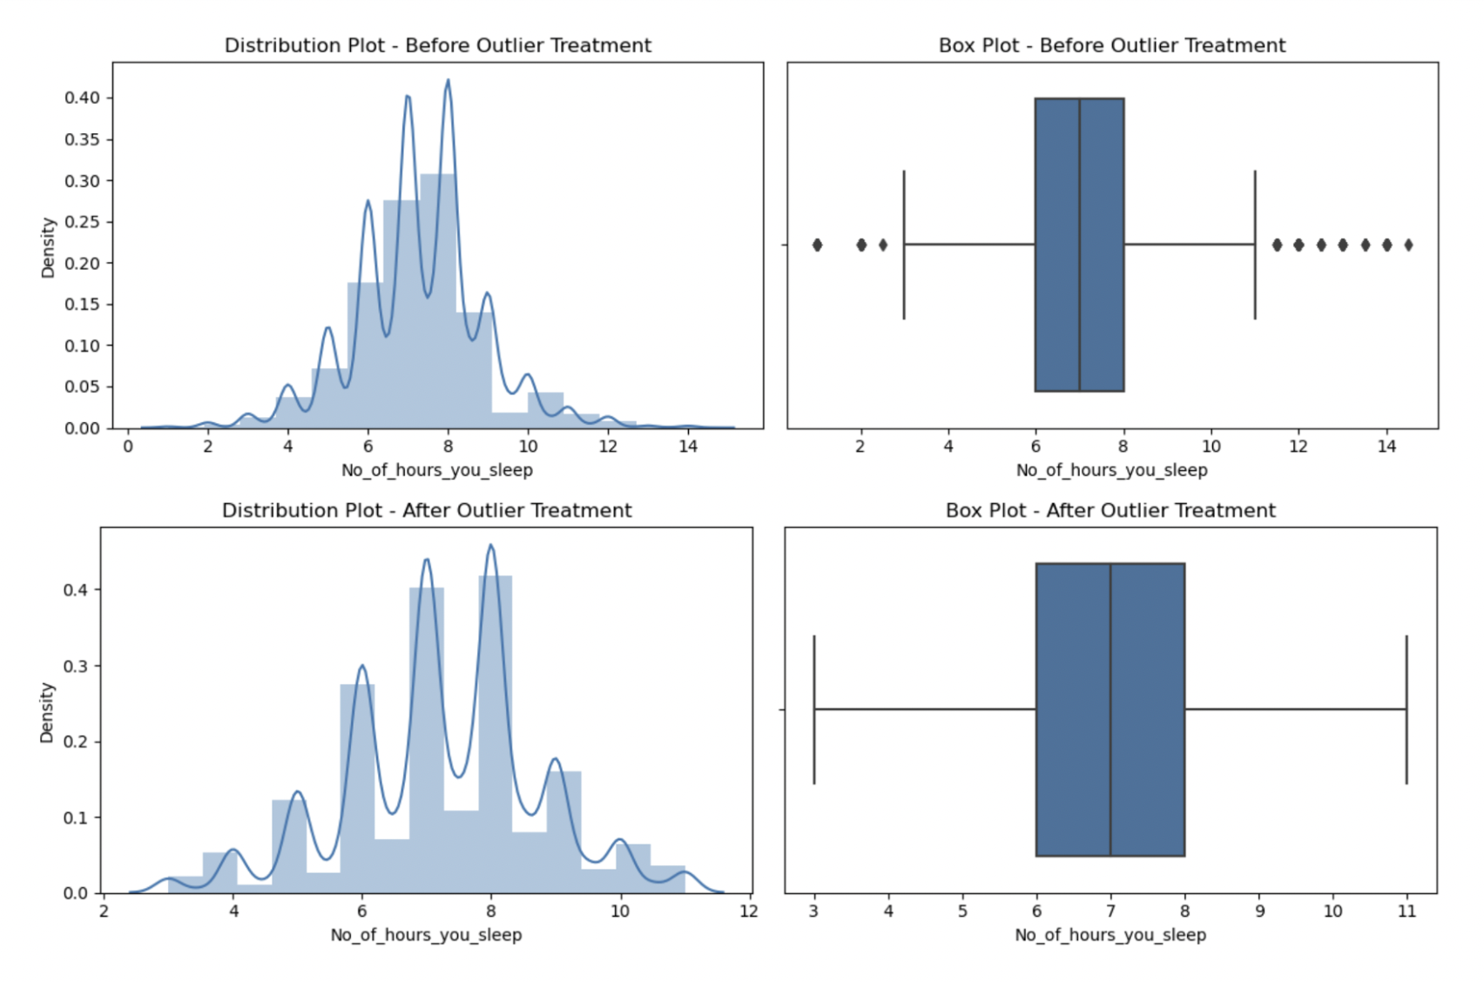

Slide 10
Exploratory Data Analysis

Slide 11
Data Understanding
Prevalence of Symptoms
Respondents who reported experiencing symptoms of depression, such as ‘little interest in doing things’ and ‘feeling down or depressed’ had mean scores of 0.34 and 0.32, respectively.
Sleep-related issues, like trouble sleeping or sleeping too much, had a mean score of 0.57, indicating somewhat prevalent sleep disturbances among the respondents.
Demographic Characteristics
Gender: Balanced Representation
Race: Non Hispanic/White dominated
Marital Status: Married/Living with Partner - predominant
Education Category: High School Graduate

Slide 12
Data Understanding
Females affected more than Males - Need for more gender specific mental health considerations
Socio-economic Factors
Higher the education level, high the incidence of depression - Potential Connection between Education and Mental health
Correlation - Very low positive correlation between Sleep Apnea/Hypertension and Depression

Slide 13
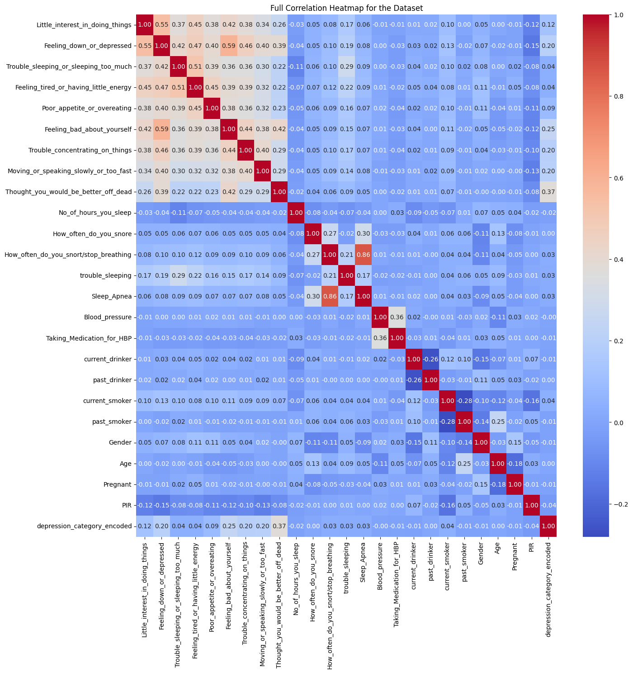
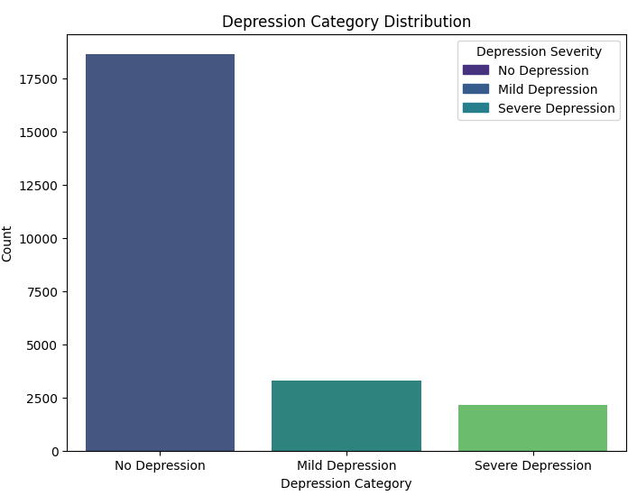
Correlation Heat Map
Depression Class Distribution

Slide 14
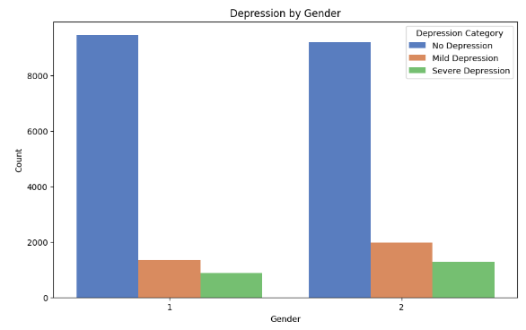
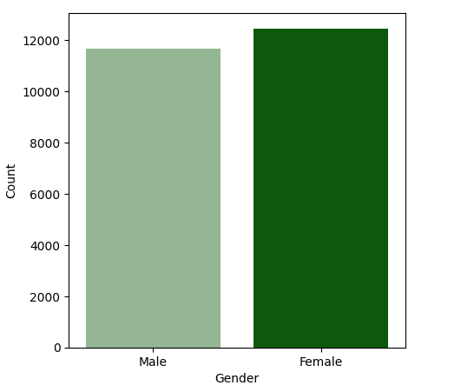
Depression and Gender

Slide 15
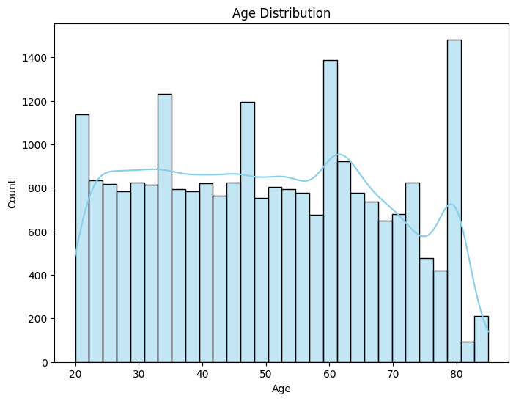
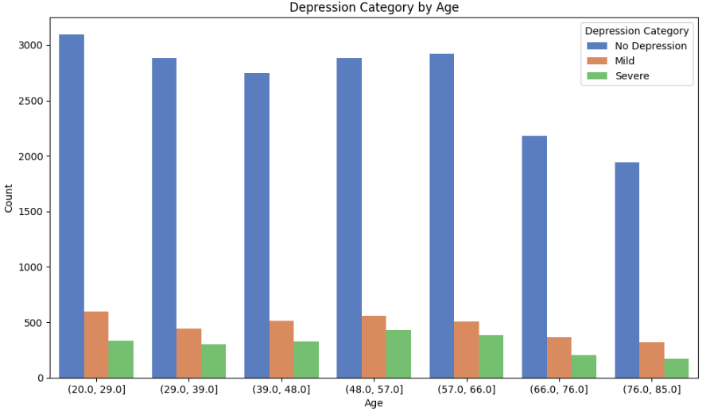
Age and Depression

Slide 16
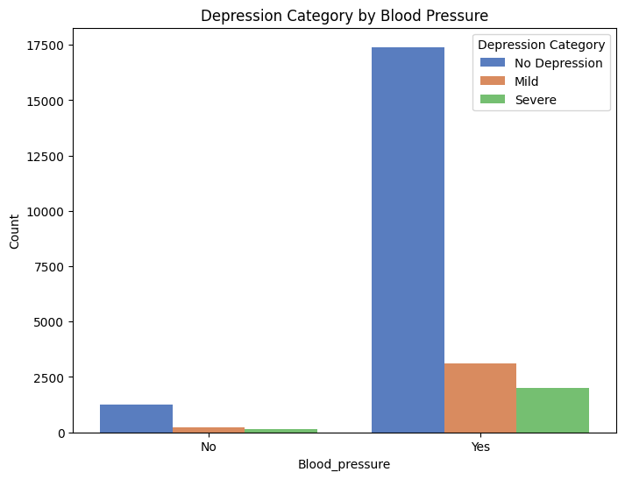
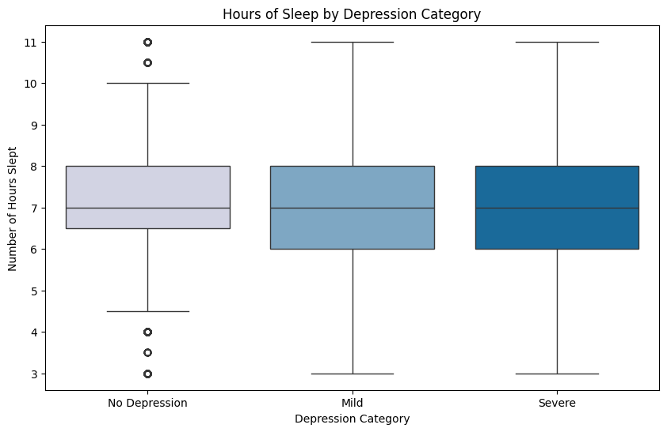
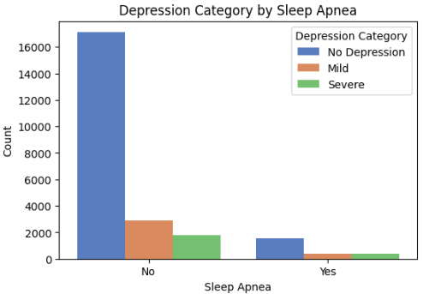
Hours of sleep vs Depression
Blood Pressure vs Depression
Blood Pressure vs Sleep Apnea

Slide 17
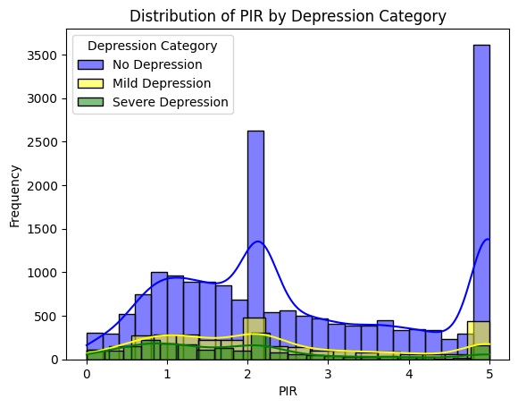
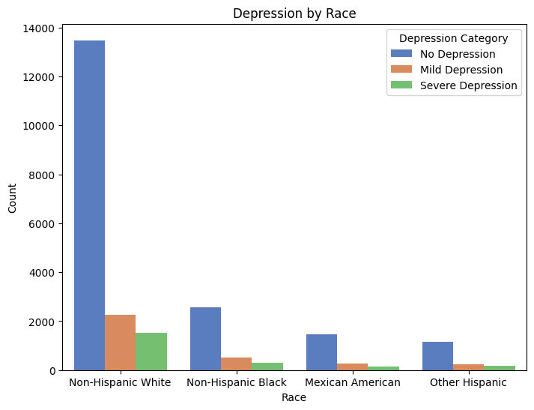
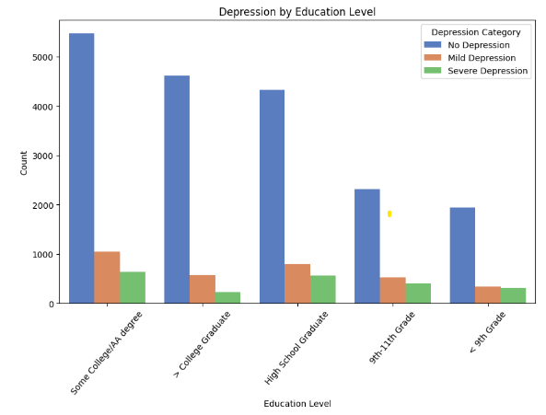
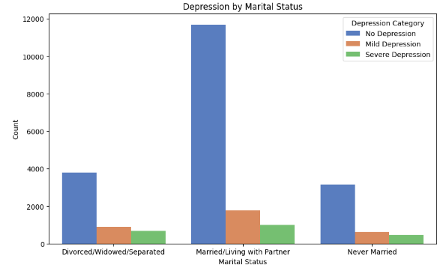
Depression and Income
Depression and Race
Depression and Education level
Depression and Marital Status

Slide 18
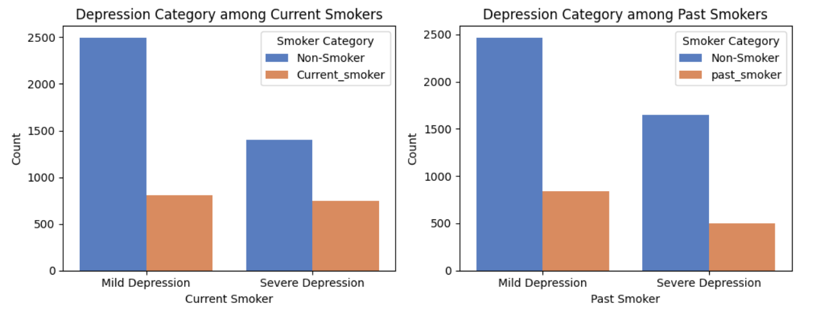
Depression and Smoker

Slide 19
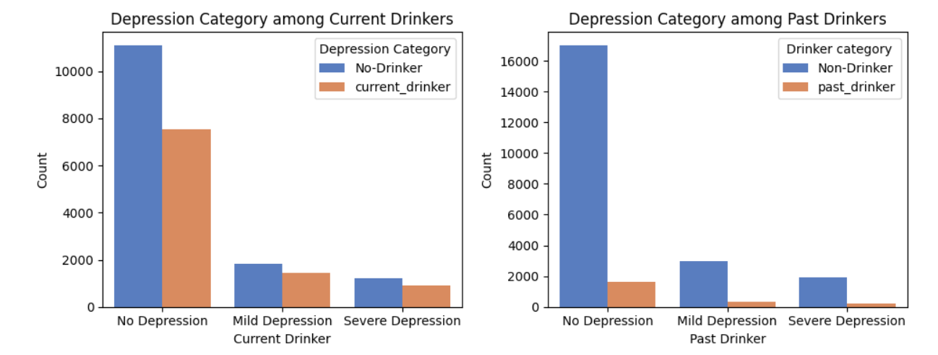
Depression and Alcoholism

Slide 20
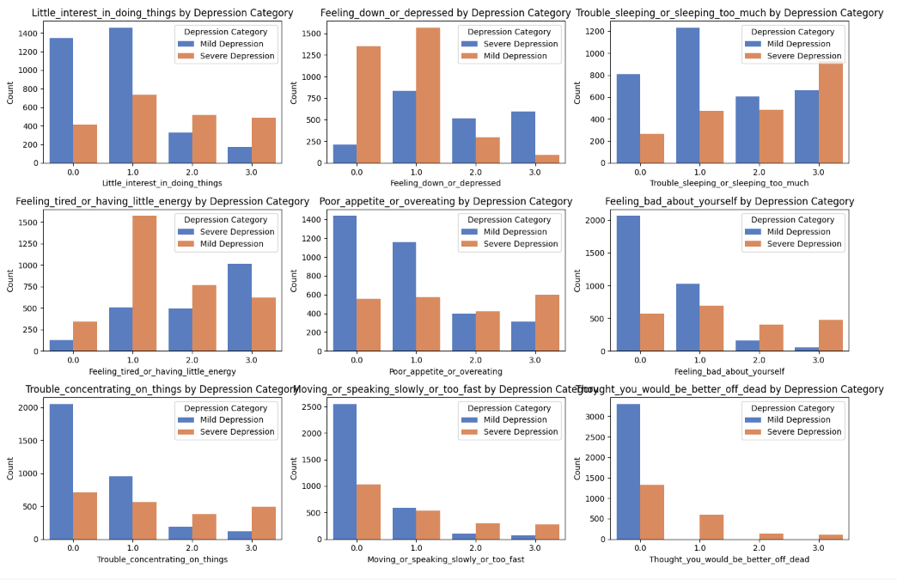
Major Symptoms in Depressed Patients

Slide 21
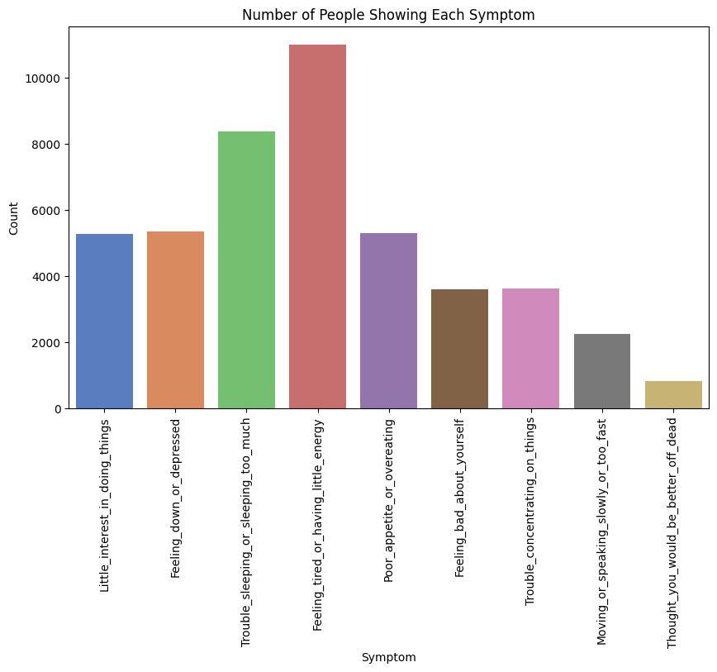
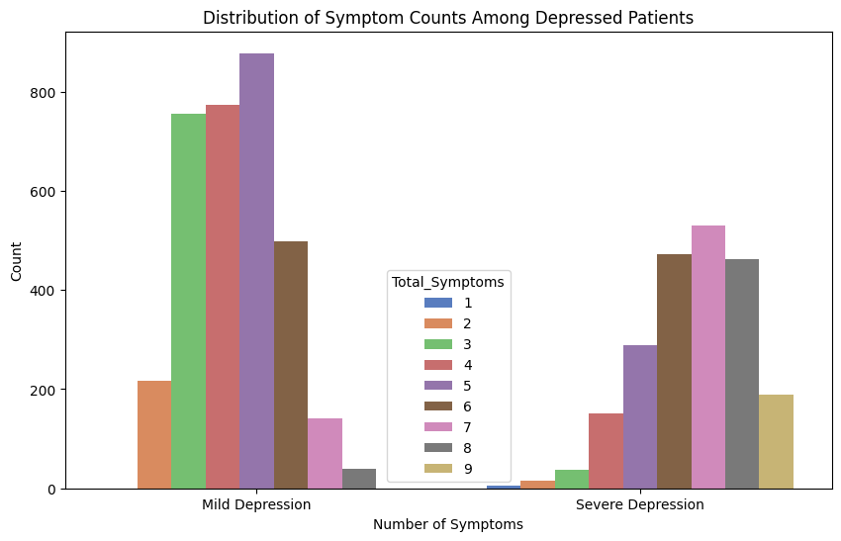
Count of each symptom in the population
Count of symptoms in depressed patients

Slide 22
Analysis Findings
Even though even distribution of Gender was considered the distribution of Marital status , Education level , Race was not balanced in the survey results.
Depression may not be significantly related into any health conditions.
Depression mainly deals the status of current stress levels, feelings of the patient. That is if the person thinks different from normal regular mood changes about everyday life for a longer time then he or she will will be stuck in depression.
Depression can be the cause for the sleep apnea, but not vice versa.

Slide 23
Community Contribution

Slide 24
Community Impact
We can further enhance the results by adding additional questions to the existing survey list to conduct a more comprehensive analysis.
By developing a machine learning application a person can answer these questions to get to know their current mental well-being.
This helps in taking proactive steps for the depression, which in other case could lead to many other physiological and health factors or even death.
Develop targeted mental health campaigns for more susceptible groups
Guide hospitals, healthcare providers to offer more personalized support to those dealing with sleep apnea, hypertension, and depression
Optimize health resource allocation - Ultimately improving the overall well-being of our communities

Slide 25
REFERENCES
https://wwwn.cdc.gov/nchs/nhanes/continuousnhanes/default.aspx?Cycle=2017-2020
https://www.frontiersin.org/articles/10.3389/fpubh.2023.1348803/full
https://journals.plos.org/plosone/article?id=10.1371/journal.pone.0272330
https://link.springer.com/content/pdf/10.1186/s12888-023-05109-9.pdf

Slide 26
Thank You

