Slide 1
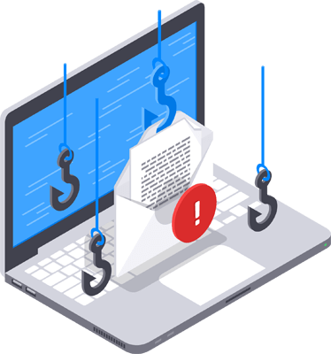
Phishing Awareness Program
Cyber Security Internship
CODSOFT
Prepared by:
Shruti Basliyal

Slide 2
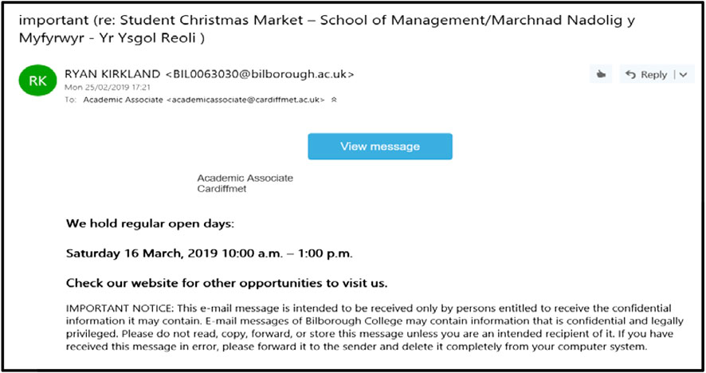
What is Phishing?
Phishing is a cyber attack where attackers:
🎭 Pretend to be a trusted person or organization
📧 Send fake emails, messages, or websites
🔑 Trick users into revealing passwords and bank details
💳 Steal personal or financial information

Slide 3
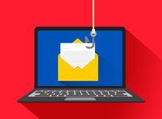
Why is Phishing Dangerous?
Phishing can have serious consequences for individuals and organizations.
💰 Financial loss due to stolen banking information
🔐 Identity theft using personal information
📂 Data breaches and loss of confidential data
🏢 Damage to company reputation
⚠️ Malware or ransomware infections

Slide 4
Types of Phishing
📧 Email Phishing
Fake emails pretending to be from trusted organizations.
🎯 Spear Phishing
Targeted attacks aimed at a specific individual or organization.
🐋 Whaling
Targets senior executives or high-profile individuals.
📱 Smishing
Phishing attacks through SMS or text messages.
📞 Vishing
Phishing attacks using phone calls or voice messages.
Type | Medium
Email Phishing | Email
Spear Phishing | Personalized Email
Whaling | Executives
Smishing | SMS
Vishing | Phone Call

Slide 5

How to Identify Phishing Emails
Unknown sender or suspicious email address
Urgent or threatening language ("Your account will be suspended!")
Suspicious links (hover over links before clicking)
Unexpected attachments
Spelling and grammar mistakes
Requests for passwords, OTPs, or bank details

Slide 6
Fake Websites & Login Pages
Common Characteristics
Similar-looking website URL (e.g., arnazon.com instead of amazon.com)
Missing or suspicious HTTPS/security certificate
Copied logos and website design
Pop-ups asking for personal or banking information
Fake login forms that steal your credentials
What are Fake Websites?
Fake websites are designed to look exactly like legitimate websites to trick users into entering sensitive information such as usernames, passwords, credit card details, or OTPs.

Slide 7
Social Engineering Techniques
Social Engineering
Social engineering is a technique where attackers manipulate people into revealing confidential information by exploiting trust, fear, curiosity, or urgency.
Common Techniques
Impersonation – Pretending to be a trusted person or organization.
Urgency – Pressuring users to act immediately.
Baiting – Offering fake rewards or free downloads.
Pretexting – Creating a believable story to gain trust.
Fear Tactics – Threatening account suspension or legal action.

Slide 8
Real-Life Phishing Case Study
Google & Facebook Scam (2013–2015)
A cybercriminal tricked Google and Facebook by sending fake invoices pretending to be from a legitimate supplier.
Impact
Over $100 million was transferred.
Fake emails and invoices appeared genuine.
The attacker was later arrested and convicted.
Lesson Learned
Always verify payment requests and email authenticity before taking action.

Slide 9
Best Practices to Stay Safe
Follow These Safety Tips:
Verify the sender's email address.
Hover over links before clicking.
Use strong, unique passwords.
Enable Multi-Factor Authentication (MFA).
Keep software and antivirus updated.
Never share passwords or OTPs.
Report suspicious emails immediately.

Slide 10
Common Warning Signs
Be Alert If You Notice:
Unexpected emails or messages.
Poor spelling and grammar.
Suspicious or shortened links.
Requests for passwords or banking details.
Urgent or threatening messages.
Unexpected attachments.
Unknown sender or unusual email address.
Remember: If something seems suspicious, verify it before taking any action.

Slide 11
Quiz
Test Your Knowledge
Q1. What is phishing?
A) A fishing technique
B) A cyber attack to steal information ✅
C) A type of antivirus
Q2. Which is a warning sign of phishing?
A) Official company email
B) Urgent request for passwords ✅
C) Secure HTTPS website
Q3. What should you do before clicking a link?
A) Hover over it to check the URL ✅
B) Click immediately
C) Ignore the sender

Slide 12
Conclusion
Key Takeaways
Phishing is one of the most common cyber threats.
Attackers exploit human trust rather than technical weaknesses.
Always verify emails, links, and websites before sharing information.
Stay informed and practice safe online habits.

Slide 13
References
Use reliable sources such as:
Microsoft Security
Google Safety Center
Cisco Cybersecurity
Norton Cyber Safety
CISA (Cybersecurity and Infrastructure Security Agency)

