Slide 1
MAJOR PROJECT_II
Group Number – 17
Project Title- Credit Trust: A Digital Credit Transparency System for Local Retail Shops
SDG Goal – SDG 8 – Decent Work and Economic Growth
Team Members
Shruti Tiwari 0187CS221189
Siya Gajbhiye 0187CS221192
Sitvat Fatima 0187CS221191
Guide
Dr. Komal Tahiliani
Department of Computer Science & Engineering

Slide 2
Digital Credit Transparency System
Faced Challenges
Proposed Solution
1.Manual Credit Record Errors :Maintaining udhar in paper registers leads to calculation mistakes and missing entries.
2. Difficulty in Recovering Credit Payments: Improper or unclear records make it difficult for shopkeepers to recover full payment from customers.
3. Mismanagement of Supplier Bills : Bills from different suppliers often get mixed up or lost, causing confusion in expense tracking.
4. Risk of Record Loss or Damage : Paper-based records can be easily lost, damaged, or misplaced, resulting in permanent data loss.
Smart mobile application for digital credit and shop management.
Shopkeeper can add customers, record udhari, and store supplier bills digitally.
Firebase database securely stores all records and transaction history.
Customers can view their credit records anytime and raise flags if any issue is found.
Provides real-time tracking, secure storage, and transparency between shopkeeper and customer.
.

Slide 3
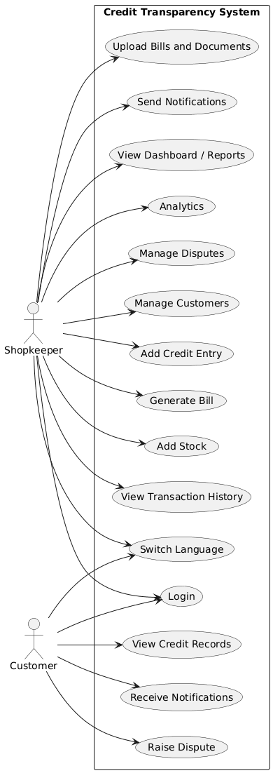
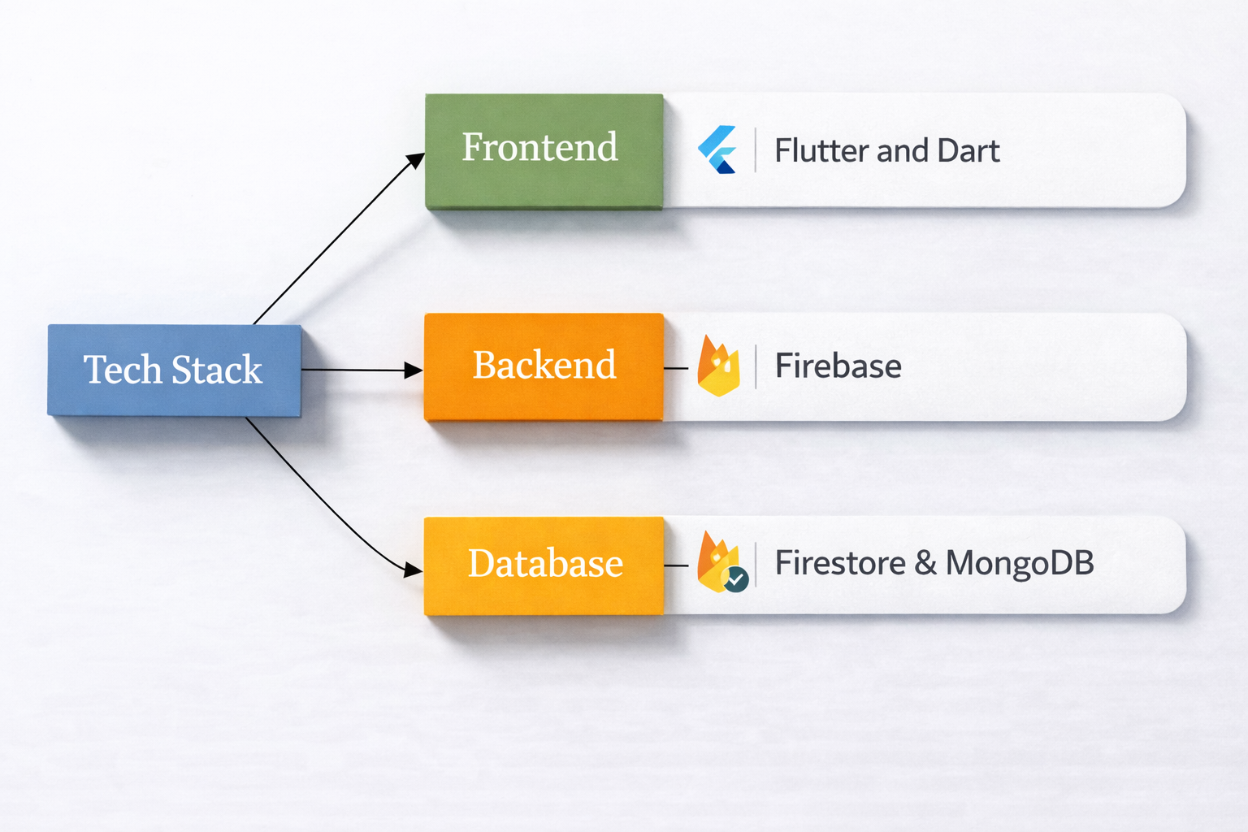
Flow Chart :
Technology Stack :

Slide 4
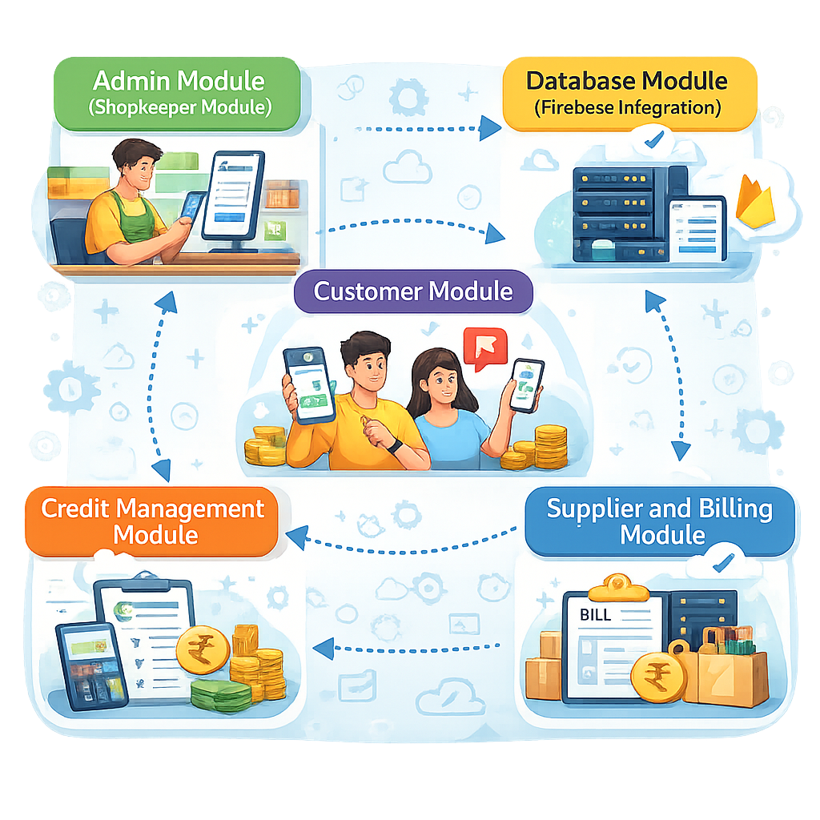
Modules Used in the Project
1. Admin Module (Shopkeeper Module)
Allows the shopkeeper to login, add customers, record udhari, upload bills, and manage credit records.
2. Customer Module
Allows customers to view credit records, transaction history, and raise flags for incorrect entries.
3. Credit Management Module
Manages adding, updating, and storing customer credit records with date and time.
4. Supplier and Billing Module
Stores supplier details and purchase bills for easy tracking and management.
5. Database Module (Firebase Integration)
Securely stores all customer, credit, and billing data in Firebase cloud database.
4

Slide 5
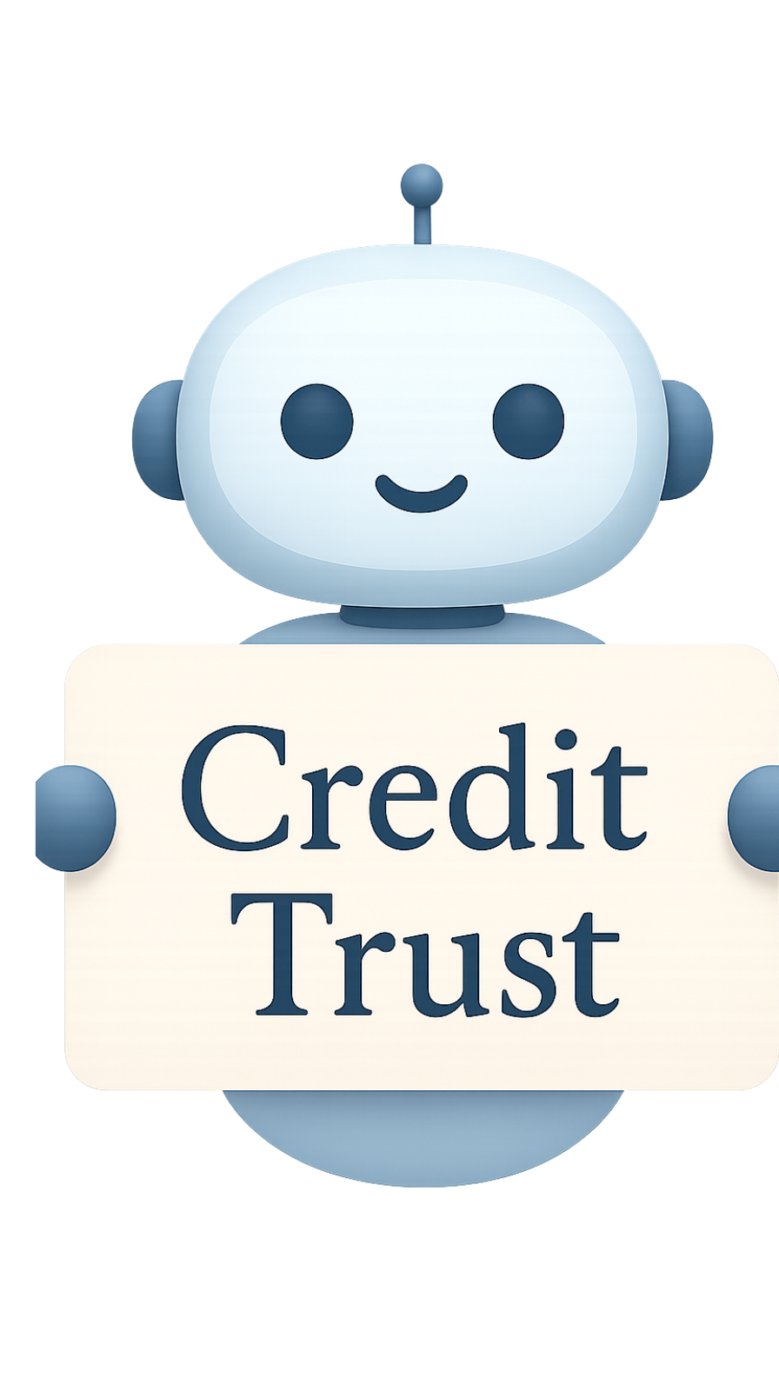
FEASIBILITY AND VIABILITY
Analysis of the feasibility of the idea:-
Technical: Uses Android application with Flutter, Dart and Firebase, easy to develop, scalable, and supports real-time data storage and access.
Economic: Low development and maintenance cost, uses free tools like Android Studio and Firebase, affordable for small shopkeepers.
Market: High demand among local retail shops and grocery stores, helps replace traditional khata system with a digital and transparent solution.
Strategies for Overcoming These Challenges
The application will be developed step by step to ensure proper working. A simple and user-friendly design will help shopkeepers use it easily. All records will be stored safely to avoid data loss. The system will be properly tested to ensure accurate credit entries. Feedback from shopkeepers will be used to improve the system. The main focus will be on providing transparency and easy record management.
5

Slide 6
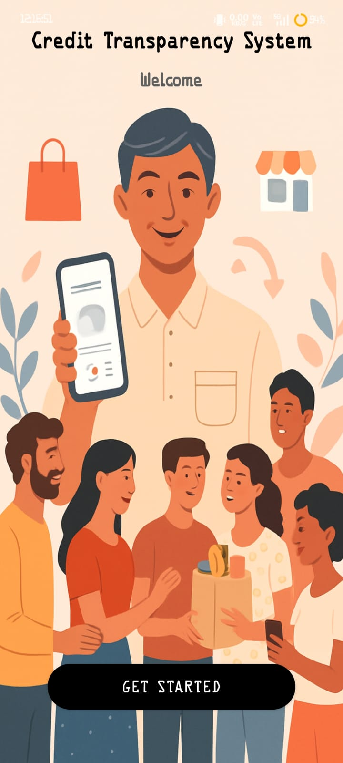
IMPACT AND BENEFITS
Potential Impact
Improves transparency as both shopkeeper and customer can clearly view credit records.
Encourages shopkeepers to move from paper registers to digital record keeping.
Builds trust between shopkeeper and customer by maintaining accurate and clear records.
Key Benefits of the System
Makes it easy for shopkeepers to add, view, and manage udhari records.
Stores all credit records and bills safely, reducing risk of data loss.
Saves time and effort by replacing manual record keeping with a digital system.

Slide 7

RESEARCH AND REFERENCES
Details / Links of the reference and research work
References:
1. Research on Digital Transformation of Kirana Stores https://www.researchgate.net/publication/400100801_KIRANA_40_Measuring_the_Impact_of_Phygital_Transformation_of_Small_Retailers_on_BOP_Consumer_Behaviour This research shows that digital systems improve customer trust, satisfaction, and overall retail efficiency in kirana stores.

Slide 8
THANK YOU !!
WELCOME QUESTION ??
8

