Slide 1

Design of a mechanism for precise change of amplitude of variable pitch Vertical axis wind turbine
Project Supervisor: Dr. Abhishek
Submitted BY: Shrutikirti Singh

Slide 2
motivation
VAWTs present distinct advantages over their horizontal-axis counterparts, such as reduced noise, enhanced safety, and simplified maintenance, optimizing their efficiency remains a complex task, particularly in the face of fluctuating wind conditions
Efficiency of VAWTs is inherently linked to their ability to adapt to varying wind speeds and directions. This adaptability is crucial for ensuring consistent and optimal energy output.
The motivation for this project arises from the desire to enhance the controllability and efficiency of VAWTs by introducing a variable-length linkage mechanism. By drawing inspiration from the precision of a screw gauge, we aim to create a mechanism that can dynamically adjust the length of the ground link, influencing the pitch amplitude of the turbine blades in real-time.
The ability to fine-tune the pitch amplitude based on varying wind speeds is crucial for maximizing energy capture efficiency. This project's motivation is rooted in the belief that a novel approach to pitch control in VAWTs can significantly contribute to the advancement of wind energy technology, making it more competitive, efficient, and viable in a broader range of environmental conditions.

Slide 3
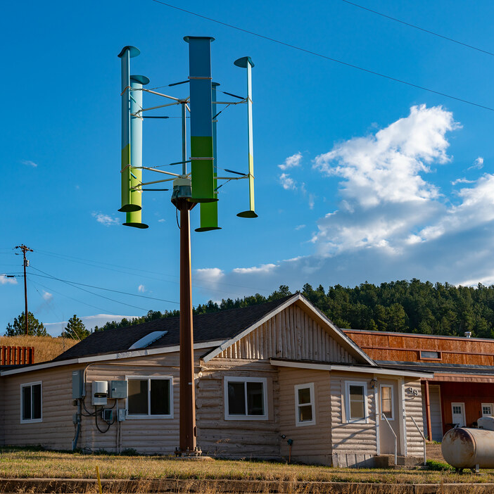
Introduction
Our project focuses on optimizing VAWTs through a variable-length linkage mechanism inspired by the precision of a screw gauge. The goal is to investigate the influence of varying linkage lengths on the pitch amplitude of the turbine blades.

Slide 4
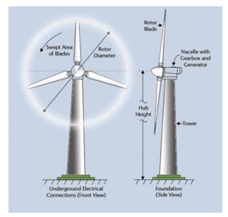
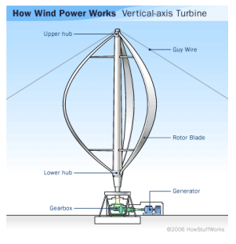
Wind Turbines
HAWT | VAWT
Situated in Rural areas | Alternative for populated regions
Less aerodynamic complexity | More complexity due to non-normal plane of rotation to the flow direction
Accessibility not easy | Lower assembly lower maintenance cost (as it is ground place)

Slide 5
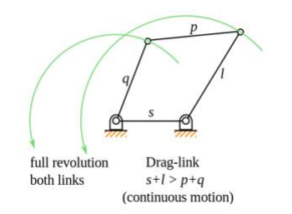
Four-bar linkage
This study employs a four-bar linkage mechanism to dynamically adjust the blade pitch angle, enabling precise control over the blade orientation concerning the tangential direction and, consequently, modifying the angle of attack.

Slide 6
PRINCIPAL OF SCREW GAGE
The fundamental principle of the screw gauge mechanism revolves around the conversion of rotary motion into linear displacement. This is achieved through the interaction of a threaded screw and a corresponding nut. Why this is chosen? The primary advantage of the screw gauge lies in its ability to offer fine-tuned adjustments, making it an ideal choice for applications where precision is paramount.

Slide 7
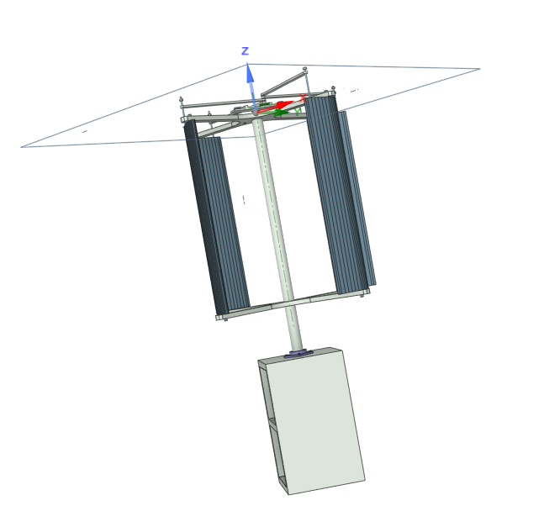
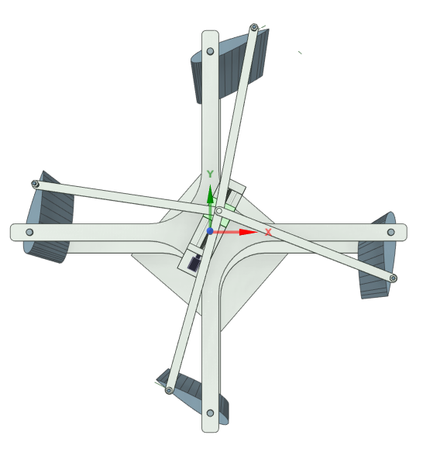
VAWT
Top view:

Slide 8
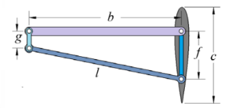
Four-bar Linkage
g = ground link = 50 mm b = input link = 425 mm f = floating link = 110 mm l = output link = 429 mm

Slide 9
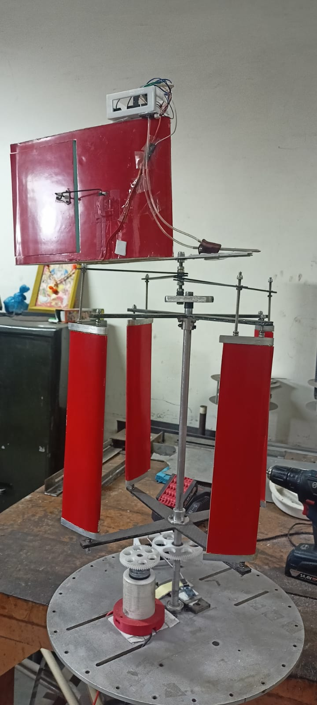
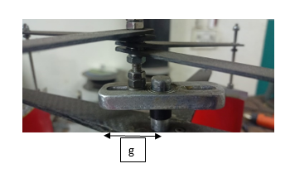
VAWT

Slide 10
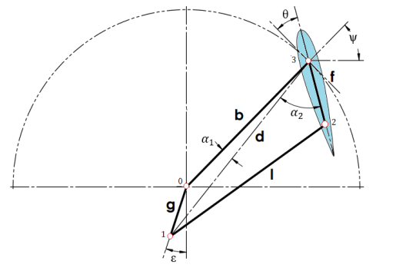
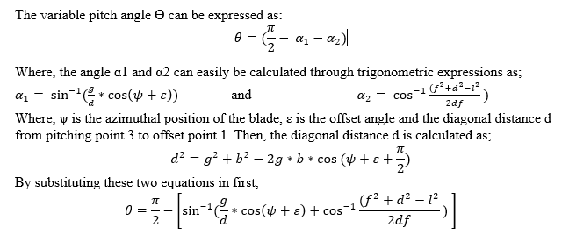
PITCH ANGLE CALCULATION

Slide 11
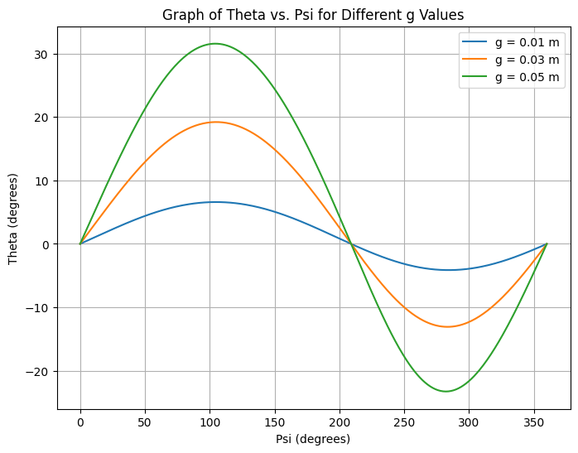
SIMULATION RESULT

Slide 12
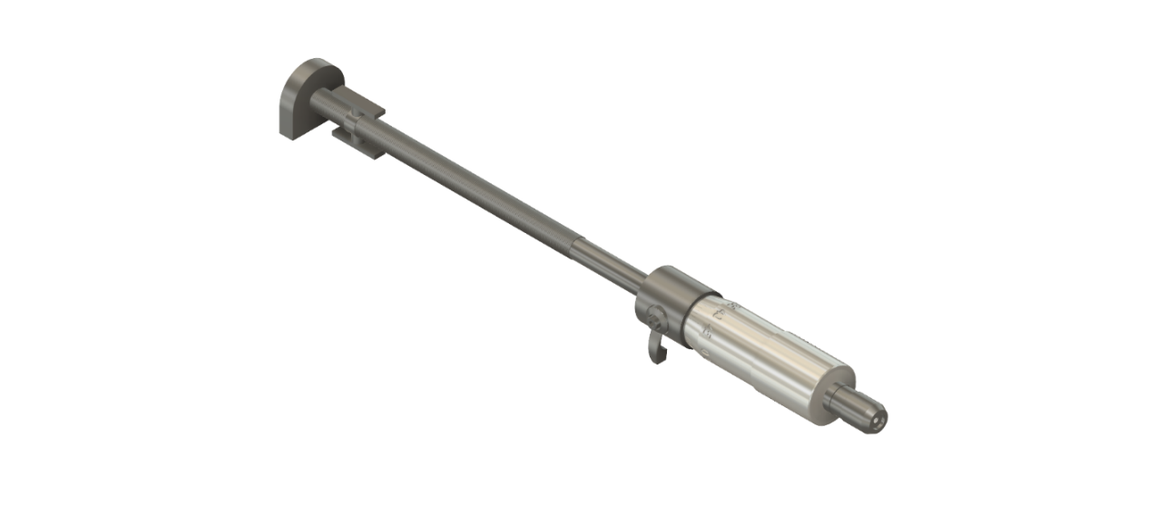
MECHANISM
Pitch = 0.5 mm Least count = 0.01 mm

Slide 13
Conclusions
With the help of this mechanism the PITCHING CONTROL OF VERTICAL AXIS WIND TURBINE IS OPTIMISED.

Slide 14

IMPACT
This project represents a significant advancement in renewable energy technology. By dynamically adjusting blade pitch in response to varying wind conditions, the system aims to enhance VAWT efficiency and optimize energy capture. This innovative approach holds the potential to contribute to a more sustainable future by improving the performance of wind turbines, a crucial component in the global transition to cleaner energy sources.

Slide 15


Thank you

