Slide 1
APOGEE INNOVATION CHALLENGE
REFLEXIS SYSTEMS PROBLEM STATEMENT
Presented by:
Archana (Team Lead)
Shruti Sharma
Ankit Pandey

Slide 2
Objective
Identify correct number of Staff Schedule Hours for a store given the historical data for the same
Impact of change of Staff Schedule Hours made by the manager
And determining which manager made better changes
Determine factors/ changes made by the manager that result in
better schedule adjustment
worse/non-optimal labor schedule & cost
Identifying generalised metrics that quantify store performance

Slide 3
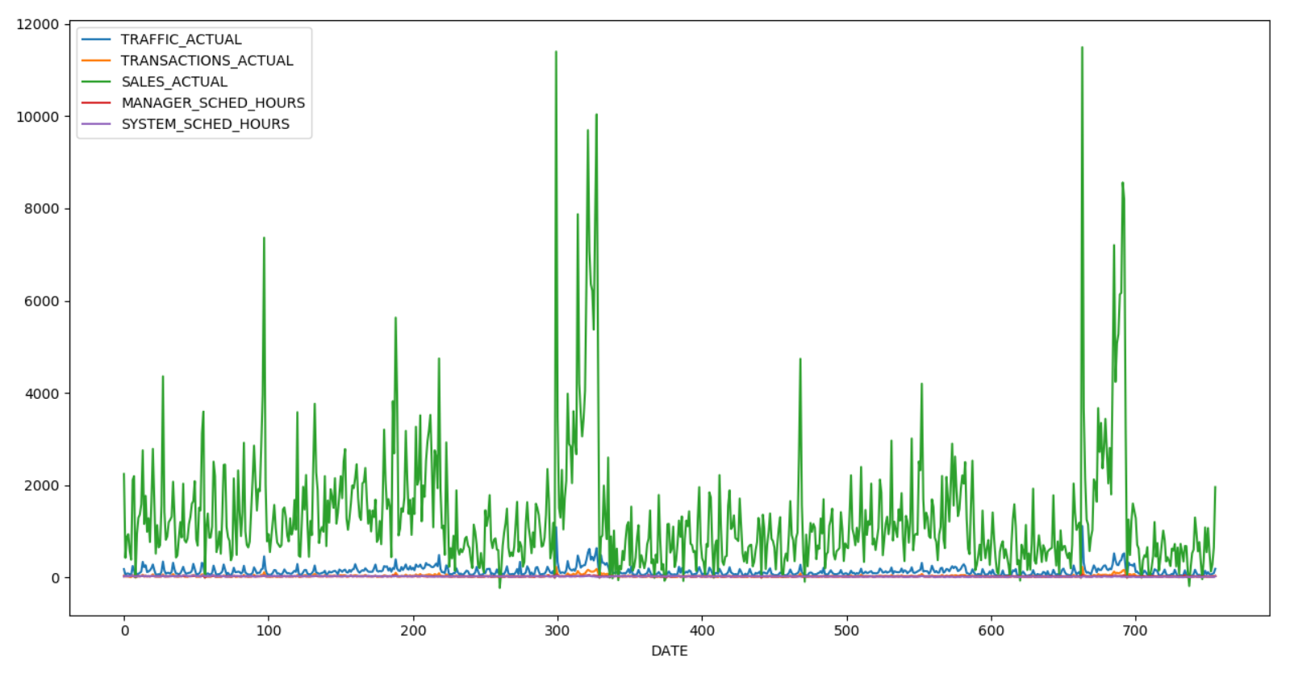
Data Visualisation
STORE 203

Slide 4
Regression Models
•Machine Learning problems are classified into two major types:
•Regression
•Classification
•Since the response variable (scheduled hours of labour) is continuous, this problem has been modelled as a regression problem.
•Three regression models have been used in the approach:
•Linear Regression
•Polynomial Regression
•Support Vector Regression

Slide 5
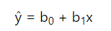
Linear Regression
Linear Regression is a simple, widely used regression algorithm that attempts to find the best fitting straight line (known as least squares regression line) for the observations in a dataset.
Population regression line is:
where b₀ and b₁ are the intercept and slope respectively.
Model implemented for store no. 203.
Data split into training and testing sets using 80:20 ratio.
Implemented using LinearRegression function of sklearn library.
Has a tendency to underfit (not in this case though)

Slide 6
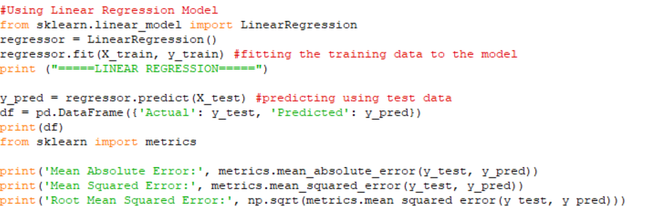
Linear Regression (cont.)
CODE SNIPPET:

Slide 7
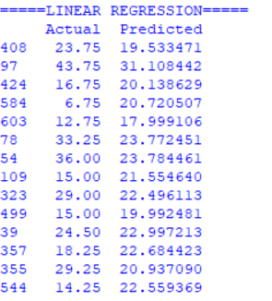
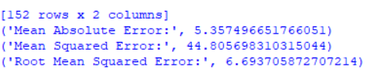
Linear Regression (cont.)
Actual vs Predicted Values
Metrics (MAE, MSE, RMSE)

Slide 8
Polynomial Regression
To overcome the underfitting problem of linear regression, polynomials can be used to fit the observations in the dataset.
Different models were tried using different degrees of the polynomial.
A fourth order polynomial was used to fit the data since it had the minimum error
Using a lower order polynomial than required might lead to underfitting of the data (less flexibility)
Using a higher order polynomial than required might lead to overfitting of the data (high flexibility)

Slide 9
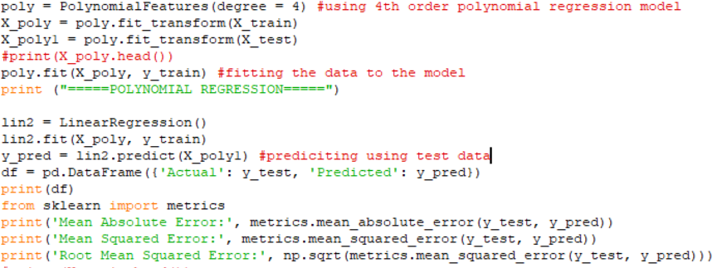
Polynomial Regression (cont.)
CODE SNIPPET:

Slide 10
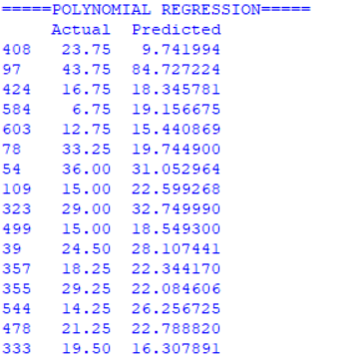
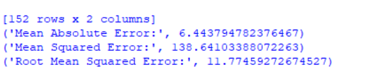
Polynomial Regression (cont.)
Actual vs Predicted Values
Metrics (MAE, MSE, RMSE)

Slide 11
Support Vector Regression
One of the most widely used models for regression models.
Based on the idea of Support Vector Machine (SVM) – finding the maximum margin hyperplane.
Allowing for a margin of tolerance by using slack variables (epsilon).
Can be linear or non-linear SVR.
Here, SVR with “linear” kernel has been used.
Data split into training and testing sets using 80:20 ratio.
Done only for store number ‘203’, can be extended easily for others.

Slide 12
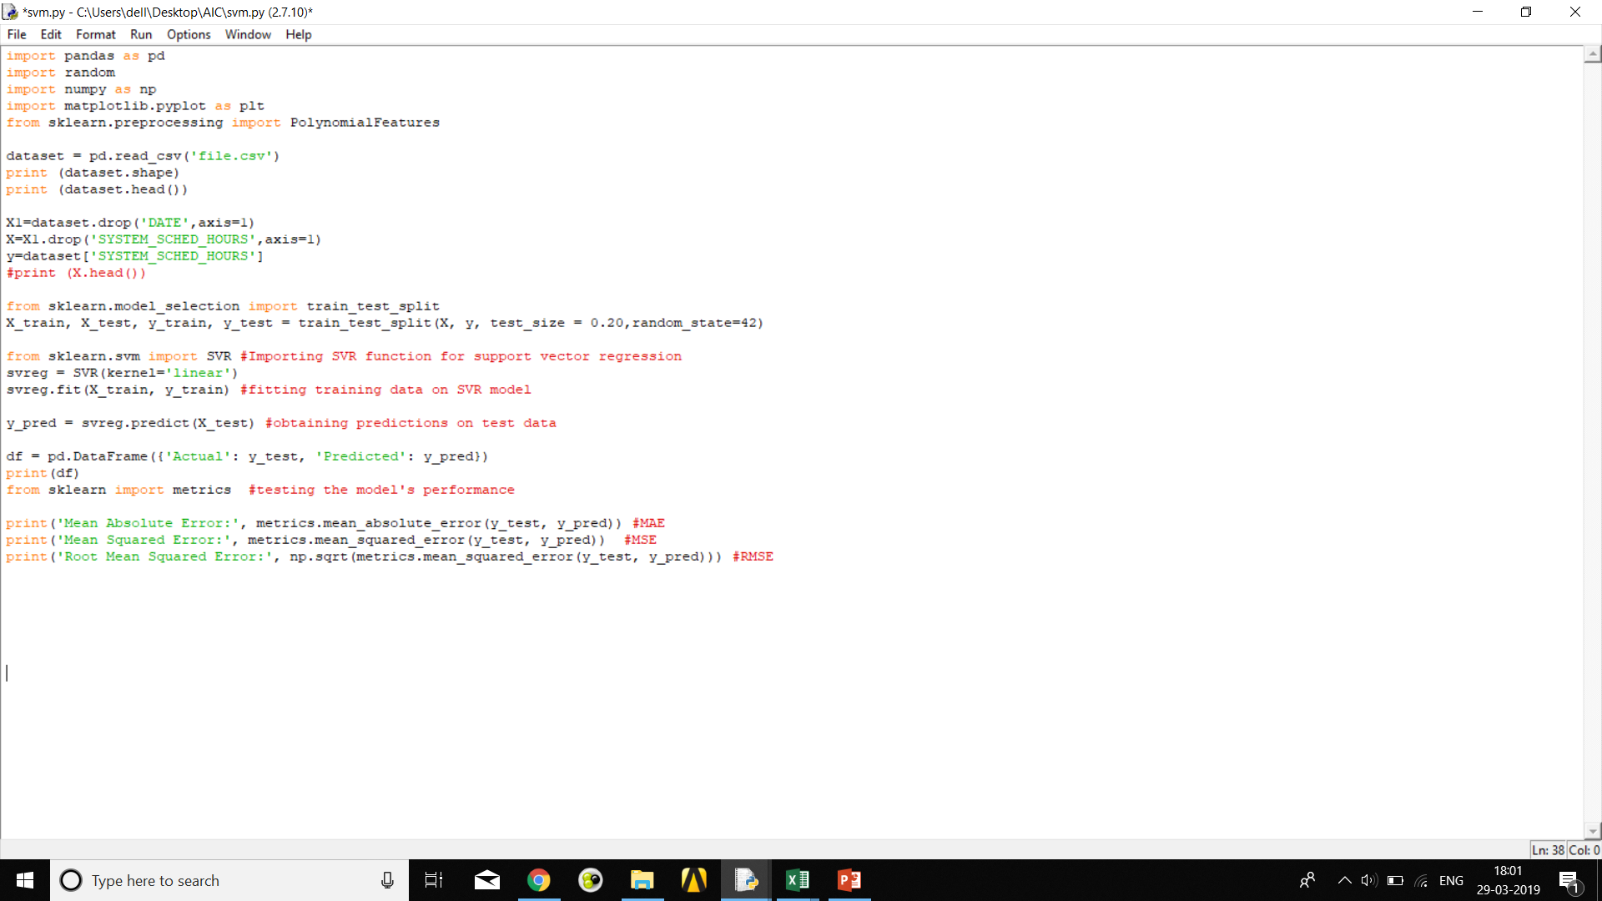
Support Vector Regression (cont.)
CODE SNIPPET :

Slide 13
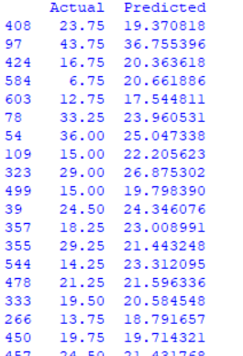
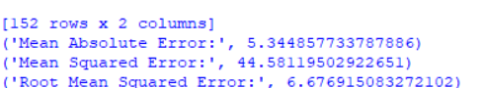
Support Vector Regression (cont.)
Actual vs Predicted Values
Metrics (MAE,MSE,RMSE)

Slide 14
Dimensionality Reduction ?
Process of mapping higher dimensional data to lower dimensional space in order to eliminate random/non-contributing variables.
Principal Component Analysis (PCA) - Most widely used dimensionality reduction technique. Based on the idea of finding principal components that capture most of the variance in the data
PCA was applied to the original dataset before fitting the models.
Error in all the cases was slightly higher than before
Possible Reason ? PCA is probably interfering with important attributes that contribute to prediction of response variable.

Slide 15
Generalised Metrics
Help in establishing parameters that determine store performance considering sales, labour cost and customer traffic.
Three metrics established:
Profit
Difference between Actual Sales Price and Labour Cost (assuming wage rate as $10/hour)
Profit obtained considering Manager Scheduled Hours – P1
Profit obtained considering System Scheduled Hours – P2
Average Sale Price
Ratio of total sales to total number of transactions in a day.
Effectivity/Customer Conversion Ratio
Ratio of number of actual transactions to total number of customers visiting a particular store on a given day.
Can be used for finding Return on Investment (ROI) for a given store

Slide 16
Manager’s Impact on Store Performance
Manager has the ability to modify the scheduled hours based on changes in local weather, employee leave requests, current sales pattern and other factors.
Whether the decision taken by the manager has positively or negatively impacted the store has to be determined.
Approach:
Average values of metrics P1 and P2 have been found for each store over the entire interval of time (around 2 years)
If P1 exceeds P2, it implies that the decision taken by the manager has positively impacted the store’s profit. Otherwise, impact has been negative (or absent).
Code written using file handling techniques.

Slide 17
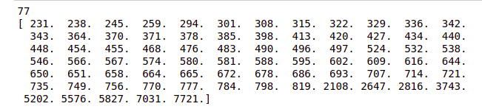
Manager’s Impact (cont.)
List of stores for which P1 exceeds P2:
Total number of managers: 167
Total number of managers with positive impact: 77
Stores with managers having positive impact are:

Slide 18
Metric Ranges
To decide if a given store is performing well or not, we need a range of metrics.
Average values of metrics is calculated for all the stores
Top 30 % performing stores are considered as good performing stores and their corresponding metric values are taken as the threshold for good performance
Threshold for the metrics are as follows:
Customer traffic: 330
Effectivity: 30%
Average Sale Price: $ 51
Profit: $ 4945

Slide 19
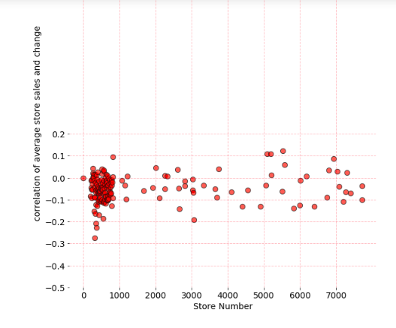
Correlation is used to visualize the impact of manager’s decision on -
Average sales vs change in profit

Slide 20
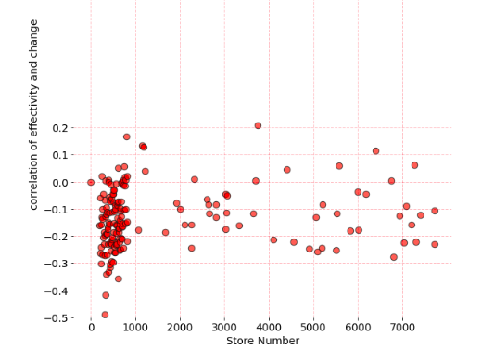
2. Effectivity vs change in profit
ee

Slide 21
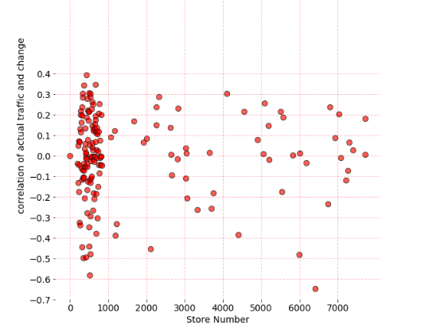
3. Actual traffic vs change in profit

Slide 22
THANK YOU
Submitted by -
Archana ( 2016B4ABPS0552P )
Ankit Pandey ( 2016A4PS0847P )
Shruti Sharma ( 2016ABPS0833P )

