Slide 1
Smart Farming
2023 - 2024
TEAM : CREEDORIAN
Guided by :
Prof. C. U. Chauhan sir
Prof. S. W. Shende Sir

Slide 2
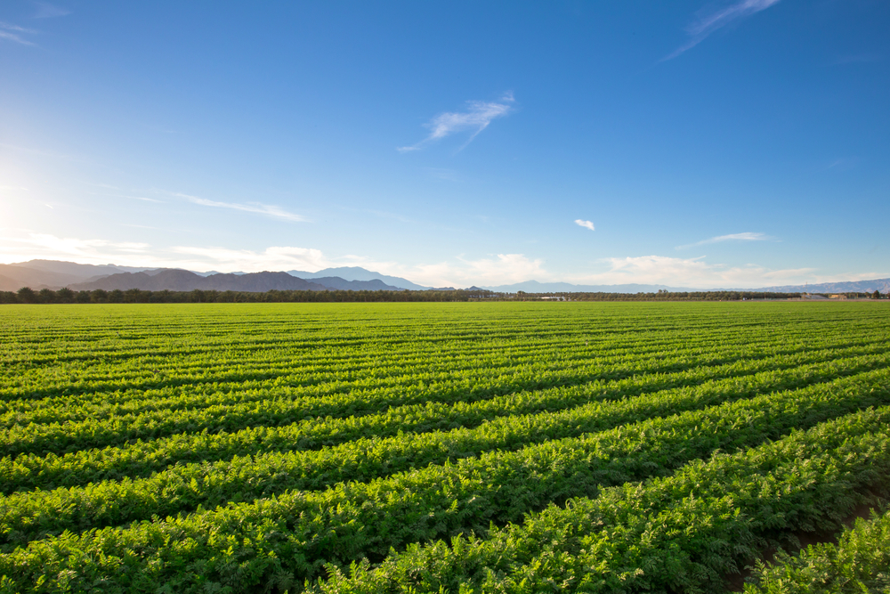
A BETTER WORLD STARTS AT THE FARMS !!!!

Slide 3

AGENDA
Problem Statement
Abstract
Objective
Plan Of Action
Software and Hardware Requirement
Literature survey
Conclusion
Reference

Slide 4
PROBLEM STATEMENT
In agriculture , Water savings are not taken into account when using traditional irrigation systems. Because the water is applied directly to the soil. As much as 50% of this water is wasted due to overwatering. Similarly , either spraying excess of fertilizers or lack of proper fertilizers at improper time also affect the plants health. The solution for such problems is the smart farming method that consist of proper irrigation and nutrients detection by using soil moisture and soil nutrients identification respectively.

Slide 5
Abstract
Smart irrigation system for optimized usage of water in agriculture. .
The system has a distributed wireless network of soil moisture, humidity, and temperature sensors placed at the root zone of plants.
The system checks the humidity and temperature of the soil using the soil sensor and waters the plants based on the readings.
.
It aims at saving time and avoiding problems like constant vigilance.

Slide 6
Abstract
A system was designed where the Soil fertility index for the nutrients is predicted at different places.
The prediction is done automatically using regression methods specifically like support vector regression and more.
The data obtained is useful for making decision of amount of fertilizers to be used.
.
It aims at saving time and avoiding problems like constant vigilance.

Slide 7
OBJECTIVES
.
Water Conservation
Precision Farming
Increased crop yield
Cost-effectiveness.
Analyzing soil data and predicting nutrient levels

Slide 8

PLAN OF ACTION
Sensors Deployment
Data Collection and Analysis
Automation and Decision Making
Providing Interface through LED
Feedback and Analysis
Energy Efficiency and Sustainability
Ensures water conservation measures
Nutrient Management

Slide 9

SOFTWARE AND HARDWARE REQUIREMENTS
Arduino UNO
Soil Moisture Sensors
Soil Nutrients Sensors
Machine Learning Algorithms

Slide 10
LITERATURE SURVEY
Sr. | Title of Paper | Author Name | Major Observations
1. | The Smart Irrigation System Using IOT | Dr. C. K. Gomathy, Mr. A. Vamsikumar, Mr. B. Karthik, Mr. A. Purushothamreddy | The study include the efficient use of water resources.
2. | Arduino Based Smart Irrigation System Using IOT | R.Nandhini, S. Poovizhi, Priyanka Jose, R. Ranjitha, Dr. S. Anila(2017) | The main obj. of the smart irrigation is to make it more innovative, user friendly, time saving & more efficient
3. | Smart Farming Using Machine Learning and Deep Learning Techniques | Senthil Kumar Swami Durai, Mary Divya Shamili(2022) | The aim of this work is to help an individual cultivate crops efficiently

Slide 11

This method OF SMART FARMING creates an Arduino-based automatic plant irrigation system. The components we employ in the system are easily accessible and simple to use. As a result, this system is an effective AGRICULTURE system.
CONCLUSION :

Slide 12
Reference
https://www.researchgate.net/publication/357748563_THE_SMART_IRRIGATION_SYSTEM_USING_IOT
https://scholar.google.com/scholar?hl=en&as_sdt=0%2C5&q=smart+irrigation+system+using+iot&oq=#d=gs_qabs&t=1705374395738&u=%23p%3DSQfapPiXISgJ
https://www.researchgate.net/publication/351481738_Crop_Recommendation_on_Analyzing_Soil_Using_Machine_Learning
https://www.researchgate.net/publication/355370085_Detection_and_classification_of_nutrient_deficiencies_in_plants_using_machine_learning

Slide 13
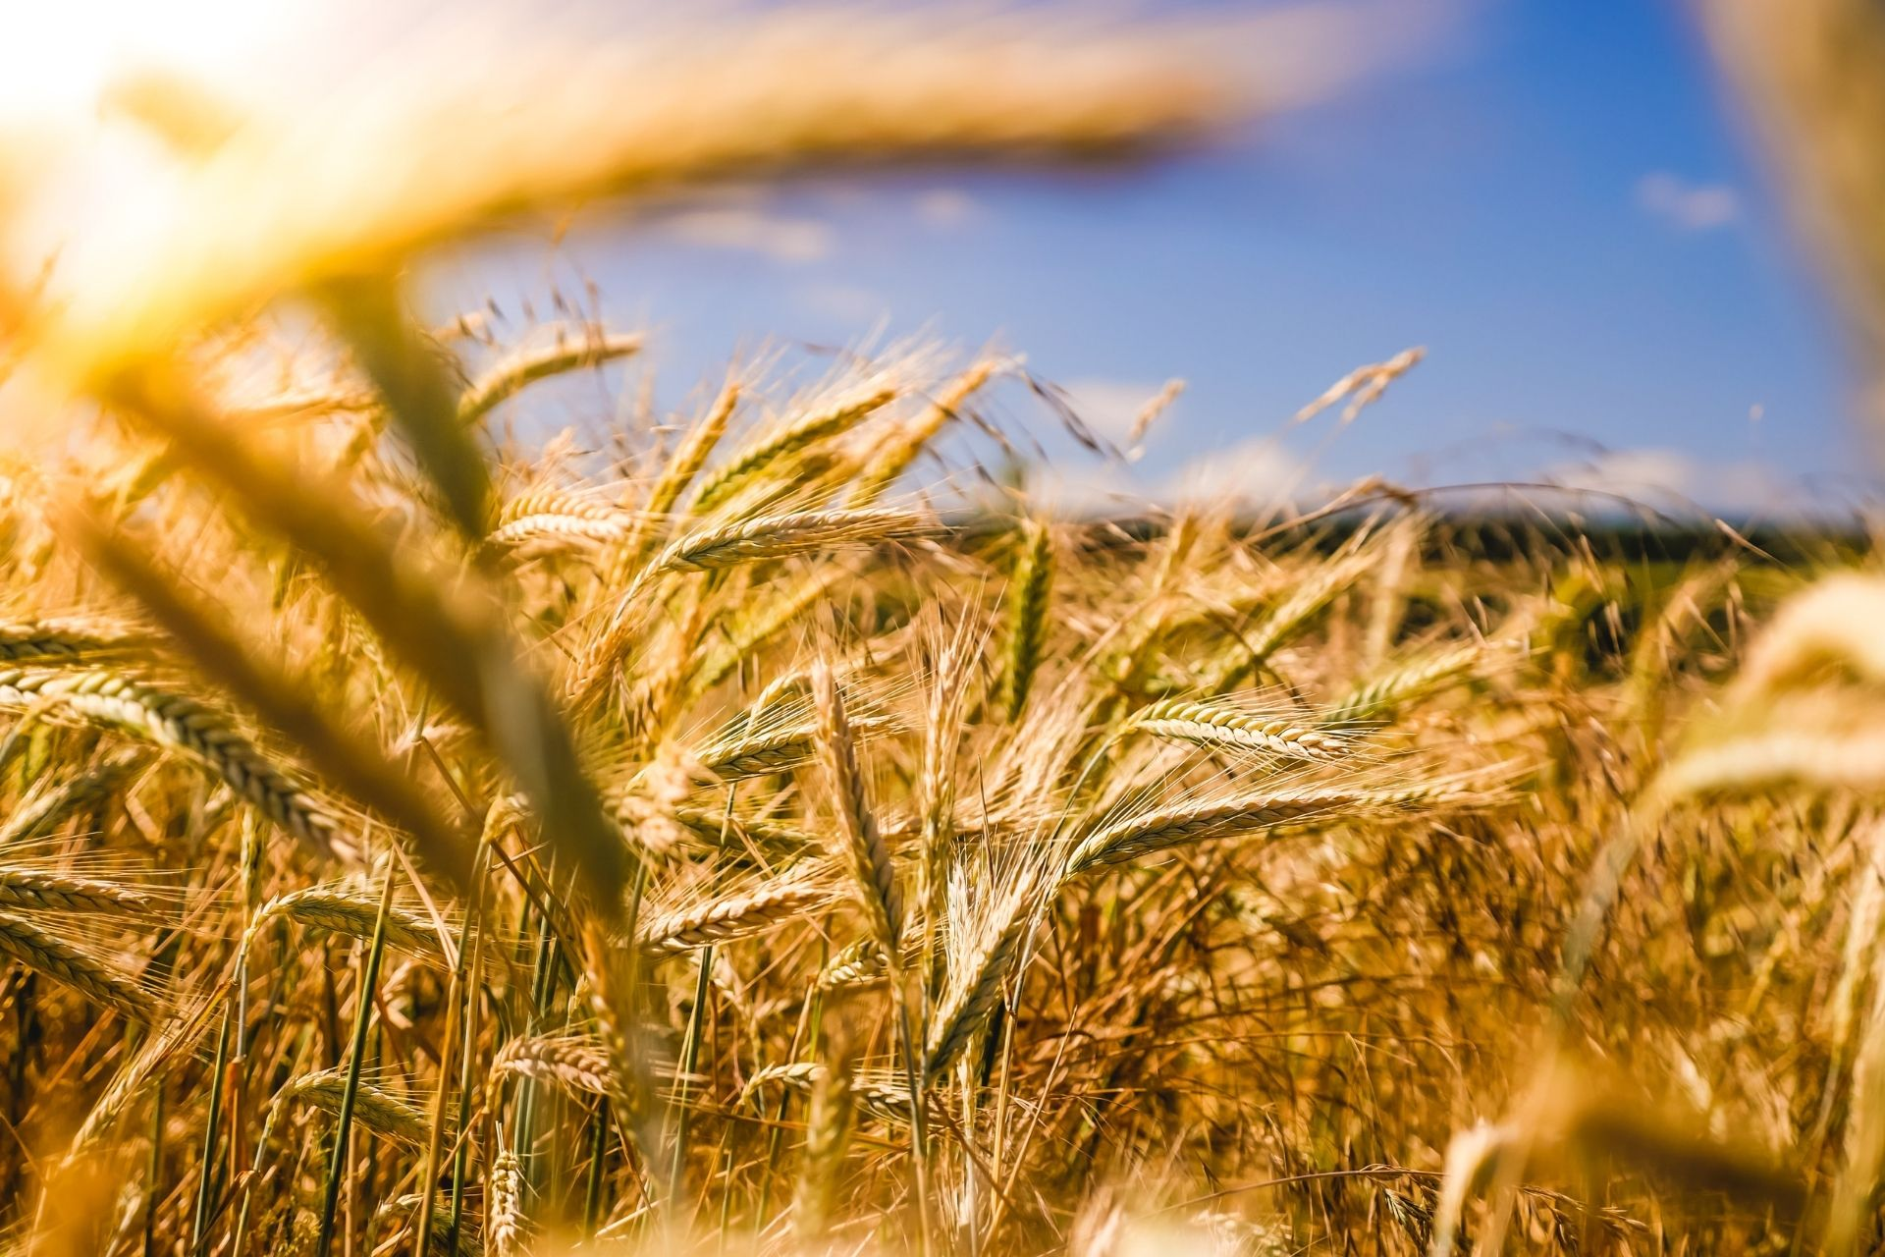
THANK YOU !!!!!!

