Slide 1
SMART FARMING
2023 - 2024
TEAM : CREEDORIANS
Guided by:
Prof. S. W. Shende
Prof. C. U. Chauhan

Slide 2
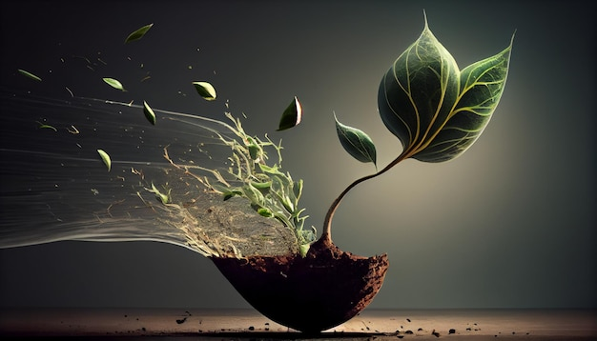
AGENDA
Problem Statement
Abstract
Objective
Plan Of Action
Software and Hardware Requirement
Literature survey
Conclusion
Reference

Slide 3
PROBLEM STATEMENT
Traditional irrigation methods often lead to inefficient water usage and increased operational costs for farmers. Also, In urban environments, maintaining green spaces such as parks, gardens, and golf courses presents a challenge due to inefficient irrigation practices. Traditional timer-based systems often lead to over or under-watering, resulting in water wastage and unhealthy plants . The solution for such problems is our smart farming that consist of an smart irrigation system that optimized the use of water by getting the real time analysis of soil moisture and provide the sufficient amount of water to the plants.

Slide 4
ABSTRACT
Intelligent irrigation system being an automated system has a distributed wired network of soil moisture, humidity, and temperature sensors placed at the root zone of plants. The system analyze the moisture of the soil using the soil sensors and waters the plants based on the real time analysis of soil. It helps analyze and detect the problem with real-time irrigation system monitoring, allowing farmers to take corrective actions.

Slide 5
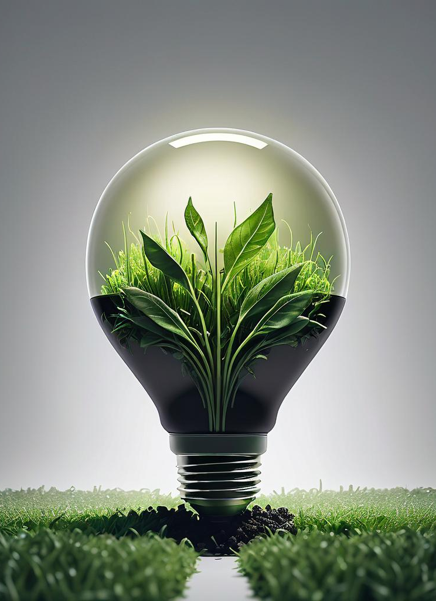
1. Water Conservation. 2. Precision Farming. 3. Automatically irrigating based on soil moisture levels. 4. To ensures that the plants have adequate moisture, promotes healthier growth. 5. To reduces the risk of under or over-watering which can lead to plant stress, disease, and reduced yields.
OBJECTIVES

Slide 6
PLAN OF ACTION
Defining Requirements
Selection of sensors, actuators, microcontroller
Sensors Calibration
Data Processing
And Testing
Deployment and maintenance

Slide 7
WORKING
Start
If the current moist< threshold value
Initialize the components
Motor off
Read the soil moisture using soil sensors
Motor on
Display the current soil moisture on LCD
Wait for sometime

Slide 8

HARDWARE AND SOFTWARE REQUIREMENTS
Hardware Requirements:
Arduino UNO
Sensors
Actuators
Display (optional)
Power Supply

Slide 9
HARDWARE AND SOFTWARE REQUIREMENTS
Software Requirements:
Arduino IDE
Control Algorithm

Slide 10
Literature Survey
Sr. | Title of Paper | Author Name | Major Observations
1. | The Smart Irrigation System Using IOT | Dr. C. K. Gomathy, Mr. A. Vamsikumar, Mr. B. Karthik, Mr. A. Purushothamreddy | The study include the efficient use of water resources.
2. | Arduino Based Smart Irrigation System Using IOT | R.Nandhini, S. Poovizhi, Priyanka Jose, R. Ranjitha, Dr. S. Anila(2017) | The main obj. of the smart irrigation is to make it more innovative, user friendly, time saving & more efficient
3. | Smart Farming Using Machine Learning and Deep Learning Techniques | Senthil Kumar Swami Durai, Mary Divya Shamili(2022) | The aim of this work is to help an individual cultivate crops efficiently

Slide 11
CONCLUSION
In conclusion, the smart farming project demonstrates the potential of technology to revolutionize agriculture. By integrating sensors, actuators, and data analytics, smart farming can improve agricultural productivity, reduce resource wastage, and promote sustainable farming practices. Future work could involve expanding the system to include more sensors, optimizing the machine learning algorithm, and integrating remote monitoring and control capabilities.

Slide 12
REFERENCES
https://medwinpublishers.com/CCLSJ/CCLSJ16000141.pdf
https://scholar.google.com/scholar?hl=en&as_sdt=0%2C5&q=smart+irrigation+system+using+iot&oq=#d=gs_qabs&t=1705374395738&u=%23p%3DSQfapPiXISgJ
https://www.researchgate.net/publication/351481738_Crop_Recommendation_on_Analyzing_Soil_Using_Machine_Learning
https://www.researchgate.net/publication/355370085_Detection_and_classification_of_nutrient_deficiencies_in_plants_using_machine_learning

Slide 13
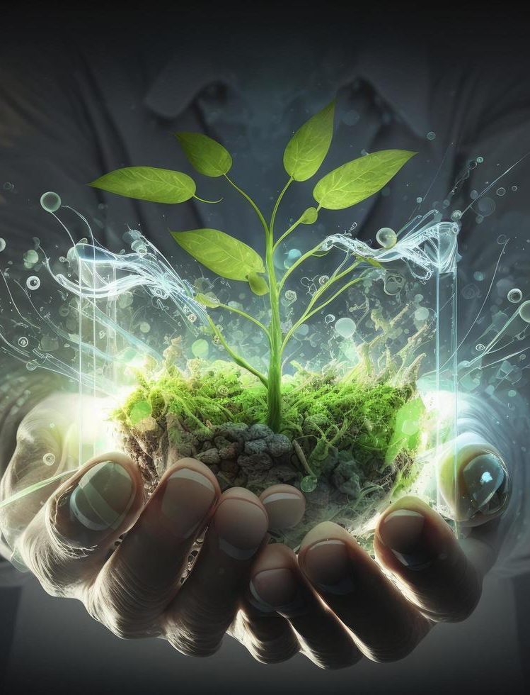
THANK YOU
____BY CREEDORIANS

Slide 14
ANY QUESTIONS???

