Slide 1
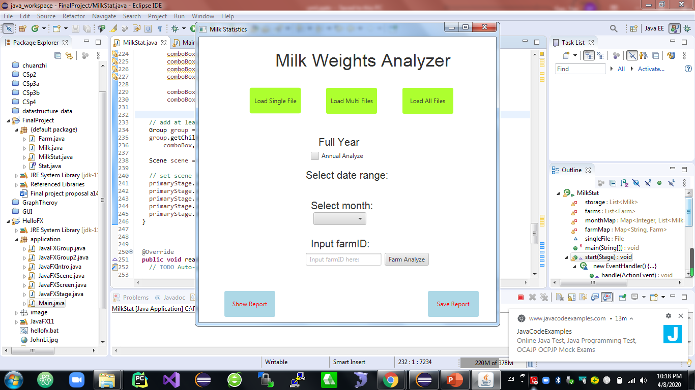

Slide 2
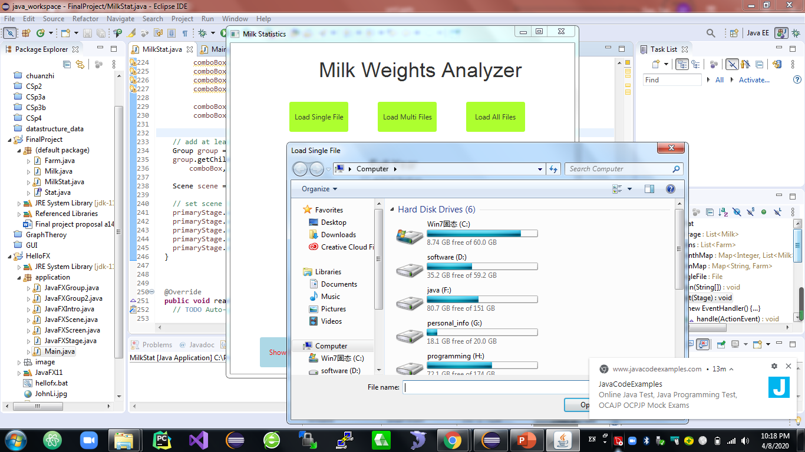

Slide 3
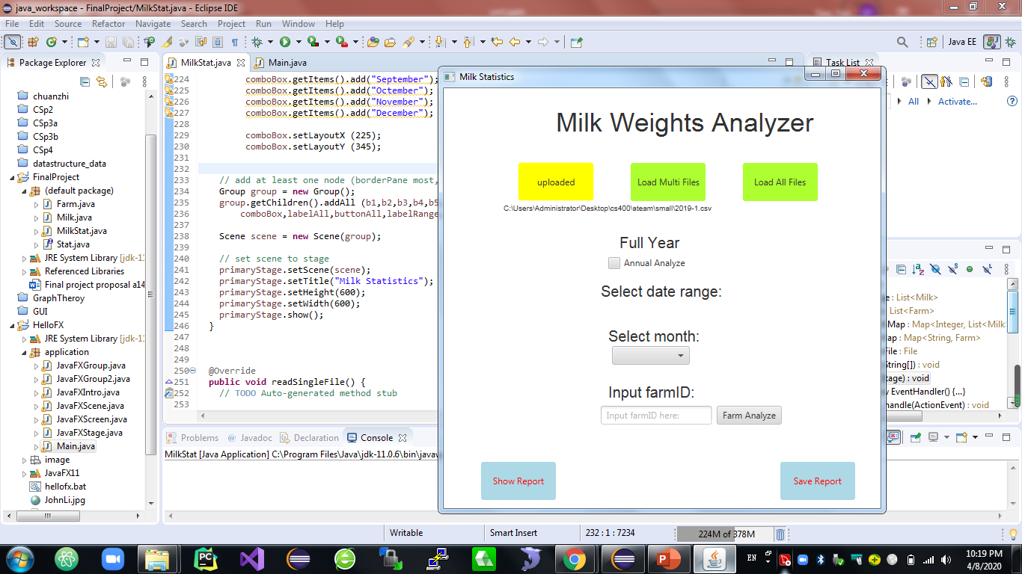

Slide 4
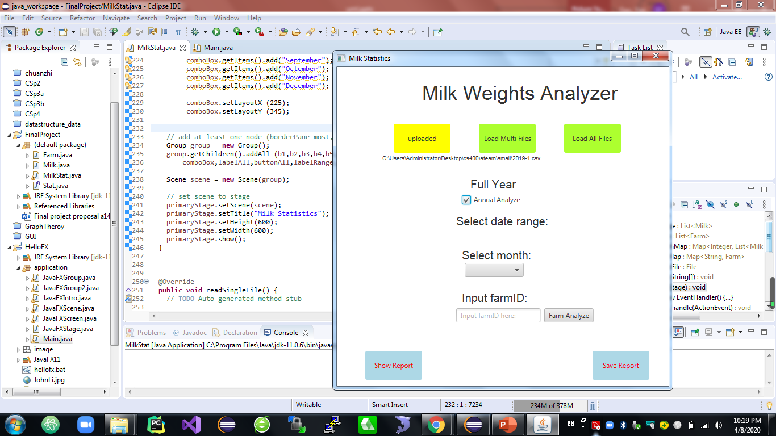

Slide 5
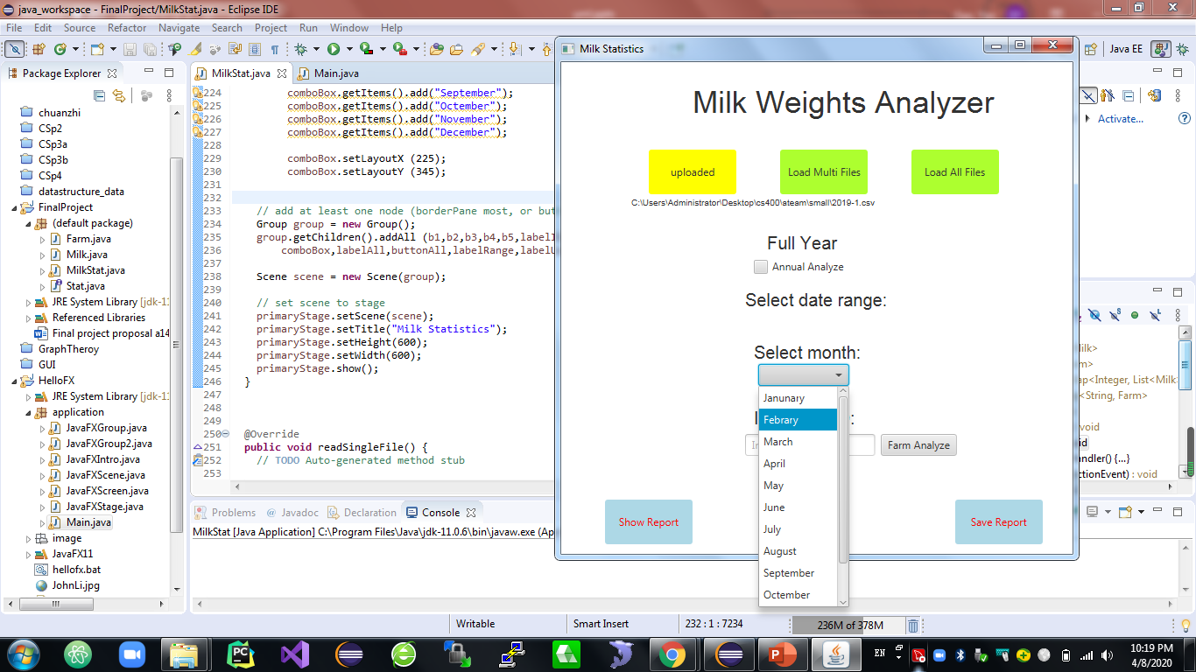

Slide 6
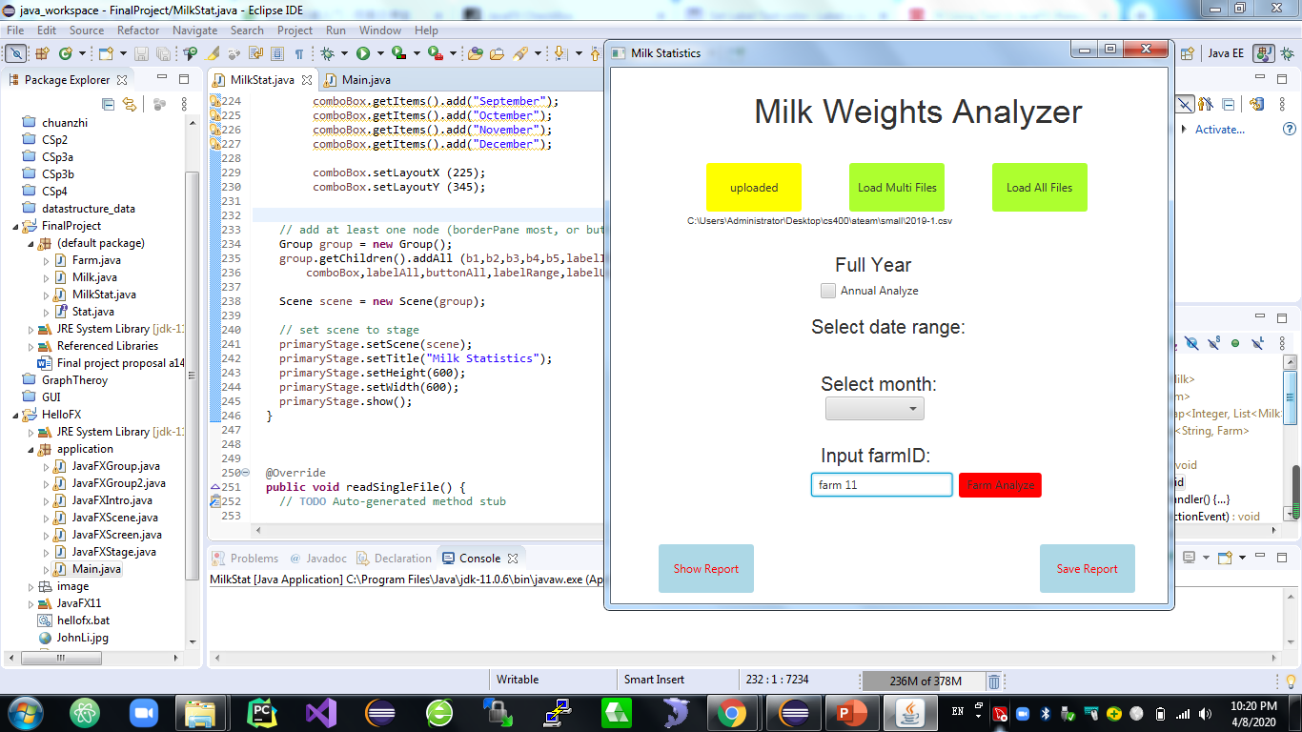

Slide 7
farmMap
farm1
farm2
Storage List <Milk>
Farms List <Farm>
Milk “milk1”
Milk “milk7”
Milk “milk9”
Farm “farm 1”
Milk “milk2”
Farm “farm 2”
Milk “milk3”
Milk “milk1”
Milk “milk2”
Farm “farm 3”
Milk “milk4”
Milk “milk5”
List<Milk>
Milk “milk6”
Milk “milk8”
Milk “milk7”
monthMap
Milk “milk1”
0
Milk “milk6”
.
.
Milk “milk7”
1
Milk “milk10”
List<Milk>
11
Milk “milk2”
Milk “milk11”

